Slide 1
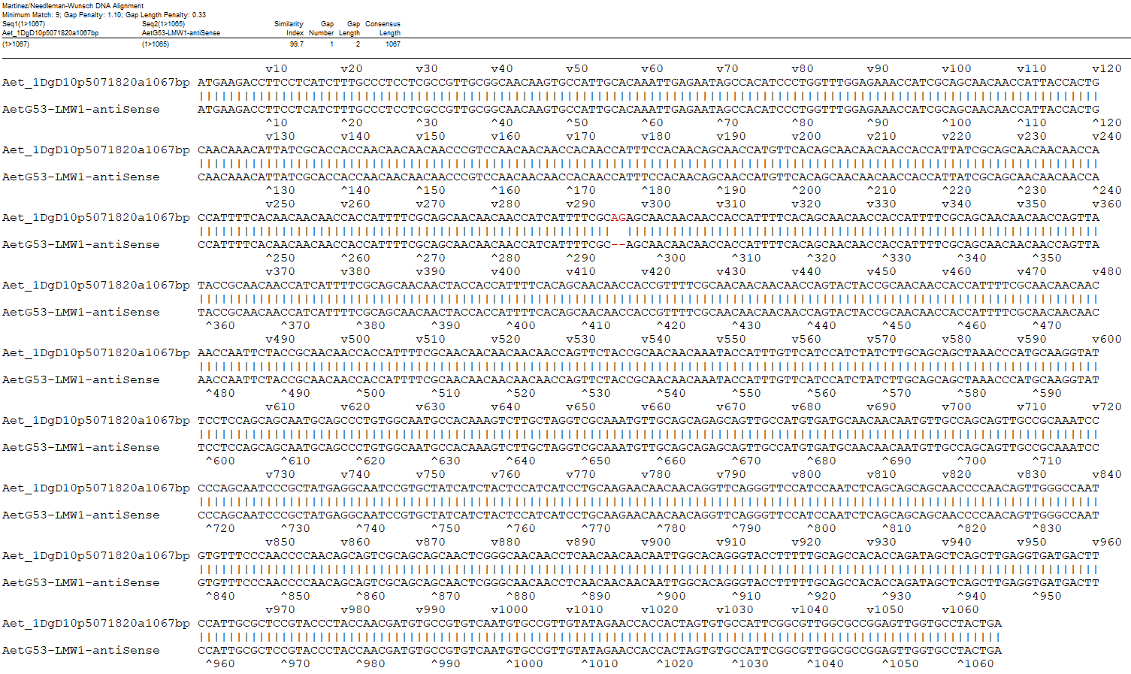
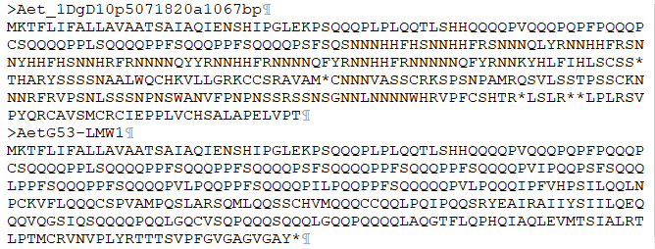
A
B
C
Fig. S10 Sequence comparison of Aet_1DgD10p5071820a1067bp (annotated by LMWgsFinder) with AetG53-LMW1 (annotated by Dong et al., 2016) (A, B) and expression profiles of LMW-GS genes in the Aet genome based on RNA-seq data (Jia et al., 2013) (C).

