Slide 1
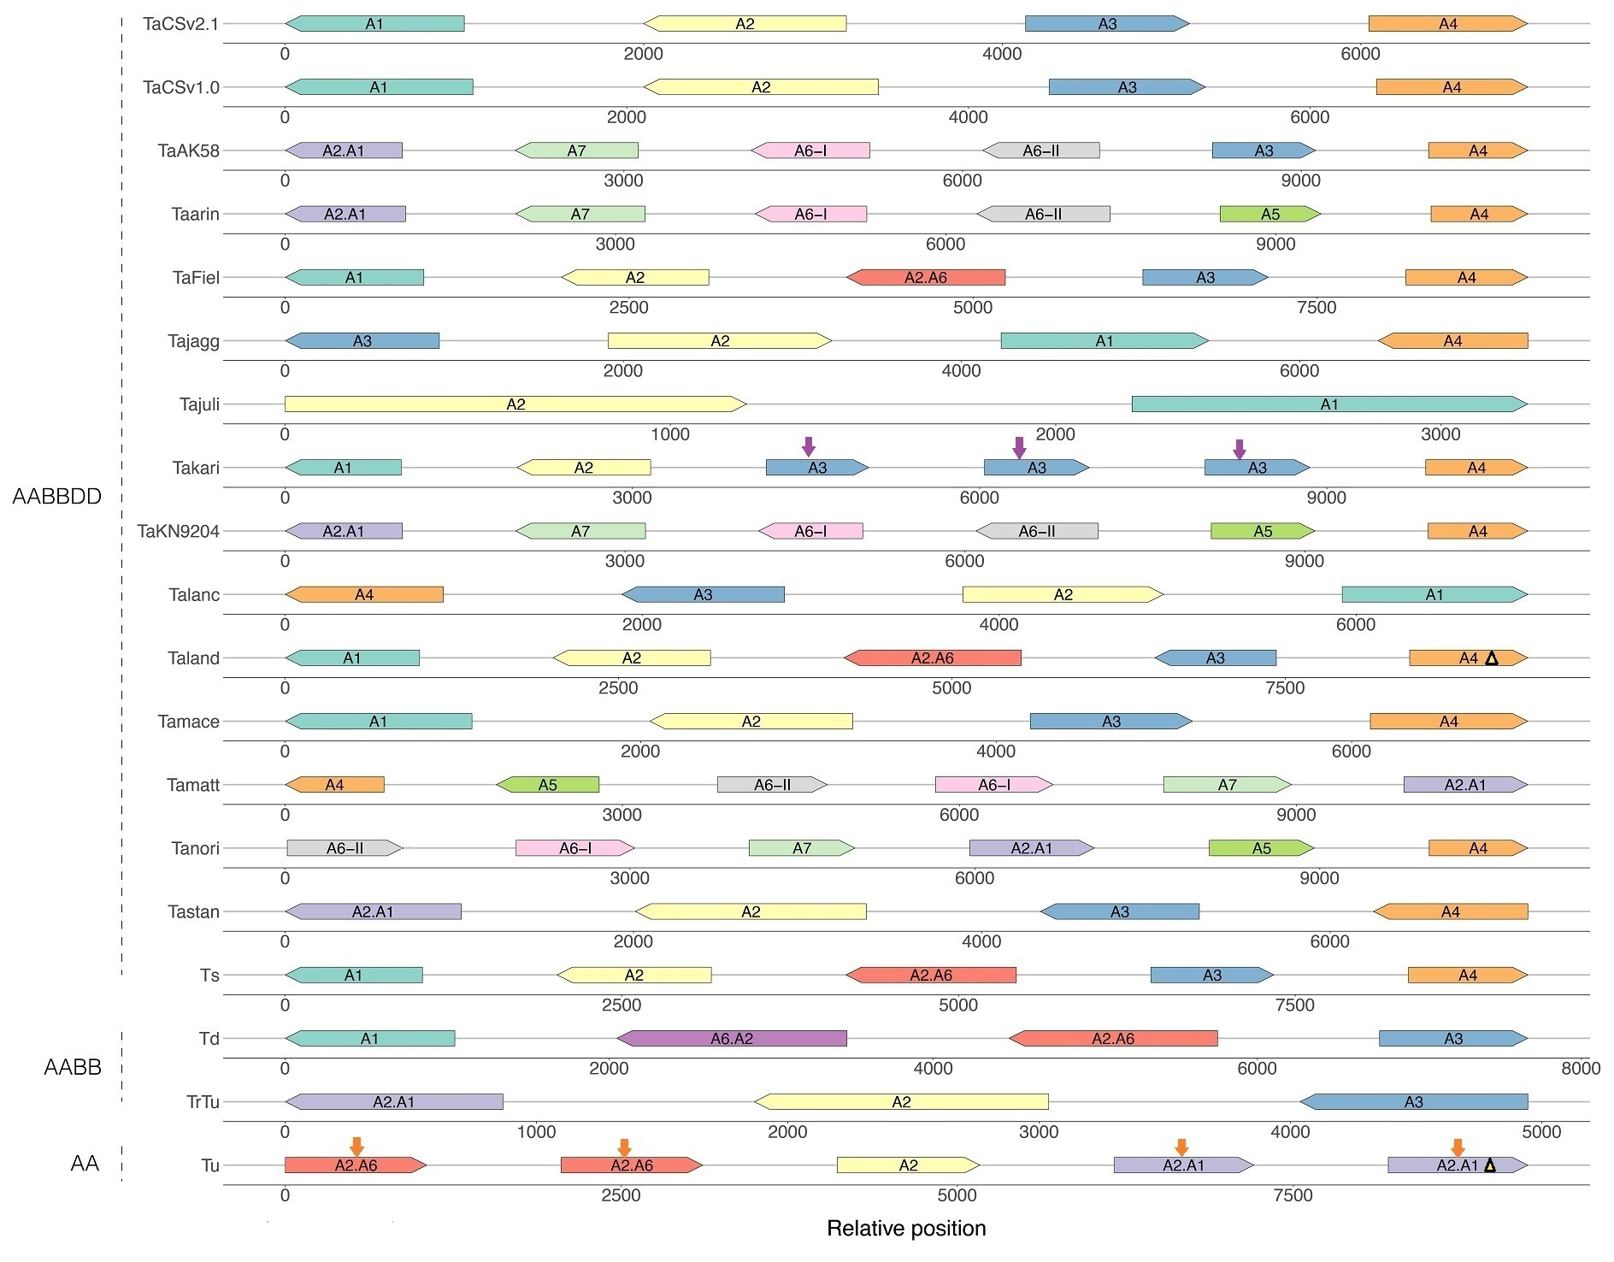
A
i
104.7 2518.0 171.8
105.4 2313.8 43.5
m
129.3 55.2 71.1 1961.4 42.9
m
132.0 54.7 71.1 1209.7 27.8
i
116.0 186.5 3146.2 110.2
1670.1 105.2 2931.1
105.0
i
m
m
104.5 4031.7 63.5 38.5 21.8
i
m
120.4 54.6 71.1 1251.6 27.7
53.8 1611.2 105.6
117.6 191.0 447.6
105.6 1617.7 35.0
m
27.7 1200.6 71.1 54.6 129.6
m
71.2 54.7 132.5 2063.9 27.9
101.0 970.7 494.6
112.0 186.7 1395.0 51.8
98.1 138.0 1698.0
m
100.7 1102.2
m
i
i
i
i
i
1420.9 341.7 84.0
Fig. S13A Composition and chromosomal relative position of LMW-GS genes in the A (A), B (B), and D (C) subgenomes of different wheat varieties and their related species identified in this study. Different colored boxes represent different LMW-GS genes (with i, s, and m types labeled with corresponding letters for genes with normal coding regions), and the length of the boxes corresponds to the length of the coding region of the gene. A5, D10, D9, and D11 are orthologous to A3, D1, D2, and D7 in the CS genome, respectively (see Table S1 for details). Arrows indicate the transcription direction of the genes. The number on the line connecting LMW-GS genes on the same chromosome represents the actual distance between the two genes, measured in kb (Kilobase pairs). For visual clarity and convenience, the distance between LMW-GS genes on the same chromosome is assumed to be 1000 bp, as detailed in the annotations of Table S6. Using the homologous region of the TaCSv2.1 genome as a reference, this figure shows whether the corresponding DNA fragments in other wheat varieties or their related species have undergone inversion. The figure was created using the R program with two R packages, tidyverse and gggenes.

