Slide 1
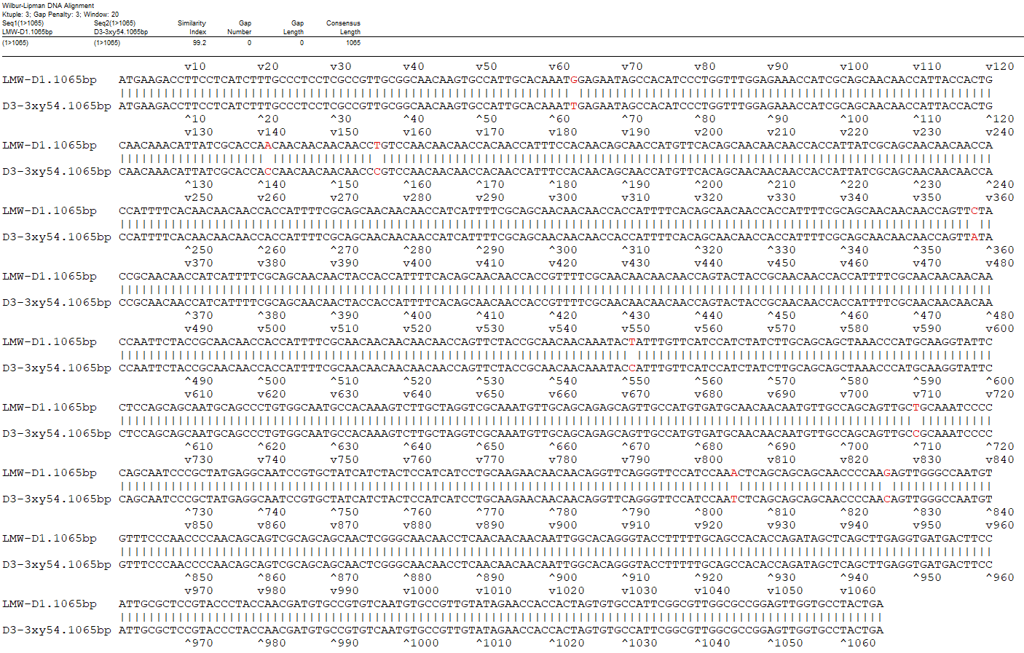
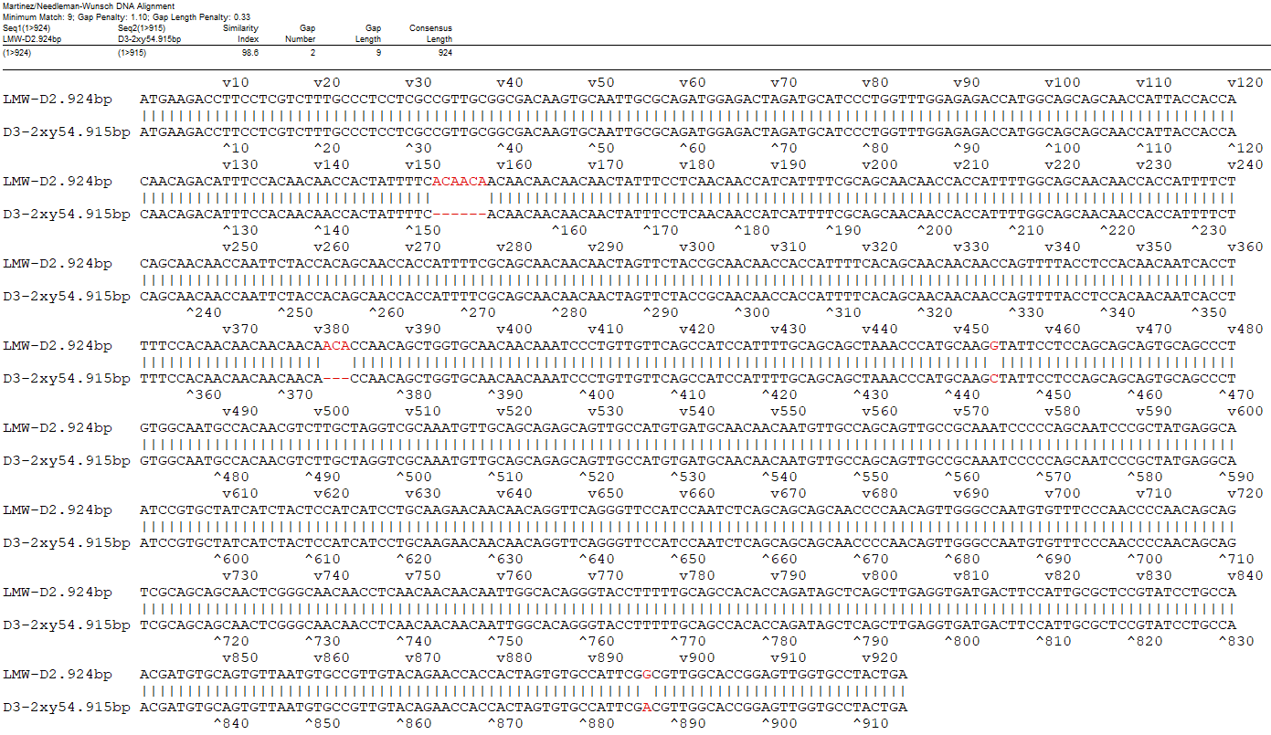
A
B
Fig. S18 Comparison of CDS sequences of D1 and D10 (D3-3xy54) (A), and D2 and D9 (D3-2xy54) (B) genes.

