Slide 1
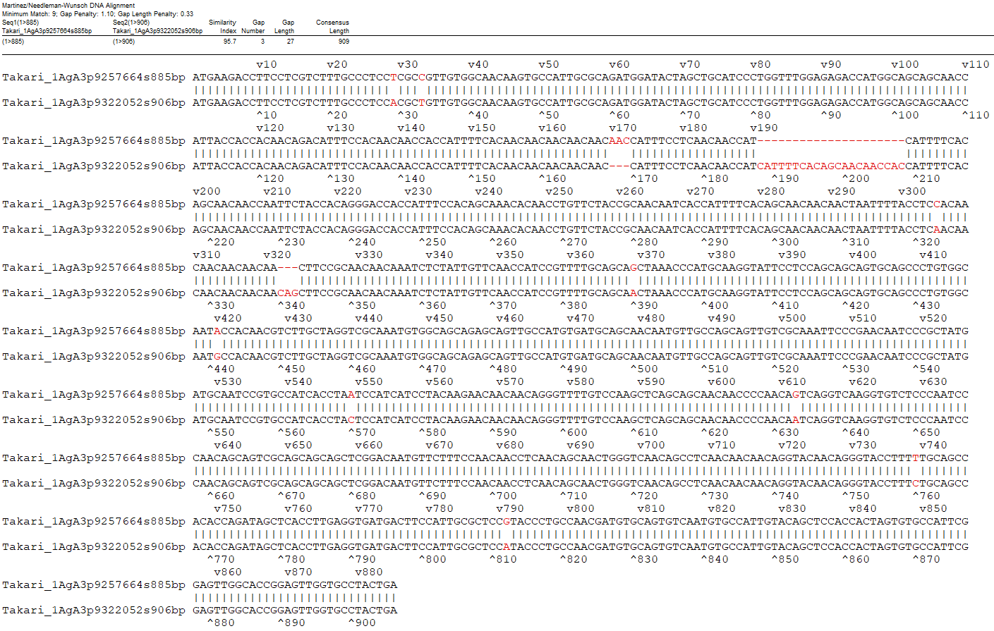
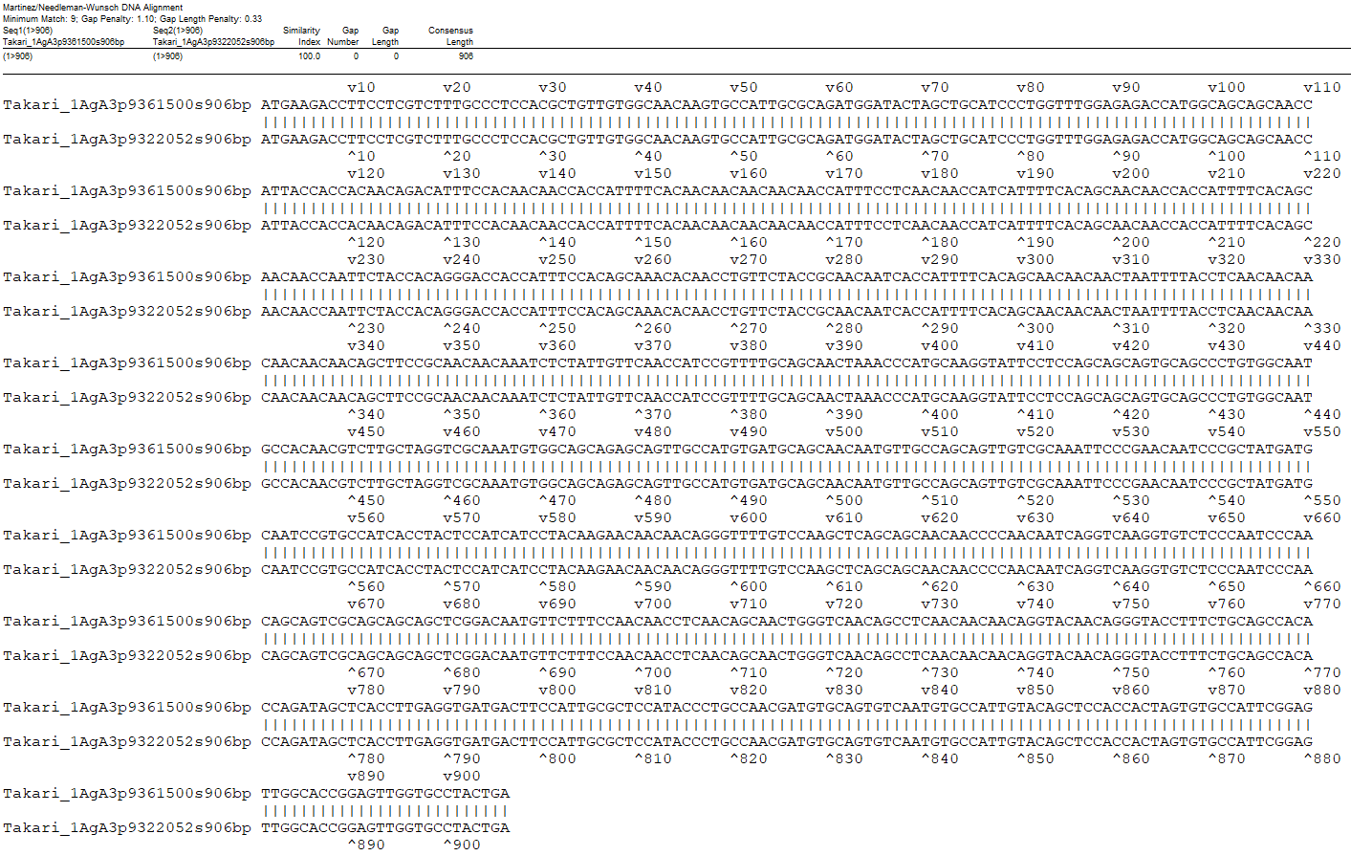
A
B
Fig. S7 Annotation comparison between A3-I (Takari_1AgA3p9257664s885bp) and A3-II (Takari_1AgA3p9322052s906bp) (A), and between A3-II and A3-III (Takari_1AgA3p9361500s906bp) (B) identified in TaKari by LMWgsFinder.

