Slide 1
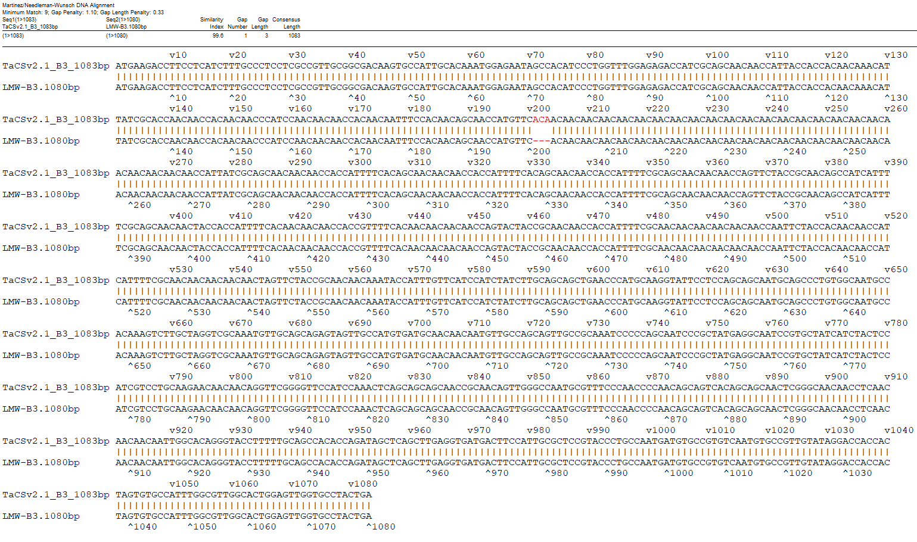
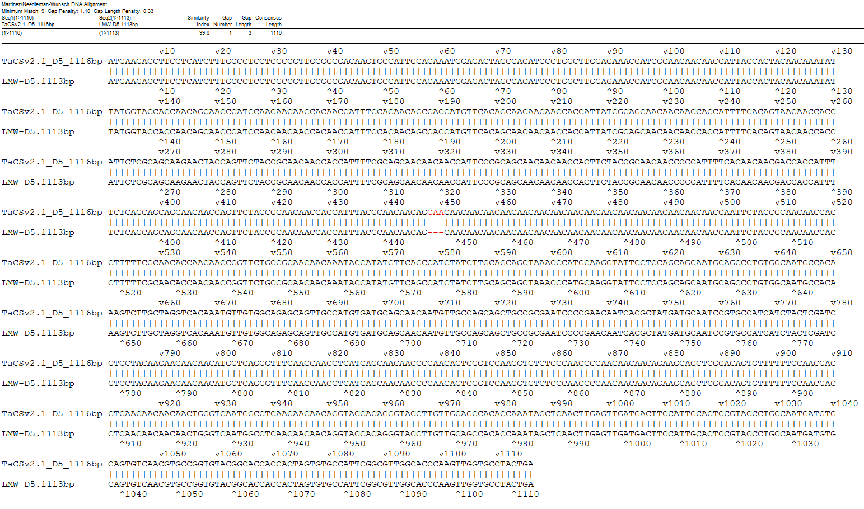
A
B
Fig. S5 Annotation comparison of B3 (A) and D5 (B) between LMWgsFinder and frontiers in plant science (FinPS) (containing "LMW-" in gene names).

