Slide 1
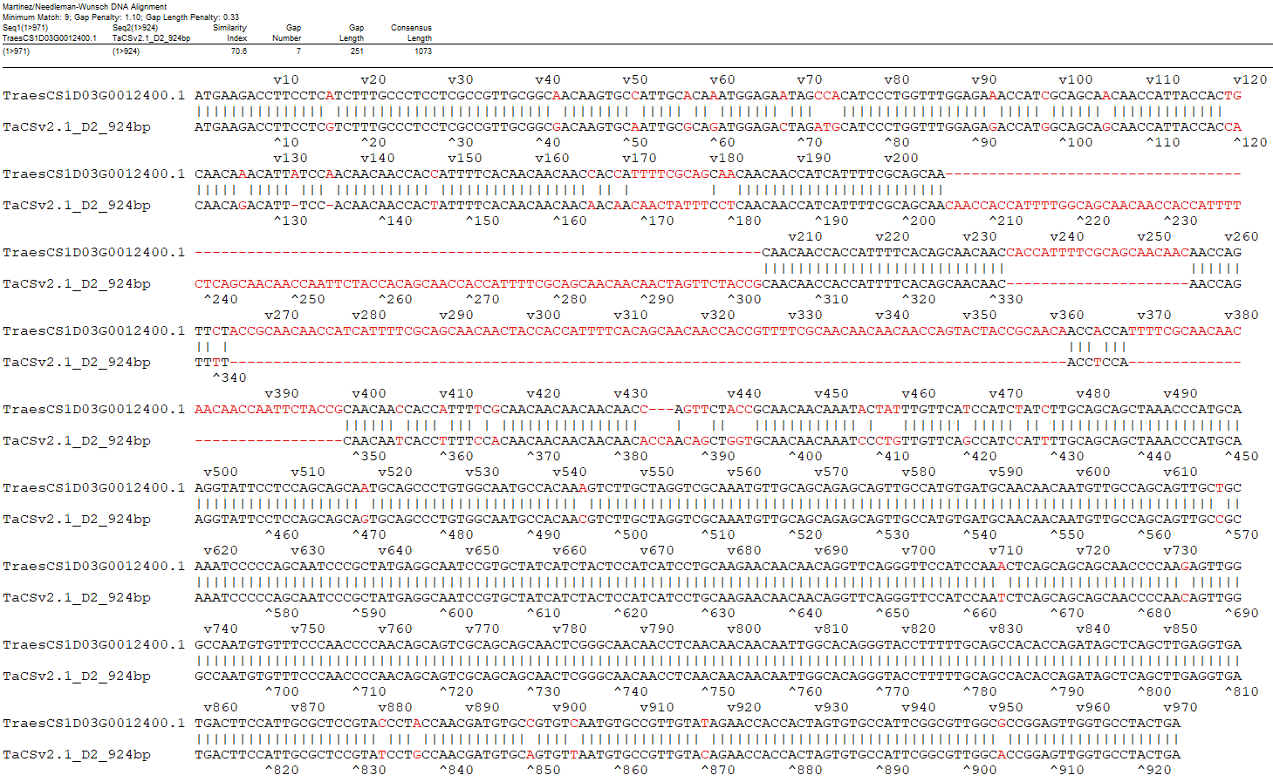
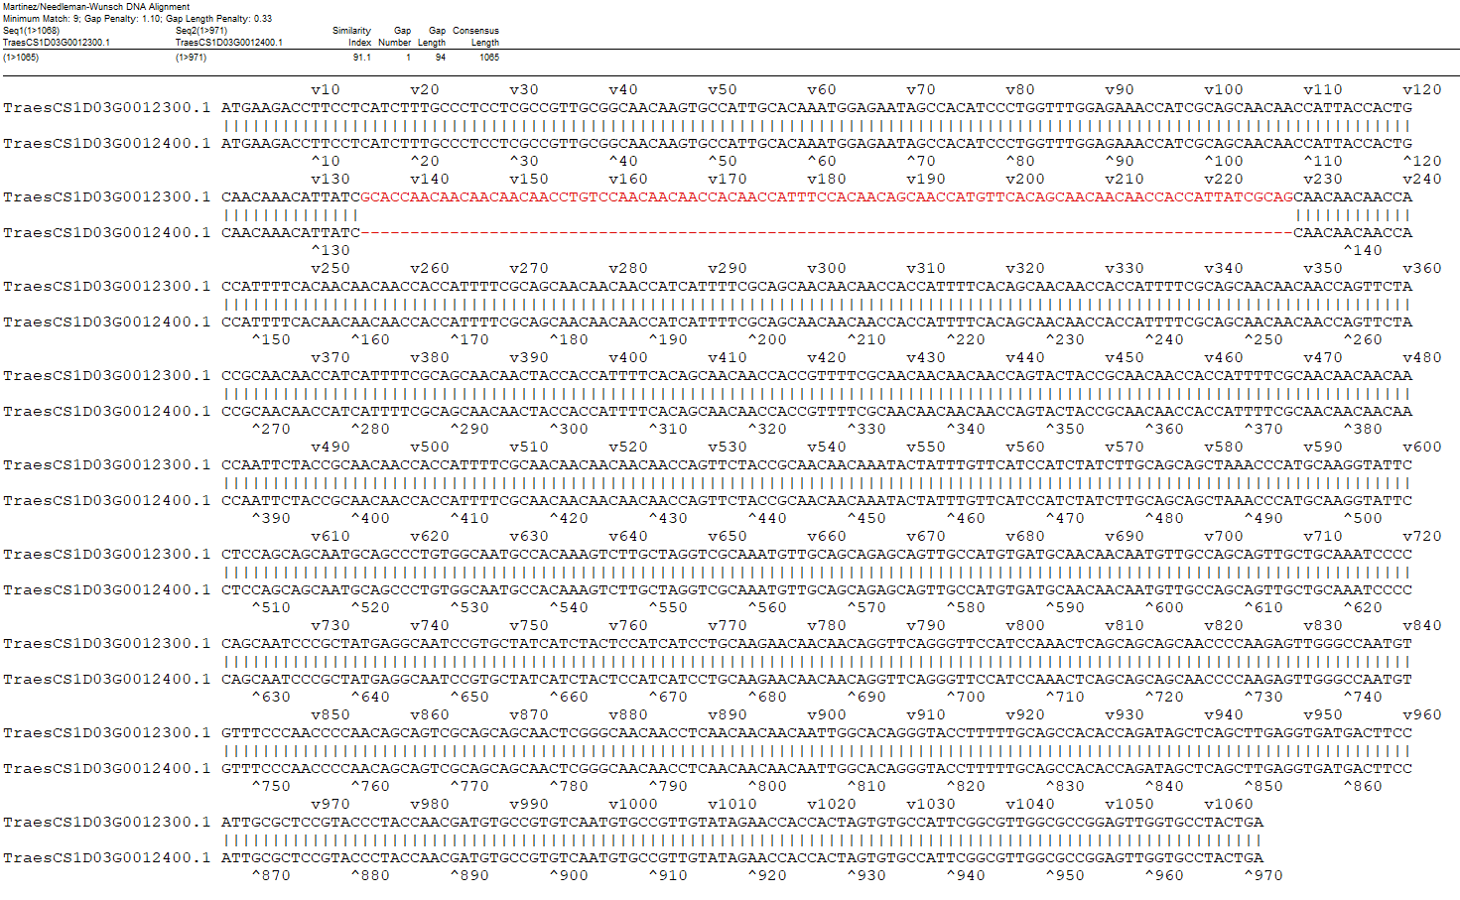
A
B
Fig. S4 Annotation comparison of D2 between IWGSCv2.1 (containing “03G” in gene names) and LMWgsFinder (A) and annotation comparison of D1 and D2 in IWGSCv2.1 (B).

