Slide 1
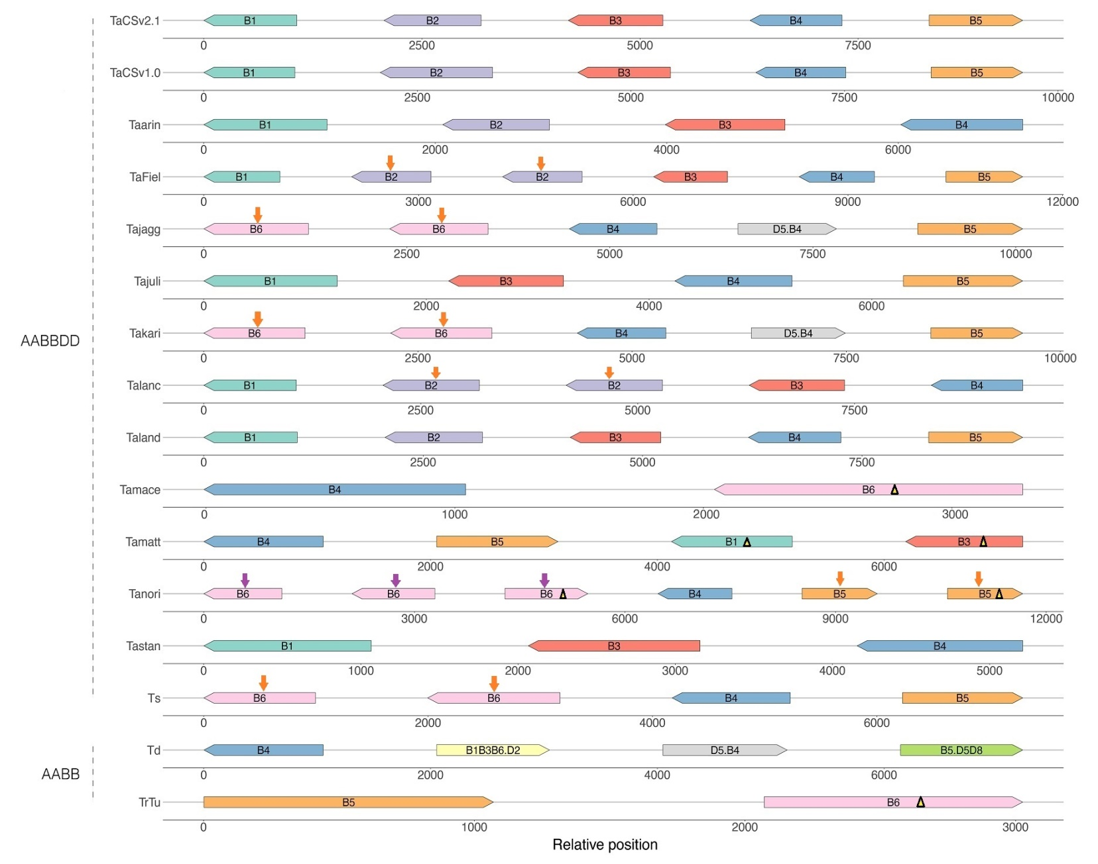
B
s
s
m
64.2 99.5 744.0 16132.4
s
m
63.4 101.1 748.7 15748.2
s
m
68.8 108.2 1116.9
s
s
s
m
65.3 36.2 108.0 1590.8 15657.6
20.7 1481.1 298.3 19941.3
s
m
188.7 1382.2 15366.8
s
s
m
m
20.7 1515.8 296.1 16154.6
s
s
s
m
63.2 13.0 99.3 1127.9
s
s
m
71.9 111.9 1407.3 13472.7
m
m
13473.1
s
s
1367.3
s
m
20.7 14547.4
s
m
170.1 750.9
s
m
20.7 1005.3 15948.9
m
m
m
200.3 225.3 11542.3
Fig. S13B Composition and chromosomal relative position of LMW-GS genes in the A (A), B (B), and D (C) subgenomes of different wheat varieties and their related species identified in this study.

