Slide 1
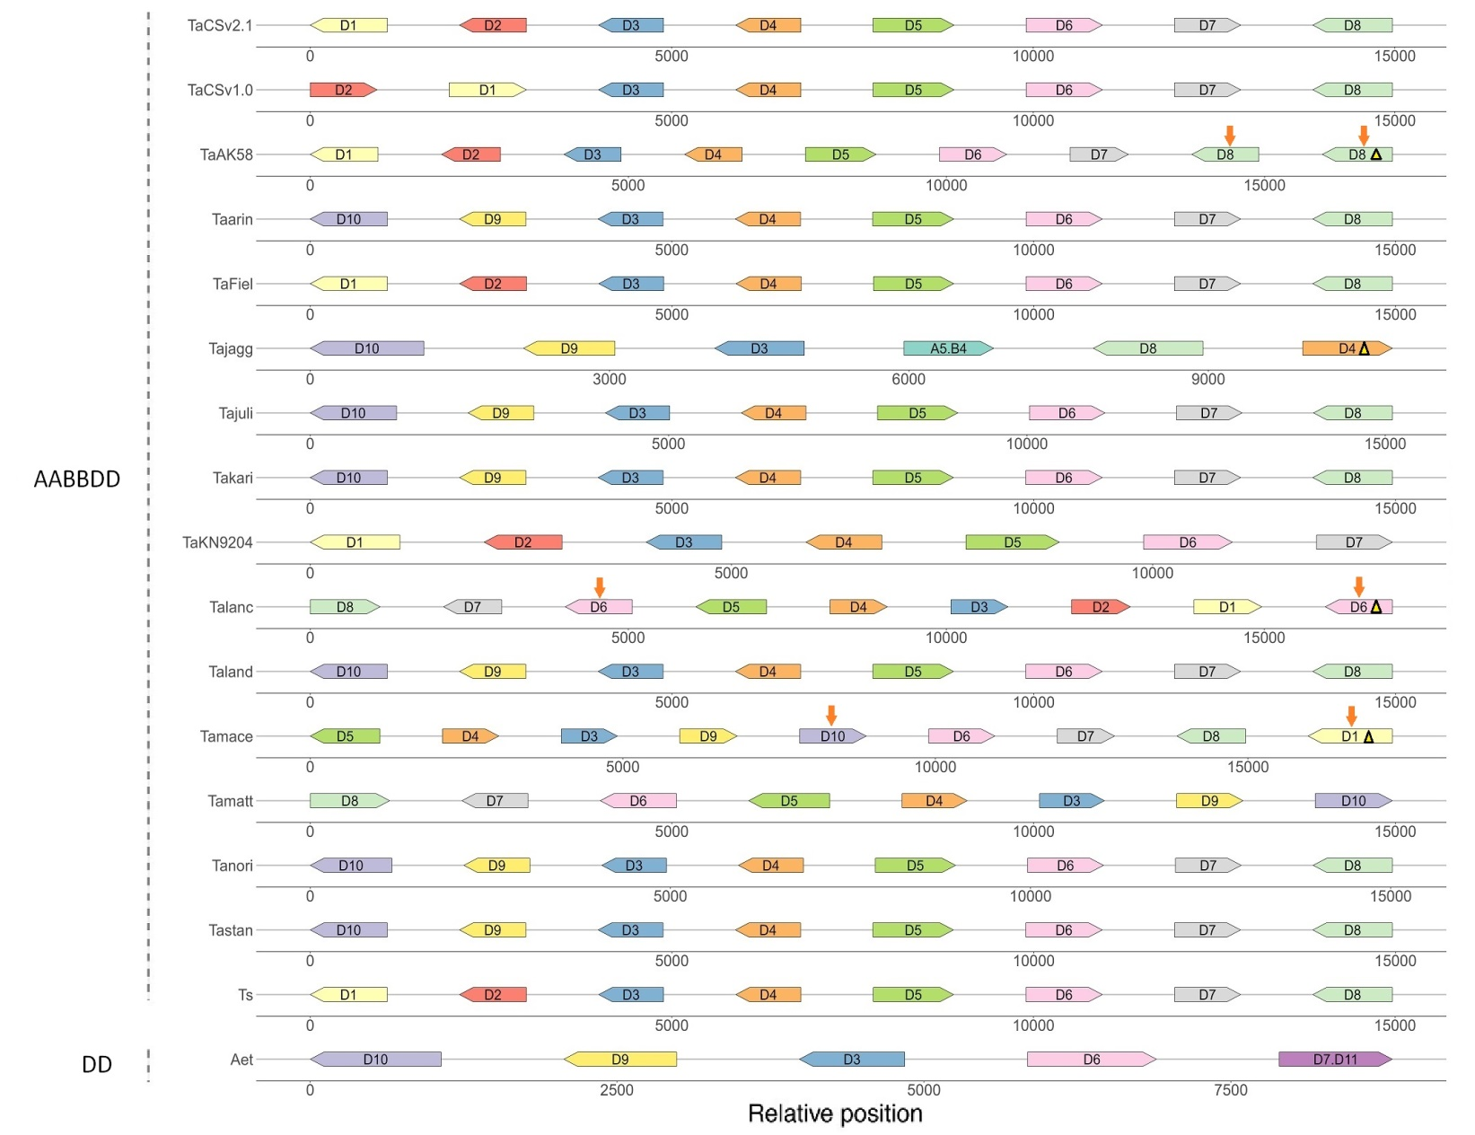
C
s
m
m
m
m
m
13.8 732.1 114.9 513.7 1037.1 214.7 1783.0
m
s
m
m
m
m
13.8 3609.2 114.9 515.4 796.3 216.6 1797.9
s
m
m
m
m
13.8 723.3 119.0 544.2 1022.3 214.9 1827.5
s
m
m
m
m
m
15.9 615.0 118.0 514.1 1027.8 214.5 1767.5
s
m
m
m
m
m
13.8 746.1 113.3 510.2 1057.9 214.2 1754.4
m
m
16.1 595.5 45.7 1976.4
m
m
m
m
m
16.1 607.8 118.2 520.1 959.3 214.4 1768.0
s
m
m
m
m
m
15.9 587.3 113.3 510.2 1068.2 214.2 1730.0
s
m
m
m
m
13.8 697.0 133.3 531.6 1013.8 214.3
m
m
m
m
m
s
m
1769.0 214.6 998.5 510.2 114.0 684.4 13.8
s
m
m
m
m
m
15.9 576.5 116.7 549.8 835.6 215.5 1800.0
m
m
s
m
m
m
509.6 114.6 597.6 15.9 625.8 214.5 1769.2
m
m
m
m
m
s
1767.9 214.2 966.0 500.8 113.5 600.0 15.9
m
m
m
m
m
15.9 571.5 113.8 501.9 967.7 215.2 1777.8
s
m
m
m
m
m
15.9 584.3 122.1 554.8 990.2 215.6 1748.5
s
m
m
m
m
m
13.8 695.8 96.1 503.4 998.4 215.7 1763.5
m
m
m
m
13.7 1098.4 259.6 208.8
Fig. S13C Composition and chromosomal relative position of LMW-GS genes in the A (A), B (B), and D (C) subgenomes of different wheat varieties and their related species identified in this study.

