Slide 1
Supplementary information
Visualizing Local Electrical Properties of Composite Electrodes
in Sulfide All-Solid-State Batteries by Scanning Probe Microscopy
Misae Otoyama,^{1,2} Takehiro Yamaoka,³ Hiroyuki Ito,³ Yuki Inagi,³
Atsushi Sakuda,^{1,*} Masahiro Tatsumisago,¹ and Akitoshi Hayashi¹
¹ Department of Applied Chemistry, Graduate School of Engineering, Osaka Prefecture University,
1-1 Gakuen-cho, Naka-ku, Sakai, Osaka 599-8531, Japan
² National Institute of Advanced Industrial Science and Technology (AIST),
Midorigaoka 1-8-31, Ikeda, Osaka 563-8577, Japan
³ Tokyo Solution Group, Analysis System Solution Development Dept., Hitachi High-Tech Corporation, 3-2-1 Sakado, Takatsu-ku, Kawasaki, Kanagawa 213-0012, Japan
*Correspondence to: saku@chem.osakafu-u.ac.jp

Slide 2
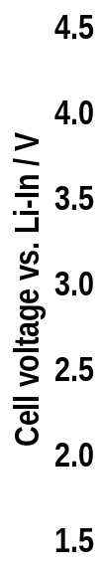


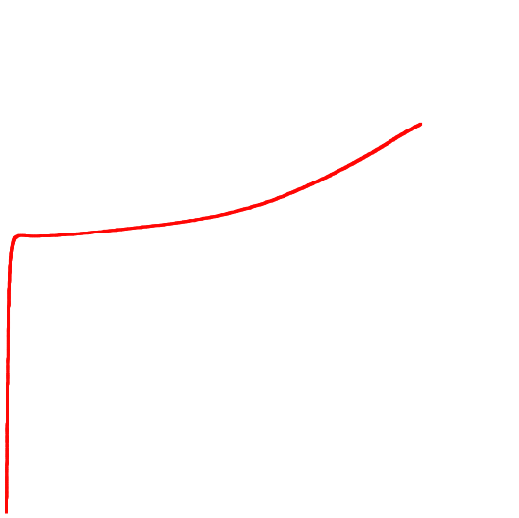
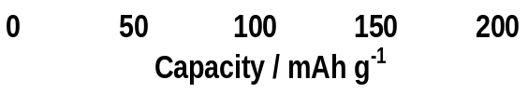
1st
25°C, 0.13 mA cm⁻²
~4.4 V (vs. Li⁺/Li)
Figure S1. Initial charge curve of the all-solid-state cell. The cell was charged to 4.4 V (vs. Li⁺/Li) under a current density of 0.13 A cm⁻² at 25°C.

Slide 3
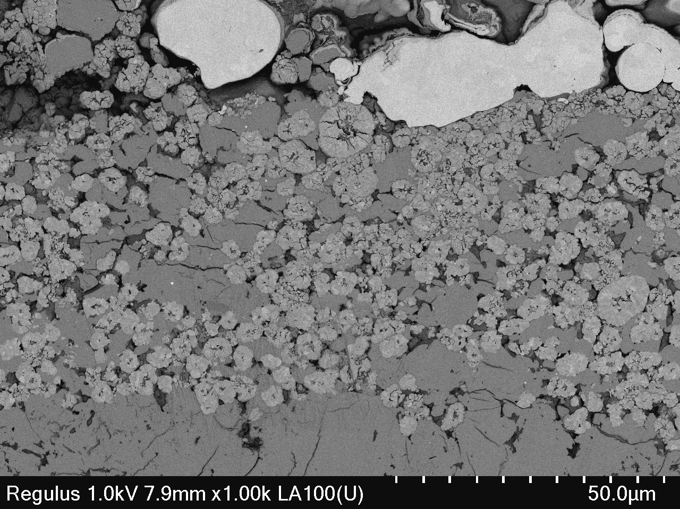
SUS powder
Composite positive electrode
Measurement area
SE layer
10 μm
Figure S2. SEM image of the cross-sectional composite positive electrode layer before the charge test. Red square is a measurement area for KPFM, C-AFM and SSRM.

Slide 4

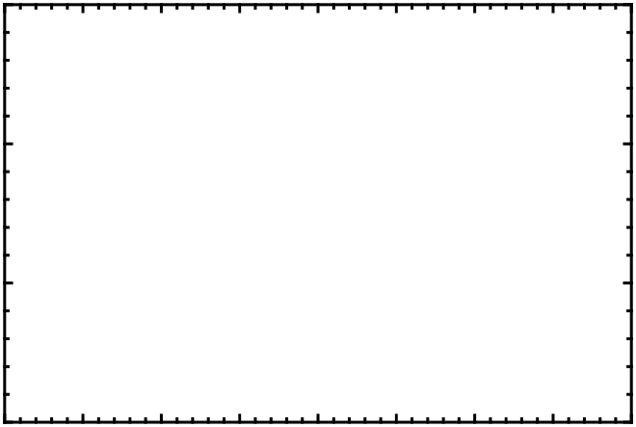
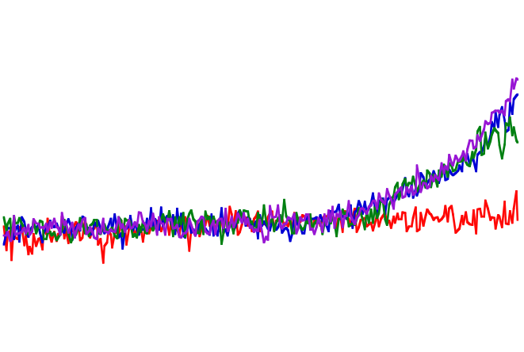
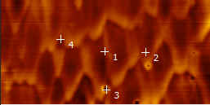

(b)
(a)
(2)
(4)
(3)
(4)
(1)
(2)
1 μm
(1)
(3)
Figure S3. (a) C-AFM image and (b) I-V curve of the SE layer before charging. Current changes were investigated with the bias voltage sweep from -2 V to 2 V at the 4 points indicated in the (a) C-AFM image.

Slide 5

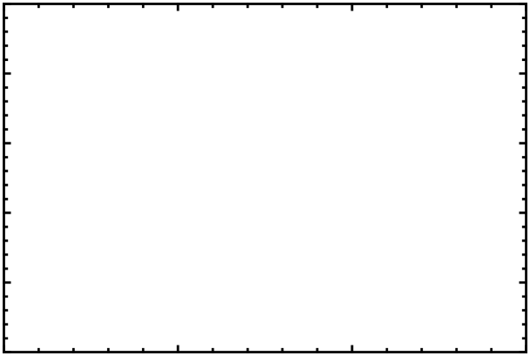
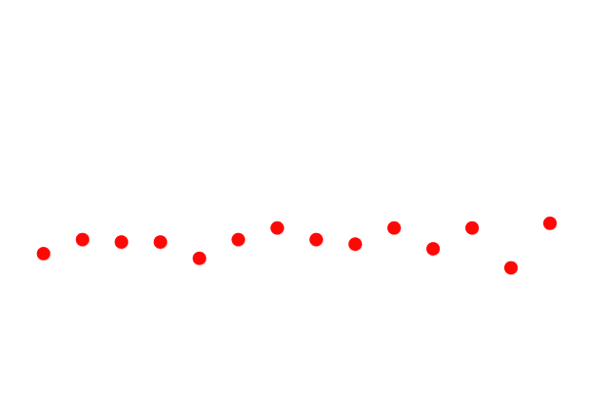


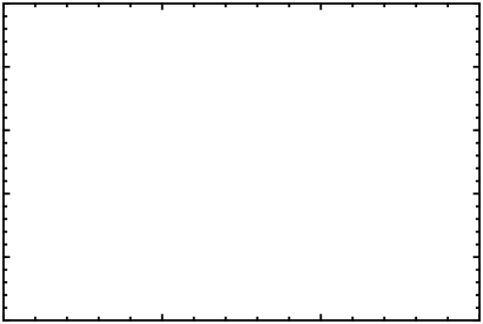
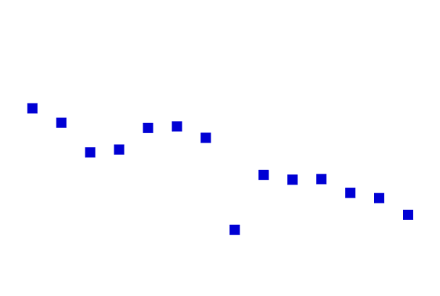
(a)
Before charge test
CC side
SE layer side
(b)
After charge test
CC side
SE layer side
Figure S4. V_{CPD}’ of each NMC particle in KPFM images (Figure 4(a) and (c)) before (a) and after (b) the charge test. The higher and lower numbers on the NMC particles indicate their position near the SE layer side and the current collector (CC) side, respectively.

