Slide 1
Supplementary Figures
Signatures of genetic variation in human microRNAs point to processes of positive selection and population-specific disease risks
Human Genetics
Pablo Villegas-Mirón¹, Alicia Gallego², Jaume Bertranpetit¹, Hafid Laayouni#^{1, 3} and Yolanda Espinosa-Parrilla# ^{4,5,6}
¹Institut de Biologia Evolutiva (UPF-CSIC), Universitat Pompeu Fabra, Barcelona, Catalonia, Spain.
²Centro de Biología Molecular Severo Ochoa, CSIC-UAM, Madrid, Spain.
³Bioinformatics Studies, ESCI-UPF, Pg. Pujades 1, 08003 Barcelona, Spain
⁴Escuela de Medicina, Universidad de Magallanes, Punta Arenas, Chile
⁵Laboratorio de Medicina Molecular - LMM, Centro Asistencial, Docente y de Investigación - CADI, Universidad de Magallanes, Punta Arenas, Chile
⁶Interuniversity Center on Healthy Aging, Chile
*Author for Correspondence: Hafid Laayouni (hafid.laayouni@upf.edu) and Yolanda Espinosa Parrilla (yolanda.espinosa@umag.cl)
# Equally contributors

Slide 2
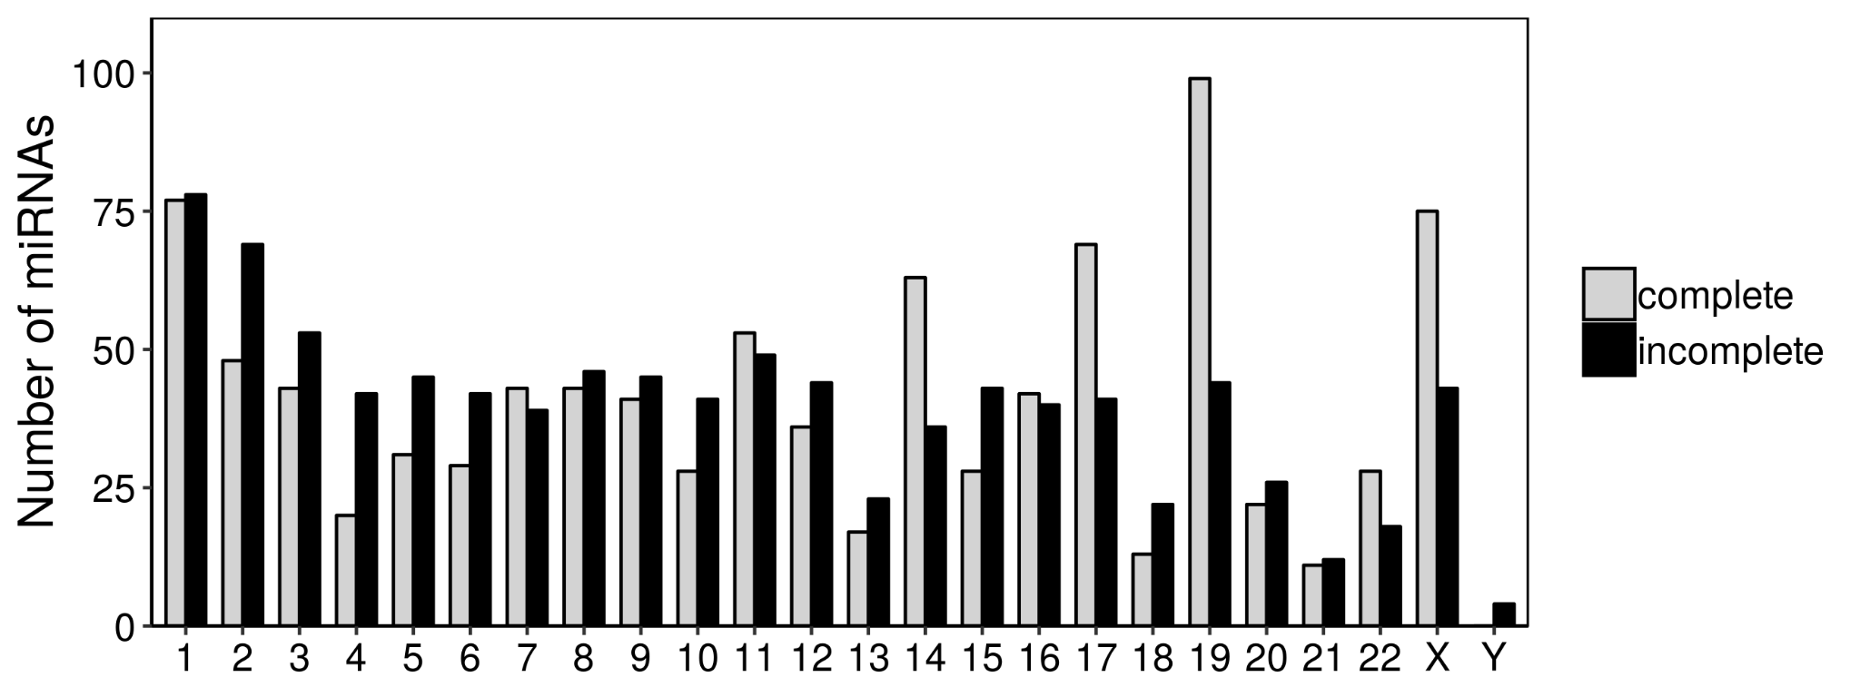
Supplementary Fig. S1 Number of miRNAs per chromosome that present both mature sequences in their hairpin (complete annotation) and only one mature sequence in one of their arms (incomplete annotation).

Slide 3
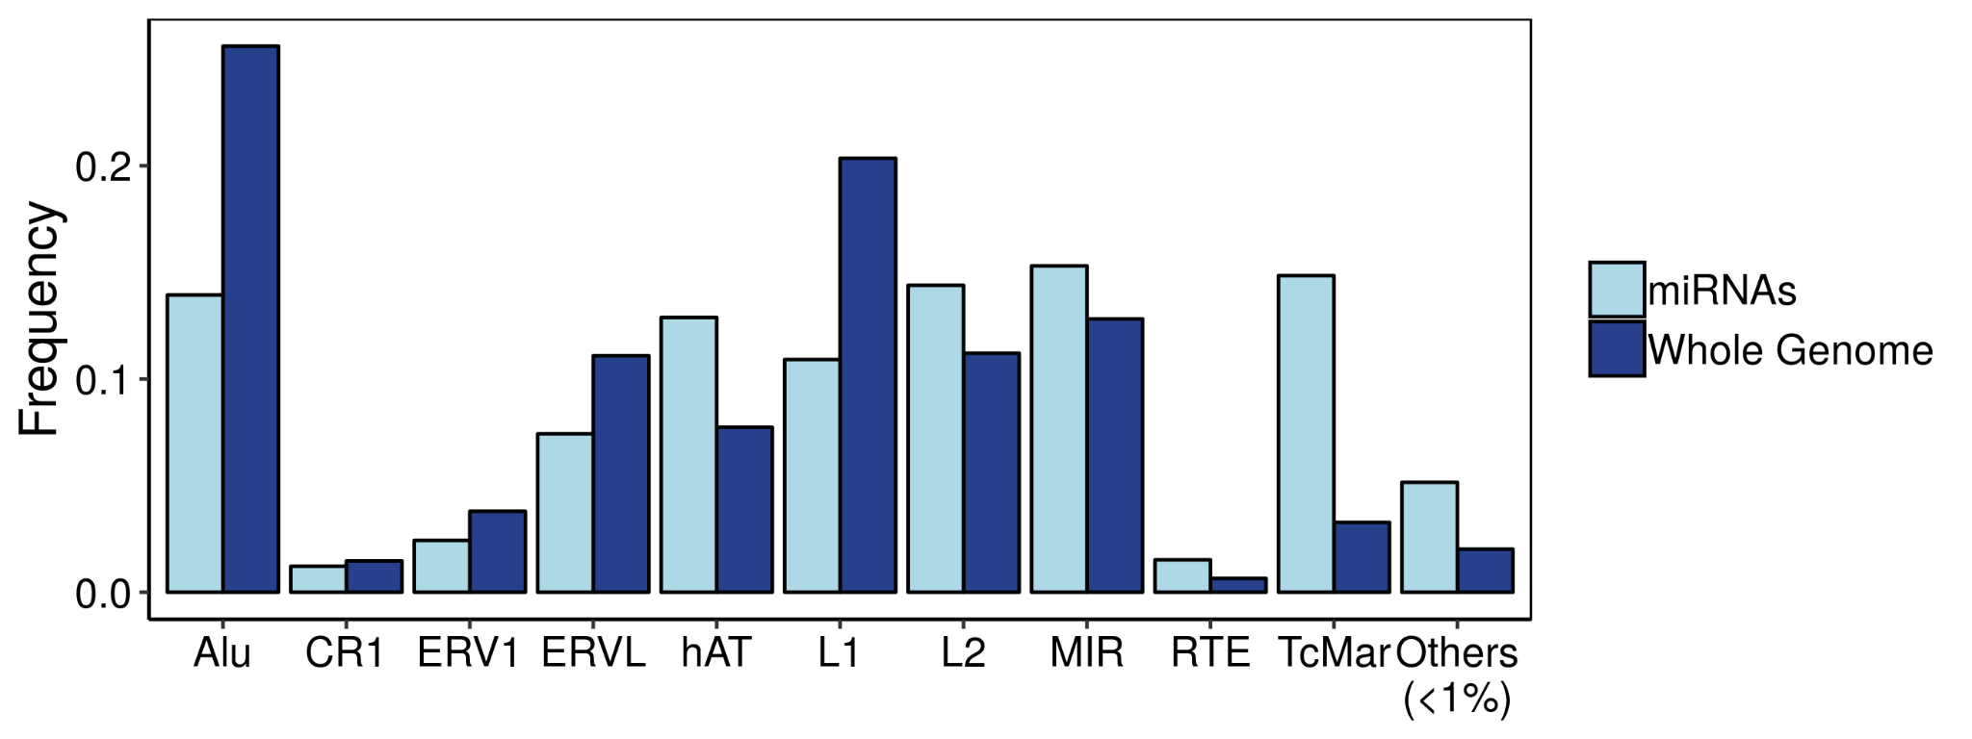
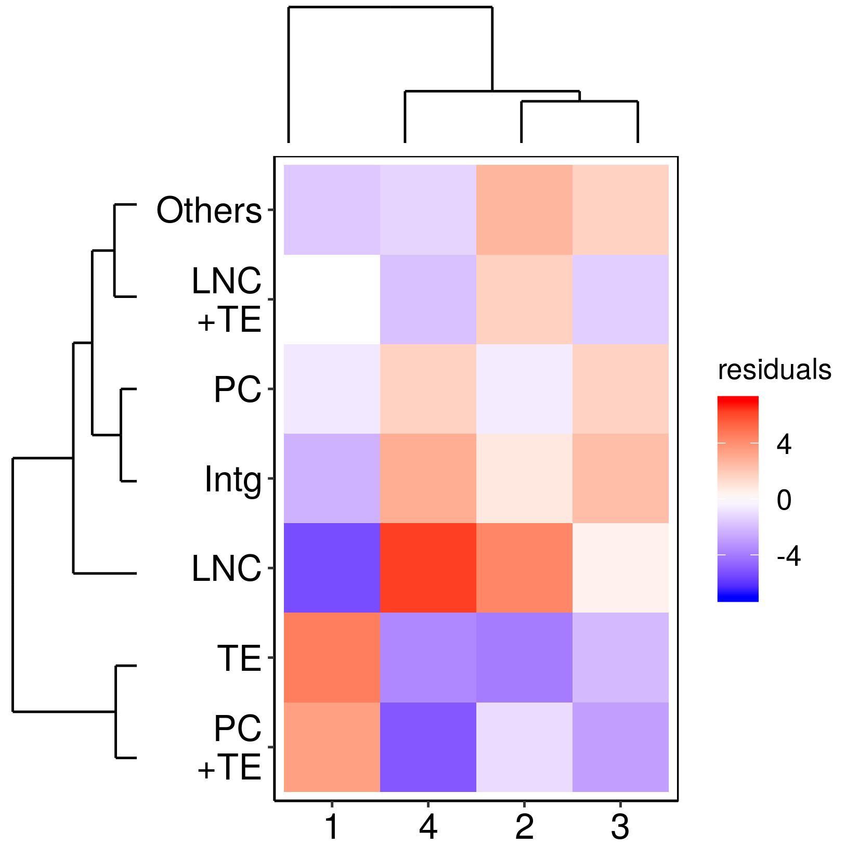
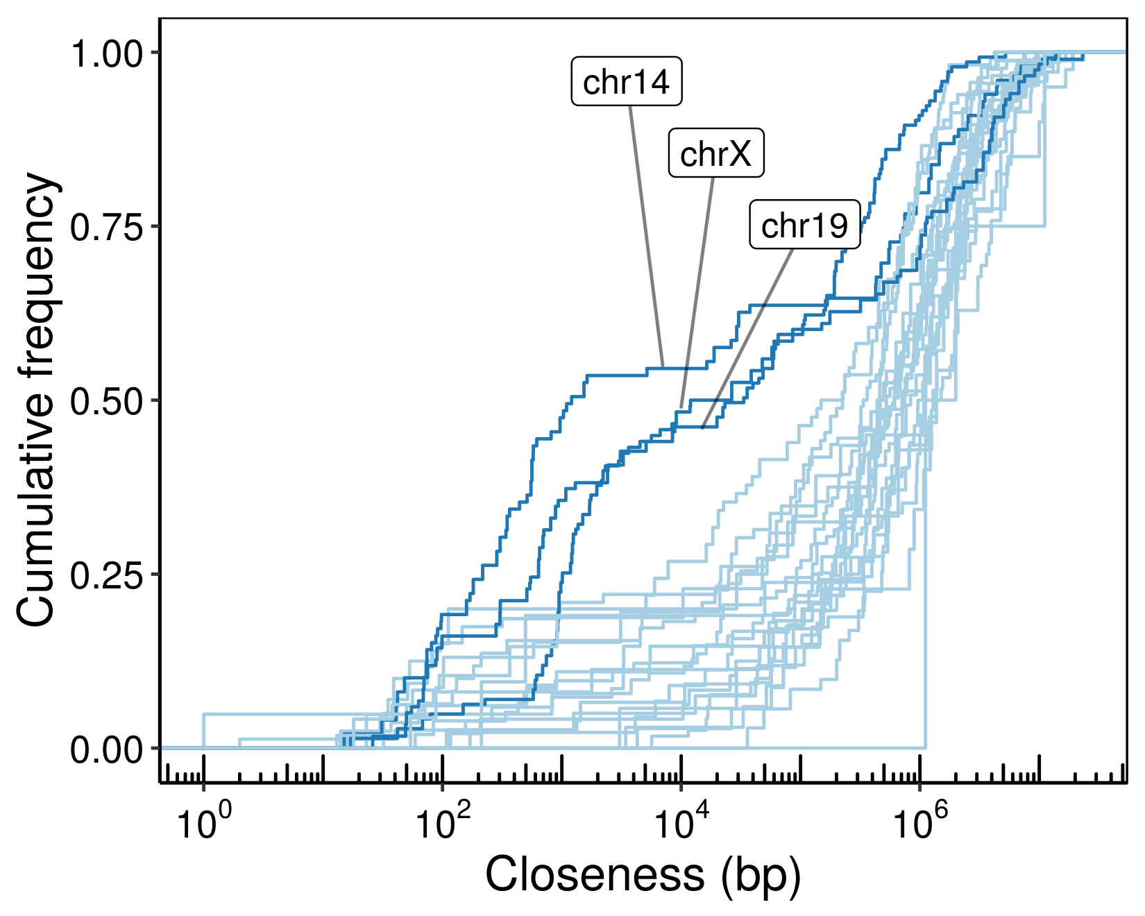
a
b
c
Supplementary Fig. S2 (a) Frequencies of transposable elements (Tes) described by the RepeatMasker database (v4.0.5) in the whole genome and found overlapping miRNA sequences. (b) Chi square residuals associated with each of the genomic context categories across conservation groups. Dendrograms show the hierarchical clustering performed across rows (genomic context) and columns (conservation). (c) Cumulative frequency of the closeness found between miRNAs (distance to the closest miRNA) in each chromosome. The increase of frequency in chromosomes 14, 19 and X shows groups of highly close miRNAs that correspond to the main clustering hotspots in the human genome.

Slide 4
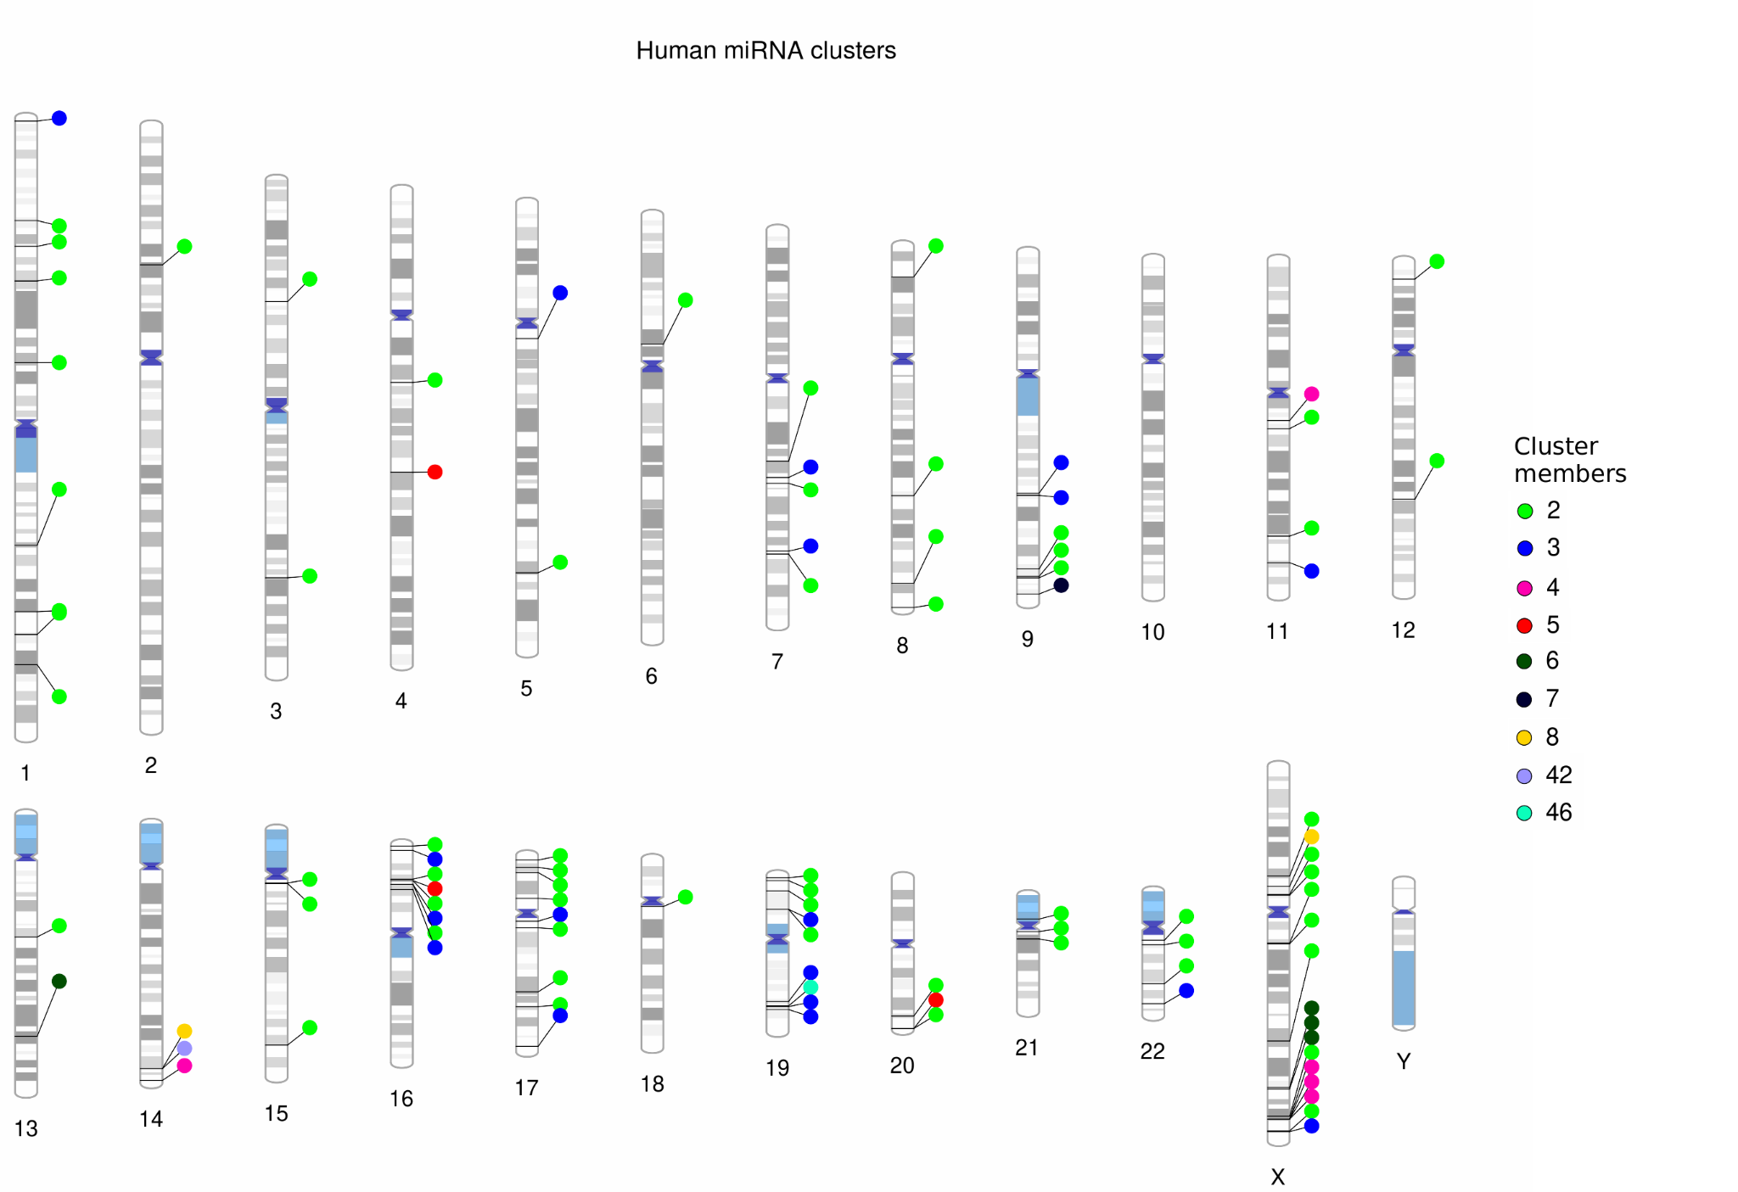
Supplementary Fig. S3 Genomic location of human miRNA clusters.

Slide 5
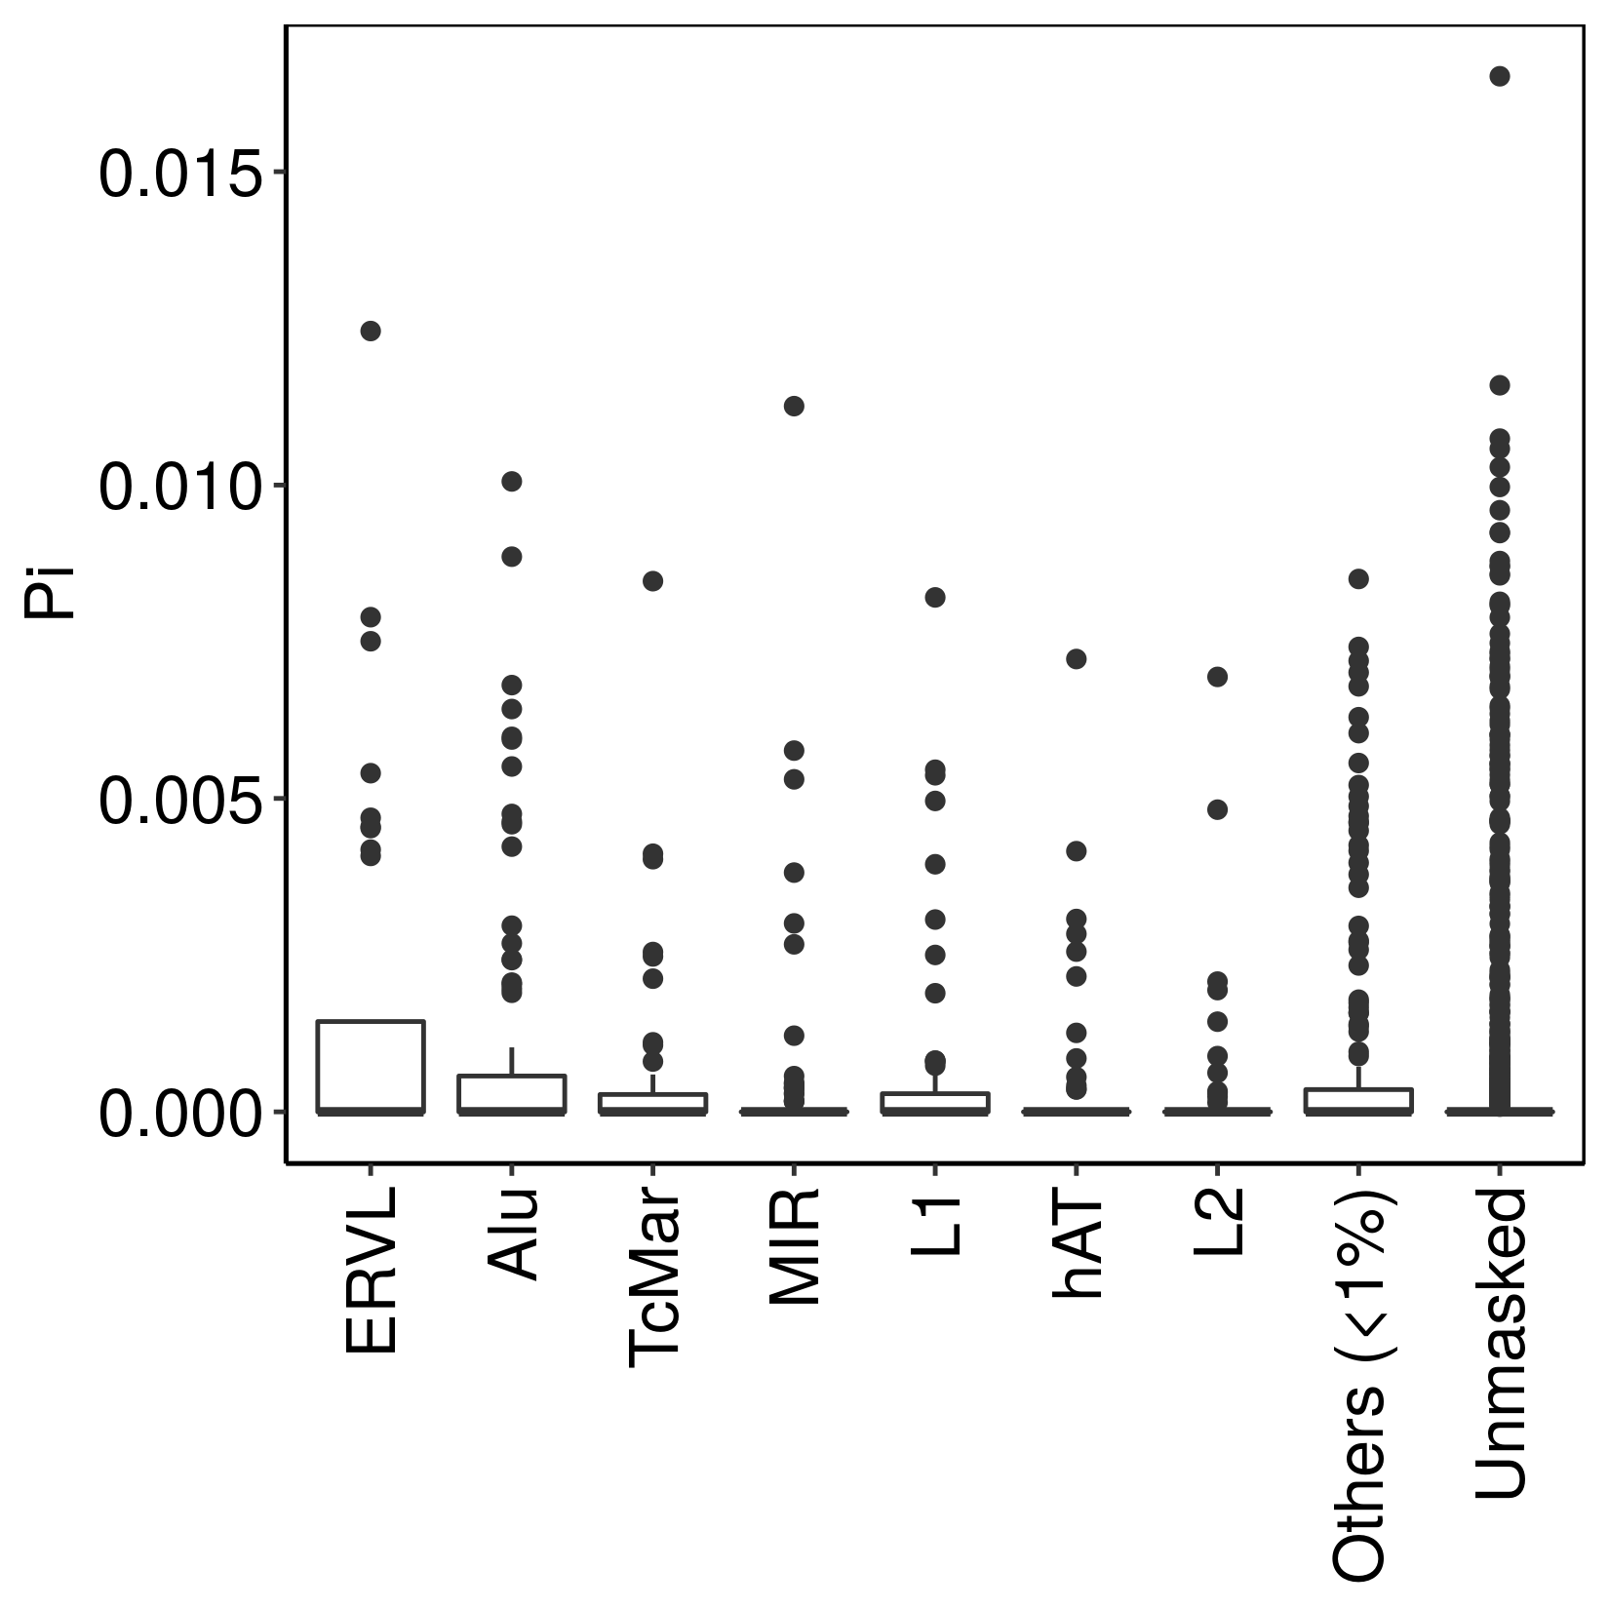
Supplementary Fig. S4 Nucleotide diversity (Pi) of miRNAs hosted by the different families of transposable elements (TEs). The “Others” category is made by minor categories represented by less than 1% of the total miRNAs.

Slide 6
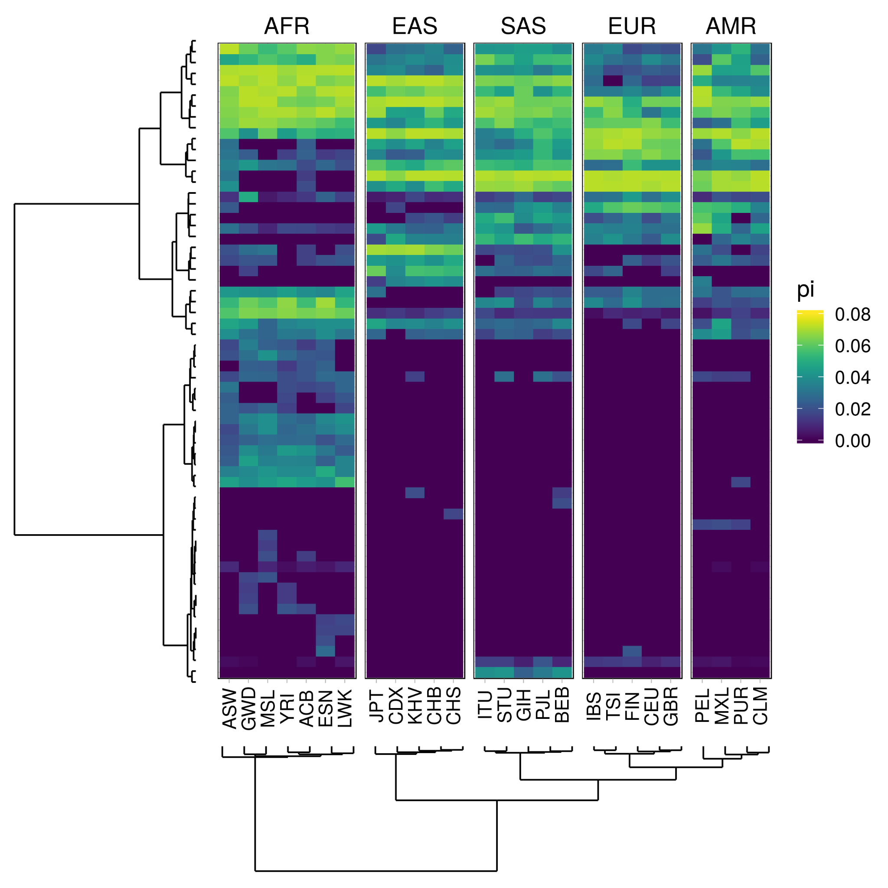
Supplementary Fig. S5 Heatmap showing the mean nucleotide diversity values per population of the seed regions harbouring one or more SNPs of the whole dataset. The dendrograms represent the hierarchical clustering performed on the miRNAs (rows) and populations (columns).

