Slide 1
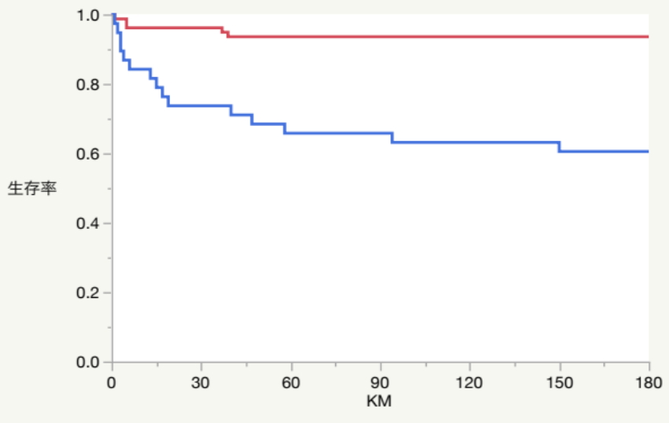





Impact of organ dysfunction on outcomes
in pediatric hypernatremia
AIM: To clarify the clinical backgrounds of contemporary children with hypernatremia and identify prognostic factors,
including the impact of organ dysfunction on mortality.
DESIGN & OUTCOMES:
91% Hospital-aquired
hypernatremia
■Kaplan–Meier estimated survival rates by
number of organ dysfunctions
Variables of organ dysfunctions
<4
Survival rate (%)
≥4
91% with underlying chronic diseases
Kidney
Respiratory
<4 vs ≥4 organ dysfunctions
116 children with
serum Na ≥150mmol/L
on or during admission
Central Nervous System
Coagulation
18% Mortality
Days from onset of hypernatremia
Children with ≥4 organ dysfunctions
at onset of hypernatremia had higher mortality (OR 5.83, 95% CI 1.92-17.7)
Liver
Cardiovascular
CONCLUSION: Pediatric hypernatremia was mostly hospital-acquired, and predominantly occurred in children with medical complexities.
The number of organ dysfunctions was a strong predictor of mortality.
Mihara et al. 2025

