Slide 1
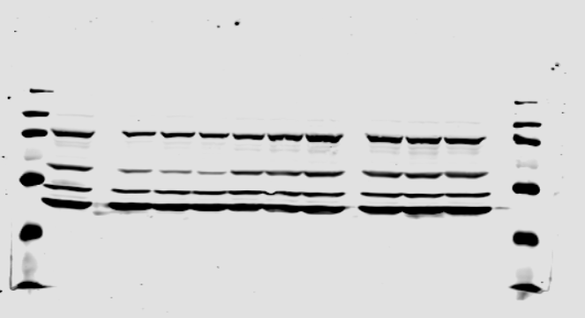
P-AKT, figure 1B
0
0.01
0.1
1
P-AKT

Slide 2
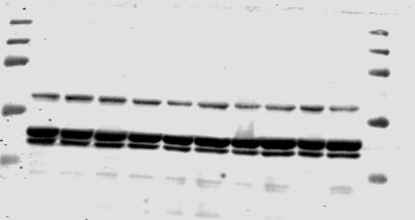
AKT, figure 1B
CUDC
μM
-
0.01
0.1
1
AKT

Slide 3
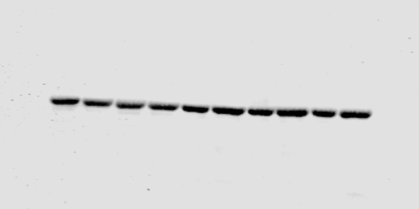
Actin, figure 1B
CUDC
μM
-
0.01
0.1
1
actin

Slide 4
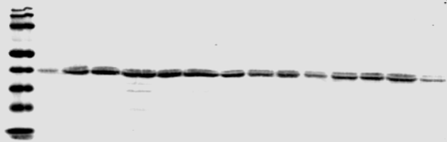
P-MAPK (figure 1C)
Ishikawa
HEC-1-A
Selumetinib
Trametinib
PD0325901
Selumetinib
Trametinib
PD0325901
μM
-
0.1
1
0.1
1
0.1
1
-
0.1
1
0.1
1
0.1
1
P-MAPK

Slide 5
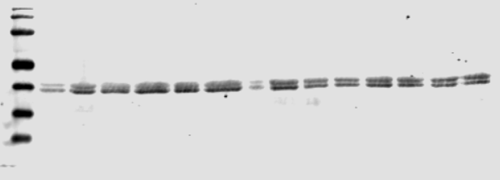
MAPK (figure 1C)
Ishikawa
HEC-1-A
Selumetinib
Trametinib
PD0325901
Selumetinib
Trametinib
PD0325901
μM
-
0.1
1
0.1
1
0.1
1
-
0.1
1
0.1
1
0.1
1
MAPK

Slide 6
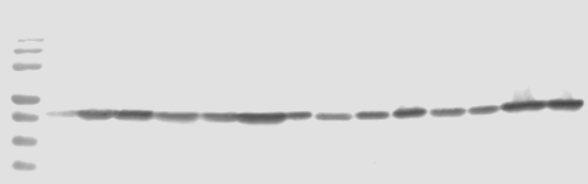
P-MEK (figure 1C)
Ishikawa
HEC-1-A
Selumetinib
Trametinib
PD0325901
Selumetinib
Trametinib
PD0325901
μM
-
0.1
1
0.1
1
0.1
1
-
0.1
1
0.1
1
0.1
1
P-MEK

Slide 7
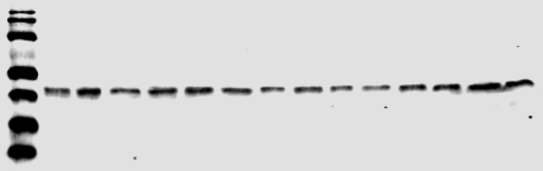
MEK (figure 1C)
Ishikawa
HEC-1-A
Selumetinib
Trametinib
PD0325901
Selumetinib
Trametinib
PD0325901
μM
-
0.1
1
0.1
1
0.1
1
-
0.1
1
0.1
1
0.1
1
MEK

Slide 8
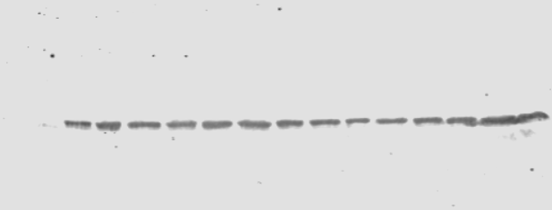
ACTIN (figure 1C)
Ishikawa
HEC-1-A
Selumetinib
Trametinib
PD0325901
Selumetinib
Trametinib
PD0325901
μM
-
0.1
1
0.1
1
0.1
1
-
0.1
1
0.1
1
0.1
1
actin

Slide 9
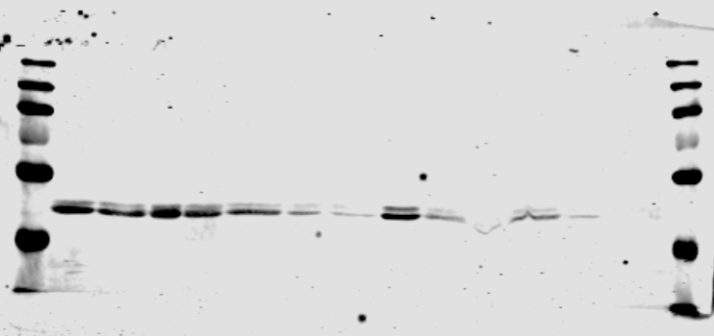
P-MAPK, Figure 2.B
Ishikawa
Trametinib 0.01μM+CUDC
Trametinib 0.1μM+CUDC
μM
0.01
0.1
1
0.01
0.1
1
P-MAPK

Slide 10
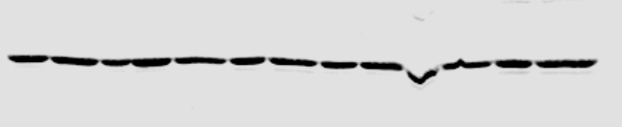
Actin, Ishikawa, Figure 2.B
Ishikawa
Trametinib 0.01μM+CUDC
Trametinib 0.1μM+CUDC
μM
0.01
0.1
1
0.01
0.1
1
actin

Slide 11
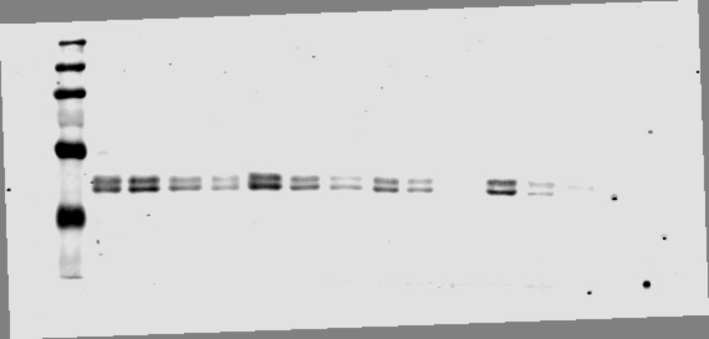
P-MAPK, Figure 2.B
HEC1A
Trametinib 0.01μM+CUDC
Trametinib 0.1μM+CUDC
μM
0.01
0.1
1
0.01
0.1
1
P-MAPK

Slide 12
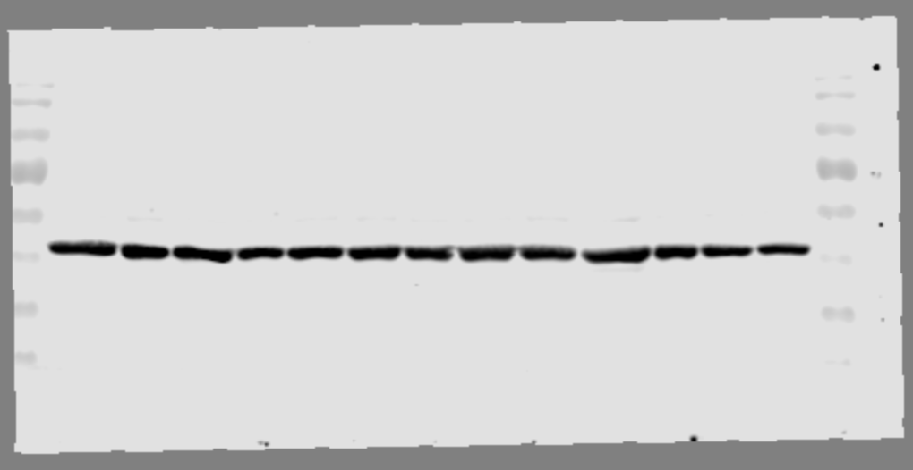
Actin, HEC-1-A, Figure 2.B
HEC1A
Trametinib 0.01μM+CUDC
Trametinib 0.1μM+CUDC
μM
0.01
0.1
1
0.01
0.1
1
actin

Slide 13
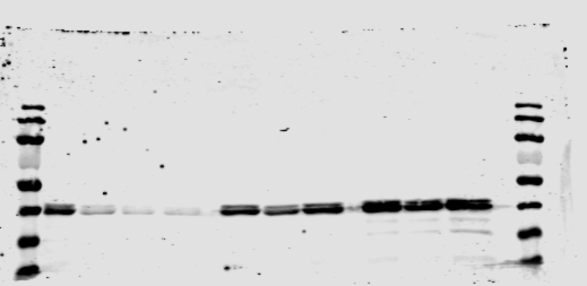
P-MAPK, figure 3.B
PD0325901 0.1μM+CUDC
μM
-
0.01
0.1
1
P-MAPK

Slide 14
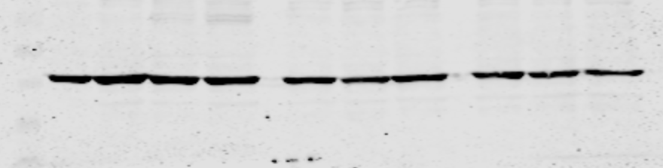
Actin, figure 3.B
PD0325901 0.1μM+CUDC
μM
-
0.01
0.1
1
actin

