Slide 1
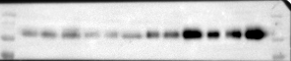
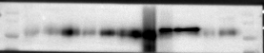
Fig 1 A
1# 2# 3# 4#
5# 6# 7# 8#
180 KDa
N LC N LC N LC N LC
180 KDa
N LC N LC N LC N LC
130 KDa
130 KDa
100 KDa
100 KDa
70 KDa
70 KDa
B7-H3
B7-H3
55 KDa
55 KDa
40 KDa
40 KDa
35 KDa
β-tubulin
35 KDa
β-tubulin
5#
4#
6#
7#
1#
8#
2#
3#
N PC LC
N PC LC
N PC LC
N PC LC
N PC LC
N PC LC
N LC
N PC LC
180 KDa
180 KDa
130 KDa
130 KDa
100 KDa
100 KDa
70 KDa
B7-H3
B7-H3
55 KDa
70 KDa
40 KDa
55 KDa
35 KDa
GAPDH
40 KDa
35 KDa
GAPDH

Slide 2
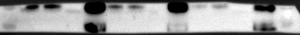
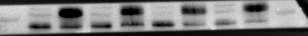
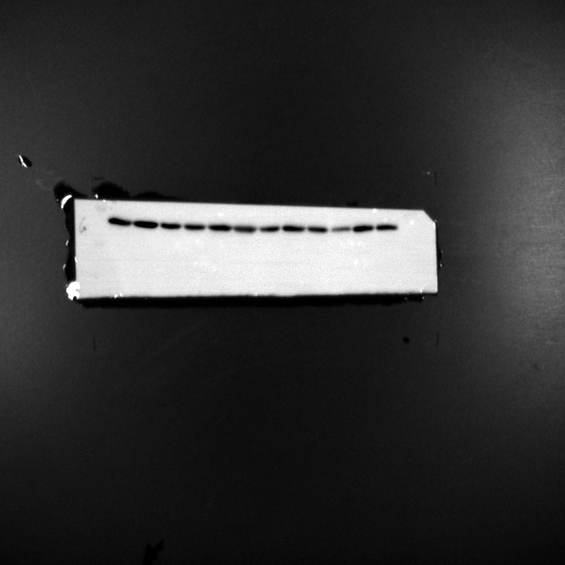
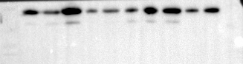
Fig 1 B
OE Vector
OE Vector
OE Vector
100 KDa
100 KDa
70 KDa
70 KDa
B7-H3-1
B7-H3-3
40 KDa
40 KDa
35 KDa
35 KDa
GAPDH-3
25 KDa
GAPDH-1
GAPDH-2
25 KDa
MOCK KO
MOCK KO
MOCK KO
100 KDa
70 KDa
B7-H3-1
B7-H3-2
B7-H3-3
40 KDa
35 KDa
25 KDa
GAPDH-1
GAPDH-2
GAPDH-3

Slide 3
Fig 1 D
OE Vector
OE Vector
OE Vector
55 KDa
55 KDa
40 KDa
40 KDa
35 KDa
35 KDa
25 KDa
PCNA-1
PCNA-2
PCNA-3
55 KDa
55 KDa
40 KDa
40 KDa
35 KDa
β-tubulin-1
35 KDa
25 KDa
GAPDH-2
GAPDH-3
MOCK KO
MOCK KO
MOCK KO
55 KDa
55 KDa
40 KDa
40 KDa
35 KDa
35 KDa
25 KDa
PCNA-2
PCNA-1
25 KDa
PCNA-3
55 KDa
55 KDa
40 KDa
40 KDa
35 KDa
β-tubulin-2
β-tubulin-1
35 KDa
β-tubulin-3
25 KDa
25 KDa

Slide 4
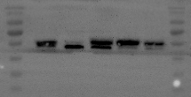
Fig S1 B
A549 H460 H1975 Calu3 BEAS-2B
A549 H460 Calu3 H1975 BEAS-2B
180 KDa
180 KDa
130 KDa
130 KDa
100 KDa
100 KDa
70 KDa
70 KDa
55 KDa
B7-H3-2
40 KDa
55 KDa
35 KDa
B7-H3-1
40 KDa
25 KDa
35 KDa
25 KDa
GAPDH-2
180 KDa
130 KDa
100 KDa
A549 H460 H1975 Calu3 BEAS-2B
70 KDa
55 KDa
180 KDa
130 KDa
40 KDa
100 KDa
70 KDa
35 KDa
B7-H3-3
25 KDa
GAPDH-1
55 KDa
40 KDa
35 KDa
25 KDa
GAPDH-3

Slide 5
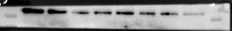
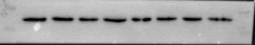
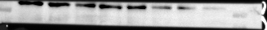
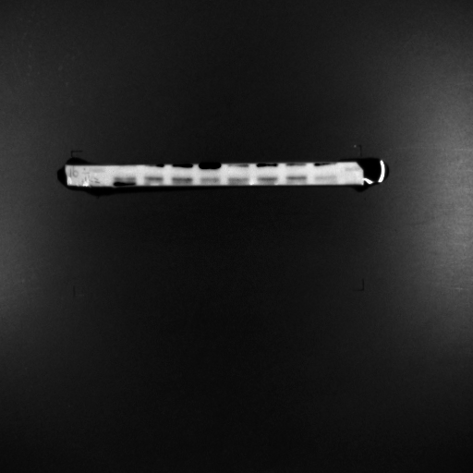
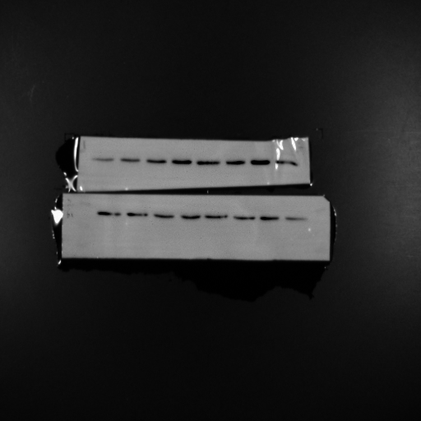
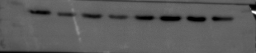
Fig 2 D
OE Vector OE Vector OE Vector
100 KDa
HK2-1 HK2-2 HK2-3
40 KDa
35 KDa
GAPDH-1 GAPDH-2 GAPDH-3
NC KO NC KO
NC KO
100 KDa
100 KDa
HK2-1 HK2-2
HK2-3
40 KDa
40 KDa
35 KDa
35 KDa
GAPDH-1 GAPDH-2
GAPDH-3

Slide 6
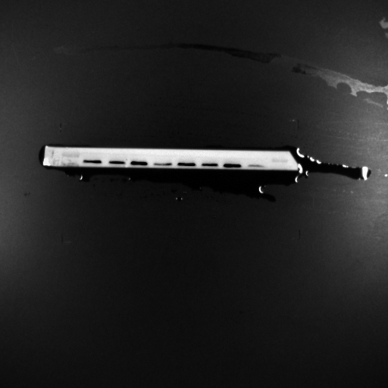
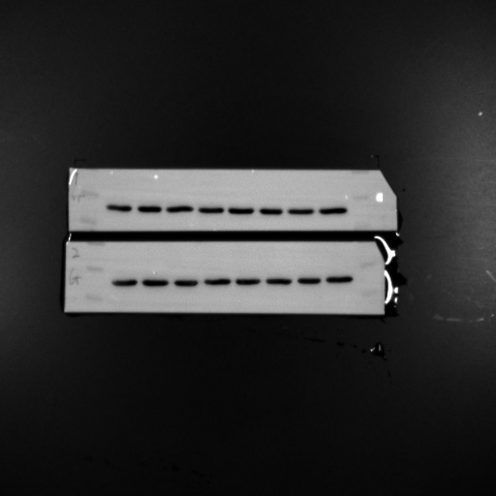
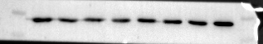
Fig 2 E
Vector OE
Vector OE
Vector OE
NC siHK2 NC siHK2
NC siHK2 NC siHK2
NC siHK2 NC siHK2
130 KDa
130 KDa
100 KDa
HK2-1
HK2-2 HK2-3
40 KDa
40 KDa
35 KDa
35 KDa
GAPDH -1
GAPDH -2 GAPDH-3

Slide 7
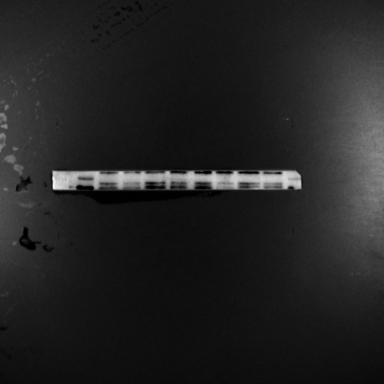
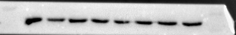
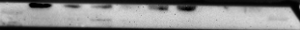
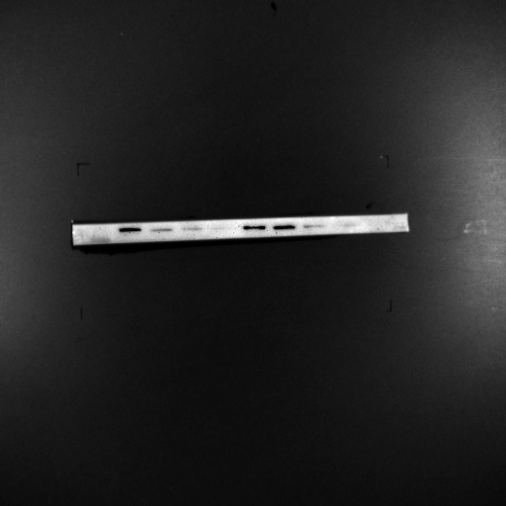
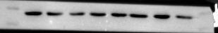
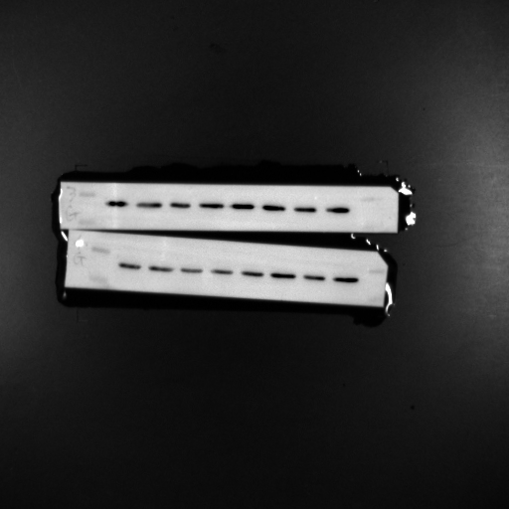
Fig 2 G
Vector OE
2-DG - + - +
100 KDa
70 KDa
HK2-1
40 KDa
35 KDa
GAPDH-1
OE Vector
OE Vector
2-DG - + - +
2-DG - + - +
100 KDa
100 KDa
HK2-2
HK2-3
40 KDa
40 KDa
35 KDa
35 KDa
GAPDH-3
GAPDH-2

Slide 8
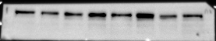
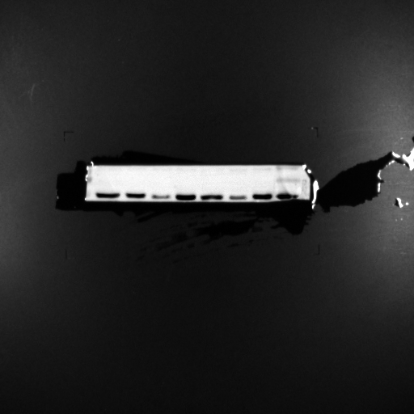
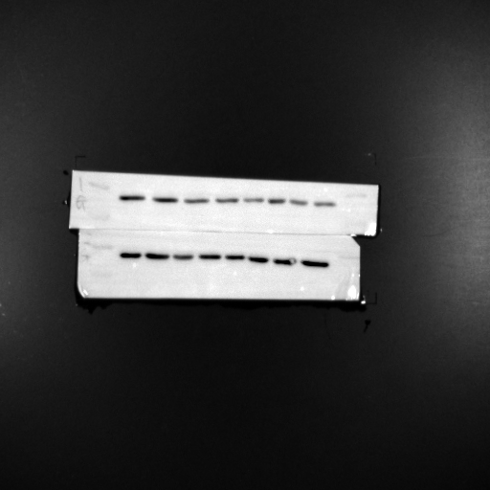
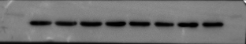
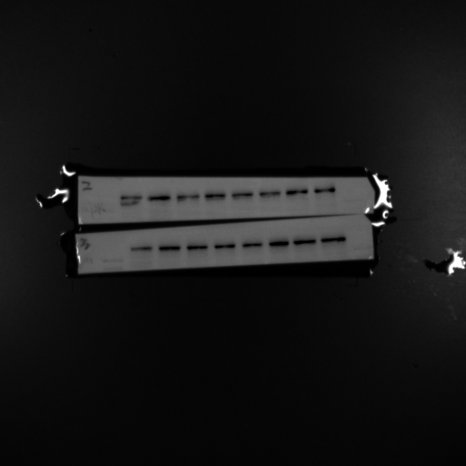
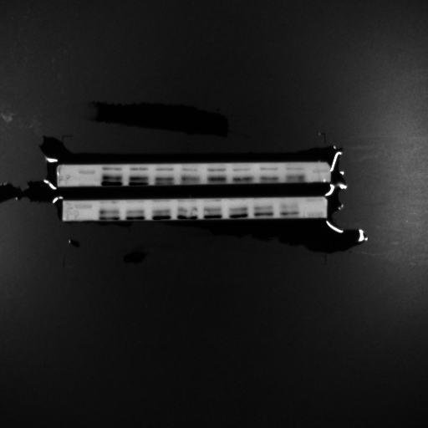
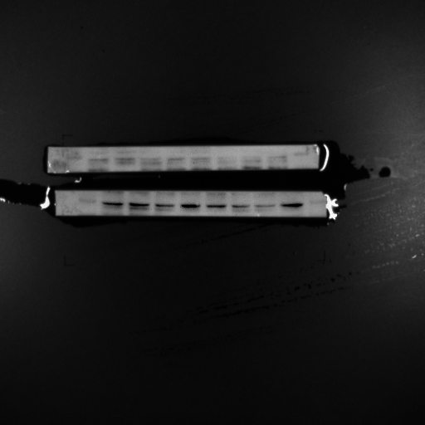
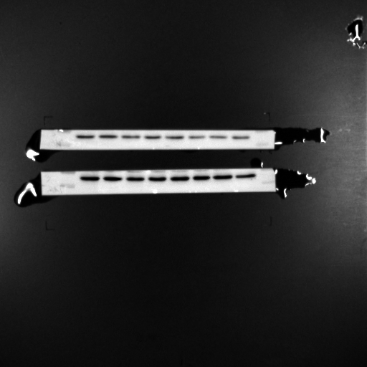
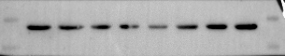
Fig 3A
Vector OE
OE Vector
OE Vector
Vector OE
180 KDa
180 KDa
180 KDa
130 KDa
130 KDa
130 KDa
p-mTOR-2
p-mTOR-1
p-mTOR-3
100 KDa
100 KDa
70 KDa
40 KDa
p-PI3K-3
p-PI3K-1
35 KDa
p-PI3K-2
70 KDa
55 KDa
GAPDH-3
55 KDa
p-AKT-2
p-AKT-1
p-AKT-3
40 KDa
40 KDa
35 KDa
35 KDa
25 KDa
GAPDH-1
GAPDH-2
GAPDH-2
Vector OE
OE Vector
OE Vector
180 KDa
180 KDa
130 KDa
130 KDa
mTOR-2
mTOR-3
mTOR-1
100 KDa
100 KDa
PI3K-2
70 KDa
PI3K-3
70 KDa
PI3K-1
55 KDa
55 KDa
p-AKT-2
p-AKT-1
p-AKT-3
40 KDa
40 KDa
35 KDa
35 KDa
GAPDH-2
GAPDH-1
GAPDH-3

Slide 9
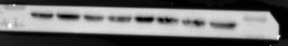
Fig 3A
MOCK KO
MOCK KO
MOCK KO
180 KDa
180 KDa
180 KDa
p-mTOR-2
130 KDa
130 KDa
p-mTOR-1
p-mTOR-3
130 KDa
100 KDa
100 KDa
100 KDa
p-PI3K-1
p-PI3K-3
p-PI3K-2
70 KDa
70 KDa
70 KDa
55 KDa
55 KDa
p-AKT-3
55 KDa
p-AKT-2
40 KDa
p-AKT-1
40 KDa
40 KDa
35 KDa
35 KDa
35 KDa
25 KDa
GAPDH-3
25 KDa
GAPDH-2
GAPDH-1
MOCK KO
MOCK KO
MOCK KO
180 KDa
180 KDa
130 KDa
130 KDa
mTOR-2
mTOR-3
mTOR-1
100 KDa
100 KDa
PI3K-2
PI3K-3
PI3K-1
70 KDa
70 KDa
55 KDa
55 KDa
p-AKT-2
p-AKT-3
p-AKT-1
40 KDa
40 KDa
35 KDa
35 KDa
25 KDa
GAPDH-2
25 KDa
GAPDH-3
GAPDH-1

Slide 10
Fig 3B
MOCK OE
MOCK OE
MOCK OE
MOCK OE
Rrapamycin - + - +
- + - + Rrapamycin
Rrapamycin - + - +
- + - + Rrapamycin
130 KDa
180 KDa
100 KDa
130 KDa
70 KDa
100 KDa
HK2-2 HK2-3
70 KDa
HK2-1
180 KDa
130 KDa
180 KDa
100 KDa
70 KDa
p-mTOR-3
p-mTOR -1 p-mTOR-2
180 KDa
180 KDa
130 KDa
100 KDa
70 KDa
mTOR-1
mTOR-3 mTOR-2
40 KDa
40 KDa
30 KDa
30 KDa
25 KDa
25 KDa
GAPDH-3
GAPDH-1 GAPDH-2
15 KDa
15 KDa

Slide 11
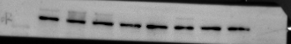
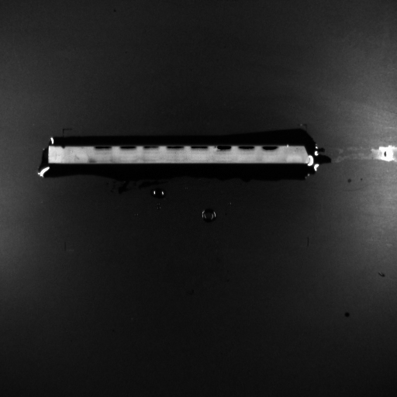
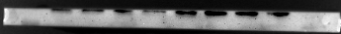
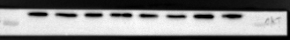
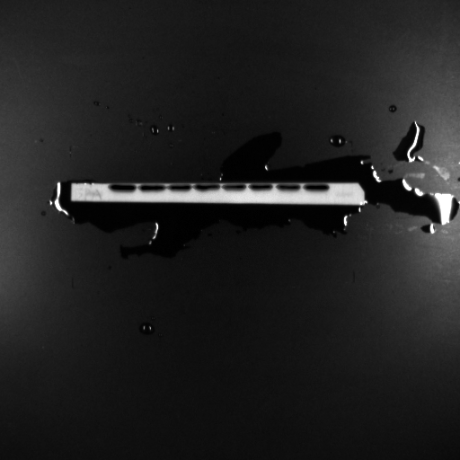
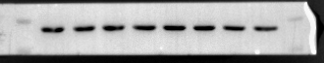
Fig 3D
MOCK OE
MOCK OE
MOCK OE
MOCK OE
NC siHK2 NC siHK2
NC siHK2 NC siHK2
NC siHK2 NC siHK2
NC siHK2 NC siHK2
180 KDa
180 KDa
130 KDa
130 KDa
p-mTOR-2
p-mTOR-3
p-mTOR-1
100 KDa
100 KDa
70 KDa
70 KDa
p-PI3K-2
p-PI3K-1
p-PI3K-3
55 KDa
55 KDa
p-AKT-2
p-AKT-1
p-AKT-3
40 KDa
40 KDa
35 KDa
GAPDH-2
GAPDH-1
35 KDa
GAPDH-3
180 KDa
180 KDa
130 KDa
130 KDa
mTOR-2
mTOR-3
mTOR-1
70 KDa
100 KDa
70 KDa
PI3K-2
PI3K-2
PI3K-3
55 KDa
55 KDa
AKT-1
AKT-2
AKT-3
40 KDa
40 KDa
35 KDa
35 KDa
GAPDH-2
GAPDH-1

Slide 12
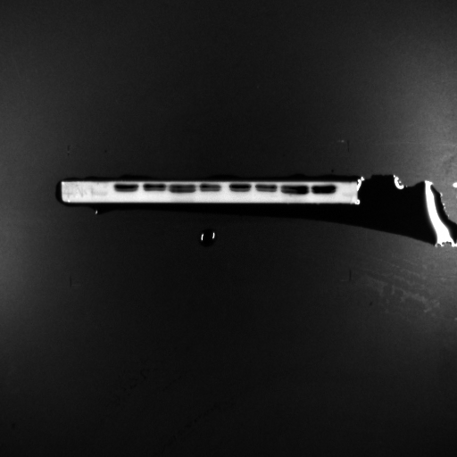
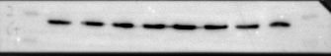
Fig 3E
Vector OE
Vector OE
Vector OE
Vector OE
2-DG - + - +
- + - + 2-DG
2-DG - + - +
- + - + 2-DG
180 KDa
180 KDa
130 KDa
130 KDa
p-mTOR-1
p-mTOR-3
p-mTOR-3
p-mTOR-2
100 KDa
100 KDa
70 KDa
70 KDa
p-PI3K-2
p-PI3K-1
p-PI3K-3
55 KDa
55 KDa
p-AKT-1
p-AKT-2
p-AKT-3
40 KDa
40 KDa
35 KDa
GAPDH-1
GAPDH-2
35 KDa
GAPDH-3
180 KDa
180 KDa
130 KDa
130 KDa
mTOR-2
mTOR-1
mTOR-3
100 KDa
100 KDa
70 KDa
70 KDa
PI3K-2
PI3K-3
PI3K-1
55 KDa
55 KDa
AKT-1
AKT-2
AKT-3
40 KDa
40 KDa
35 KDa
35 KDa
GAPDH-1
GAPDH-2
GAPDH-3

Slide 13
Fig S2 A
H1975
H1975
H1975
NC siB7-H3
NC siB7-H3
NC siB7-H3
180 KDa
180 KDa
130 KDa
130 KDa
100 KDa
100 KDa
70 KDa
70 KDa
B7-H3-1
B7-H3-2
B7-H3-3
55 KDa
40 KDa
35 KDa
25 KDa
GAPDH-1
GAPDH-2
GAPDH-3

Slide 14
Fig S2 D
H1975
H1975
H1975
NC siB7-H3
NC siB7-H3
NC siB7-H3
40 KDa
40 KDa
35 KDa
35 KDa
25 KDa
25 KDa
PCNA-2
PCNA-3
PCNA-1
55 KDa
55 KDa
40 KDa
40 KDa
35 KDa
35 KDa
25 KDa
GAPDH-2
GAPDH-3
25 KDa
β-tubulin-1

Slide 15
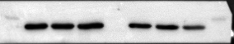
Fig S4 D
H1975
H1975
H1975
NC siB7-H3
NC siB7-H3
NC siB7-H3
180 KDa
180 KDa
130 KDa
130 KDa
100 KDa
100 KDa
HK2-1
HK2-2
HK2-3
55 KDa
55 KDa
40 KDa
40 KDa
35 KDa
GAPDH-1
GAPDH-2
35 KDa
GAPDH-3

