Slide 1
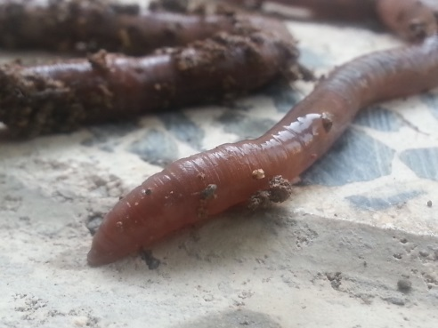
Phthalates (PAEs)
dimethyl phthalate (DMP)
Ecotoxicological effects
Earthworms;
Soil Bioindicators
Oxidative stress manifestations
MDA/LPO, CP, CAT, GST
TAC
NRR-time

