Slide 1
Consultant Responses
Uganda Trauma Fellowship - Consultants
February 18th 2024, 11:27 am PST

Slide 2
Q1 - Age
Answer | % | Count
20-30 years | 0.00% | 0
31-40 years | 65.22% | 30
41 -50 years | 17.39% | 8
51+ years | 17.39% | 8
Total | 100% | 46

Slide 3
Q2 - Gender
# | Answer | % | Count
1 | Female | 20.45% | 9
2 | Male | 79.55% | 35
 | Total | 100% | 44

Slide 4
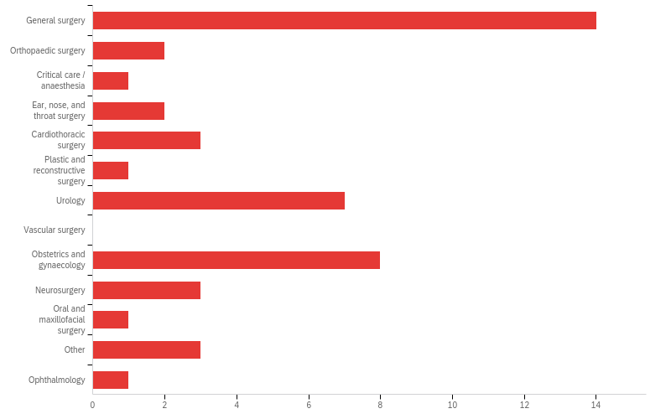
Q3 - Specialty

Slide 5
Q3 - Specialty
Answer | % | Count
General surgery | 30.43% | 14
Obstetrics and gynaecology | 17.39% | 8
Urology | 15.22% | 7
Cardiovascular and thoracic surgery | 8.70% | 4
Neurosurgery | 6.52% | 3
Ear, nose, and throat surgery | 4.35% | 2
Orthopaedic surgery | 4.35% | 2
Critical care / anaesthesia | 2.17% | 1
Emergency medicine | 2.17% | 1
Ophthalmology | 2.17% | 1
Oral and maxillofacial surgery | 2.17% | 1
Plastic and reconstructive surgery | 2.17% | 1
Upper GI / HPB | 2.17% | 1
Total | 100% | 46

Slide 6
Q4d - GenSurg_skills
Question | 1 | 2 | 3 | 4 | 5 | 6 | 7 | 8 | 9 | 10 | 11 | 12 | 13 | Total
Complex wound debridement and/or closure | 4 | 0 | 0 | 1 | 0 | 1 | 1 | 1 | 0 | 1 | 0 | 1 | 1 | 11
Splenectomy / splenorrhaphy | 3 | 3 | 0 | 0 | 0 | 0 | 0 | 0 | 0 | 0 | 1 | 1 | 0 | 8
Small intestine resection and anastomosis, lysis of adhesions | 2 | 0 | 2 | 1 | 1 | 1 | 0 | 0 | 1 | 2 | 0 | 0 | 0 | 10
Ureteral repair | 1 | 1 | 1 | 1 | 0 | 0 | 3 | 1 | 1 | 2 | 0 | 0 | 1 | 12
Diagnostic laparoscopy | 1 | 1 | 0 | 1 | 0 | 2 | 0 | 1 | 1 | 1 | 0 | 1 | 3 | 12
Bladder repair/resection | 1 | 1 | 0 | 0 | 1 | 2 | 1 | 1 | 1 | 1 | 0 | 1 | 0 | 10
Colectomy, colostomy | 0 | 2 | 2 | 2 | 1 | 0 | 0 | 1 | 1 | 0 | 0 | 1 | 0 | 10
Nephrectomy | 0 | 2 | 0 | 0 | 3 | 0 | 1 | 1 | 1 | 0 | 3 | 0 | 0 | 11
Abdominal wall reconstruction | 0 | 1 | 2 | 1 | 0 | 0 | 0 | 3 | 1 | 0 | 1 | 0 | 3 | 12
Rectal repair | 0 | 1 | 0 | 2 | 1 | 0 | 3 | 0 | 0 | 0 | 3 | 1 | 0 | 11
Pancreas repair, resection, drainage | 0 | 0 | 1 | 1 | 1 | 1 | 0 | 0 | 2 | 2 | 1 | 1 | 0 | 10
Gastrectomy, repair of gastric perforation | 0 | 0 | 1 | 1 | 2 | 1 | 1 | 0 | 1 | 1 | 1 | 0 | 0 | 9
Cholecystectomy, common bile duct exploration, hepaticoenterostomy | 0 | 0 | 1 | 0 | 1 | 1 | 1 | 3 | 0 | 0 | 0 | 2 | 1 | 10

Slide 7
Q4f - OBG_skills
Question | 1 | 2 | 3 | 4 | Total
Cesarean section | 4 | 1 | 0 | 2 | 7
Manual / vacuum-assisted evacuation | 4 | 0 | 1 | 1 | 6
Repair of perineal tear | 0 | 3 | 2 | 0 | 5
Hysterectomy | 0 | 1 | 1 | 2 | 4
Notes:
8 respondents

Slide 8
Q4k - Urology_skills
Question | 1 | 2 | 3 | 4 | Total
Bladder repair | 3 | 0 | 1 | 1 | 5
Nephrostomy tube placement | 2 | 2 | 0 | 2 | 6
Ureteral repair | 1 | 0 | 3 | 0 | 4
Nephrectomy | 0 | 3 | 1 | 0 | 4
Notes:
7 respondents

Slide 9
Q4a - CT_skills
Question | 1 | 2 | 3 | 4 | 5 | 6 | Total
Thoracostomy | 1 | 0 | 1 | 0 | 0 | 2 | 4
Thoracotomy | 1 | 0 | 0 | 2 | 0 | 0 | 3
Vascular repair | 1 | 1 | 1 | 0 | 0 | 0 | 2
Esophageal repair | 0 | 0 | 1 | 0 | 1 | 0 | 2
Diaphragmatic repair | 0 | 0 | 0 | 1 | 1 | 0 | 2
Chest wall repair/plating | 0 | 0 | 0 | 0 | 0 | 1 | 1
Notes:
4 respondents

Slide 10
Q4e - Neurosurg_skills
Question | 1 | 2 | 3 | 4 | 5 | Total
Decompressive craniotomy (Burr hole) | 1 | 0 | 0 | 0 | 1 | 2
Craniectomy | 0 | 1 | 1 | 0 | 0 | 2
Neurosurgical interventions are outside the scope of what a trauma specialist should know | 0 | 1 | 0 | 0 | 0 | 1
Prevention of secondary brain injury | 0 | 0 | 0 | 1 | 0 | 1
Mild TBI (concussion) management | 0 | 0 | 0 | 0 | 1 | 1
Notes:
3 respondents

Slide 11
Q4c - ENT_skills
Question | 1 | 2 | 3 | 4 | 5 | Total
Epistaxis management | 0 | 0 | 0 | 0 | 1 | 1
Neck exploration and vascular repair | 0 | 0 | 0 | 0 | 1 | 1
Tracheal repair | 0 | 0 | 0 | 1 | 0 | 1
Tracheostomy | 0 | 0 | 0 | 0 | 0 | 0
Cricothyroidotomy | 0 | 0 | 0 | 0 | 0 | 0
Must have ranked 5 as highest priority
Notes:
2 respondents

Slide 12
Q4i - Ortho_skills
Question | 1 | 2 | 3 | 4 | Total
Fasciotomy | 1 | 0 | 1 | 0 | 2
External fixation | 1 | 0 | 1 | 0 | 2
Limb amputation | 0 | 1 | 0 | 1 | 2
Complex wound debridement | 0 | 1 | 0 | 1 | 2
Notes:
2 respondents

Slide 13
Q4b - Crit_care_skills
Question | 1 | 2 | 3 | 4 | 5 | 6 | 7 | 8 | Total
Advanced airway management (e.g. intubation) | 1 | 0 | 0 | 0 | 0 | 0 | 0 | 0 | 1
Hypovolemic shock | 0 | 1 | 0 | 0 | 0 | 0 | 0 | 0 | 1
Sedation | 0 | 0 | 1 | 0 | 0 | 0 | 0 | 0 | 1
Ventilator management | 0 | 0 | 0 | 1 | 0 | 0 | 0 | 0 | 1
Distributive shock (anaphylactic, septic, neurogenic) | 0 | 0 | 0 | 0 | 1 | 0 | 0 | 0 | 1
Cardiogenic shock | 0 | 0 | 0 | 0 | 0 | 1 | 0 | 0 | 1
Management of severe electrolyte derangements and nutrition | 0 | 0 | 0 | 0 | 0 | 0 | 1 | 0 | 1
Management of renal failure | 0 | 0 | 0 | 0 | 0 | 0 | 0 | 1 | 1
Notes:
1

Slide 14
Q4m - EM_skills
Question | 1 | 2 | 3 | Total
Chest tube insertion | 1 | 0 | 0 | 1
Wound closure | 0 | 1 | 0 | 1
Fracture management | 0 | 0 | 1 | 1
Notes:
1

Slide 15
Q4g - Ophtho_skills
Question | 1 | 2 | 3 | Total
Management of chemical eye injuries | 1 | 0 | 0 | 1
Lateral canthotomy | 0 | 1 | 0 | 1
Ophthalmologic interventions are outside the scope of what a trauma specialist should know | 0 | 0 | 1 | 1
Notes:
1

Slide 16
Q4h - OMF_skills
Question | 1 | 2 | 3 | 4 | Total
Repair of facial fractures | 1 | 0 | 0 | 0 | 1
Repair of lip/tongue laceration | 0 | 0 | 0 | 0 | 0
Emergent airway management | 0 | 0 | 0 | 0 | 0
Epistaxis management | 0 | 0 | 0 | 0 | 0
Notes:
1

Slide 17
Q4j - Plastics_skills
Question | 1 | 2 | 3 | 4 | Total
Resuscitation of severely burned patients | 1 | 0 | 0 | 0 | 1
Burn debridement / escharotomy | 0 | 1 | 0 | 0 | 1
Skin grafting | 0 | 0 | 1 | 0 | 1
Free flap | 0 | 0 | 0 | 1 | 1
Notes:
1

Slide 18
Q4m - UpperGI_skills
Question | 1 | 2 | 3 | Total
Splenectomy | 1 | 0 | 0 | 1
Damage control surgery | 0 | 1 | 0 | 1
Hepatectomy | 0 | 0 | 1 | 1
Notes:
1

Slide 19
Q6 - Percent_trauma
Answer | % | Count
0% | 6.52% | 3
1-25% | 47.8% | 22
26-50% | 23.9% | 11
51-75% | 15.2% | 7
76-100% | 6.52% | 3
Total | 100% | 46
Notes:
What percentage of your patients are presenting for a trauma-related problem?

Slide 20
Q7 - State_trauma
# | Answer | % | Count
1 | Very satisfied | 2.17% | 1
2 | Satisfied | 4.35% | 2
3 | Neutral | 26.09% | 12
4 | Dissatisfied | 41.30% | 19
5 | Very dissatisfied | 26.09% | 12
 | Total | 100% | 46
Notes:
What is your impression of the current state of care for injured patients at Mulago National Referral Hospital?

Slide 21
Q8 - Outcomes_trauma
Answer | % | Count
Insufficient/inadequate material resources | 89.13% | 41
Delayed/late presentation to hospital | 82.61% | 38
Insufficient/inadequate human resources | 80.43% | 37
Inappropriate/inadequate resuscitation | 78.26% | 36
No trained specialists in trauma | 41.30% | 19
Inadequate inpatient care despite good ED resuscitation | 36.96% | 17
Total | 100% | 46
Notes:
Reason for poor outcomes

Slide 22
Q9 - Role_trauma
Answer | % | Count
Strongly agree | 67.39% | 31
Agree | 21.74% | 10
Neutral | 6.52% | 3
Disagree | 2.17% | 1
Strongly disagree | 2.17% | 1
Total | 100% | 46
Notes:
What is your impression of the following statement? In the Ugandan setting, there is a role for a surgeon who specializes in the management of traumatically injured patients.

Slide 23
Q10 - Peds_trauma
Answer | % | Count
Very necessary | 91.30% | 42
Somewhat necessary | 6.52% | 3
Equivocal | 2.17% | 1
Unnecessary | 0.00% | 0
Very Unnecessary | 0.00% | 0
Total | 100% | 46
Notes:
How necessary is it for a trauma specialist to have familiarity with the care of injured children?

Slide 24
Q11 - Fellowship_setting
Answer | % | Count
Hybrid of local and international settings | 78.26% | 36
Entirely in Uganda, with Ugandan faculty | 17.39% | 8
Entirely internationally, at established training programmes | 4.35% | 2
Total | 100% | 46

Slide 25
Q12 - Fellowship_duration
Answer | % | Count
12 months | 36.96% | 17
18 months | 21.74% | 10
24 months | 41.30% | 19
Total | 100% | 46

Slide 26
Q13 - Fellows_other_nations
Answer | % | Count
Yes | 93.48% | 43
No | 6.52% | 3
Total | 100% | 46
Fellows_no_other_nations
We habmve the burden of trauma victims but the training facilities are very much lacking in equipment and order. It would be unfair to bring someone for this training, they pay their money and leave have baked or with the wrong idea of trauma management.
Uganda has critical shortage of human resources for health and therefore we need to be selfish for some yesrs

Slide 27
Q15 - Format_fellowship
Answer | % | Count
Trauma surgery | 97.73% | 43
Emergency general surgery - management of bowel perforation, appendicitis, cholecystitis | 65.91% | 29
Surgical critical care - longer or multiple rotations to match the time on trauma ward / theatre | 63.64% | 28
Surgical critical care - short rotation(s) | 59.09% | 26
Total | 100% | 44
SCC – longer only | SCC – shorter only | both
14 | 12 | 14

Slide 28
Q16 - Hindrance_trauma
Answer | % | Count
Lack of proper trauma systems in Uganda | 86.36% | 38
Lack of a training program in Uganda | 75.00% | 33
Lack of recognition of need for specialized training | 54.55% | 24
No current specialists in trauma to inspire trainees | 45.45% | 20
Lack of interest by surgeons | 25.00% | 11
Large amount of non-operative care, less time in the theatre | 11.36% | 5
Total | 100% | 44
Notes:
What do you think has hindered surgeons in pursuing a career in trauma? (select all that apply)

Slide 29
Q17 - Barriers_fellowship
Answer | % | Count
Lack of trauma infrastructure (supplies, staff, theatre time/space) | 81.82% | 36
Lack of trauma fellowship curriculum | 70.45% | 31
Poor employment prospects after training | 65.91% | 29
Lack of funding | 61.36% | 27
No available faculty to train the fellows | 59.09% | 26
Lack of accreditation (certifying body) at present | 52.27% | 23
Total | 100% | 44
Notes:
What do you perceive as barriers to establishing a TACS fellowship in Uganda? (select all that apply)

Slide 30
Q18 - Facilitators_fellowship
Answer | % | Count
High burden of injured patients | 70.45% | 31
Established accreditation pathway in other specialties (urology, pediatric surgery) | 65.91% | 29
Motivated faculty | 61.36% | 27
Motivated residents | 50.00% | 22
Potential for political/ministry support | 47.73% | 21
Total | 100% | 44
Notes:
What do you perceive as facilitating factors in the establishment of a TACS fellowship in Uganda? (select all that apply)

Slide 31
Q19 - Productivity_fellowship
Answer | % | Count
It would improve patient outcomes. | 93.18% | 41
It would enhance learning for other trainees and medical students. | 77.27% | 34
It would increase efficiency and improve overall staffing. | 68.18% | 30
It would add redundant physicians to the team. | 11.36% | 5
It would take away learning opportunities from other trainees. | 6.82% | 3
Total | 100% | 44
Notes:
How do you think the presence of a TACS fellowship in Uganda would affect productivity and learning opportunities? (select all that apply)

Slide 32
Q20 - Other_comments
Coding legend:
Support
Suggestion Concern
Other_comments
Every surgeon is taught how to manage all classes of patients. They just need to be dedicated enough to do it. If this is going to be a trauma management course, let it be general trauma management. Which means you are training people in actually managing patients efficiently enough to get them to their specialist alive. Adding things like repairing intestinal perforation and all other specific emergencies eg reattaching a finger. Such operations can be lengthy and it would crowd trauma theatre. For this course to hold water, let someone come from internship be an M.O for 1 year or be a clinical officer and enroll for the course straight away otherwise one can as well put a surgeon in A n E. I feel it’s overlapping with surgical training. So one can’t come from mmed surgery and do this fellowship. As they are the surgical first responders, they need to know when to call the specialist and not struggle alone. And to get buy in from MoH emphasize that they should be posted in regional referral hospitals not busy town hospitals which are fully covered. You could advocate for MoH to create posts for this so as to increase jobs for medical workers.
It is long overdue. The need is enormous.
the training may be incorporated in other specialties too
It should start immediately. And should be open to all surgucal displines. Not only general surgery

Slide 33
Q20 - Other_comments
Coding legend:
Support
Suggestion Concern
Other_comments
Uganda is overwhelmed with trauma ,there is urgent need for better traige and emergency mgt systems
There is need to start this program as soon as yesterday.
None
If you realize how many inadequacies there are in the management of trauma patients visa vi the burden of trauma in the country, the introduction of this fellowship would be deemed long over due. It would be a great opportunity for individuals and also benefit the community. Bottlenecks include lack of easy access to theatre space as well as other diagnostic modalities. However these can be addressed in the long run.
Most of the trauma emergencies are handled by the various surgical disciplines Isn't this duplicating in some disciplines
This is an excellent opportunity to develop skills and train Trauma specialist both locally and regionally.
The political will will be very helpful longterm. In terms of Pay structure Jobs Trainning Or else external funding has to tae precident

Slide 34
Q20 - Other_comments
Coding legend:
Support
Suggestion Concern
Other_comments
None
Employment opportunities, recognition and Career pathway in Uganda are the major hindrances and yet Trauma patient survival would increase exponentially.
Health financing will be a big challenge in the private hospitals. While chronic logistical limitations cause frustration in the public hospitals
Potential trainees worry that the specialty does not offer opportunities for lucrative private practice. Private practice (and poor pay by government for specialists working in public hospitals) has become a major obstacle to the provision of quality care at public teaching hospitals. This needs to be addressed in some way.
It is a speciality that should have been started several years ago. The number of trauma patients is continuing to increase, and I believe the high morbidity and mortality rates stem from our not treating them correctly. This applies to the entire country. More and more Surgeons are sub-specialising and are not really interested in the trauma patient unless it involves an anatomical area of their interest. So TACS Fellowship should begin ASAP. Thanks.
None

Slide 35
Q20 - Other_comments
Coding legend:
Support
Suggestion Concern
Other_comments
None
None
This is a good idea, the burden of trauma is immense which requires a multi-disciplinary approach. Trauma surgeons should also be able to do eFAST and place central venous lines. Broad consensus should be sought from other specialist training programs like emergency medicine etc.
nil
Career path should be clear and how they relate with other specialities Discussion should be healed with ministry of health and public service to have the speciality structure within the Uganda government services
How will their integration be handled? They will learning mostly orthopedics general surgery care. Will there not be fight for who does what first? What impact has emmergecy medicine specialists had in trauma in mulago. Will the ministry recognise the trauma fellows. Will it be a superspeciality ad which baseline physicians will be allowed in the programme?
The Training should be pursued with notification of the MOH and public service for consideration of employment after training.

Slide 36
Q20 - Other_comments
Coding legend:
Support
Suggestion Concern
Other_comments
The set up at Mulago may not be favourable for the training
Rotations in other surgical sub specialities for purposes of surgical intervention in case the specialist is unavailable. I.e neuro - boreholes Ortho - ex fix, amputation Vascular repair Emergency thoracotomy Emergency imaging training especially efast and fast.
The modern approach to patient care today is to use highly specialised healthcare workforce.
This will be the best thing in as far as trauma care in Uganda is concerned...

Slide 37
Resident Responses
Uganda Trauma Fellowship - Residents
February 18th 2024, 10:44 am PST

Slide 38
Q1 - Age
Answer | % | Count
20-30 years | 14.29% | 6
31-40 years | 78.57% | 33
41-50 years | 7.14% | 3
51+ years | 0.00% | 0
Total | 100% | 42

Slide 39
Q2 - Gender
Answer | % | Count
Female | 19.51% | 8
Male | 80.49% | 33
Total | 100% | 41

Slide 40
Q3 - Year_residency
Answer | % | Count
1 | 42.11% | 16
2 | 2.63% | 1
3 | 55.26% | 21
Total | 100% | 38

Slide 41
Q4 - Trauma_rotation
Answer | % | Count
No | 42.86% | 18
Yes | 57.14% | 24
Total | 100% | 42

Slide 42
Q5 - Prepared
Answer | % | Count
Very prepared | 8.33% | 2
Adequately prepared | 45.83% | 11
Somewhat prepared | 45.83% | 11
Mostly unprepared | 0.00% | 0
Not at all prepared | 0.00% | 0
Total | 100% | 24
Notes:
How prepared were you to manage complex trauma patients after your rotation?

Slide 43
Q6 - State_trauma
Answer | % | Count
Very satisfied | 0.00% | 0
Satisfied | 0.00% | 0
Neutral | 45.83% | 11
Dissatisfied | 41.67% | 10
Very dissatisfied | 12.50% | 3
Total | 100% | 24
Notes:
How do you feel about the current state of care for injured patients at Mulago National Referral Hospital?

Slide 44
Q7 - Outcomes_trauma
Answer | % | Count
Insufficient/inadequate material resources | 85.71% | 36
Delayed/late presentation to hospital | 73.81% | 31
Inappropriate/inadequate resuscitation | 71.43% | 30
Insufficient/inadequate human resources | 69.05% | 29
Inadequate inpatient care despite good ED resuscitation | 59.52% | 25
No trained specialists in trauma | 52.38% | 22
Total | 100% | 42
Notes:
In your experience, what are the causes of poor outcomes in trauma? (select all that apply)

Slide 45
Q8 - Consider_fellowship
# | Answer | % | Count
1 | Yes | 83.33% | 35
2 | No | 4.76% | 2
3 | Unsure | 11.90% | 5
 | Total | 100% | 42
Notes:
Would you consider a TACS fellowship and a career in trauma surgery?

Slide 46
Q9 - Reasons_fellowship
Answer | % | Count
It would allow me to better take care of injured patients (reduce mortality from trauma) | 76.19% | 32
All surgeons should be able to handle all trauma | 64.29% | 27
It would allow me to better take care of critically ill patients | 64.29% | 27
This specialty is not yet recognized by the government | 30.95% | 13
There is no accrediting body for trauma surgeons in Uganda | 26.19% | 11
There are no trained trauma specialists to serve as role models | 23.81% | 10
It has not been done before, and I want to have a specialized trauma skill set | 23.81% | 10
It is a very stressful carrier choice | 14.29% | 6
It has not been done before, and that makes me worried | 9.52% | 4
Total | 100% | 42
Notes:
What are some of the reasons that draw you toward or away from pursuing a TACS fellowship? (select all that apply)

Slide 47
Q10 - ICU
# | Answer | % | Count
1 | Yes | 58.54% | 24
2 | No | 24.39% | 10
3 | Unsure | 17.07% | 7
 | Total | 100% | 41
Notes:
Upon completion of your surgical training, would you want to work as a surgical critical care doctor in the ICU periodically/on rotation?

Slide 48
Q11 - Trauma_EGS_CritCare
Answer | % | Count
Trauma surgery | 80.49% | 33
Surgical critical care | 75.61% | 31
Emergency general surgery (management of bowel perforation, appendicitis, cholecystitis) | 65.85% | 27
Total | 100% | 41

Slide 49
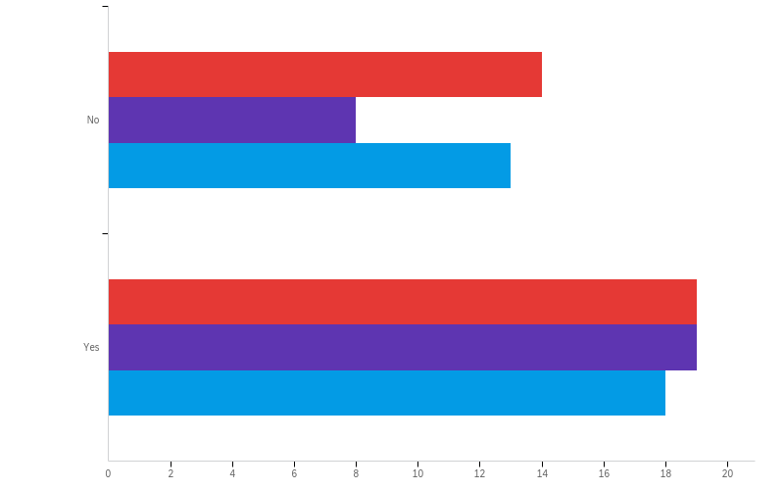
Q11 - Trauma_EGS_CritCare – broken down into those who have/haven’t completed their trauma rotation

Slide 50
Q12 - Setting_fellowship
Answer | % | Count
Hybrid of local and international settings | 73.81% | 31
Entirely internationally, at established training programmes | 16.67% | 7
Entirely in Uganda, with Ugandan faculty | 9.52% | 4
Total | 100% | 42

Slide 51
Q13 - Duration_fellowship
Answer | % | Count
12 months | 35.71% | 15
18 months | 21.43% | 9
24 months | 42.86% | 18
Total | 100% | 42

Slide 52
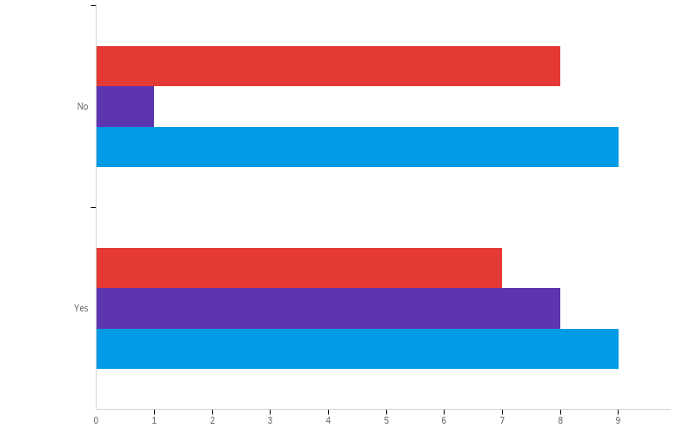
Q13 - Duration_fellowship – broken down into those who have/haven’t completed their trauma rotation

Slide 53
Q14 - Other_comments
Coding legend:
Support
Suggestion Concern
Other_comments
With the high numbers of trauma patients across the country, well equiped trauma centres should be established in most of these regional refferal hospitals where the trained trauma surgeons will be designated.
We should have had this specialized training start more than 20 years ago!
This would be a good speciality that would empower residents with critical life saving skills, especially with the incorporation of intensive critical care, as a paucity of such services exist in rural settings.
The available surgical workforce is skilled enough to handle most of the trauma-related workload. We are only let down by lack of equipment and utilities at most centres
TACS training should be open to all general and specialist surgeons
TACS fellowship will be a good initiative in Uganda but will face challenges of supplies especially in government structured hospitals. TACS therefore would be fundamentally impacted if its incorporated in Liaising with funding bodies to effect the objectives of this fellowship
Surgeons from all regions of the country should be trained on trauma surgery.

Slide 54
Q14 - Other_comments
Coding legend:
Support
Suggestion Concern
Other_comments
Should enrolled it in all regional referrals
Real UpTo stardarand emergency units should be built or constructed in Uganda just like other neighbouring countries have , because truth be told our country has non let even be the national hospital MNRH , ....we can't talk about emergency medicine ,yet we even don't have those real emergency UpTo stardad units .thanks.
Organisation of a proper and comfortable place to receive patients. Provide basics instruments for diagnosis in emergency.
None.
None
Mulago is long overdue for TACS
Its long over due, it needs to be instated urgently because the need is nakedly visible.
It would be very usefull if we get proper services and will be helpfull for patients in order to reduce mortality and morbidity rate
It would be interesting to liase with and make emergency equipments easily accessible and affordable Most challenges is the need to search for items from scratch for an emergency position

Slide 55
Q14 - Other_comments
Coding legend:
Support
Suggestion Concern
Other_comments
It would be great to have the fellowship
It would be better if we get trained trauma care doctors it will be also usefull for patiens in order to reduce mortality and morbidity rate
It will be a great opportunity
It should be given to all the surgery subspecialties with emphasis on trauma I their speciality eg a urologist should be better positioned to handle trauma involving the urogenital and urinary system. Trauma fellowship should be subdivided and particular skills given to particular subspecialties.
It a very welcome Fellowship. But needs to be recognised by UMDPC
I think it should be done by every surgeon in the country no matter the sub speciality
Every Surgeon should be trained in basic skills of Trauma being the commonest patients recieved at our emergency centers. A fellowship should be accredited here in Uganda for the interested Surgeons
Encourage the mulago hospital directors to set up a designated and dedicated trauma center (even if its a level 2 center) with the most basic and necessary requirements that we can use to provide the right trauma care to patients. Learning without having the right equipment to use is a waste of time for mulago and wont be beneficial to mulago patients but will hopefully be for other private hospital patients. Goal should be to train for provision of the right adequate trauma care to those that need it most especially the less priviledged patients of mulago as many of us including you and I can end up there after a trauma invident. Thank you

Slide 56
Q14 - Other_comments
Coding legend:
Support
Suggestion Concern
Other_comments
Am just excited about this,we have the protocols for management of trauma patients but minimal implementation is done due to inadequate skills, resources and poor attitude.
All regional referrals in Uganda are wanting interms of trauma management Mulago notwithstanding
All Surgeons should have an interest in trauma since most surgical emergencies at our accident and emergency departments are mainly trauma patients especially from Road traffic accidents. All hospital care givers should be trained in basics of primary and epsecondary survey plus resustation. Logistics for life saving must be giving priority during procurement of hospital supplies. Surgeons should be encouraged to take up this fellowship. Advocacy for starting the fellowship at Mulago and other Universities in Uganda should be a priority. vocate

