Slide 1
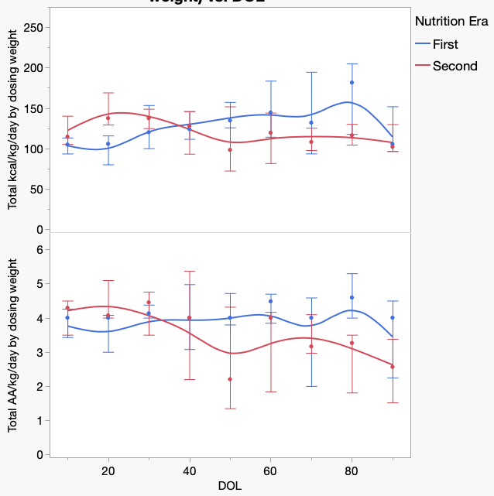

Growth in neonates with congenital kidney failure requiring
renal replacement therapy
AIM: To identify energy and protein prescription dosing for neonates and infants on CRRT
22% female
Median birth weight 2505g
Median birth length 46
Median gestational age 35.85
DESIGN & OUTCOMES:
No clinical significance
Demographics
18 neonates with CKF on RRT >42 days
Respiratory failure
Pneumothorax
Pulmonary hypertension
Necrotizing enterocolitis
ECMO
No clinical significance
Comorbidities
CRRT dose
Era 1 - 2000/1.73/m²/ hr
Era 2 – 24mL/kg/hr
Era 2 – Better weight z-scores
Energy/protein prescription
Era 1 – 90-110kcal/kg/day 3.5g/kg/day AA
Era 2 - >130kcal/kg/day and >4g/kg/day AA
Era 2 – Better weight and length z-scores
Growth during the first 3 postnatal months in infants with congenital kidney failure requiring continuous renal replacement therapy
Short et al. 2024
CONCLUSION: In this small cohort, we found that less clearance and more nutrition, at least 130kcal/kg/day and 4g/kg/day of amino acids, is better for neonates with CKF on CRRT. More studies are needed.

