Slide 1
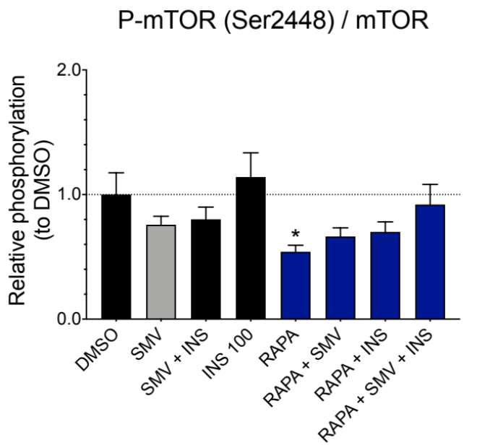
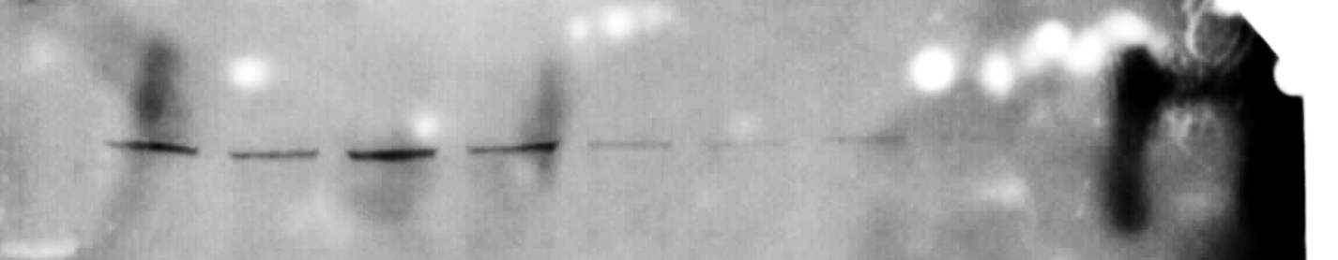
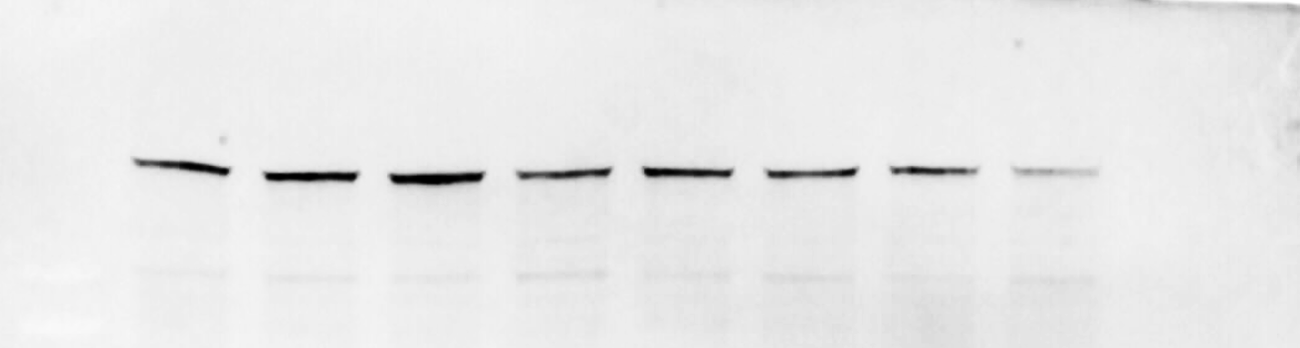
Fig. S1
A
P-mTOR (Ser2448) / mTOR
B
SMV + INS 100
RAPA + SMV
RAPA + SMV + INS
INS 100
RAPA + INS
DMSO
RAPA
SMV
P-mTOR (Ser2448)
289 kDa
mTOR
289 kDa

