Slide 1
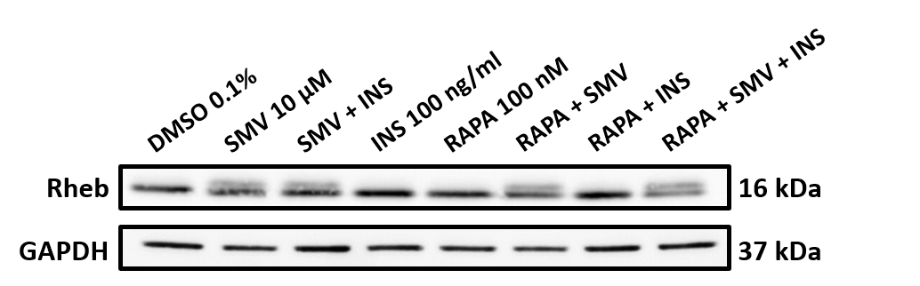
Fig. S2
A
Rheb protein expression
SMV + INS 100
RAPA + SMV
RAPA + SMV + INS
INS 100
RAPA + INS
DMSO
RAPA
SMV
Upper band: unprenylated form
Lower band: prenylated form
B

