Slide 1
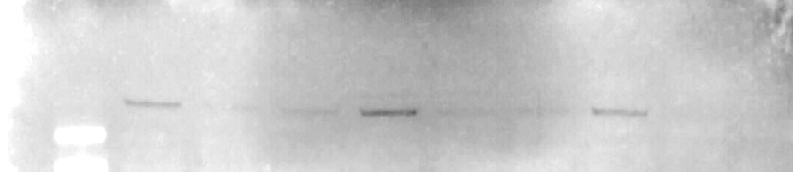
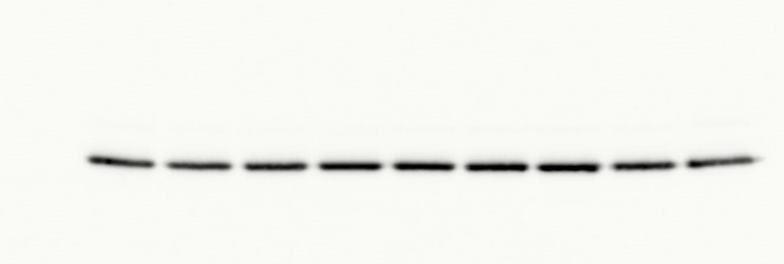
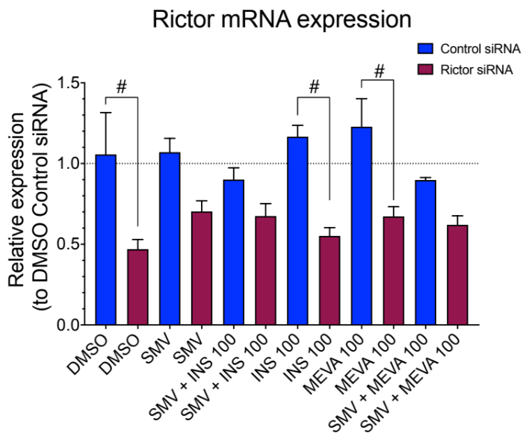
Fig. S3
A
Rictor siRNA knock-down
24 hours post
transfection
48 hours post
transfection
72 hours post
transfection
Rictor siRNA 1
Rictor siRNA 1
Rictor siRNA 2
Rictor siRNA 2
Rictor siRNA 2
Rictor siRNA 1
Control siRNA
Control siRNA
Control siRNA
Rictor
200 kDa
GAPDH
37 kDa
B
Rictor mRNA expression
24 hours post
transfection

