Slide 1
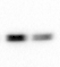
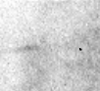
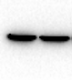
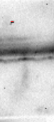
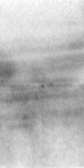
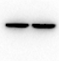
a
siR-CDX2-3
siR-CDX2-3
siR-CDX2-3
siR-NC
siR-NC
siR-NC
100 KDa
25 KDa
100 KDa
70 KDa
70 KDa
55 KDa
55 KDa
40 KDa
15 KDa
β-actin
CDX2
Reg IV
40 KDa
35 KDa
10 KDa
35 KDa
25 KDa
25 KDa
b
siR-CDX2-1
siR-CDX2-1
siR-CDX2-1
siR-NC
siR-NC
siR-NC
100 KDa
100 KDa
70 KDa
70 KDa
70 KDa
55 KDa
55 KDa
β-actin
40 KDa
55 KDa
40 KDa
40 KDa
35 KDa
CDX2
35 KDa
35 KDa
25 KDa
25 KDa
25 KDa
15 KDa
Reg IV
15 KDa
10 KDa
10 KDa

