Slide 1
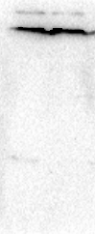
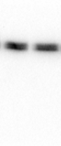
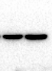
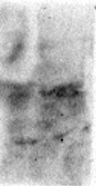
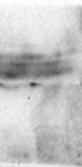
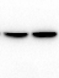
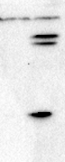
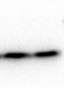
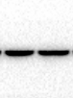
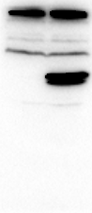
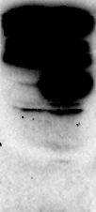
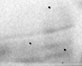
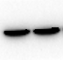
a
siR-Reg IV
siR-Reg IV
siR-Reg IV
siR-NC
siR-NC
siR-NC
100 KDa
100 KDa
70 KDa
70 KDa
70 KDa
55 KDa
55 KDa
β-actin
55 KDa
40 KDa
CDX2
40 KDa
40 KDa
35 KDa
35 KDa
35 KDa
25 KDa
25 KDa
25 KDa
Reg IV
15 KDa
15 KDa
10 KDa
10 KDa
b
siR-Reg IV
siR-Reg IV
siR-Reg IV
siR-NC
siR-NC
siR-NC
100 KDa
100 KDa
70 KDa
70 KDa
70 KDa
55 KDa
55 KDa
55 KDa
β-actin
40 KDa
40 KDa
CDX2
40 KDa
35 KDa
35 KDa
35 KDa
25 KDa
25 KDa
25 KDa
Reg IV
15 KDa
15 KDa
10 KDa
10 KDa
c
pEGFP-C1-Reg IV
pEGFP-C1-Reg IV
pEGFP-C1-Reg IV
pEGFP-C1
pEGFP-C1
pEGFP-C1
70 KDa
70 KDa
100 KDa
55 KDa
55 KDa
70 KDa
EGFP-Reg IV
40 KDa
40 KDa
β-actin
55 KDa
35 KDa
CDX2
35 KDa
40 KDa
25 KDa
25 KDa
35 KDa
25 KDa
Endogenous
Reg IV
15 KDa
10 KDa
d
pEGFP-C1-Reg IV
pEGFP-C1-Reg IV
pEGFP-C1-Reg IV
pEGFP-C1
pEGFP-C1
pEGFP-C1
70 KDa
170 KDa
170 KDa
55 KDa
130 KDa
130 KDa
40 KDa
100 KDa
100 KDa
CDX2
35 KDa
70 KDa
70 KDa
55 KDa
55 KDa
25 KDa
EGFP-Reg IV
40 KDa
40 KDa
35 KDa
35 KDa
pEGFP-C1-Reg IV
25 KDa
25 KDa
pEGFP-C1
15 KDa
Endogenous
Reg IV
15 KDa
70 KDa
10 KDa
10 KDa
55 KDa
Manual expose: 38.3 s
Manual expose: 607.0 s
β-actin
40 KDa
35 KDa

