Slide 1
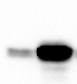
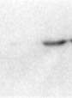
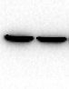
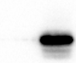
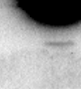
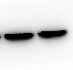
a
pcDNA4/TO-CDX2
pcDNA4/TO-CDX2
pcDNA4/TO-CDX2
pcDNA4/TO
pcDNA4/TO
pcDNA4/TO
100 KDa
25 KDa
100 KDa
70 KDa
70 KDa
55 KDa
β-actin
55 KDa
40 KDa
Reg IV
15 KDa
40 KDa
CDX2
35 KDa
10 KDa
35 KDa
25 KDa
25 KDa
b
pcDNA4/TO-CDX2
pcDNA4/TO-CDX2
pcDNA4/TO-CDX2
pcDNA4/TO
pcDNA4/TO
pcDNA4/TO
100 KDa
25 KDa
70 KDa
70 KDa
55 KDa
55 KDa
β-actin
40 KDa
15 KDa
40 KDa
CDX2
Reg IV
35 KDa
35 KDa
10 KDa
25 KDa

