Slide 1
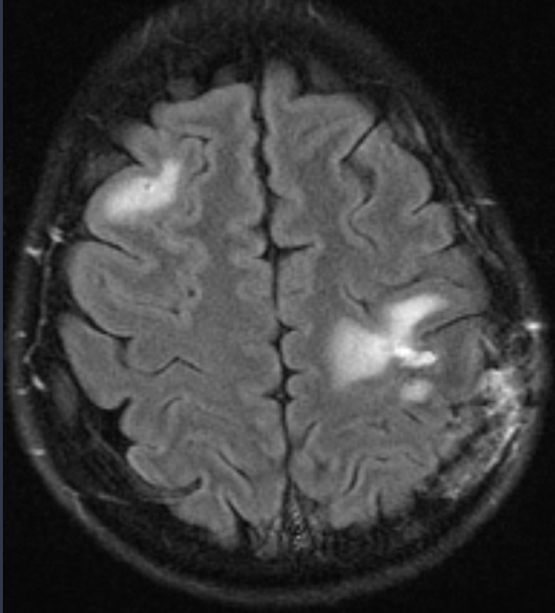
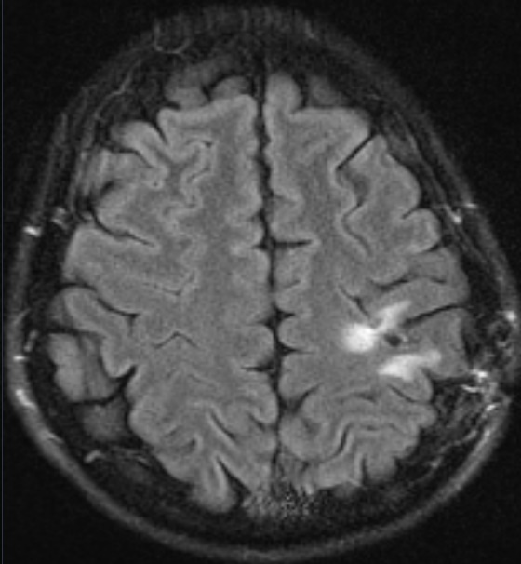
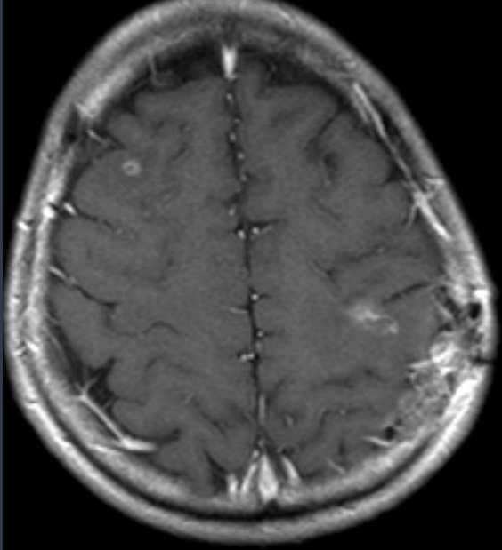
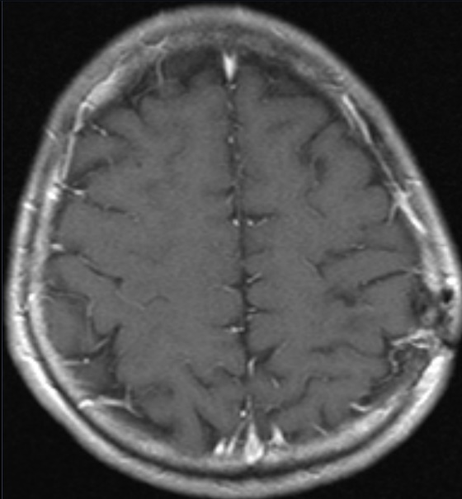
A
B
Perilesional flair
Perilesional flair
Pre-treatment scans
30 month post -treatment scans
T1 post gadolinium
T1 post gadolinium
Supplementary figure 1

