Slide 1
ROLE OF SEX HORMONES AND THEIR RECEPTORS ON GASTRIC NRF2 AND NEURONAL NITRIC OXIDE SYNTHASE FUNCTION IN AN EXPERIMENTAL HYPERGLYCEMIA MODEL
Jeremy Sprouse¹, DDS, Chethan Sampath², PhD, Pandu R Gangula², PhD
School of Graduate Studies and Research¹, Department of ODS & Research², Meharry Medical College, School of Dentistry, Nashville, TN 37208
Supplementary Data

Slide 2
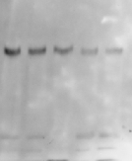
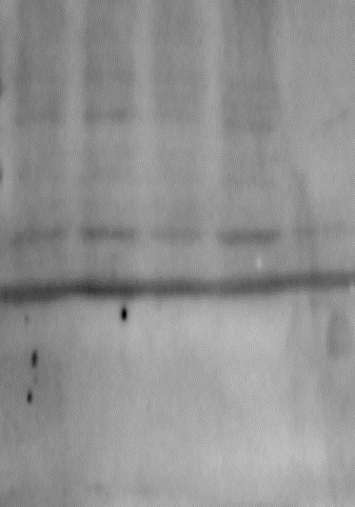
Fig. 3 A
nNOS α 155 kD
β-Actin 43 kD
NG
NG
+ICI 182780
+ ru-486 (100 nM)
+ICI 182780
+ICI 182780
+ ru-486 (100 nM)
+ICI 182780
+ ru-486 (100 nM)
+ ru-486 (100 nM)

Slide 3
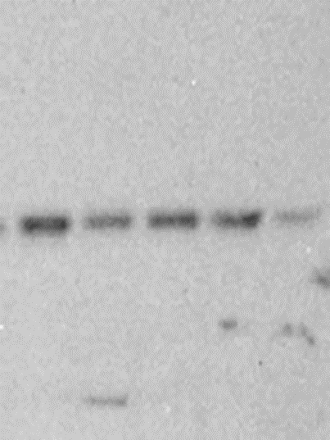
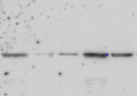

Fig. 3 B - C
Er α 67 kD
Nrf2 57 kD
β-Actin 43 kD
NG
NG
NG
+ICI 182780
+ICI 182780
+ICI 182780
+ ru-486 (100 nM)
+ICI 182780
+ ru-486 (100 nM)
+ICI 182780
+ICI 182780
+ ru-486 (100 nM)
+ ru-486 (100 nM)
+ ru-486 (100 nM)
+ ru-486 (100 nM)

Slide 4
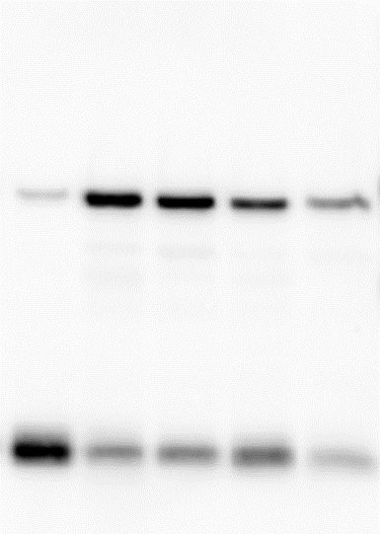
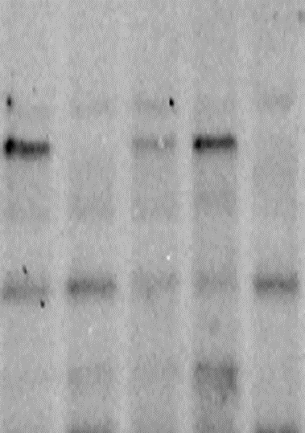
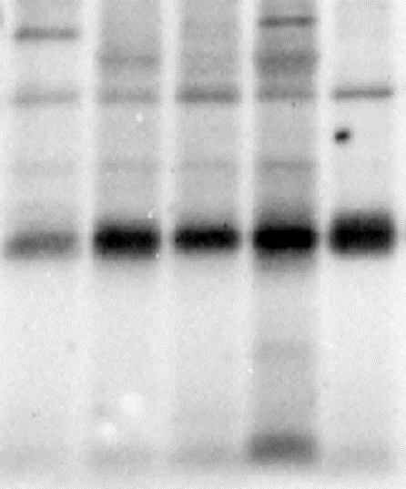
Fig. 3 D-E
ER β 57 kD
β-Actin 43 kD
HO-1 32 kD
NG
NG
NG
+ICI 182780
+ ru-486 (100 nM)
+ICI 182780
+ICI 182780
+ICI 182780
+ICI 182780
+ ru-486 (100 nM)
+ICI 182780
+ ru-486 (100 nM)
+ ru-486 (100 nM)
+ ru-486 (100 nM)
+ ru-486 (100 nM)

Slide 5
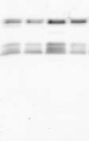
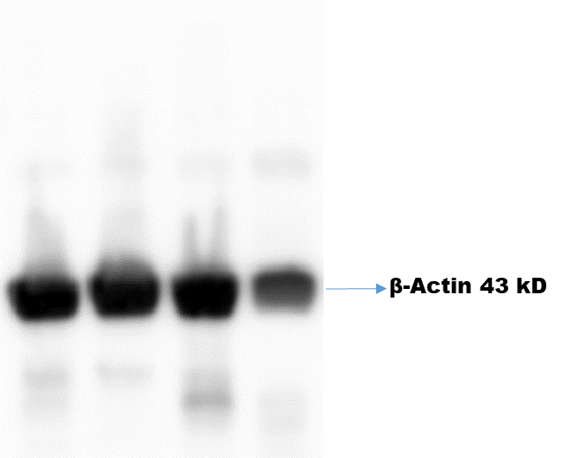
Fig. 6A
nNOS α 155 kD
NG
50 mM HG
30 mM HG
NG
50 mM HG
50 mM Mannitol
30 mM HG
50 mM Mannitol

Slide 6
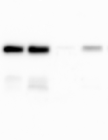
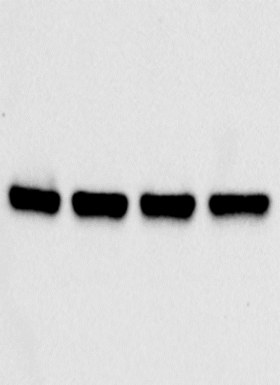
Fig. 6B
Nrf2 57 kD
β-Actin 43 kD
NG
50 mM HG
NG
50 mM HG
30 mM HG
30 mM HG
50 mM Mannitol
50 mM Mannitol

Slide 7
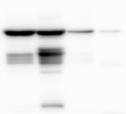
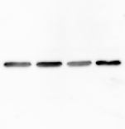
Fig. 6C
Er α 67 kD
β-Actin 43 kD
NG
50 mM HG
30 mM HG
NG
50 mM HG
30 mM HG
50 mM Mannitol
50 mM Mannitol

Slide 8
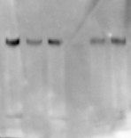
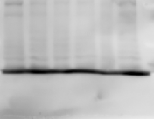
Fig. 6 D
nNOS α 155 kD
β-Actin 43 kD
NG
NG
HG
HG
HG + PPT (10 nM)
HG + PPT (10 nM)
HG + PPT (100 nM)
HG + PPT (100 nM)
HG + DPN (1.0 μM)
HG + DPN (1.0 μM)
HG + DPN (10 μM)
HG + DPN (10 μM)

Slide 9
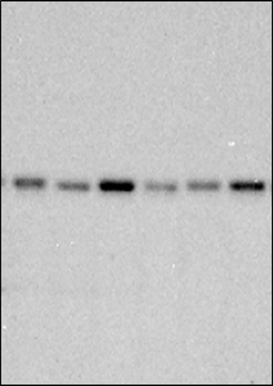
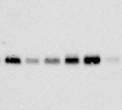
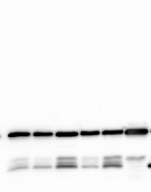
Fig. 6 E-F
ER α 67 kD
Nrf2 57 kD
β-Actin 43 kD
NG
HG
NG
HG
NG
HG + PPT (10 nM)
HG + PPT (10 nM)
HG
HG + PPT (100 nM)
HG + PPT (100 nM)
HG + DPN (1.0 μM)
HG + DPN (10 μM)
HG + DPN (1.0 μM)
HG + DPN (10 μM)
HG + PPT (10 nM)
HG + PPT (100 nM)
HG + DPN (1.0 μM)
HG + DPN (10 μM)

Slide 10
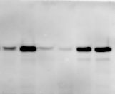
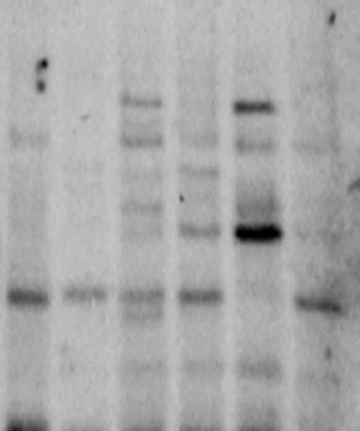
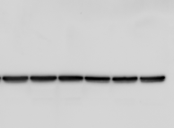
Fig. 6 G-H
Er β 57 kD
β-Actin 43 kD
HO-1 32 kD
NG
HG
NG
NG
HG
HG
HG + PPT (10 nM)
HG + PPT (10 nM)
HG + PPT (100 nM)
HG + PPT (100 nM)
HG + PPT (10 nM)
HG + DPN (1.0 μM)
HG + DPN (10 μM)
HG + DPN (1.0 μM)
HG + PPT (100 nM)
HG + DPN (10 μM)
HG + DPN (1.0 μM)
HG + DPN (10 μM)

Slide 11
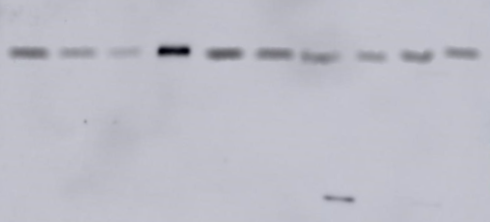
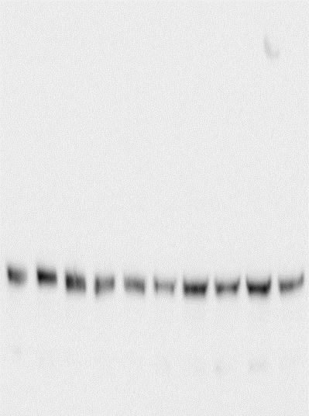
Fig. 7A
nNOS α 155 kD
β-Actin 43 kD
+P₄ 100 nM
+P₄ 100 nM
+E₂ 10 nM
30 mM HG
+E₂ 10 nM
50 mM HG
30 mM HG
+E₂ 100 nM
50 mM HG
+E₂ 100 nM
+P₄ 1000 nM
+P₄ 1000 nM
NG
+E₂ 10nM P₄ 100 nM
NG
+E₂ 10nM P₄ 100 nM
50 mM Mannitol
+E₂ 10 nM+P₄ 100 nM
50 mM Mannitol
+E₂ 10 nM+P₄ 100 nM

Slide 12
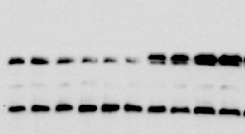
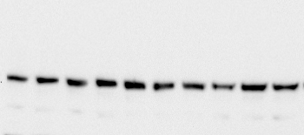
Fig. 7B
Nrf2 57 kD
β-Actin 43 kD
+P₄ 100 nM
+P₄ 100 nM
+E₂ 10 nM
30 mM HG
50 mM HG
+E₂ 10 nM
+E₂ 100 nM
30 mM HG
50 mM HG
+P₄ 1000 nM
+E₂ 100 nM
+P₄ 1000 nM
NG
+E₂ 10nM P₄ 100 nM
NG
+E₂ 10nM P₄ 100 nM
50 mM Mannitol
+E₂ 10 nM+P₄ 100 nM
50 mM Mannitol
+E₂ 10 nM+P₄ 100 nM

