Slide 1
ROLE OF SEX HORMONES AND THEIR RECEPTORS ON GASTRIC NRF2 AND NEURONAL NITRIC OXIDE SYNTHASE FUNCTION IN AN EXPERIMENTAL HYPERGLYCEMIA MODEL
Jeremy Sprouse¹, DDS, Chethan Sampath², PhD, Pandu R Gangula², PhD
School of Graduate Studies and Research¹, Department of ODS & Research², Meharry Medical College, School of Dentistry, Nashville, TN 37208
Supplementary Data

Slide 2
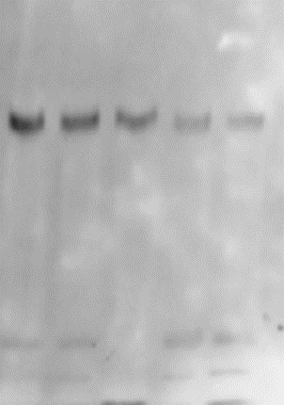
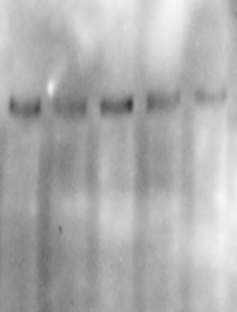
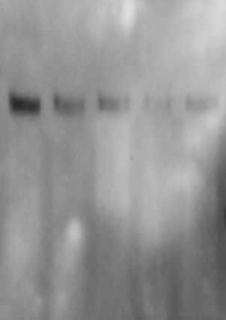
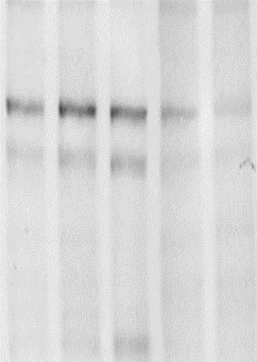
Fig. 3 A nNOSα
MW
Marker
nNOS𝝰 1
MW
Marker
nNOS𝝰 2
MW
Marker
nNOS𝝰 3
MW
Marker
nNOS𝝰 4
250 kD
250 kD
250 kD
250 kD
nNOS α 155 kD
nNOS α 155 kD
nNOS α 155 kD
nNOS α 155 kD
150 kD
150 kD
150 kD
150 kD
110 kD
110 kD
100 kD
110 kD
100 kD
100 kD
75 kD
100 kD
75 kD
75 kD
75 kD
50 kD
50 kD
50 kD
50 kD
NG
NG
+ICI 182780
NG
NG
+ICI 182780
+ICI 182780
+ICI 182780
+ ru-486 (100 nM)
+ICI 182780
+ICI 182780
+ ru-486 (1000 nM)
+ ru-486 (1000 nM)
+ICI 182780
+ ru-486 (100 nM)
+ICI 182780
+ ru-486 (1000 nM)
+ ru-486 (1000 nM)
+ ru-486 (100 nM)
+ ru-486 (100 nM)

Slide 3
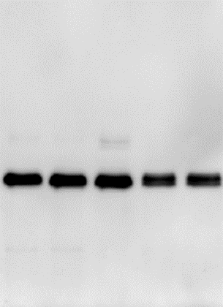
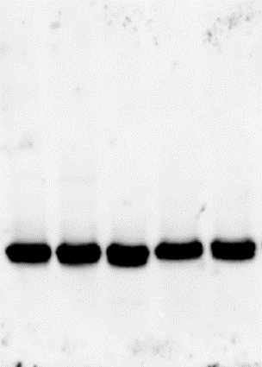
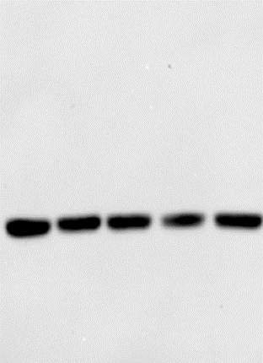
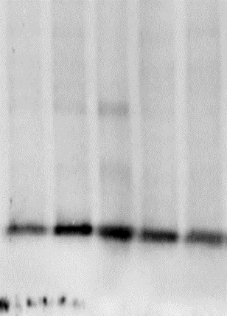
Fig. 3 A: New 𝝱-Actin
MW
Marker
β-Actin 1
MW
Marker
β-Actin 2
MW
Marker
β-Actin 3
β-Actin 4
MW
Marker
250 kD
250 kD
250 kD
150 kD
150 kD
150 kD
150 kD
100 kD
100 kD
75 kD
100 kD
100 kD
75 kD
75 kD
75 kD
50 kD
β-Actin
43 kD
β-Actin
43 kD
50 kD
50 kD
β-Actin
43 kD
50 kD
37 kD
β-Actin
43 kD
37 kD
37 kD
25 kD
25 kD
37 kD
25 kD
25 kD
20 kD
20 kD
20 kD
NG
NG
NG
+ICI 182780
+ICI 182780
+ICI 182780
+ ru-486 (1000 nM)
+ICI 182780
+ ru-486 (1000 nM)
NG
+ICI 182780
+ ru-486 (1000 nM)
+ICI 182780
+ ru-486 (100 nM)
+ICI 182780
+ ru-486 (100 nM)
+ ru-486 (100 nM)
+ICI 182780
+ ru-486 (1000 nM)
+ ru-486 (100 nM)

Slide 4
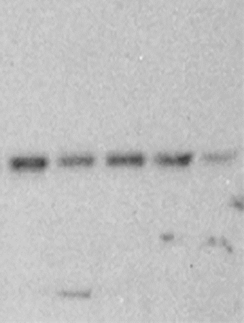
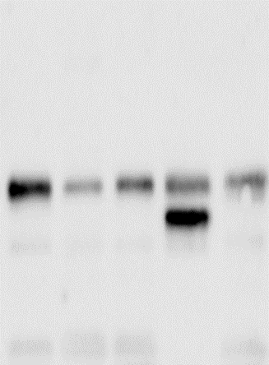
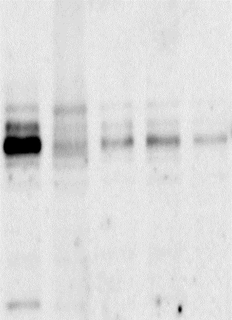
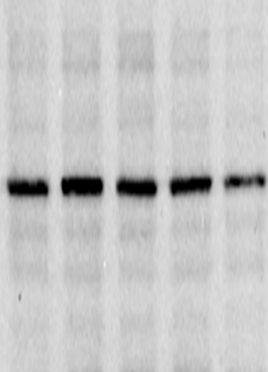
Fig. 3 B: ER α
MW
Marker
ER α 1
ER α 2
ER α 3
MW
Marker
ER α 4
MW
Marker
MW
Marker
250 kD
250 kD
250 kD
250 kD
150 kD
150 kD
150 kD
100 kD
150 kD
100 kD
100 kD
100 kD
75 kD
ER α 67 kD
75 kD
ER α 67 kD
75 kD
ER α 67 kD
75 kD
ER α 67 kD
50 kD
50 kD
50 kD
50 kD
37 kD
37 kD
37 kD
37 kD
25 kD
25 kD
25 kD
25 kD
NG
NG
NG
NG
+ICI 182780
+ICI 182780
+ICI 182780
+ICI 182780
+ICI 182780
+ ru-486 (100 nM)
+ICI 182780
+ICI 182780
+ ru-486 (1000 nM)
+ICI 182780
+ ru-486 (1000 nM)
+ ru-486 (100 nM)
+ ru-486 (100 nM)
+ ru-486 (100 nM)
+ ru-486 (1000 nM)
+ ru-486 (1000 nM)

Slide 5
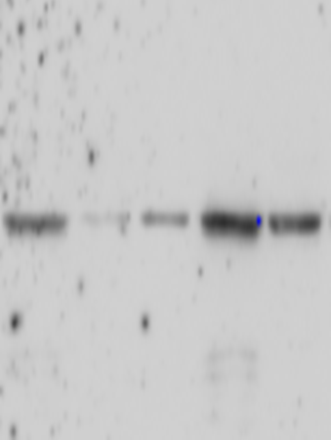
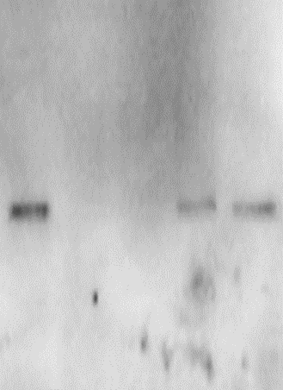
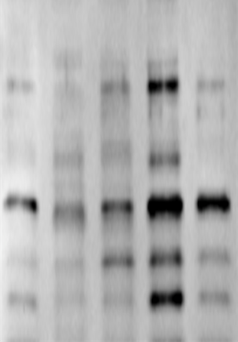
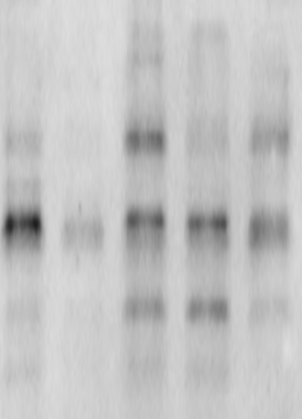
Fig. 3C : Nrf2
MW
Marker
Nrf2 1
MW
Marker
Nrf2 2
MW
Marker
Nrf2 3
MW
Marker
Nrf2 4
250 kD
250 kD
250 kD
250 kD
150 kD
150 kD
150 kD
150 kD
100 kD
100 kD
100 kD
100 kD
Nrf2 57 kD
75 kD
75 kD
Nrf2 57 kD
75 kD
Nrf2 57 kD
75 kD
Nrf2 57 kD
50 kD
50 kD
50 kD
37 kD
50 kD
37 kD
37 kD
25 kD
37 kD
25 kD
20 kD
25 kD
25 kD
20 kD
20 kD
20 kD
NG
NG
NG
+ ru-486 (100 nM)
+ICI 182780
NG
+ ru-486 (100 nM)
+ICI 182780
+ ru-486 (1000 nM)
+ ru-486 (100 nM)
+ ru-486 (100 nM)
+ICI 182780
+ ru-486 (1000 nM)
+ICI 182780
+ ru-486 (1000 nM)
+ ru-486 (1000 nM)
+ICI 182780
+ICI 182780
+ICI 182780
+ICI 182780

Slide 6
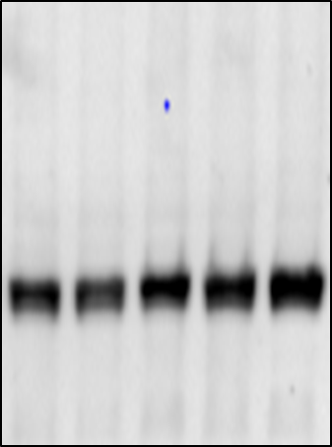
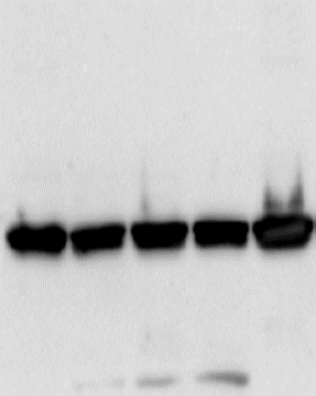
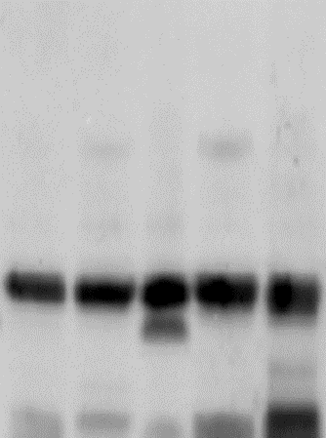
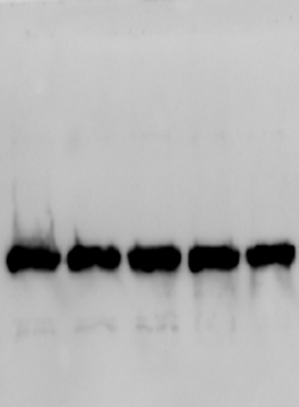
Fig. 3 B-C: 𝝱-Actin for ERα and Nrf2
MW
Marker
β-Actin 1
MW
Marker
β-Actin 2
MW
Marker
β-Actin 3
MW
Marker
β-Actin 4
250 kD
250 kD
250 kD
150 kD
150 kD
250 kD
150 kD
100 kD
150 kD
100 kD
100 kD
75 kD
75 kD
75 kD
100 kD
75 kD
50 kD
50 kD
β-Actin
43 kD
β-Actin
43 kD
β-Actin
43 kD
50 kD
β-Actin
43 kD
50 kD
37 kD
37 kD
37 kD
37 kD
25 kD
25 kD
25 kD
25 kD
20 kD
20 kD
20 kD
20 kD
NG
NG
+ICI 182780
+ ru-486 (1000 nM)
NG
NG
+ICI 182780
+ICI 182780
+ICI 182780
+ ru-486 (1000 nM)
+ ru-486 (100 nM)
+ICI 182780
+ICI 182780
+ ru-486 (1000 nM)
+ICI 182780
+ ru-486 (100 nM)
+ ru-486 (100 nM)
+ICI 182780
+ ru-486 (1000 nM)
+ ru-486 (100 nM)

Slide 7
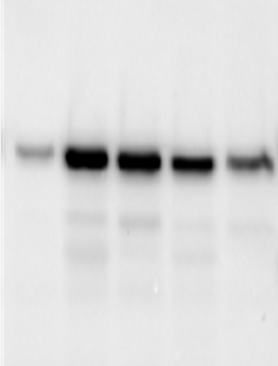
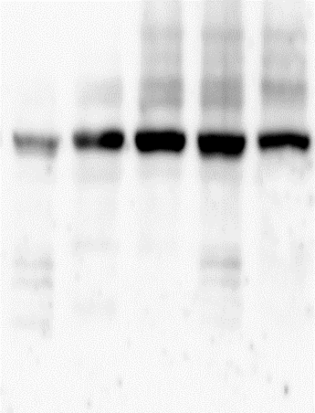
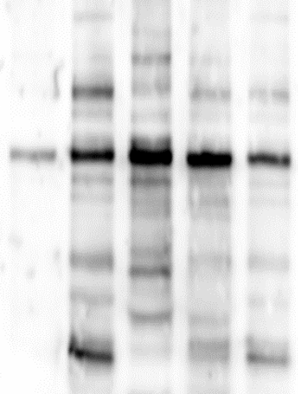
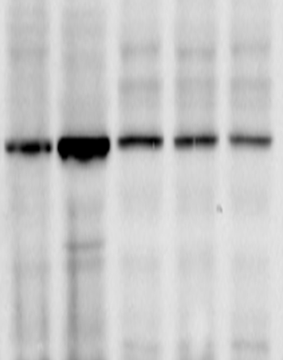
Fig. 3 D: ERβ
MW
Marker
ERβ 1
MW
Marker
ERβ 2
MW
Marker
ERβ 3
MW
Marker
ERβ 4
150 kD
150 kD
150 kD
250 kD
100 kD
100 kD
100 kD
150 kD
75 kD
ER β 57 kD
75 kD
100 kD
75 kD
ER β 57 kD
75 kD
75 kD
ER β 57 kD
ER β 57 kD
50 kD
50 kD
50 kD
50 kD
37 kD
37 kD
37 kD
37 kD
25 kD
25 kD
25 kD
25 kD
20 kD
NG
NG
NG
NG
+ICI 182780
+ICI 182780
+ICI 182780
+ICI 182780
+ ru-486 (100 nM)
+ICI 182780
+ ru-486 (100 nM)
+ICI 182780
+ ru-486 (100 nM)
+ICI 182780
+ ru-486 (100 nM)
+ ru-486 (1000 nM)
+ ru-486 (100 nM)
+ICI 182780
+ ru-486 (100 nM)
+ ru-486 (100 nM)

Slide 8
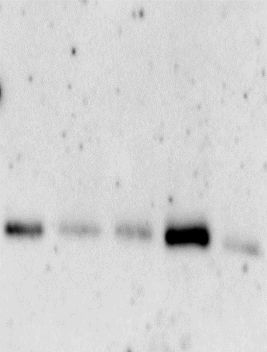
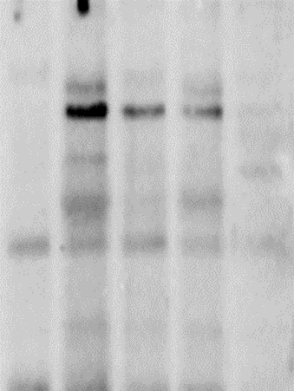
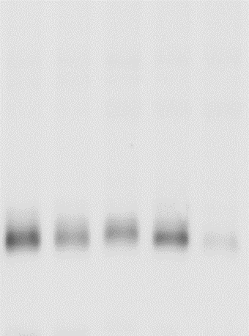
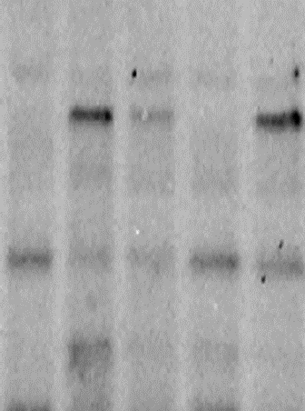
Fig. 3E : HO-1
MW
Marker
HO- 1 1
MW
Marker
HO- 1 2
MW
Marker
HO- 1 3
MW
Marker
HO- 1 4
100 kD
100 kD
100 kD
100 kD
75 kD
75 kD
75 kD
75 kD
50 kD
50 kD
50 kD
50 kD
37 kD
HO-1 32 kD
37 kD
HO-1 32 kD
37 kD
37 kD
HO-1 32 kD
HO-1 32 kD
25 kD
25 kD
25 kD
25 kD
20 kD
20 kD
20 kD
20 kD
NG
NG
NG
+ICI 182780
NG
+ICI 182780
+ ru-486 (1000 nM)
+ ru-486 (100 nM)
+ICI 182780
+ ru-486 (1000 nM)
+ICI 182780
+ICI 182780
+ ru-486 (100 nM)
+ ru-486 (1000 nM)
+ICI 182780
+ ru-486 (1000 nM)
+ ru-486 (100 nM)
+ ru-486 (100 nM)
+ICI 182780
+ICI 182780

Slide 9
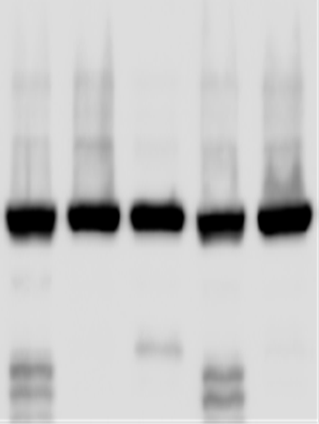
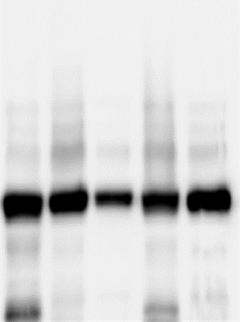
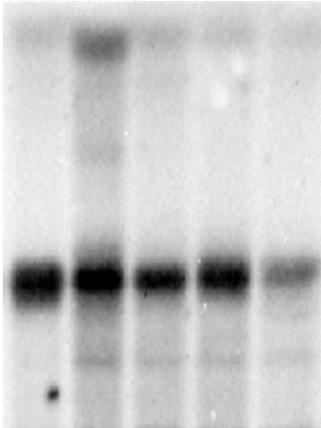
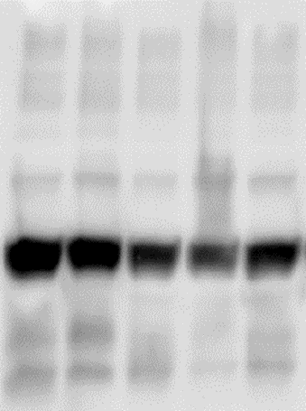
Fig. 3 D-E :
β-Actin for ERβ and HO-1
β-Actin 1
β-Actin 2
β-Actin 3
MW
Marker
MW
Marker
β-Actin 4
MW
Marker
MW
Marker
100 kD
100 kD
75 kD
100 kD
100 kD
75 kD
50 kD
75 kD
75 kD
β-Actin 43 kD
50 kD
β-Actin 43 kD
50 kD
37 kD
50 kD
β-Actin 43 kD
β-Actin 43 kD
37 kD
37 kD
37 kD
25 kD
25 kD
25 kD
25 kD
NG
NG
+ICI 182780
NG
+ICI 182780
NG
+ICI 182780
+ ru-486 (100 nM)
+ICI 182780
+ ru-486 (100 nM)
+ ru-486 (100 nM)
+ICI 182780
+ ru-486 (100 nM)
+ ru-486 (100 nM)
+ ru-486 (100 nM)
+ ru-486 (100 nM)
+ICI 182780
+ICI 182780
+ ru-486 (100 nM)
+ICI 182780

Slide 10
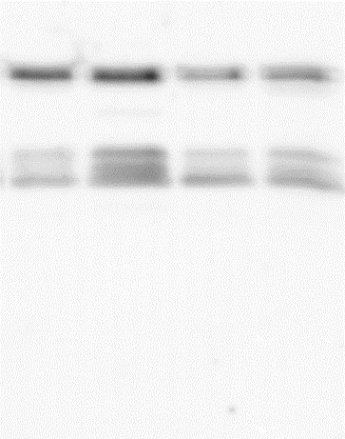
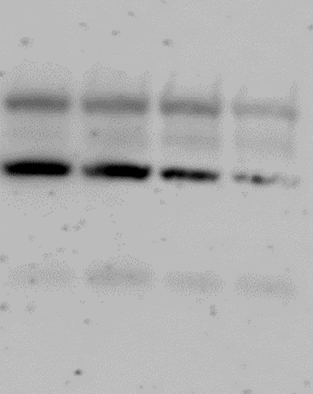
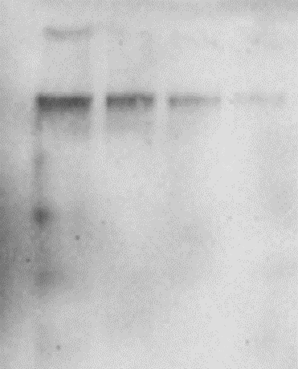
Fig. 6 A: nNOS𝝰
nNOS𝝰 1
nNOS𝝰 2
nNOS𝝰 3
MW
Marker
MW
Marker
MW
Marker
250 kD
nNOS α
155 kD
250 kD
250 kD
150 kD
nNOS α
155 kD
nNOS α
155 kD
150 kD
150 kD
100 kD
100 kD
100 kD
75 kD
75 kD
75 kD
50 kD
50 kD
50 kD
NG
50 mM HG
30 mM HG
NG
50 mM HG
50 mM Mannitol
NG
50 mM HG
30 mM HG
30 mM HG
50 mM Mannitol
50 mM Mannitol

Slide 11
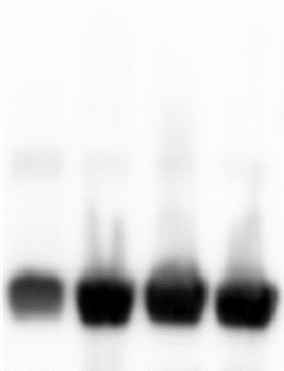
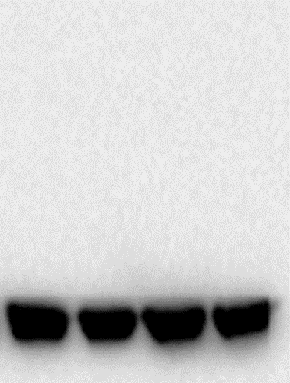
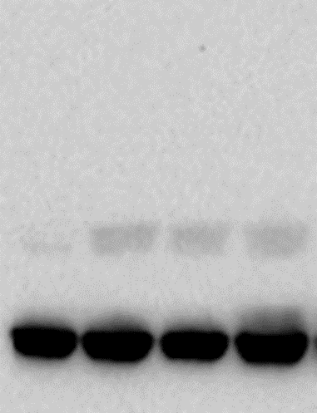
Fig. 6 A: 𝝱-Actin for nNOS𝝰
MW
Marker
MW
Marker
β-Actin 2
MW
Marker
β-Actin 3
β-Actin 1
100 kD
150 kD
250 kD
100 kD
150 kD
75 kD
100 kD
75 kD
75 kD
50 kD
50 kD
50 kD
β-Actin 43 kD
β-Actin 43 kD
37 kD
37 kD
β-Actin 43 kD
25 kD
37 kD
25 kD
25 kD
NG
50 mM HG
30 mM HG
NG
50 mM HG
30 mM HG
NG
50 mM HG
50 mM Mannitol
30 mM HG
50 mM Mannitol
50 mM Mannitol

Slide 12
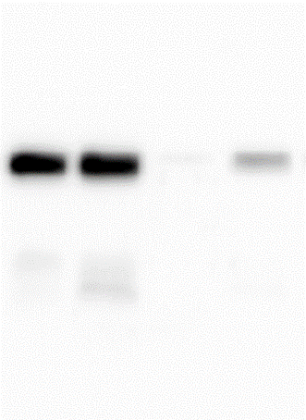
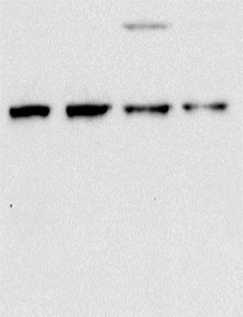
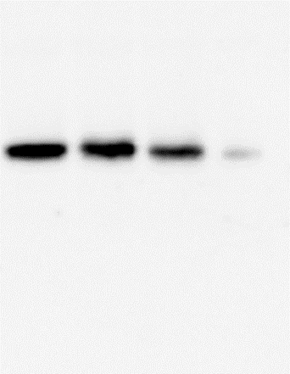
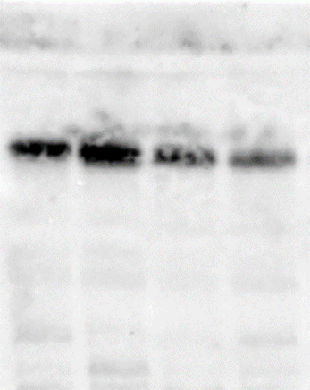
Fig. 6 B:
Nrf2
MW
Marker
Nrf2 1
Nrf2 2
MW
Marker
Nrf2 3
Nrf2 4
MW
Marker
MW
Marker
150 kD
150 kD
150 kD
150 kD
100 kD
100 kD
100 kD
100 kD
75 kD
75 kD
Nrf2
57 kD
75 kD
Nrf2
57 kD
75 kD
Nrf2
57 kD
Nrf2
57 kD
50 kD
50 kD
50 kD
50 kD
37 kD
37 kD
37 kD
37 kD
25 kD
25 kD
25 kD
25 kD
20 kD
20 kD
20 kD
20 kD
NG
50 mM HG
NG
50 mM HG
30 mM HG
30 mM HG
NG
50 mM HG
50 mM Mannitol
50 mM Mannitol
30 mM HG
NG
50 mM HG
50 mM Mannitol
30 mM HG
50 mM Mannitol

Slide 13
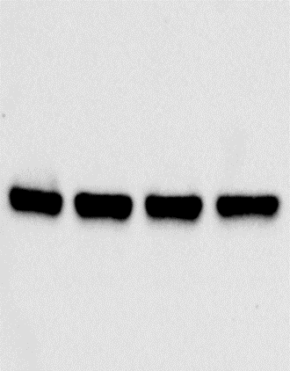
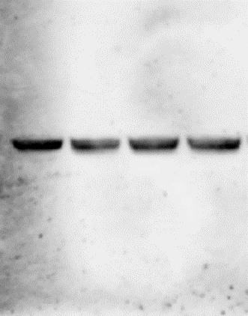
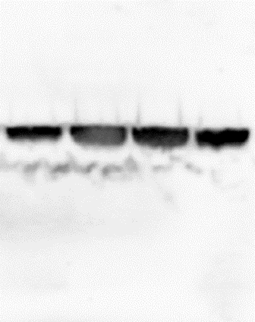
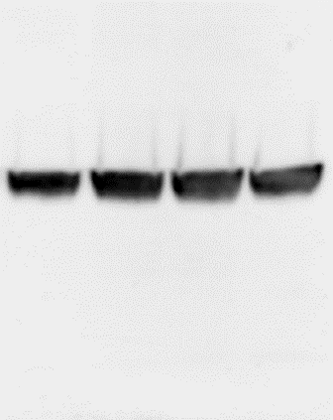
Fig. 6 B:
β-Actin for Nrf2
β-Actin 3
β-Actin 4
MW
Marker
β-Actin 1
MW
Marker
β-Actin 2
MW
Marker
MW
Marker
150 kD
100 kD
100 kD
100 kD
75 kD
100 kD
75 kD
β-Actin 43 kD
75 kD
75 kD
50 kD
50 kD
β-Actin 43 kD
50 kD
β-Actin 43 kD
50 kD
β-Actin
43 kD
37 kD
37 kD
37 kD
37 kD
25 kD
25 kD
25 kD
25 kD
20 kD
20 kD
20 kD
20 kD
NG
50 mM HG
NG
50 mM HG
NG
50 mM HG
30 mM HG
30 mM HG
30 mM HG
50 mM Mannitol
NG
50 mM HG
30 mM HG
50 mM Mannitol
50 mM Mannitol
50 mM Mannitol

Slide 14
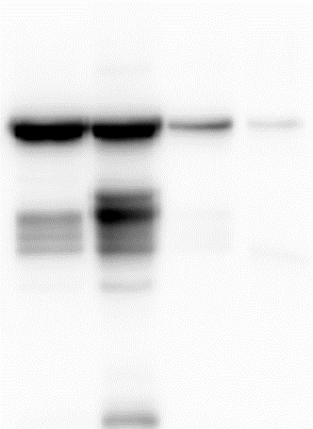
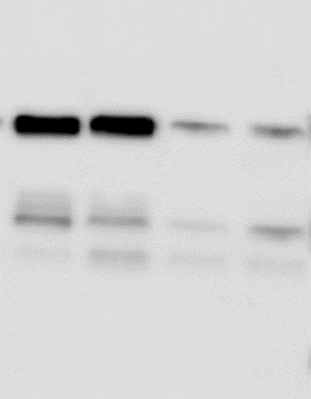
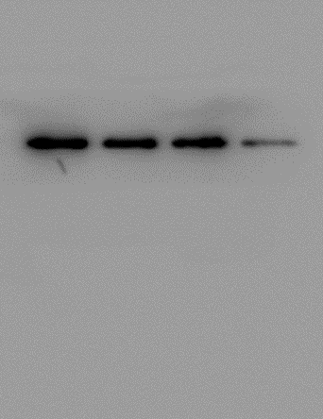
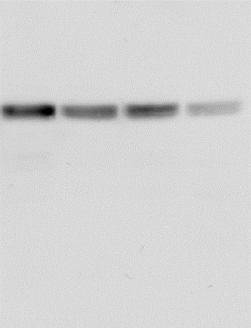
Fig. 6 C:
ERα
ER𝝰 1
MW
Marker
ER𝝰 2
ER𝝰 3
ER𝝰 4
MW
Marker
MW
Marker
MW
Marker
250 kD
250 kD
250 kD
250 kD
150 kD
150 kD
150 kD
150 kD
100 kD
Er α
67 kD
100 kD
100 kD
ER α
67 kD
75 kD
100 kD
ER α
67 kD
75 kD
ER α
67 kD
75 kD
75 kD
50 kD
50 kD
50 kD
50 kD
37 kD
37 kD
37 kD
37 kD
25 kD
25 kD
20 kD
25 kD
25 kD
20 kD
NG
50 mM HG
30 mM HG
NG
50 mM HG
30 mM HG
NG
50 mM HG
50 mM Mannitol
NG
50 mM HG
30 mM HG
50 mM Mannitol
30 mM HG
50 mM Mannitol
50 mM Mannitol

Slide 15




Fig. 6 C:
β-Actin for ERα
β-Actin 1
β-Actin 2
β-Actin 3
β-Actin 4
MW
Marker
MW
Marker
MW
Marker
MW
Marker
100 kD
100 kD
100 kD
100 kD
75 kD
75 kD
75 kD
75 kD
β-Actin 43 kD
50 kD
β-Actin 43 kD
50 kD
β-Actin 43 kD
β-Actin 43 kD
50 kD
50 kD
37 kD
37 kD
37 kD
37 kD
25 kD
25 kD
25 kD
25 kD
20 kD
20 kD
20 kD
20 kD
NG
50 mM HG
30 mM HG
NG
50 mM HG
30 mM HG
NG
50 mM HG
NG
50 mM HG
30 mM HG
30 mM HG
50 mM Mannitol
50 mM Mannitol
50 mM Mannitol
50 mM Mannitol

Slide 16




Fig. 6 D: nNOS𝝰
nNOS𝝰 1
nNOS𝝰 2
nNOS𝝰 3
nNOS𝝰 4
MW
Marker
MW
Marker
MW
Marker
MW
Marker
250 kD
250 kD
250 kD
250 kD
nNOS α 155 kD
nNOS α 155 kD
nNOS α 155 kD
nNOS α 155 kD
150 kD
150 kD
150 kD
150 kD
100 kD
100 kD
100 kD
100 kD
75 kD
75 kD
75 kD
75 kD
50 kD
50 kD
50 kD
50 kD
NG
HG
NG
HG + PPT (10 nM)
HG
HG + PPT (100 nM)
NG
HG + PPT (10 nM)
HG
HG + DPN (1.0 μM)
HG + PPT (100 nM)
NG
HG + DPN (10 μM)
HG + DPN (1.0 μM)
HG + DPN (10 μM)
HG
HG + PPT (100 nM)
HG + DPN (10 μM)
HG + DPN (1.0 μM)
HG + PPT (100 nM)
HG + PPT (10 nM)
HG + PPT (10 nM)
HG + DPN (10 μM)
HG + DPN (1.0 μM)

Slide 17




Fig. 6D : 𝝱-Actin
β-Actin 2
MW
Marker
β-Actin 1
MW
Marker
MW
Marker
β-Actin 3
MW
Marker
β-Actin 4
250 kD
250 kD
250 kD
250 kD
150 kD
150 kD
150 kD
150 kD
100 kD
100 kD
100 kD
100 kD
75 kD
75 kD
75 kD
75 kD
50 kD
β-Actin
43 kD
50 kD
50 kD
β-Actin
43 kD
50 kD
β-Actin
43 kD
β-Actin
43 kD
37 kD
37 kD
37 kD
37 kD
25 kD
25 kD
25 kD
25 kD
NG
NG
HG
NG
HG
HG + PPT (10 nM)
NG
HG
HG + PPT (10 nM)
HG
HG + PPT (10 nM)
HG + DPN (1.0 μM)
HG + DPN (1.0 μM)
HG + PPT (100 nM)
HG + PPT (10 nM)
HG + DPN (1.0 μM)
HG + PPT (100 nM)
HG + DPN (10 μM)
HG + DPN (1.0 μM)
HG + PPT (100 nM)
HG + DPN (10 μM)
HG + PPT (100 nM)
HG + DPN (10 μM)
HG + DPN (10 μM)

Slide 18




Fig. 6 E:
ERα
MW
Marker
ER𝝰 1
MW
Marker
ER𝝰 2
MW
Marker
ER𝝰 3
MW
Marker
ER𝝰 4
250 kD
250 kD
250 kD
250 kD
150 kD
150 kD
150 kD
150 kD
100 kD
100 kD
100 kD
100 kD
ER α 67 kD
75 kD
ER α 67 kD
75 kD
75 kD
ER α 67 kD
75 kD
ER α 67 kD
50 kD
50 kD
50 kD
50 kD
37 kD
37 kD
37 kD
37 kD
25 kD
25 kD
25 kD
25 kD
HG + PPT (10 nM)
HG + PPT (100 nM)
HG + PPT (10 nM)
HG + PPT (10 nM)
NG
HG + PPT (100 nM)
HG + PPT (100 nM)
HG
NG
HG + PPT (10 nM)
HG
NG
HG + DPN (1.0 μM)
HG + DPN (1.0 μM)
HG
HG + PPT (100 nM)
NG
HG + DPN (10 μM)
HG + DPN (10 μM)
HG + DPN (1.0 μM)
HG
HG + DPN (10 μM)
HG + DPN (1.0 μM)
HG + DPN (10 μM)

Slide 19




Fig. 6 F:
Nrf2
MW
Marker
Nrf2 1
MW
Marker
Nrf2 2
MW
Marker
Nrf2 3
MW
Marker
Nrf2 4
150 kD
150 kD
150 kD
150 kD
100 kD
100 kD
100 kD
100 kD
75 kD
75 kD
75 kD
Nrf2 57 kD
75 kD
Nrf2 57 kD
Nrf2 57 kD
Nrf2 57 kD
50 kD
50 kD
50 kD
50 kD
37 kD
37 kD
37 kD
37 kD
25 kD
NG
HG
NG
NG
HG
NG
HG
HG
HG + PPT (10 nM)
HG + PPT (10 nM)
HG + PPT (10 nM)
HG + PPT (10 nM)
HG + PPT (100 nM)
HG + PPT (100 nM)
HG + PPT (100 nM)
HG + PPT (100 nM)
HG + DPN (1.0 μM)
HG + DPN (1.0 μM)
HG + DPN (1.0 μM)
HG + DPN (1.0 μM)
HG + DPN (10 μM)
HG + DPN (10 μM)
HG + DPN (10 μM)
HG + DPN (10 μM)

Slide 20


Fig. 6 E-F:
β-Actin for ERα and Nrf2 (At different exposures)
MW
Marker
β-Actin 1
MW
Marker
β-Actin 1
250 kD
250 kD
150 kD
150 kD
100 kD
100 kD
75 kD
75 kD
50 kD
50 kD
β-Actin 43 kD
β-Actin 43 kD
37 kD
37 kD
25 kD
25 kD
NG
NG
HG
HG
HG + PPT (10 nM)
HG + PPT (10 nM)
HG + DPN (1.0 μM)
HG + DPN (1.0 μM)
HG + PPT (100 nM)
HG + PPT (100 nM)
HG + DPN (10 μM)
HG + DPN (10 μM)
30 second exposure
1-minute exposure

Slide 21



Fig. 6 E-F:
β-Actin for ERα and Nrf2
MW
Marker
β-Actin 2
MW
Marker
β-Actin 3
MW
Marker
β-Actin 4
100 kD
100 kD
150 kD
75 kD
75 kD
100 kD
75 kD
50 kD
50 kD
β-Actin 43 kD
β-Actin 43 kD
50 kD
β-Actin 43 kD
37 kD
37 kD
37 kD
25 kD
25 kD
25 kD
NG
HG
HG + PPT (10 nM)
NG
HG
NG
HG + PPT (10 nM)
HG
HG + DPN (1.0 μM)
HG + PPT (10 nM)
HG + PPT (100 nM)
HG + DPN (10 μM)
HG + DPN (1.0 μM)
HG + PPT (100 nM)
HG + DPN (1.0 μM)
HG + DPN (10 μM)
HG + PPT (100 nM)
HG + DPN (10 μM)

Slide 22




Fig. 6 G: ERβ
MW
Marker
ERβ 1
MW
Marker
ERβ 2
MW
Marker
ERβ 3
MW
Marker
ERβ 4
250 kD
250 kD
250 kD
250 kD
150 kD
150 kD
150 kD
150 kD
100 kD
100 kD
100 kD
100 kD
75 kD
75 kD
75 kD
75 kD
ER β 57 kD
ER β 57 kD
ER β 57 kD
ER β 57 kD
50 kD
50 kD
50 kD
50 kD
37 kD
37 kD
37 kD
37 kD
25 kD
25 kD
25 kD
25 kD
NG
HG
NG
NG
HG + PPT (10 nM)
HG
HG
NG
HG + PPT (10 nM)
HG
HG + PPT (10 nM)
HG + PPT (10 nM)
HG + DPN (1.0 μM)
HG + PPT (100 nM)
HG + DPN (1.0 μM)
HG + DPN (1.0 μM)
HG + DPN (1.0 μM)
HG + DPN (10 μM)
HG + PPT (100 nM)
HG + PPT (100 nM)
HG + PPT (100 nM)
HG + DPN (10 μM)
HG + DPN (10 μM)
HG + DPN (10 μM)

Slide 23




Fig. 6 H: HO-1
MW
Marker
MW
Marker
MW
Marker
MW
Marker
HO- 1 4
HO- 1 1
HO- 1 2
HO- 1 3
150 kD
150 kD
150 kD
150 kD
100 kD
100 kD
100 kD
100 kD
75 kD
75 kD
75 kD
75 kD
50 kD
50 kD
50 kD
50 kD
37 kD
HO-1 32 kD
HO-1 32 kD
37 kD
37 kD
HO-1 32 kD
37 kD
HO-1 32 kD
25 kD
25 kD
25 kD
25 kD
20 kD
20 kD
20 kD
20 kD
NG
HG
HG + PPT (10 nM)
NG
HG
NG
HG + PPT (10 nM)
HG + PPT (100 nM)
NG
HG
HG + DPN (1.0 μM)
HG
HG + PPT (10 nM)
HG + DPN (1.0 μM)
HG + PPT (10 nM)
HG + PPT (100 nM)
HG + DPN (10 μM)
HG + PPT (100 nM)
HG + DPN (1.0 μM)
HG + DPN (10 μM)
HG + DPN (1.0 μM)
HG + PPT (100 nM)
HG + DPN (10 μM)
HG + DPN (10 μM)

Slide 24




Fig. 6 G-H:
β-Actin for ERβ and HO-1
β-Actin 1
MW
Marker
β-Actin 2
MW
Marker
β-Actin 3
β-Actin 4
MW
Marker
MW
Marker
250 kD
250 kD
250 kD
150 kD
250 kD
150 kD
150 kD
150 kD
100 kD
100 kD
100 kD
75 kD
100 kD
75 kD
75 kD
75 kD
50 kD
50 kD
50 kD
50 kD
β-Actin 43 kD
β-Actin 43 kD
β-Actin 43 kD
β-Actin 43 kD
37 kD
37 kD
37 kD
37 kD
25 kD
25 kD
25 kD
25 kD
NG
HG
NG
NG
HG
HG
HG + PPT (10 nM)
HG + PPT (10 nM)
HG + PPT (10 nM)
HG + DPN (1.0 μM)
HG + PPT (100 nM)
HG
NG
HG + DPN (1.0 μM)
HG + DPN (1.0 μM)
HG + PPT (100 nM)
HG + PPT (100 nM)
HG + DPN (10 μM)
HG + PPT (10 nM)
HG + DPN (10 μM)
HG + DPN (10 μM)
HG + DPN (1.0 μM)
HG + PPT (100 nM)
HG + DPN (10 μM)

Slide 25




Fig. 7A: nNOS𝝰
MW
Marker
MW
Marker
nNOS𝝰 2
MW
Marker
nNOS𝝰 1
MW
Marker
nNOS𝝰 4
nNOS𝝰 3
250 kD
250 kD
250 kD
nNOS α
155 kD
250 kD
nNOS α
155 kD
nNOS α
155 kD
nNOS α
155 kD
150 kD
150 kD
150 kD
150 kD
100 kD
100 kD
100 kD
100 kD
75 kD
75 kD
75 kD
75 kD
50 kD
50 kD
50 kD
50 kD
37 kD
37 kD
37 kD
37 kD
+P₄ 100 nM
+P₄ 100 nM
+E₂ 10 nM
+E₂ 10 nM
30 mM HG
30 mM HG
50 mM HG
50 mM HG
+E₂ 100 nM
+E₂ 100 nM
+P₄ 100 nM
+P₄ 1000 nM
+P₄ 100 nM
+P₄ 1000 nM
+E₂ 10 nM
30 mM HG
+E₂ 10 nM
50 mM HG
30 mM HG
50 mM HG
+E₂ 100 nM
+E₂ 100 nM
+P₄ 1000 nM
+P₄ 1000 nM
NG
+E₂ 10nM P₄ 100 nM
NG
+E₂ 10nM P₄ 100 nM
NG
+E₂ 10nM P₄ 100 nM
50 mM Mannitol
+E₂ 10 nM+P₄ 100 nM
NG
+E₂ 10nM P₄ 100 nM
50 mM Mannitol
+E₂ 10 nM+P₄ 100 nM
50 mM Mannitol
+E₂ 10 nM+P₄ 100 nM
50 mM Mannitol
+E₂ 10 nM+P₄ 100 nM

Slide 26




Fig. 7A: 𝝱-Actin for nNOS𝝰
MW
Marker
β-Actin 1
MW
Marker
MW
Marker
MW
Marker
β-Actin 3
β-Actin 2
β-Actin 4
250 kD
250 kD
250 kD
250 kD
150 kD
150 kD
150 kD
150 kD
100 kD
100 kD
100 kD
100 kD
75 kD
75 kD
75 kD
75 kD
β-Actin
43 kD
50 kD
50 kD
50 kD
50 kD
β-Actin
43 kD
β-Actin
43 kD
β-Actin
43 kD
37 kD
37 kD
37 kD
37 kD
25 kD
25 kD
25 kD
25 kD
+P₄ 100 nM
+P₄ 100 nM
+P₄ 100 nM
+E₂ 10 nM
30 mM HG
50 mM HG
+E₂ 10 nM
30 mM HG
+E₂ 100 nM
50 mM HG
+E₂ 10 nM
30 mM HG
+P₄ 1000 nM
+P₄ 100 nM
+E₂ 100 nM
50 mM HG
+P₄ 1000 nM
+E₂ 100 nM
+E₂ 10 nM
+P₄ 1000 nM
30 mM HG
50 mM HG
+E₂ 100 nM
NG
+E₂ 10nM P₄ 100 nM
+P₄ 1000 nM
NG
+E₂ 10nM P₄ 100 nM
+E₂ 10nM P₄ 100 nM
50 mM Mannitol
+E₂ 10nM P₄ 100 nM
50 mM Mannitol
NG
+E₂ 10 nM+P₄ 100 nM
NG
+E₂ 10 nM+P₄ 100 nM
50 mM Mannitol
50 mM Mannitol
+E₂ 10 nM+P₄ 100 nM
+E₂ 10 nM+P₄ 100 nM

Slide 27




Fig. 7B:
Nrf2
MW
Marker
MW
Marker
MW
Marker
Nrf2 3
MW
Marker
Nrf2 1
Nrf2 2
Nrf2 4
250 kD
250 kD
250 kD
250 kD
150 kD
150 kD
150 kD
100 kD
150 kD
100 kD
100 kD
100 kD
75 kD
75 kD
Nrf2
57 kD
75 kD
Nrf2
57 kD
75 kD
Nrf2
57 kD
Nrf2
57 kD
50 kD
50 kD
50 kD
37 kD
50 kD
37 kD
37 kD
37 kD
25 kD
25 kD
20 kD
20 kD
25 kD
25 kD
20 kD
15 kD
15 kD
15 kD
20 kD
+P₄ 100 nM
+E₂ 10 nM
30 mM HG
+E₂ 10 nM
50 mM HG
+P₄ 100 nM
+P₄ 100 nM
+E₂ 100 nM
+E₂ 10 nM
30 mM HG
+P₄ 1000 nM
+P₄ 100 nM
30 mM HG
50 mM HG
50 mM HG
+E₂ 100 nM
+E₂ 100 nM
+E₂ 10 nM
+P₄ 1000 nM
+P₄ 1000 nM
30 mM HG
50 mM HG
+E₂ 100 nM
NG
+E₂ 10nM P₄ 100 nM
+P₄ 1000 nM
NG
+E₂ 10nM P₄ 100 nM
NG
+E₂ 10nM P₄ 100 nM
50 mM Mannitol
+E₂ 10 nM+P₄ 100 nM
+E₂ 10nM P₄ 100 nM
50 mM Mannitol
50 mM Mannitol
NG
+E₂ 10 nM+P₄ 100 nM
+E₂ 10 nM+P₄ 100 nM
50 mM Mannitol
+E₂ 10 nM+P₄ 100 nM

Slide 28




Fig. 7B:
β-Actin for Nrf2
MW
Marker
β-Actin 1
MW
Marker
β-Actin 2
MW
Marker
β-Actin 3
MW
Marker
β-Actin 4
250 kD
250 kD
250 kD
250 kD
150 kD
150 kD
150 kD
150 kD
100 kD
100 kD
100 kD
100 kD
75 kD
75 kD
75 kD
75 kD
50 kD
50 kD
β-Actin
43 kD
β-Actin
43 kD
β-Actin
43 kD
50 kD
50 kD
37 kD
37 kD
β-Actin
43 kD
37 kD
37 kD
25 kD
25 kD
20 kD
25 kD
25 kD
15 kD
20 kD
20 kD
20 kD
+P₄ 100 nM
+P₄ 100 nM
+E₂ 10 nM
30 mM HG
50 mM HG
+E₂ 10 nM
+P₄ 100 nM
+E₂ 100 nM
30 mM HG
50 mM HG
+P₄ 1000 nM
+E₂ 100 nM
+E₂ 10 nM
30 mM HG
+P₄ 1000 nM
50 mM HG
+E₂ 100 nM
+P₄ 100 nM
+P₄ 1000 nM
30 mM HG
+E₂ 100 nM
+E₂ 10nM P₄ 100 nM
+E₂ 10nM P₄ 100 nM
50 mM HG
NG
NG
+E₂ 10 nM
NG
+E₂ 10nM P₄ 100 nM
50 mM Mannitol
50 mM Mannitol
+E₂ 10 nM+P₄ 100 nM
50 mM Mannitol
+E₂ 10 nM+P₄ 100 nM
+E₂ 10 nM+P₄ 100 nM
50 mM Mannitol
+E₂ 10nM P₄ 100 nM
NG
+E₂ 10 nM+P₄ 100 nM
+P₄ 1000 nM

