Slide 1
Supplementary material
Separation of PBMCs and stimulation protocol
After centrifugation at 200g for 10 min, plasma fraction was collected and again centrifuged at 1200g for 15 min, aliquoted and stored at -80ºC. The cellular fraction was diluted with PBS and subjected to Ficoll density gradient centrifugation at 500g for 20 min. PBMCs were washed and frozen in 90% fetal bovine serum (FBS) and 10% dimethyl sulfoxide (DMSO, Sigma, USA) in liquid nitrogen. PBMCs were thawed in RPMI-1640 culture medium (Lonza, Belgium) supplemented with 10% human serum (AB serum, Sigma), 100 IU of penicillin/streptomycin/mL (Lonza, Belgium), 2 mM L-glutamine (complete Medium), and treated with ACK lysis buffer (Thermofisher, USA). PBMCs were cultured 24 hours before use in stimulation assays.
Multiple cytokines in cell culture supernatants from ex vivo stimulations were quantified Briefly, 50 µL of supernatants were mixed with beads coated with capture antibodies specific for 12 different cytokines following the above-mentioned protocol. Cytokines IL9 and IFN-α were not detected at all in any participant and were excluded from the analysis.

Slide 2
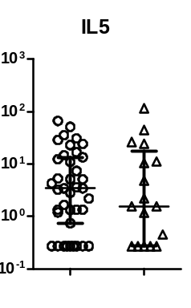
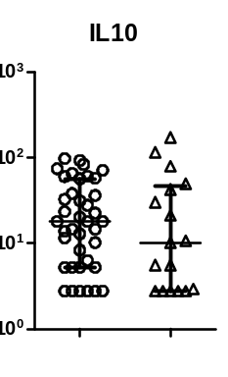
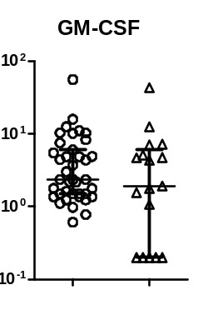
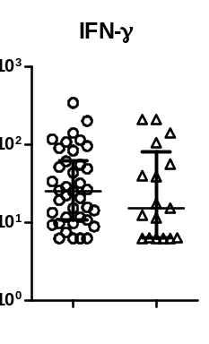
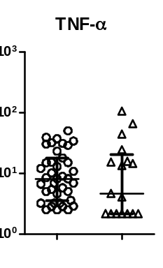
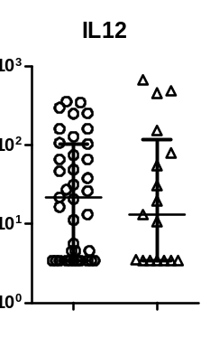
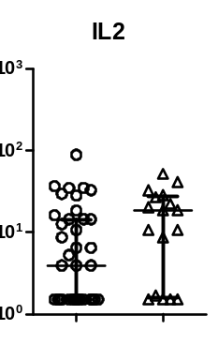
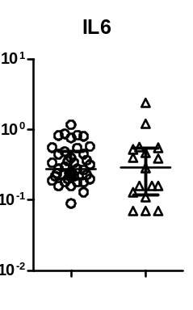
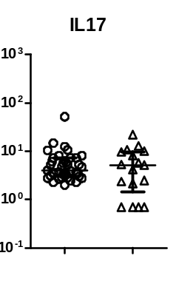
pg/mL
UI
CO
UI
CO
UI
CO
pg/mL
UI
CO
UI
CO
UI
CO
p=0,063
pg/mL
UI
CO
UI
CO
UI
CO
Supplementary Figure 1: Level of soluble plasma cytokine levels in uninfected (UI) and convalescent (CO) health care workers. IL9, IFN-α and IL4 could not be quantified. Significant when p<0.05. Not significant results are not shown. The limits of detection of each cytokine was as follows: IFN-α, 10.4 pg/mL; IFN-γ,6.26 pg/mL; TNF-α, 2.17 pg/mL; IL12, 3.44 pg/mL; GM-CSF, 0.20 pg/mL; IL9, 32.7 pg/mL; IL10, 2.76 pg/mL; IL4, 34.2 pg/mL; IL5, 0.27 pg/mL; IL17A, 0.7 pg/mL; IL2, 1.52 pg/mL; IL12p70, 3.44 pg/mL; and IL6, 0.077 pg/mL.

Slide 3
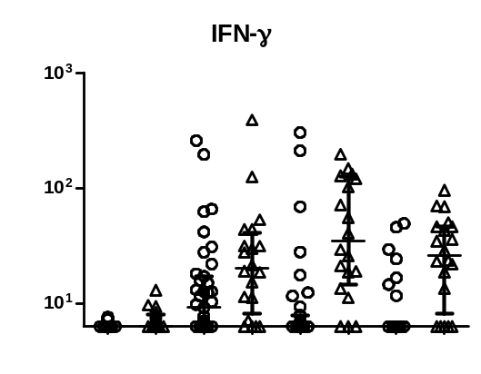
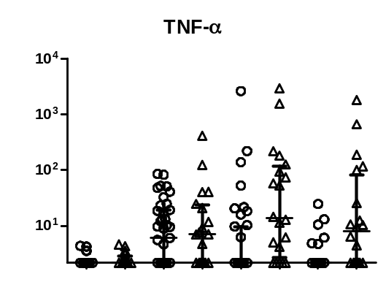
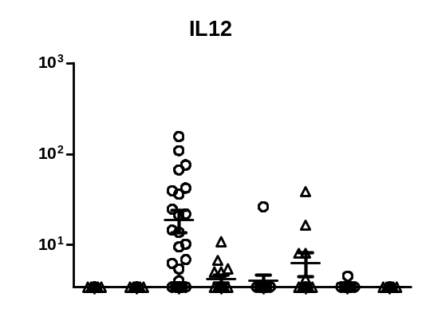
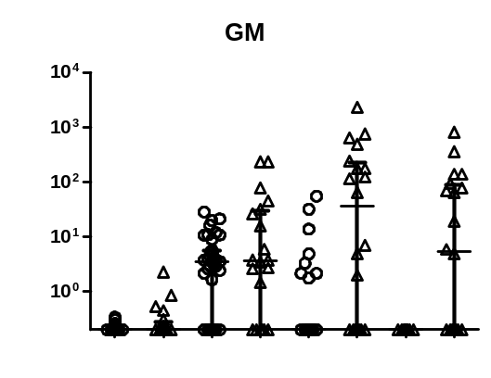
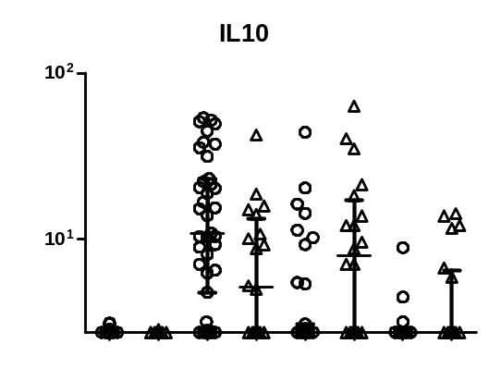
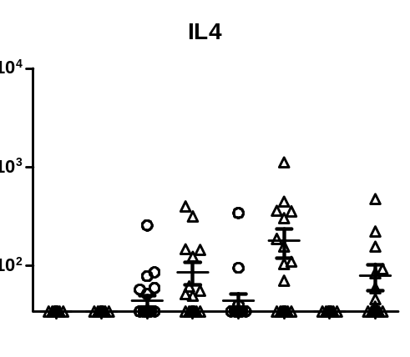
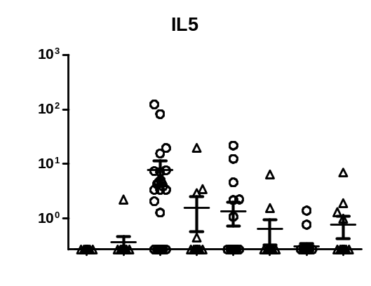
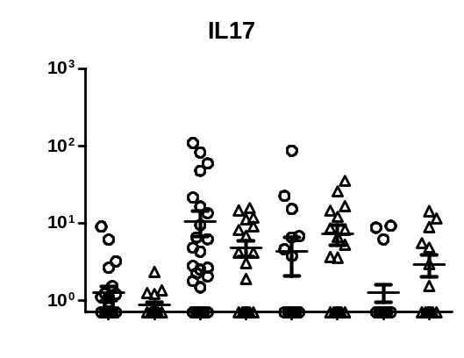
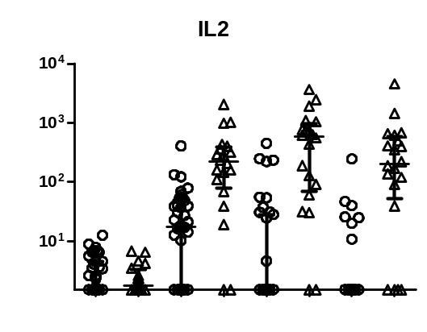
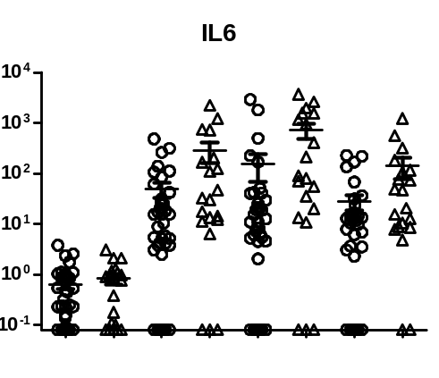
Medium
S
M
N
Medium
S
M
N
pg/mL
pg/mL
UI
CO
UI
CO
UI
CO
UI
CO
UI
CO
UI
CO
UI
CO
UI
CO
Medium
S
M
N
Medium
S
M
N
pg/mL
pg/mL
UI
CO
UI
CO
UI
CO
UI
CO
UI
CO
UI
CO
UI
CO
UI
CO
Medium
S
M
N
Medium
S
M
N
pg/mL
pg/mL
UI
CO
UI
CO
UI
CO
UI
CO
UI
CO
UI
CO
UI
CO
UI
CO
Medium
S
M
N
Medium
S
M
N
pg/mL
pg/mL
UI
CO
UI
CO
UI
CO
UI
CO
UI
CO
UI
CO
UI
CO
UI
CO
Medium
S
M
N
Medium
S
M
N
pg/mL
pg/mL
UI
CO
UI
CO
UI
CO
UI
CO
UI
CO
UI
CO
UI
CO
UI
CO

Slide 4
Supplementary Figure 2: Level of cytokine production in uninfected (UI) and convalescent (CO) health care workers, according to SARS-CoV-2 specific peptides S, M and N used for PBMC stimulation. Negative control by culture medium without any specific peptide is also shown. Positive control were always productive. Values shown represent the final concentration once subtracted the concentration found in the negative control. Production of IL6 in negative controls showed an elevated back-ground production. Significant when p<0.05. Not significant results are not shown. The limits of detection of each cytokine was as follows: IFN-α, 10.4 pg/mL; IFN-γ,6.26 pg/mL; TNF-α, 2.17 pg/mL; IL12, 3.44 pg/mL; GM-CSF, 0.20 pg/mL; IL9, 32.7 pg/mL; IL10, 2.76 pg/mL; IL4, 34.2 pg/mL; IL5, 0.27 pg/mL; IL17A, 0.7 pg/mL; IL2, 1.52 pg/mL; IL12p70, 3.44 pg/mL; and IL6, 0.077 pg/mL.

Slide 5
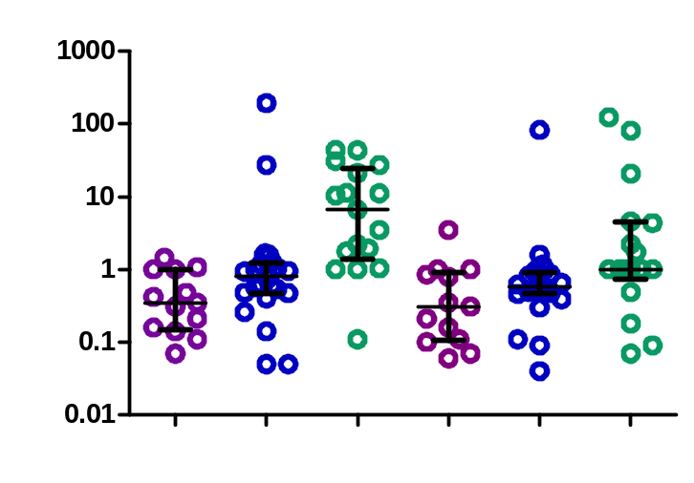
Supplementary Figure 3
IFN-γ/IL10
TNF-α/IL10
p<0,001
p=0,010
p=0,013
PR
SR
CO
PR
SR
CO
Supplementary Figure 3. Th1/Th2 ratio to SARS-CoV-2 protein S of strong (SR) and partial cellular responders (PR) compared to convalescents. IFN-γ/IL10 and TNF-α/IL10 ratio are shown since they are the most representative cytokines to protein S. Significant when p<0.05. Not significant results are not shown.

