Slide 1
Table 1. sisRNAs identified in GV RNA-seq reads by MACS according to Ensemble and RefSeq genes in Xenopus Tropicalis.
Genome size : 1,513,925,492 bps | # | Total length | % in genome |  | Length distribuion
 |  |  |  |  | average | min | median | max
All peaks by MACS (FDR=0.01) | 63,410 | 21,899,763 | 1.45% |  | 345.4 | 160 | 271 | 2,908
sisRNAs by Ensembl genes (28,937) | 34,169 | 12,184,476 | 0.80% |  | 356.6 | 160 | 283 | 2,908
sisRNAs by RefSeq genes (9,448) | 24,901 | 9,054,977 | 0.60% |  | 363.6 | 160 | 288 | 2,908

Slide 2
Table 2A. sisRNAs in RefSeq Genes
#Introns/gene | # | # of total introns | # of genes with sisRNAs | % of genes with sisRNAs | # of sisRNAs | #sisRNAs/Gene | #sisRNAs/Intron
0 | 584 | - | - | - | - | - | -
1 | 583 | 583 | 145 | 24.9% | 347 | 0.60 | 0.60
2 | 729 | 1,458 | 341 | 46.8% | 743 | 1.02 | 0.51
3 | 812 | 2,436 | 471 | 58.0% | 1,254 | 1.54 | 0.51
4 | 777 | 3,108 | 488 | 62.8% | 1,564 | 2.01 | 0.50
5 | 716 | 3,580 | 477 | 66.6% | 1,472 | 2.06 | 0.41
6 | 683 | 4,098 | 486 | 71.2% | 1,677 | 2.46 | 0.41
7 | 599 | 4,193 | 420 | 70.1% | 1,450 | 2.42 | 0.35
8 | 580 | 4,640 | 408 | 70.3% | 1,621 | 2.79 | 0.35
9 | 506 | 4,554 | 397 | 78.5% | 1,575 | 3.11 | 0.35
>=10 | 2,879 | 45,110 | 2,332 | 81.0% | 14,581 | 5.06 | 0.32
Total | 9,448 | 73,760 | 5,965 | 67.3% | 26,284 | 2.97 | 0.36
Table 2B. sisRNAs in Ensembl Genes
#Introns/gene | # | # of total introns | # of genes with sisRNAs | % of genes with sisRNAs | # of sisRNAs | #sisRNAs/Gene | #sisRNAs/Intron
0 | 2,654 | - | - | - | - | - | -
1 | 3,600 | 3,600 | 415 | 11.5% | 911 | 0.25 | 0.25
2 | 2,461 | 4,922 | 648 | 26.3% | 1,383 | 0.56 | 0.28
3 | 1,986 | 5,958 | 807 | 40.6% | 1,951 | 0.98 | 0.33
4 | 1,791 | 7,164 | 847 | 47.3% | 2,140 | 1.19 | 0.30
5 | 1,696 | 8,480 | 919 | 54.2% | 2,439 | 1.44 | 0.29
6 | 1,543 | 9,258 | 826 | 53.5% | 2,431 | 1.58 | 0.26
7 | 1,458 | 10,206 | 835 | 57.3% | 2,613 | 1.79 | 0.26
8 | 1,372 | 10,976 | 772 | 56.3% | 2,637 | 1.92 | 0.24
9 | 1,260 | 11,340 | 767 | 60.9% | 2,687 | 2.13 | 0.24
>=10 | 9,146 | 162,302 | 6,208 | 67.9% | 31,887 | 3.49 | 0.20
Total | 28,967 | 234,206 | 13,044 | 49.6% | 51,079 | 1.94 | 0.22

Slide 3
Table 3. Base compositions in whole genome, sisRNAs and introns in X. tropicalis
Bases | Genome | RefSeq sisRNAs | Ensembl sisRNAs | Introns | Introns
 |  |  |  | - sisRNAs | + sisRNAs
A | 29.97% | 29.09% | 29.14% | 30.32% | 29.74%
C | 20.04% | 20.92% | 20.88% | 19.66% | 20.27%
G | 20.04% | 21.00% | 20.91% | 19.67% | 20.32%
T | 29.96% | 28.99% | 29.07% | 30.36% | 29.67%
total | 1,359,400,017 | 9,027,876 | 12,146,831 | 117,363,589 | 105,176,094
(G+C)% | 40.07% | 41.92% | 41.79% | 39.32% | 40.59%

Slide 4
Table 4. The gene function analysis by DAVID from the 5,419 genes with sisRNAs identified by RefSeq genes.
Category | Term | Count | % | P-Value
GOTERM_MF_FAT | nucleotide binding | 690 | 13.9 | 3.30E-24
GOTERM_MF_FAT | RNA binding | 161 | 3.2 | 6.10E-17
GOTERM_MF_FAT | adenyl ribonucleotide binding | 396 | 8 | 2.10E-16
GOTERM_MF_FAT | nucleoside binding | 420 | 8.4 | 2.10E-16
GOTERM_MF_FAT | adenyl nucleotide binding | 418 | 8.4 | 2.20E-16
GOTERM_MF_FAT | ATP binding | 395 | 7.9 | 2.40E-16
GOTERM_MF_FAT | purine nucleoside binding | 418 | 8.4 | 2.90E-16
GOTERM_MF_FAT | purine nucleotide binding | 545 | 11 | 3.30E-14
GOTERM_MF_FAT | ribonucleotide binding | 523 | 10.5 | 4.60E-14
GOTERM_MF_FAT | purine ribonucleotide binding | 523 | 10.5 | 4.60E-14
GOTERM_BP_FAT | RNA processing | 119 | 2.4 | 1.30E-12
GOTERM_CC_FAT | ribonucleoprotein complex | 148 | 3 | 2.20E-12
GOTERM_CC_FAT | intracellular non-membrane-bounded organelle | 312 | 6.3 | 8.50E-11
GOTERM_CC_FAT | non-membrane-bounded organelle | 312 | 6.3 | 8.50E-11
GOTERM_BP_FAT | mRNA metabolic process | 63 | 1.3 | 1.20E-10
GOTERM_BP_FAT | modification-dependent macromolecule catabolic process | 101 | 2 | 6.60E-10
GOTERM_BP_FAT | modification-dependent protein catabolic process | 101 | 2 | 6.60E-10
GOTERM_BP_FAT | cellular macromolecule catabolic process | 117 | 2.4 | 1.80E-09
GOTERM_BP_FAT | mRNA processing | 57 | 1.1 | 2.20E-09
GOTERM_BP_FAT | protein catabolic process | 113 | 2.3 | 3.30E-09
GOTERM_BP_FAT | cell division | 58 | 1.2 | 6.40E-09
GOTERM_BP_FAT | translation | 138 | 2.8 | 8.80E-09

Slide 5

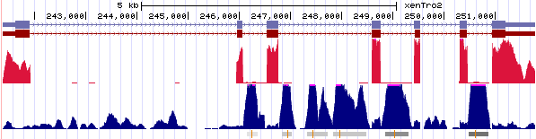
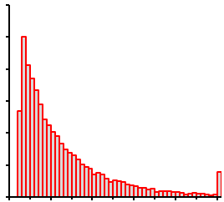
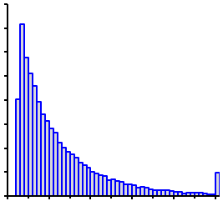
Figure 1. sisRNAs in Ensembl and RefSeq genes using GV RNA-seq reads
A
Ensembl sisRNAs (34,169)
refSeq sisRNAs (24,901)
14,149
20,020
4,881
All peaks
(63,410)
B
Scaffold_596
refSeq
Ensembl
e2f3
mRNA
Cytoplasm
RNA GV
sisRNAs
C
D
3K
refSeq sisRNAs
4K
Ensembl sisRNAs
2K
3K
# of sisRNAs
# of sisRNAs
2K
1K
1K
0
0
100
300
500
700
900
1100
100
300
500
700
900
1100
Length of sisRNAs (bps)
Length of sisRNAs (bps)

Slide 6
Figure 2. sisRNAs are widely expressed in multiple intron genes
sisRNAs identified by refSeq Genes
A
sisRNAs identified by Ensembl Genes
% of genes with sisRNAs
The number of introns in gene
B
# sisRNAs/Gene
The number of introns in gene

Slide 7
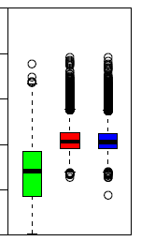
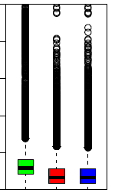
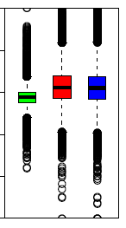
Figure 3. sisRNAs sequences are GC/CA rich while CpG poor
Trinucleotide
A
Dinucleotide
B
3-mers with CpG
Dinucleotide O/E
Genome
sisRNAs identified by refSeq Genes
3-mers
with
GC/CA
sisRNAs identified by Ensembl Genes
3-mers O/E
C
100%
D
0.25
E
0.5
80%
0.20
0.4
60%
0.15
0.3
GC%
CpG density
CA|TG density
40%
0.10
0.2
20%
0.05
0.1
0%
0
0

Slide 8
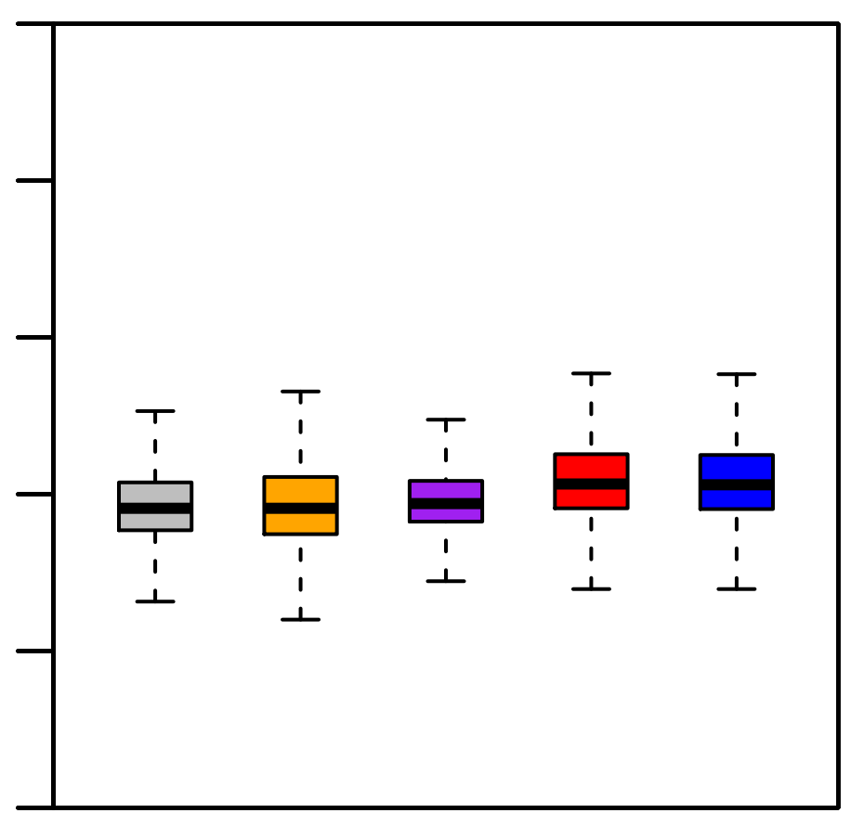
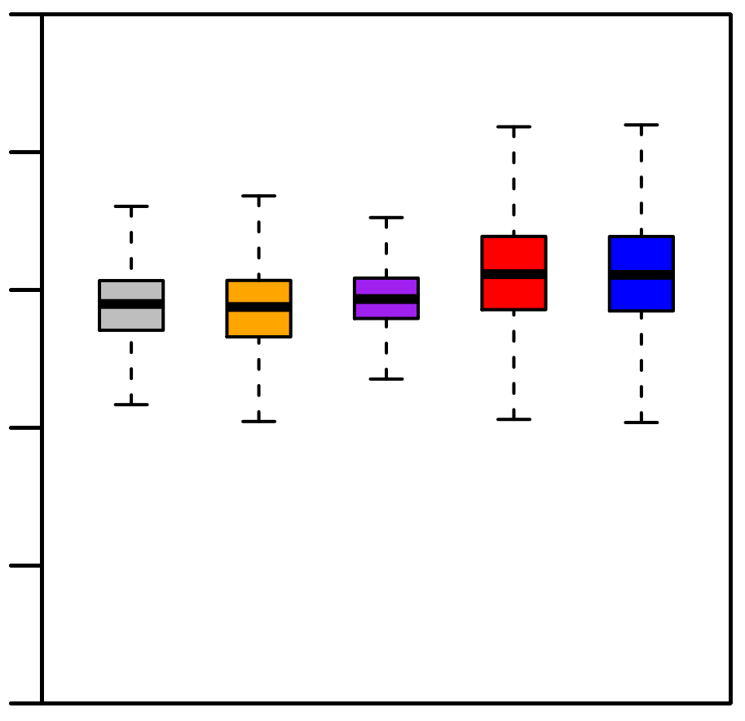
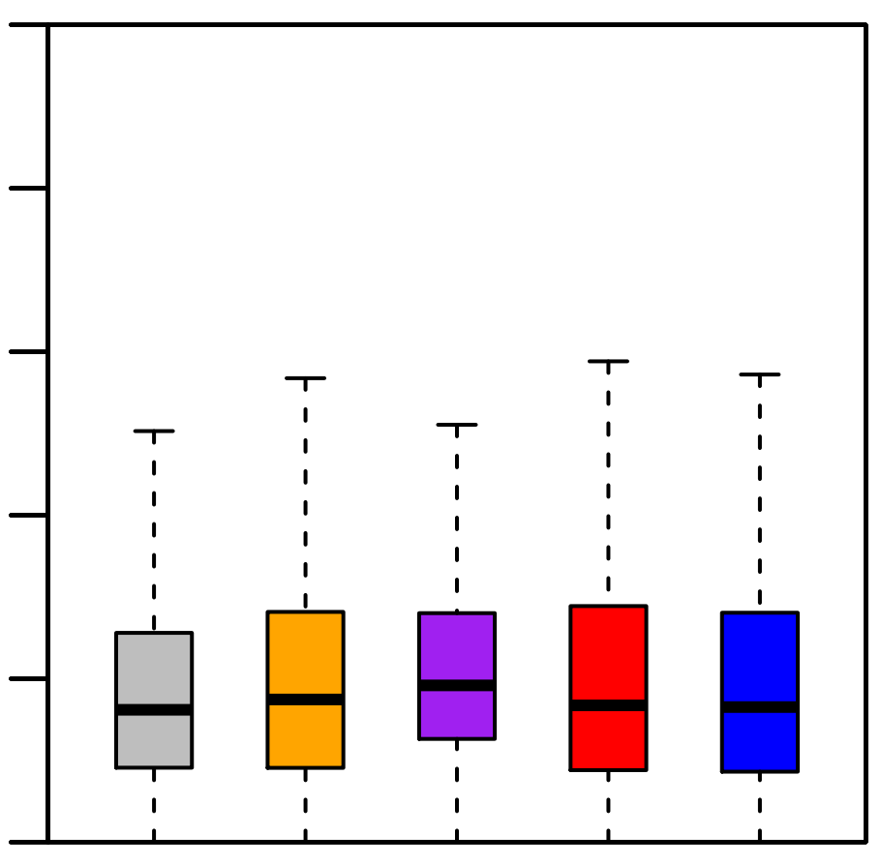
Figure 4. sisRNAs are specific regions of the introns
A
100%
C
0.5
80%
0.4
60%
0.3
GC%
CA|TG density
40%
0.2
20%
0.1
0%
0
B
0.10
Intron A: from genes without sisRNAs
0.08
Intron B: from gene with sisRNAs but itself no sisRNAs
0.06
CpG density
Intron C: with sisRNAs identified by fefSeq Genes
0.04
sisRNAs identified by refSeq Genes
0.02
sisRNAs identified by Ensembl Genes
0
Intron types according to sisRNAs and genes
Gene 1
Exon 1
Intron A
Exon 2
Gene 2
Exon 1
Intron B
Exon 2
Intron C
Exon 3
sisRNA

Slide 9
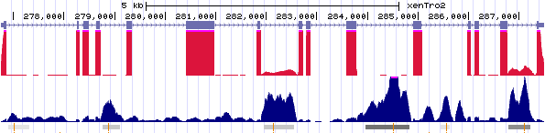
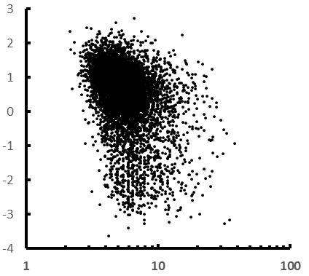
Figure 5. sisRNAs are enriched in both start and end of transcript, preferentially in end introns of transcript.
A
RefSeq sisRNAs
Ensembl sisRNAs
sisRNAs density
5’
3’
Intron 1
Intron 2
Intron 3…
Joined Introns along the Transcript (%)
B
Scaffold_4
RefSeq
mRNA
Cytoplasm
nasp
RNA GV
sisRNAs
C
R=-0.1724
Cytoplasm RNA (log10(FPKM))
sisRNA Signals (By MACS)

Slide 10
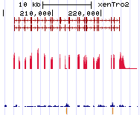
Figure 6. Specific TFBS related to transcription are enriched in sisRNAs
A
PROP1
NKX3A
NCX
Motif O/E (Introns without sisRNAs)
MYOG:NF1
GAF
STAT3
p50:p50
NF-kappaB
Motif O/E (RefSeq sisRNAs)
B
C
R=0.99
Scaffold_879
Ensembl
Stat3
mRNA
Cytoplasm
Motif O/E (Ensembl sisRNAs)
RNA GV
sisRNAs
Motif O/E (RefSeq sisRNAs )

Slide 11
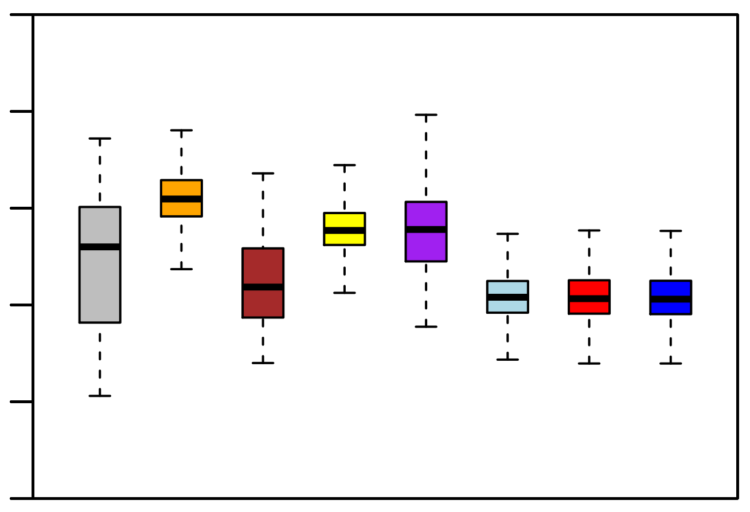
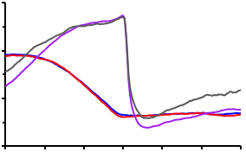
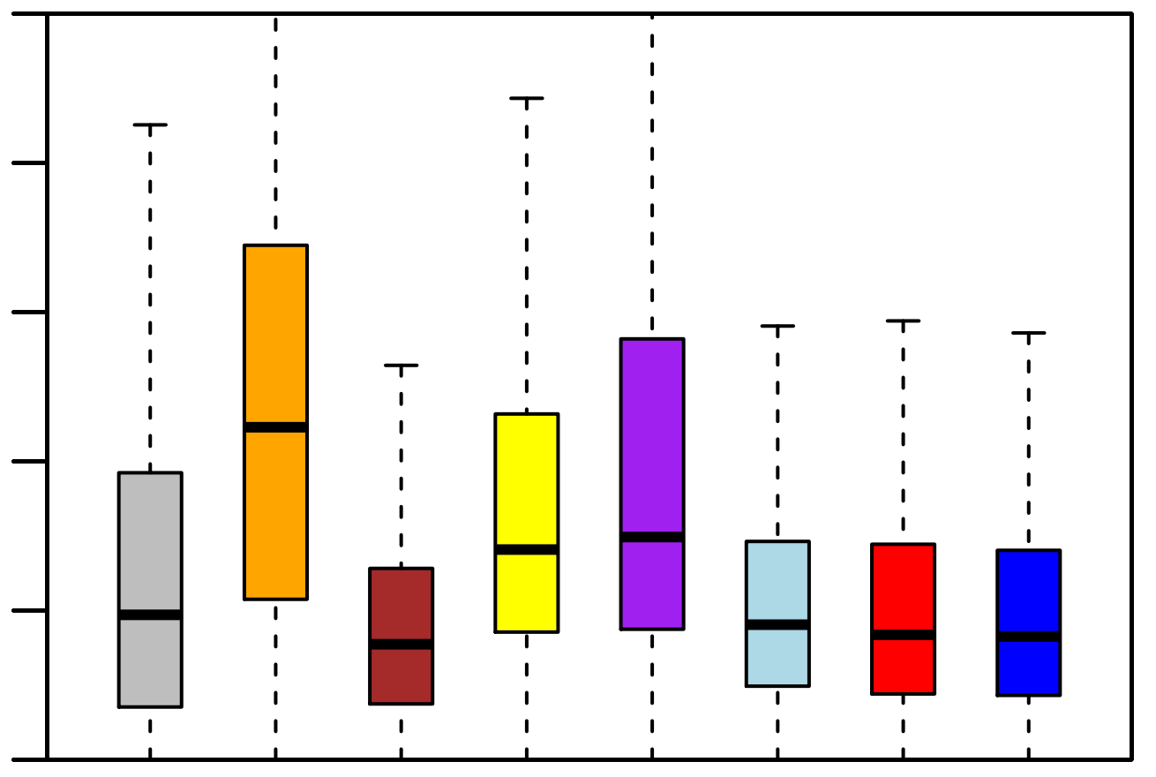
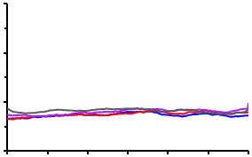
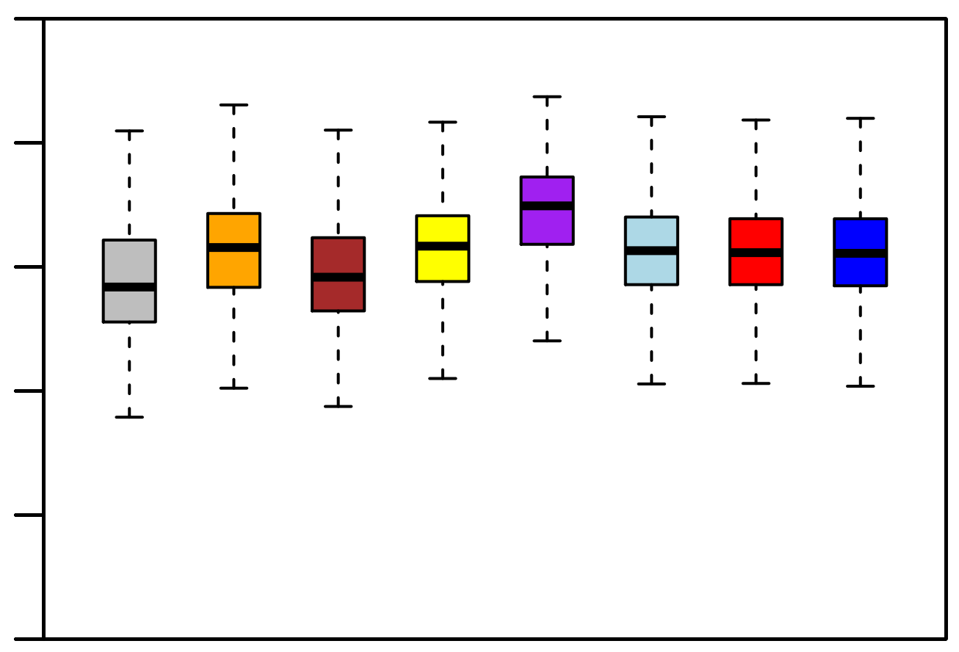
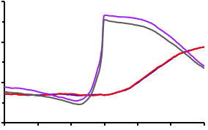
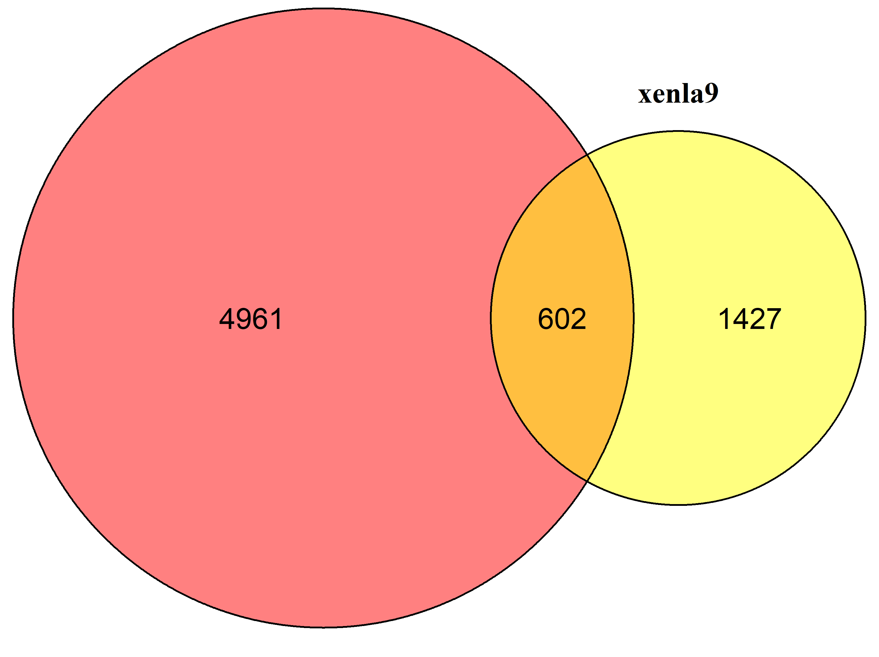
Figure 7. sisRNAs are as evolutionary conserved as introns.
sisRNAs by refGenes
D
100%
sisRNAs by ensGenes
Introns with sisRNAs
80%
Introns without sisRNAs
60%
A
5’ End
GC%
1.0
Exon|Intron
boundary
40%
20%
0.8
0%
PhastCons Score
E
0.10
0.6
0.08
0.4
0.06
-150
-100
-50
0
50
100
150
Dis. from 5’ End (bps)
CpG density
B
0.04
Middle
0.02
1.0
F
0
0.8
0.5
PhastCons Score
0.4
0.6
0.3
0.4
CA|TG density
-150
-100
-50
0
50
100
150
0.2
Dis. from Midpoint (bps)
0.1
RBC (Mm.)
ENS (XenT)
REF (XenT)
3T3 (Mm.)
XTC (XenL)
Hela (Hs.)
DF1 (galG)
C
RBC (Hs.)
3’ End
0
1.0
Intron|Exon
boundary
G
GV REF (XenT)
0.8
XTS (XenL)
PhastCons Score
0.6
0.4
-150
-100
-50
0
50
100
150
Dis. from 3’ End (bps)

Slide 12
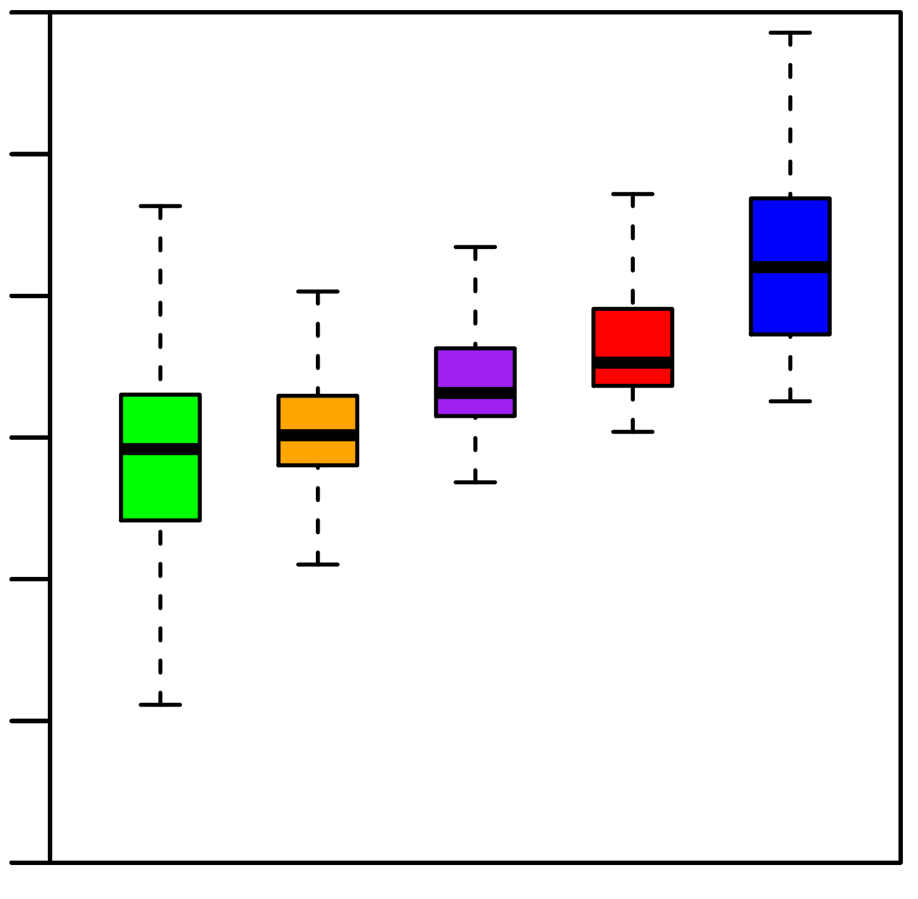
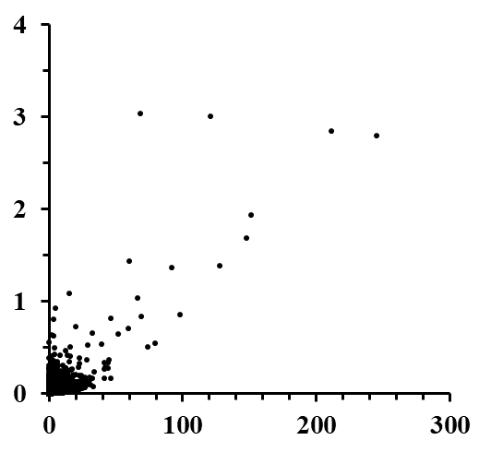
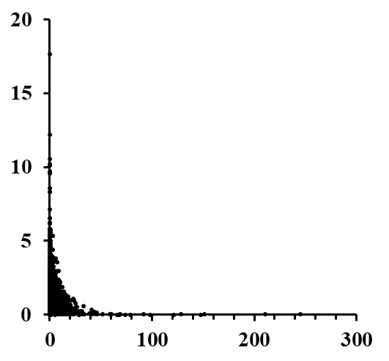
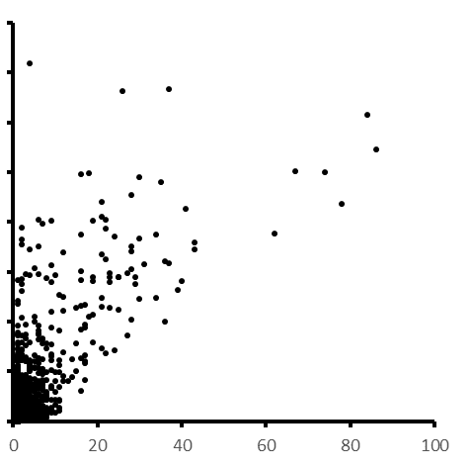
Supplementary Figure 1. Longer introns with more sisRNAs
A
10⁶
C
10⁴
Length (bps)
Intron Length (Mb)
10²
R=0.87
0
0
1
2
3
>3
#sisRNAs/gene
#sisRNAs
D
B
800K
600K
Length (bps)
#Intron/Mb (X1000)
400K
200K
R=0.72
R=0.09
0
#sisRNAs/intron
#sisRNAs/gene

Slide 13
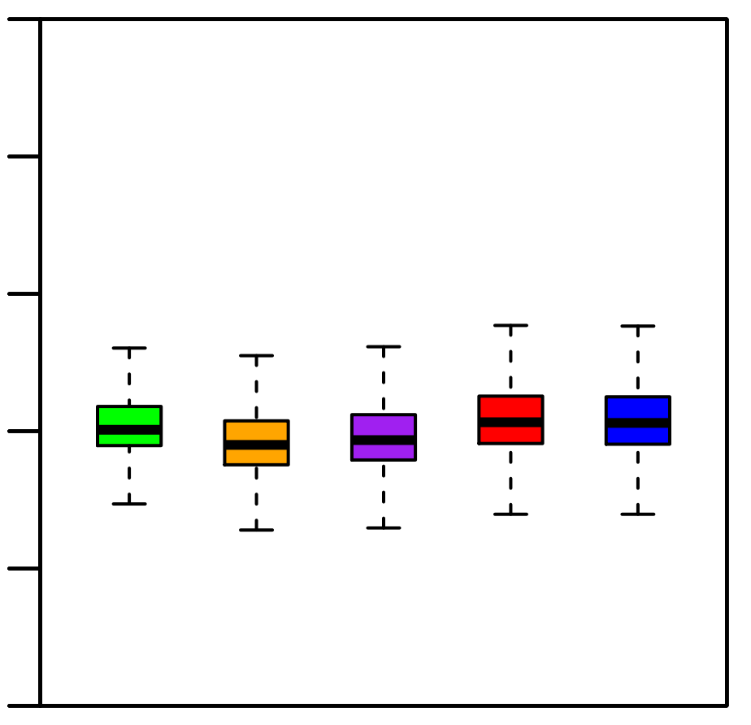
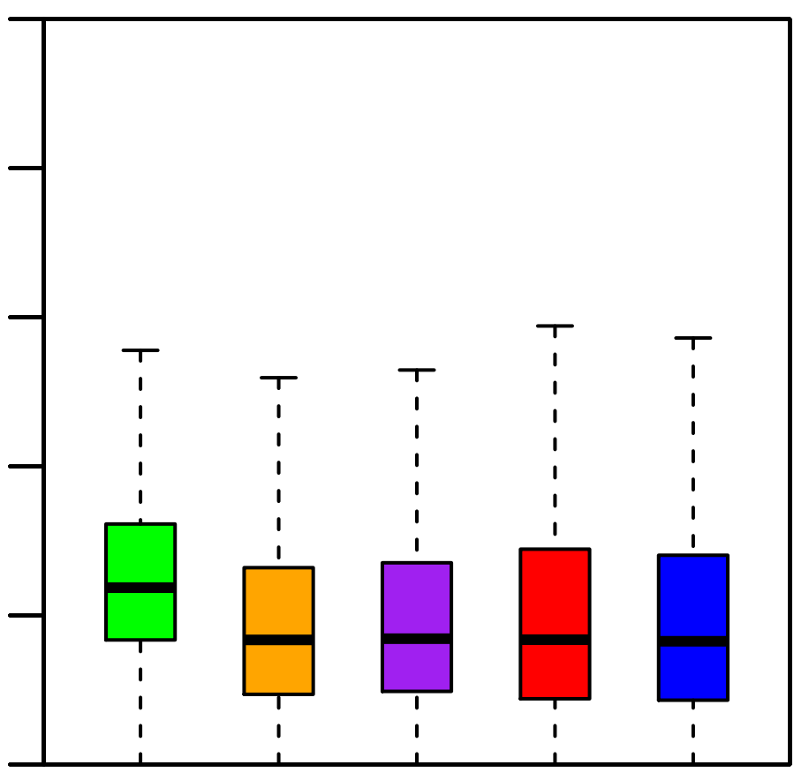
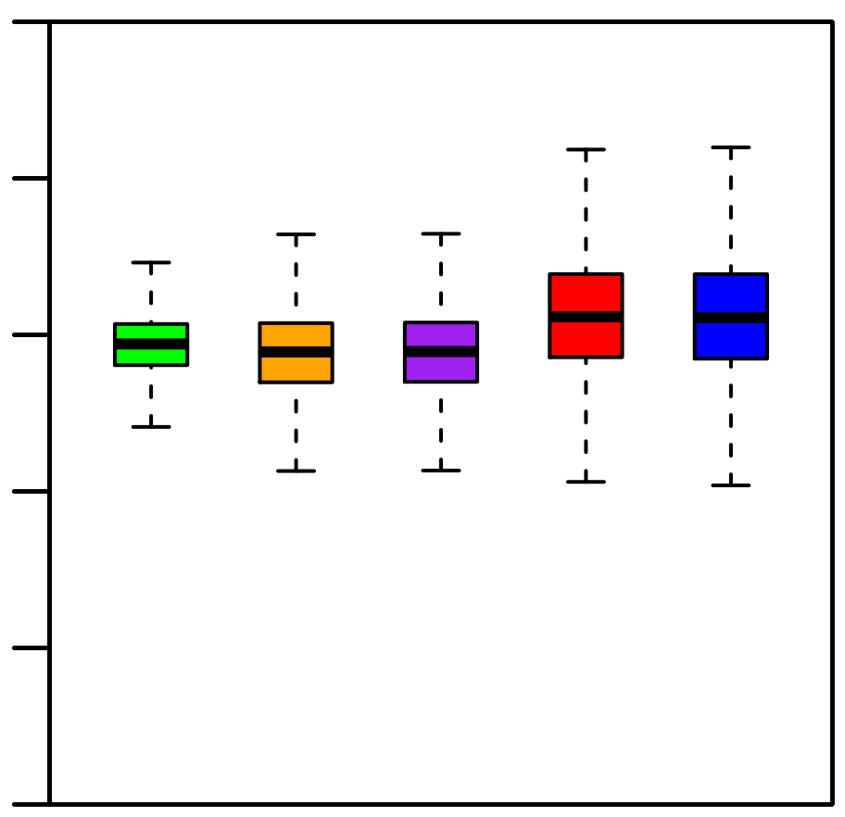
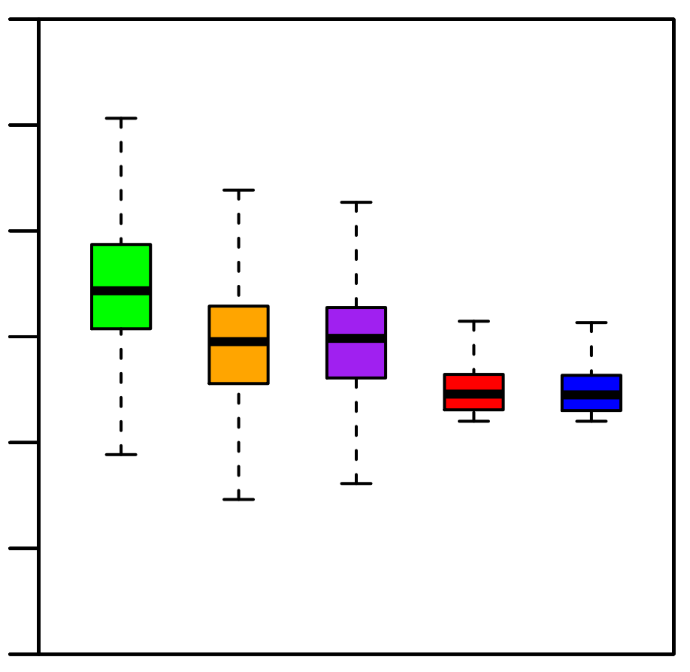
Supplementary Figure 2. sisRNAs are specific regions of the introns
A
C
100%
0.5
80%
0.4
60%
0.3
GC%
CA|TG density
40%
0.2
20%
0.1
0%
0
0.10
D
10⁶
B
0.08
10⁵
10⁴
0.06
length
CpG density
10³
0.04
10²
0.02
10
0
1
Intron S: 1st Intron
Intron M: Middle Introns
Intron E: Last Intron
sisRNAs identified by refSeq Genes
sisRNAs identified by Ensembl Genes

Slide 14
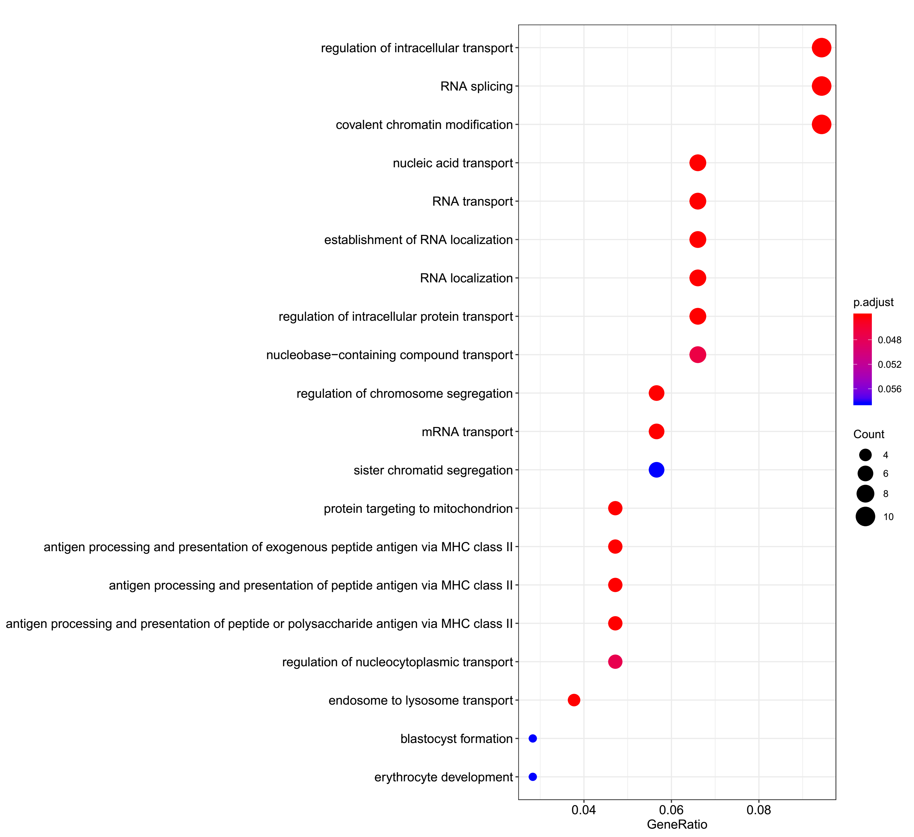
Supplementary Figure 3. GO analysis in the host genes of sisRNAs
3A Human RBC

Slide 15
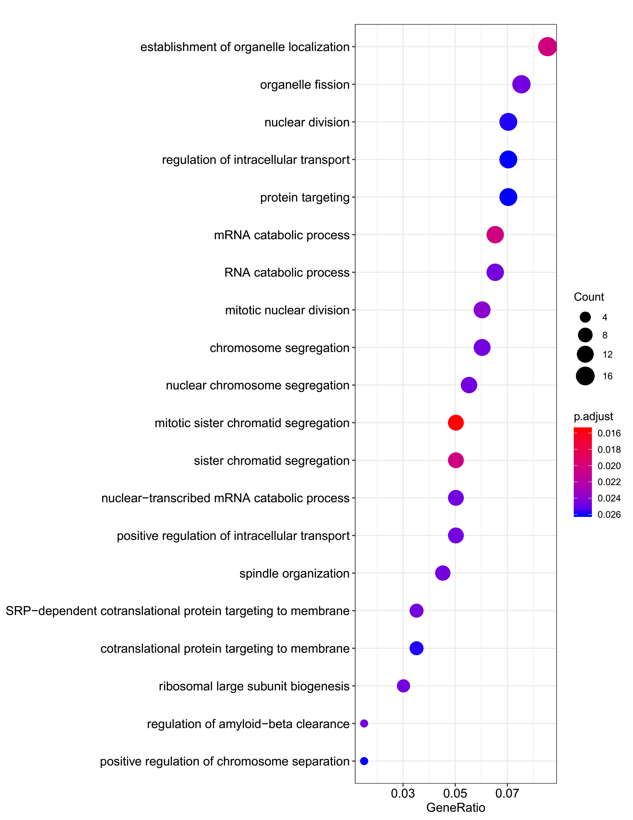
Supplementary Figure 3. GO analysis in the host genes of sisRNAs
3B Human Hela

Slide 16
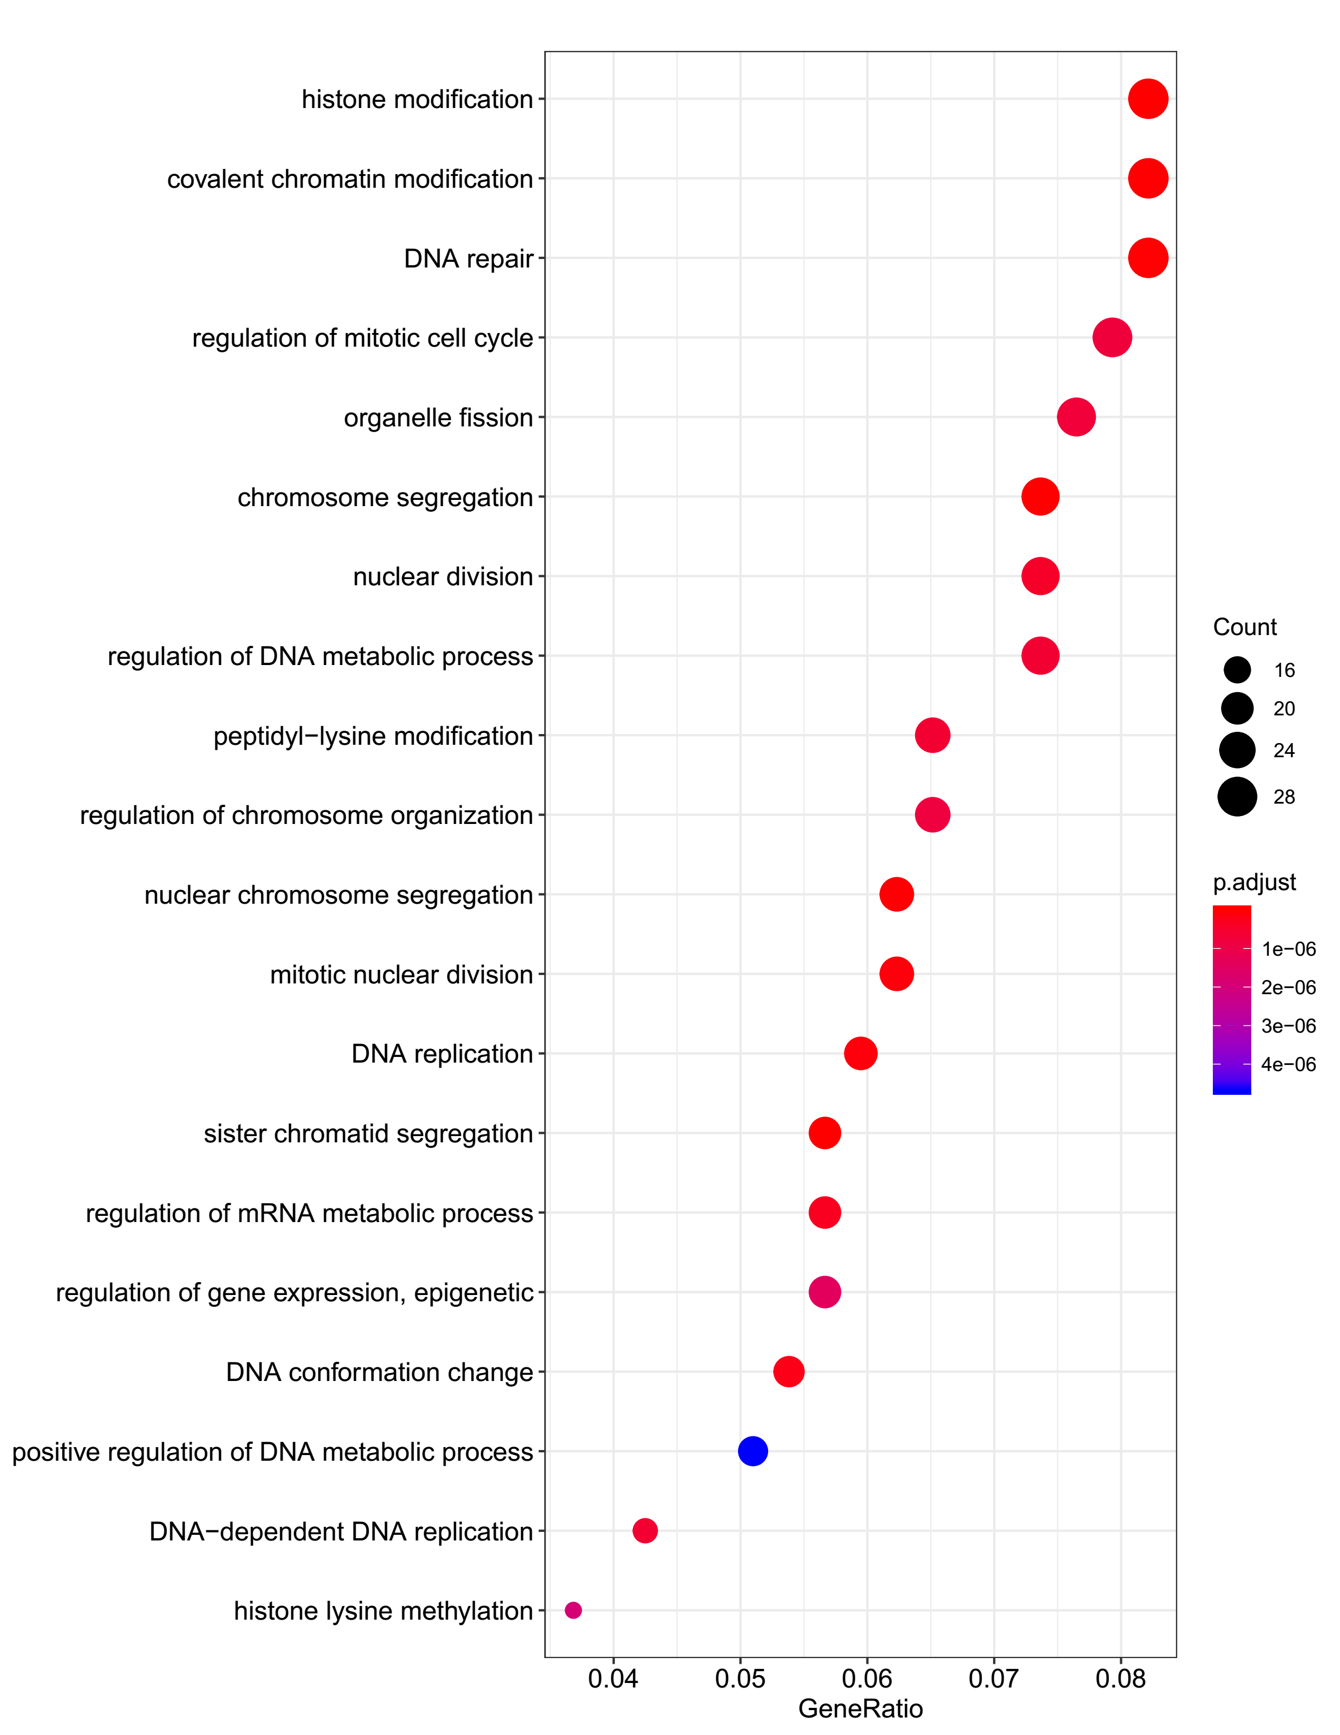
Supplementary Figure 3. GO analysis in the host genes of sisRNAs
3C Mouse RBC

Slide 17
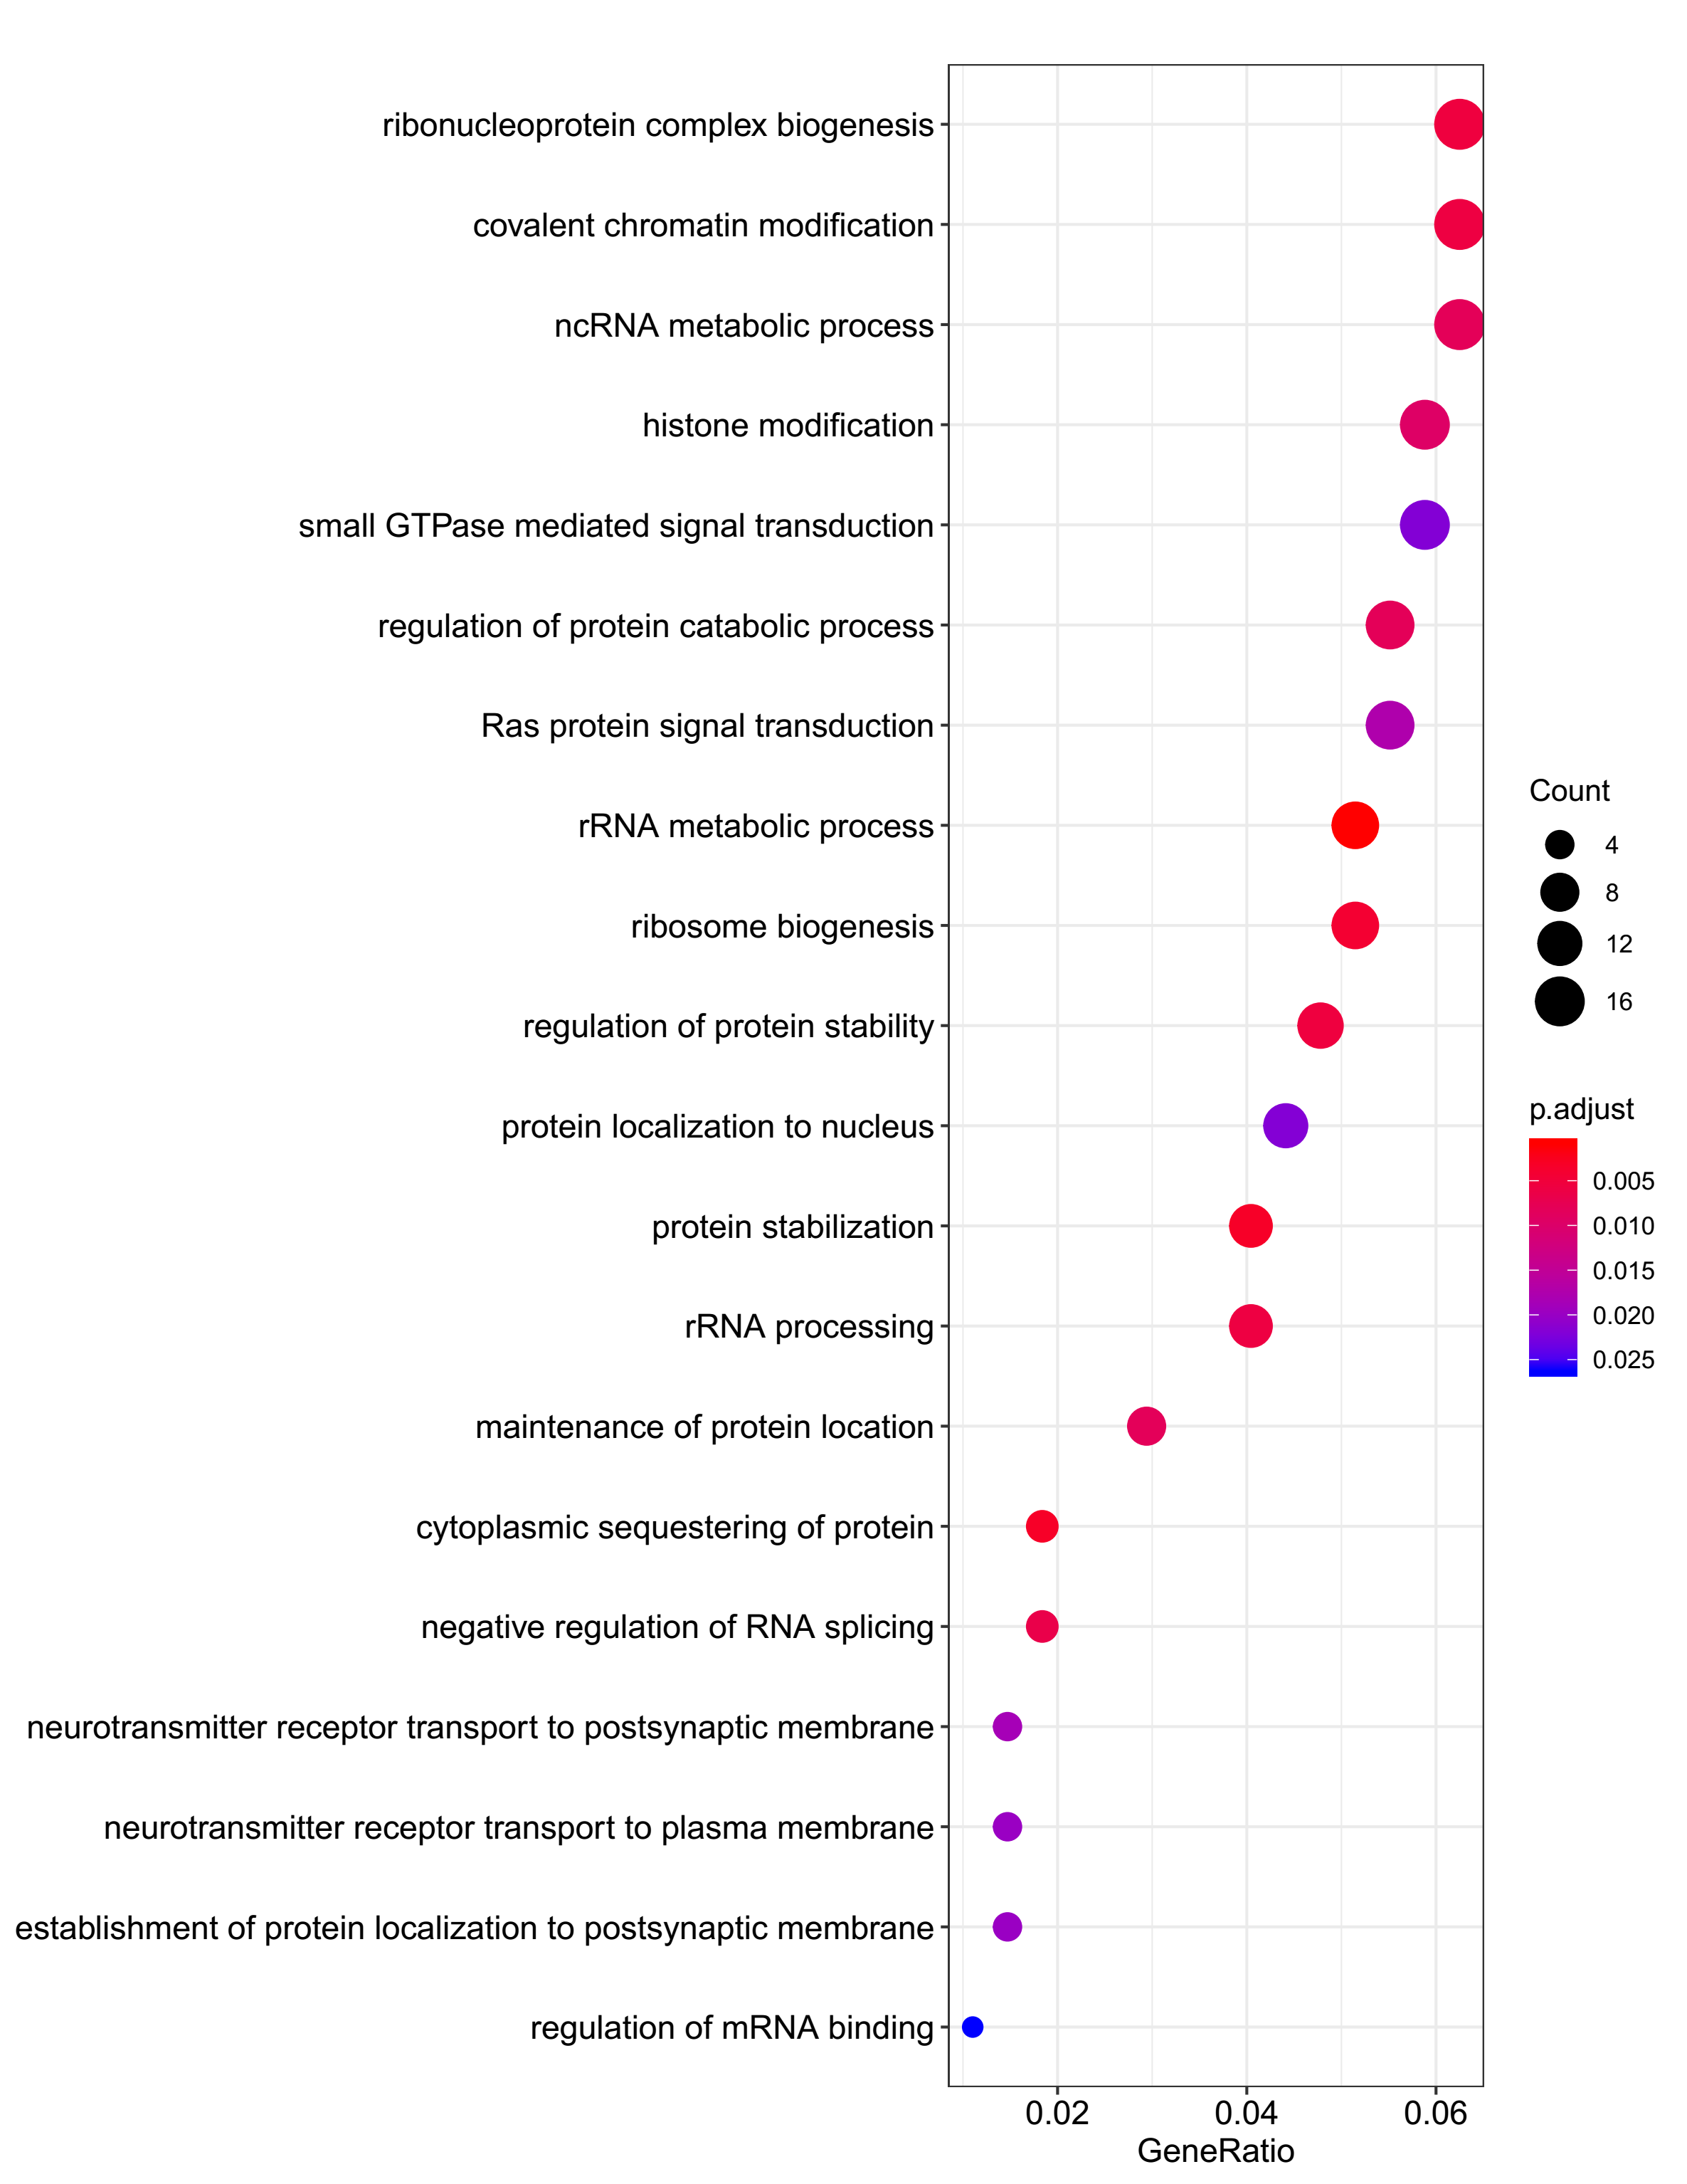
Supplementary Figure 3. GO analysis in the host genes of sisRNAs
3D Mouse 3T3

Slide 18
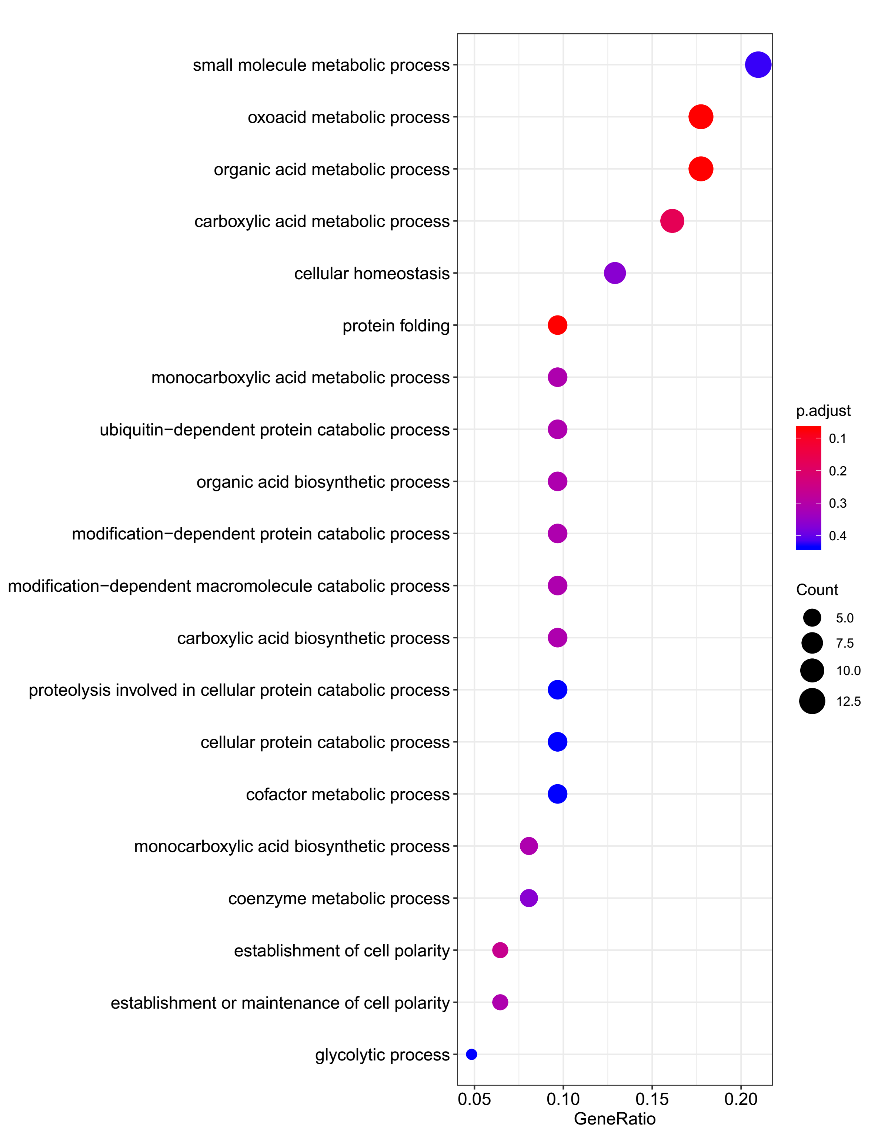
Supplementary Figure 3. GO analysis in the host genes of sisRNAs
3E Chick DF1

Slide 19
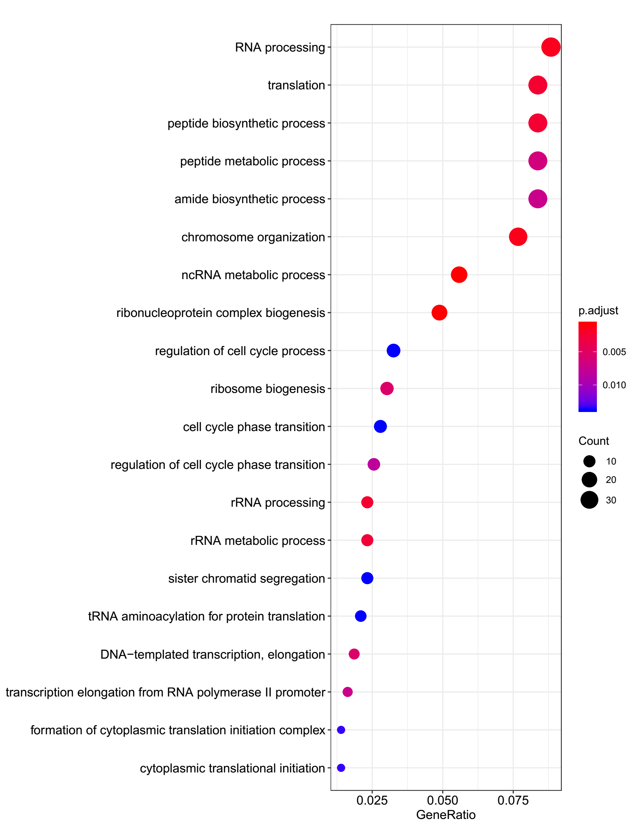
Supplementary Figure 3. GO analysis in the host genes of sisRNAs
3F Xenopus laevis XTC

