Slide 1
Supplementary Figure 1
A
HCT116
COLO205
DLD1
LoVo
Caco-2
＊＊
＊＊
＊＊
＊＊
＊＊
Relative expression
of GLUT1 mRNA
si-control
si-control
si-control
si-GLUT1
si-GLUT1
si-GLUT1
si-control
si-control
si-GLUT1
si-GLUT1
B
HCT116
COLO205
DLD1
LoVo
Caco-2
＊＊
＊＊
＊＊
＊＊
% cell proliferation
to the si-control
si-control
si-control
si-control
si-GLUT1
si-GLUT1
si-GLUT1
si-control
si-control
si-GLUT1
si-GLUT1
Supplementary Figure 1. Cell proliferation inhibition assay using small interfering RNA transfection in colorectal cancer cell lines.

Slide 2
Supplementary Figure 2
Control
BAY-876 50nM
BAY-876 1000nM
HCT116
Control
BAY-876 100nM
BAY-876 1000nM
Caco-2
Supplementary Figure 2. Increased ROS levels were visually confirmed using a fluorescence microscope.
ROS-positive cells labeled with DCFH-DA were observed using a fluorescence microscope in HCT116 and Caco-2 cells (magnification: 40×).
Notes:
Supplementary Figure 2. Increased ROS levels were visually confirmed using a fluorescence microscope.
ROS-positive cells labeled with DCFH-DA were observed using a fluorescence microscope in HCT116 and Caco-2 cells (magnification: 40×).

Slide 3
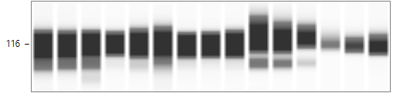
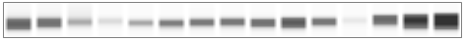
Supplementary Figure 3
HCT116
COLO205
DLD1
LoVo
Caco-2
BAY876(nM)
0 50 1000 0 50 1000 0 100 1000 0 100 1000 0 100 1000
PARP
Cleaved PARP
β-actin
Relative expression of
Cleaved PARP/ β-actin
0.36 0.42 0.76 0.39 0.33 0.46 n.d. n.d. 0.14 0.29 0.45 0.74 n.d. 0.01 0.01
Supplementary Figure 3. Western blot analysis of cleaved-PARP expression showed a pattern similar to that observed in the Annexin-V assay.
The full-length blots are presented in Supplementary Figure 8.

Slide 4
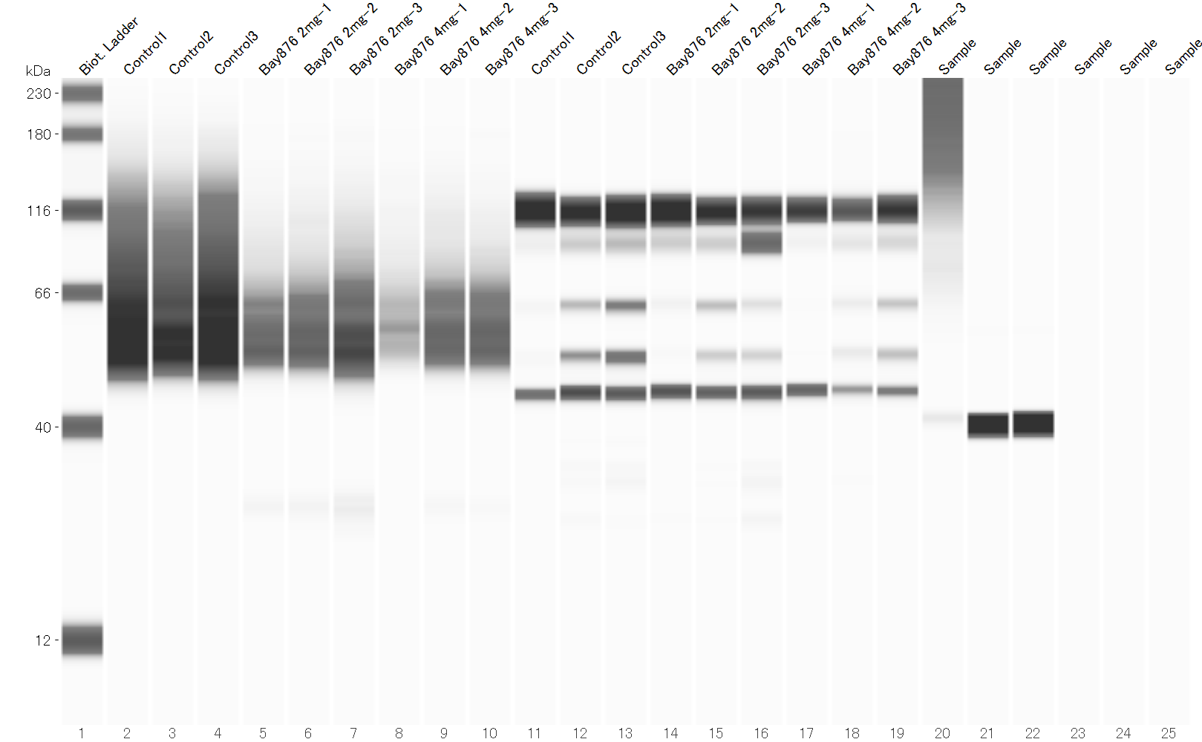
Supplementary Figure 4
Control
BAY-876 2mg
BAY-876 4mg
1 2 3
1 2 3
1 2 3
PARP
Relative expression of
Cleaved PARP/ β-actin
Cleaved PARP
β-actin
Supplementary Figure 4. Western blot analysis of cleaved-PARP expression showed a large expression difference between the samples, with no clear trend observed.
The full-length blots are presented in Supplementary Figure 9.

Slide 5
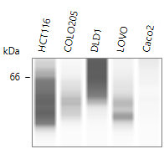
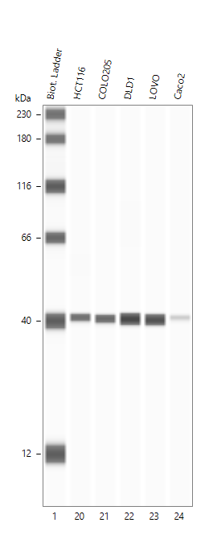
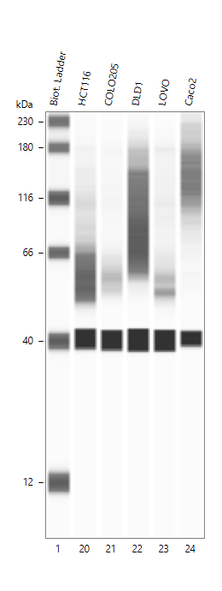
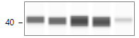
Supplementary Figure 5
GLUT1
GLUT1
GAPDH
GAPDH
GLUT1/GAPDH
Relative expression
Short exposure
Long exposure
Supplementary Figure 5. Comparison of glucose transporter 1 (GLUT1) protein expression levels between each cell line.
The expression pattern in HCT116 cells was used as a reference value.

Slide 6
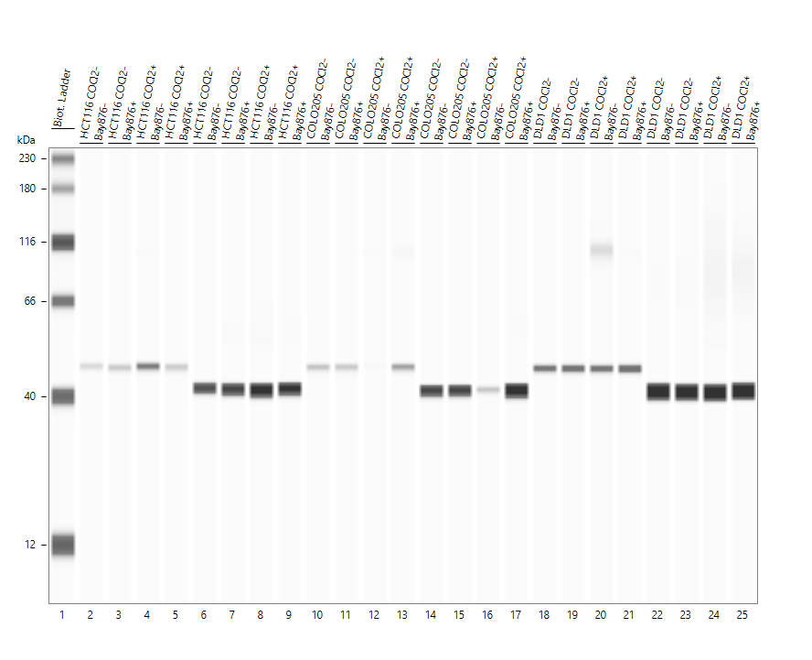
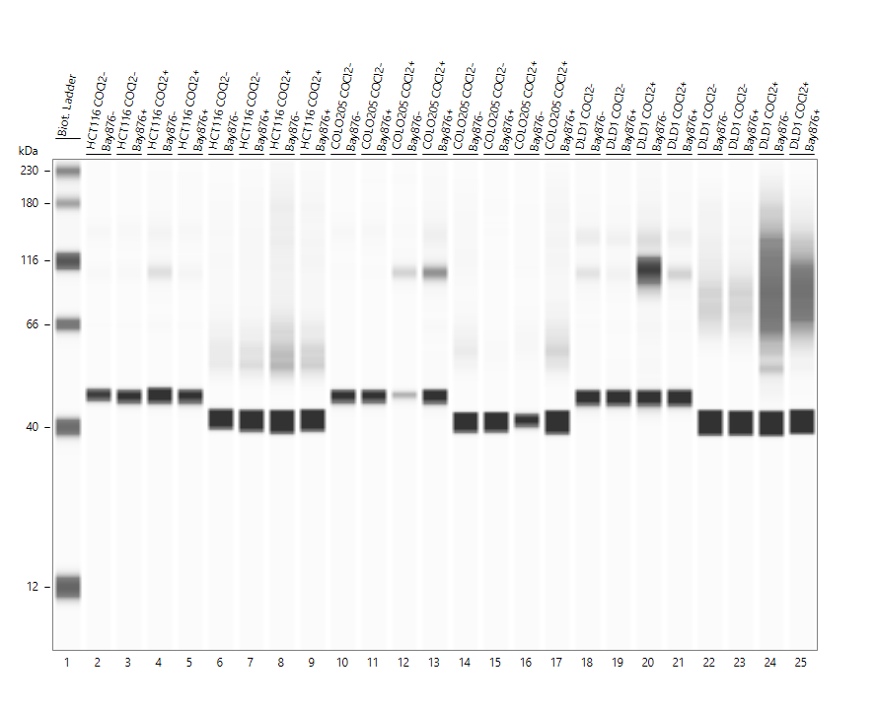
HCT116
Supplementary Figure 6A
HIF-1α
GLUT1
β-actin
GAPDH
Short exposure
Long exposure
Supplementary Figure 6A. Full-length blots of the Figure 2 HCT116 samples.
The red lines indicate cropped areas.

Slide 7
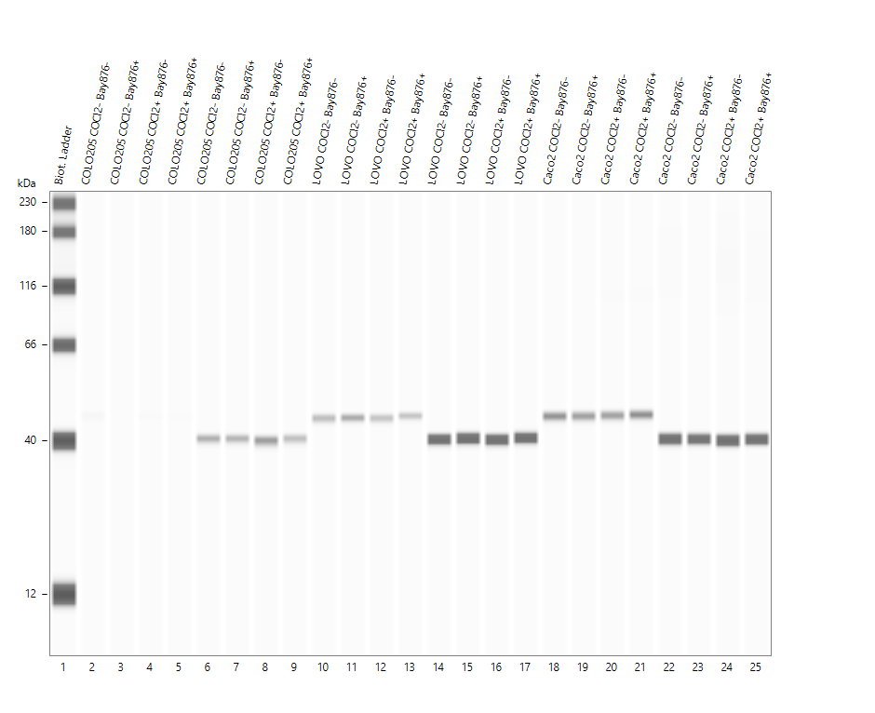
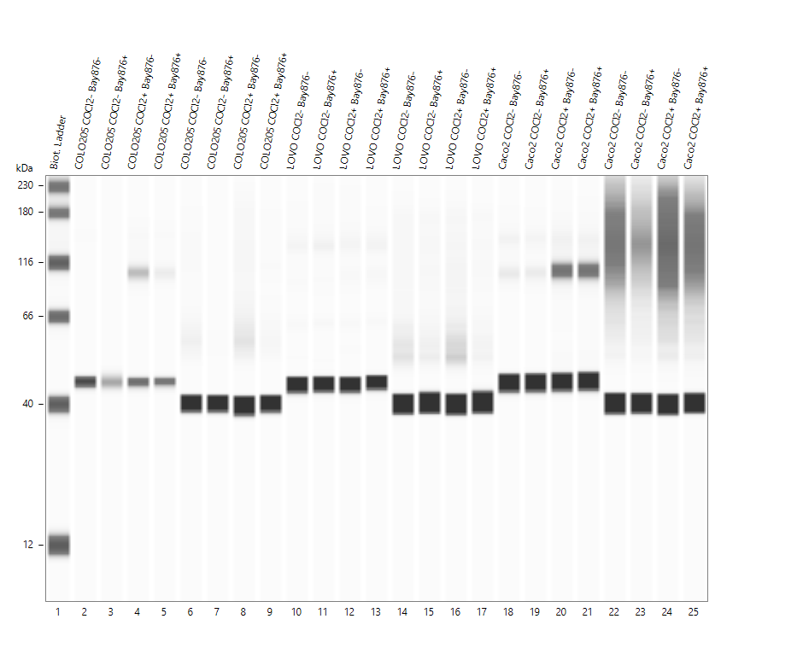
COLO205
Supplementary Figure 6B
HIF-1α
GLUT1
GAPDH
β-actin
Short exposure
Long exposure
Supplementary Figure 6B. Full-length blots of the Figure 2 COLO205 samples.
The red lines indicate cropped areas.

Slide 8
DLD1
Supplementary Figure 6C
HIF-1α
GLUT1
β-actin
GAPDH
Short exposure
Long exposure
Supplementary Figure 6C. Full-length blots of the Figure 2 DLD1 samples.
The red lines indicate cropped areas.

Slide 9
LoVo
Supplementary Figure 6D
HIF-1α
GLUT1
β-actin
GAPDH
Short exposure
Long exposure
Supplementary Figure 6D. Full-length blots of the Figure 2 LoVo samples.
The red lines indicate cropped areas.

Slide 10
Caco-2
Supplementary Figure 6E
HIF-1α
GLUT1
β-actin
GAPDH
Short exposure
Long exposure
Supplementary Figure 6E. Full-length blots of the Figure 2 Caco-2 samples.
The red lines indicate cropped areas.

Slide 11
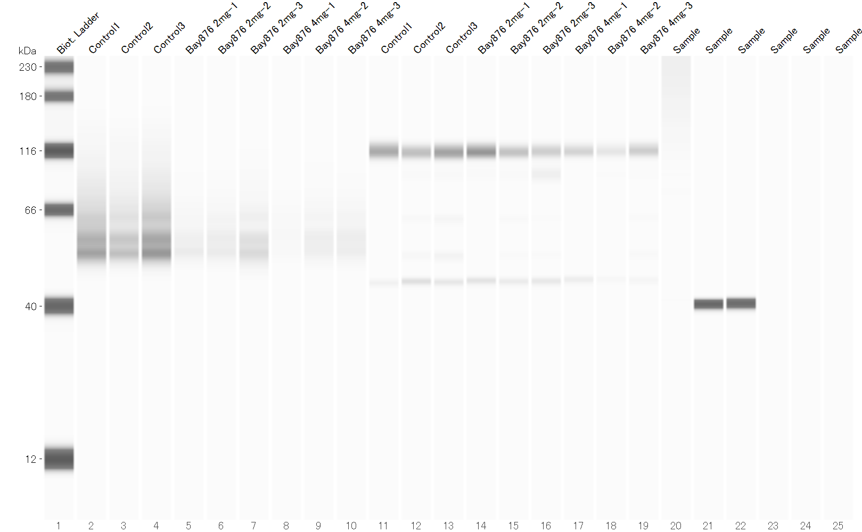
Supplementary Figure 7
GLUT1
β-actin
Short exposure
Long exposure
Supplementary Figure 7. Full-length blots of the Figure 6D samples.
The red lines indicate cropped areas.

Slide 12
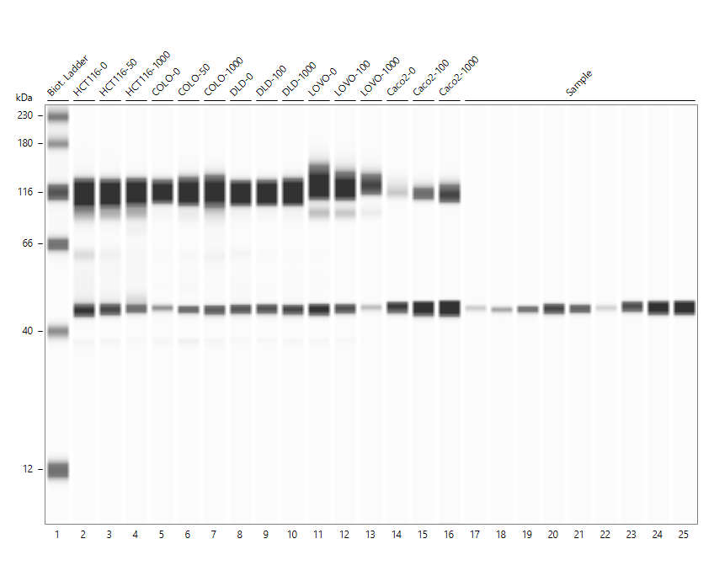
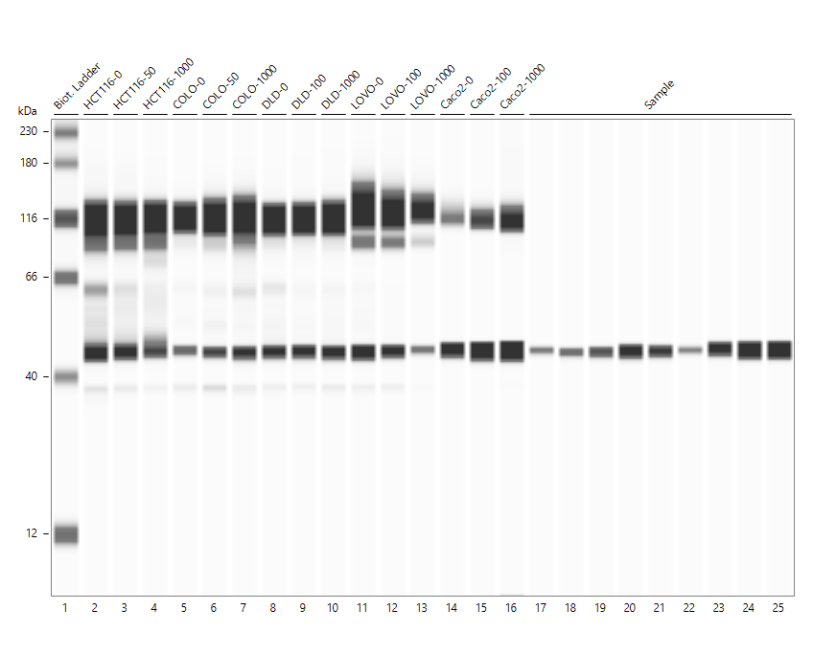
Supplementary Figure 8
PARP, Cleaved PARP
β-actin
Short exposure
Long exposure
Supplementary Figure 8. Full-length blots of the Supplementary Figure 3 samples.
The red lines indicate cropped areas.

Slide 13
Supplementary Figure 9
PARP, Cleaved PARP
β-actin
Long exposure
Supplementary Figure 9. Full-length blots of the Supplementary Figure 4 samples.
The red lines indicate cropped areas.

Slide 14
Supplementary Table1
cell lines | KRAS | BRAF
HCT116 | Mut (G13D) | WT
COLO205 | WT | Mut (V600E)
DLD1 | Mut (G13D) | WT
LoVo | Mut (G13D) | WT
Caco-2 | WT | WT
Mutation status of the colorectal cancer cell lines (WT: wild type, Mut: mutated).

Slide 15
Supplementary Table2
GAPDH (Glyceraldehyde-3-phosphate dehydrogenase) | F | ACAACTTTGGTATCGTGGAAGG
 | R | GCCATCACGCCACAGTTTC
SLC2A1(GLUT1) | F | GGCCAAGAGTGTGCTAAAGAA
 | R | ACAGCGTTGATGCCAGACAG
Sequences of the quantitative RT-PCR primers.

