Slide 1
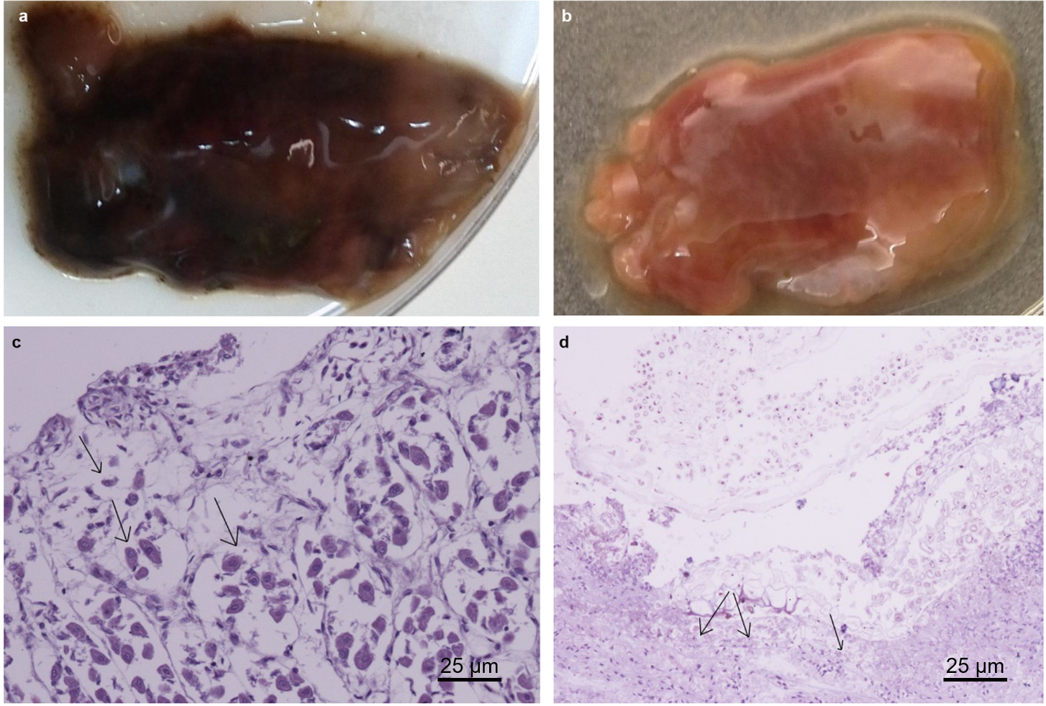
Supplementary Figure 1 Samples for histological examination. a Image and c histological examination of the intestinal mucosa of Marmota himalayana without H. himalayensis isolated (hematoxylin-eosin, original magnification ×100). A black arrow indicates normal histoarchitecture of the intestinal mucosa. b Image and d pathological examination of the intestinal mucosa of Marmota himalayana where H. himalayensis was isolated (hematoxylin-eosin, original magnification ×100). A black arrow indicates necrosis area and/or lesion area of the intestinal mucosa.

