Slide 1
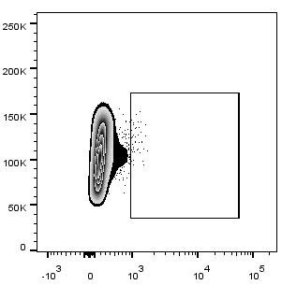
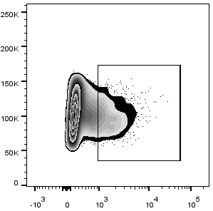
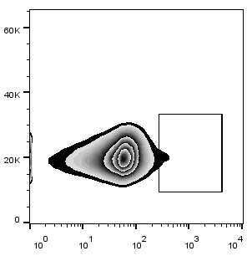
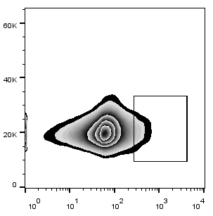
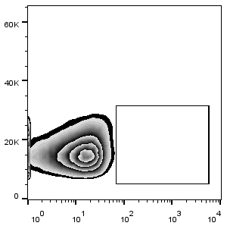
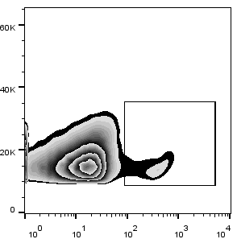
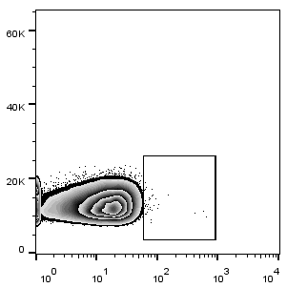
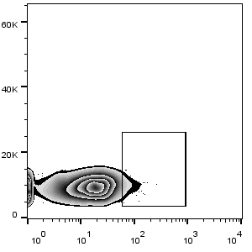
Supplementary Figures
MOLM-13 Isotype
MOLM-13
MV-4-11 Isotype
MV-4-11
8.7%
2.43%
SSC
KG-1α Isotype
KG-1α
U937 Isotype
U937
2.44%
1.9%
CD9
Figure.S1 Flow cytometry was used to detect the expression of CD9 in AML cell lines

Slide 2
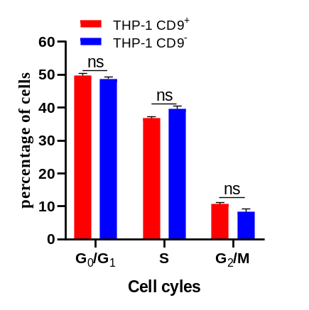
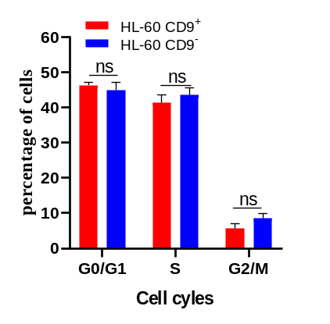
Fig. S2 Flow cytometry detects the cell cycle of CD9⁺ and CD9⁻ cells. *p<0.05, **p<0.01, ***p<0.001.

Slide 3
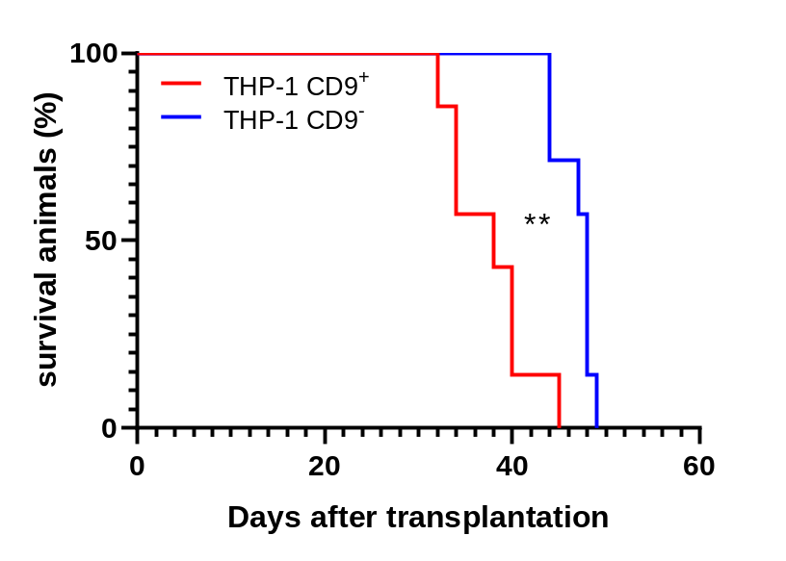
Fig. S3 Survival curve of mice transplanted with CD9⁺ THP-1 cell (n=7) and CD9⁻ THP-1 cells (n=7) (1X10⁶ cells/mouse).

Slide 4
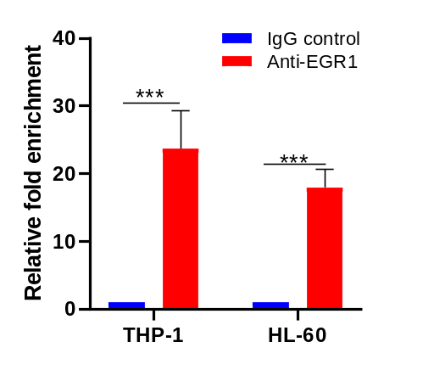
Figure.S4 ChIP was used to verified the binding of transcription factor EGR1 to the promoter of CD9. *p<0.05, **p<0.01, ***p<0.001.

