Slide 1
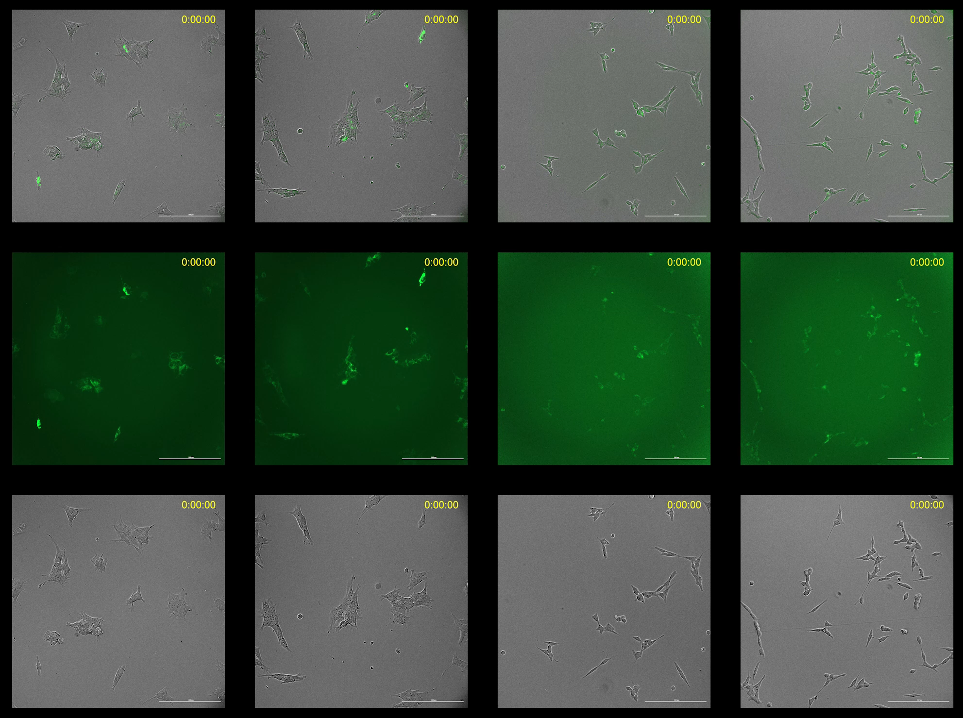
SK-N-BE(2)
CHP134
CTRL
RA
CTRL
RA
OMP25-GFP
+
Bright field
OMP25-GFP
Bright field

Slide 2
Video legend
SK-N-BE(2) and CHP134 cells expressing OMP25-GFP were plated in 96-well plates and treated with 1 µM RA, 1 µM NEN, a combination of RA+NEN, or vehicle control. Imaging was performed every hour for up to 70 hours using the Cytation 5 system, capturing both brightfield and GFP channels. The Cytation 5 system provided stable conditions at 37°C with 5% CO₂ throughout the experiment.

