Slide 1
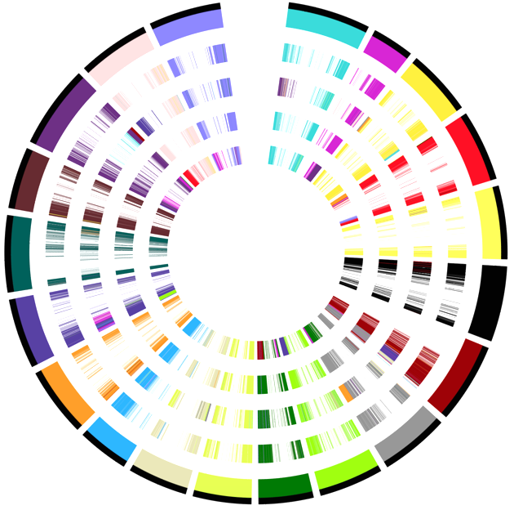
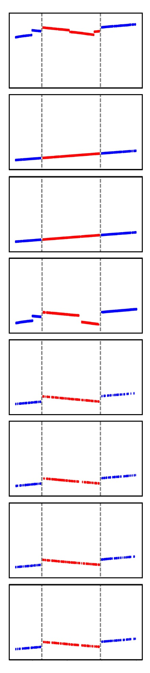
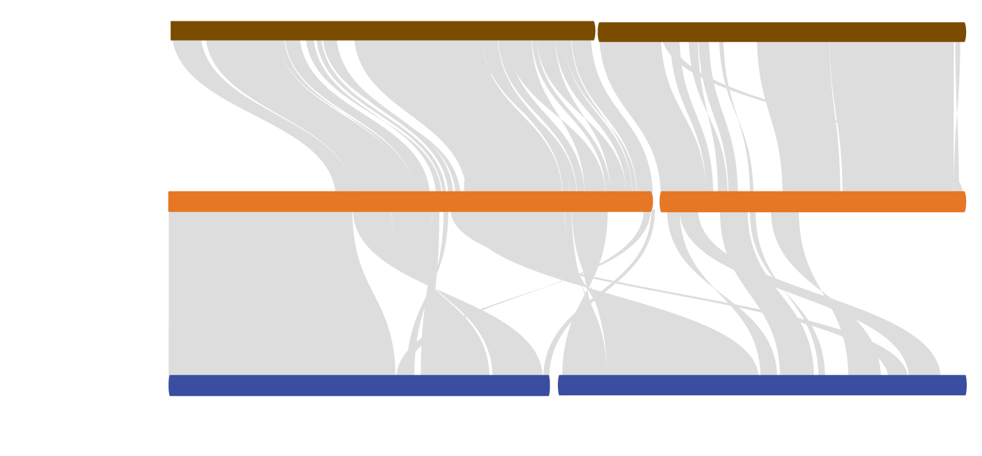
a b
chr20
F
chr01
Phaseolus vulgaris (Pv)
chr19
B
chr02
chr18
C
chr03
Glycine max (G^{m})
A
Glycine soja (G^{s})
chr17
D
chr04
chr05
Glycine falcate (F)
chr16
G. falcata as
reference
Glycine stenophita (B)
chr06
Glycine cyrtoloba (C)
chr15
Glycine syndetika (A)
chr07
chr14
Glycine tomentella D3 (D)
chr13
chr08
chr12
chr10
chr09
6,523,562
9,910,953 bp
chr11
Glycine max Chr17
c
F
A
D
Chr08 Chr10
Supplementary Fig. 1 | Genomic collinearity and rearrangements among the annual and perennial Glycine species. a, Syntenic plots of perennial Glycine species. b, Illustration of an segmental inversion occurred in the annual Glycine lineage. c, Illustration of chromosomal rearrangements involving chromosomes 8 and 10 of the A, D, and F genomes.

Slide 2
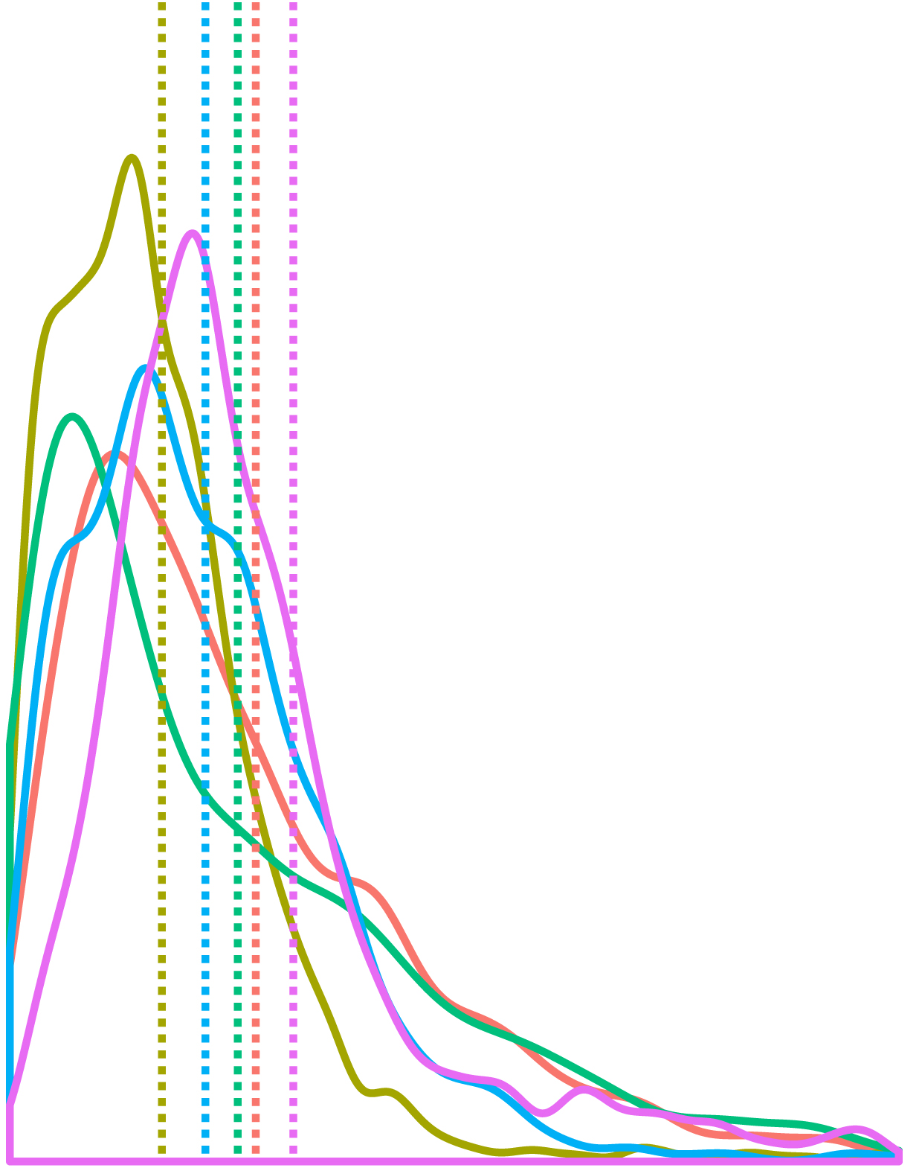
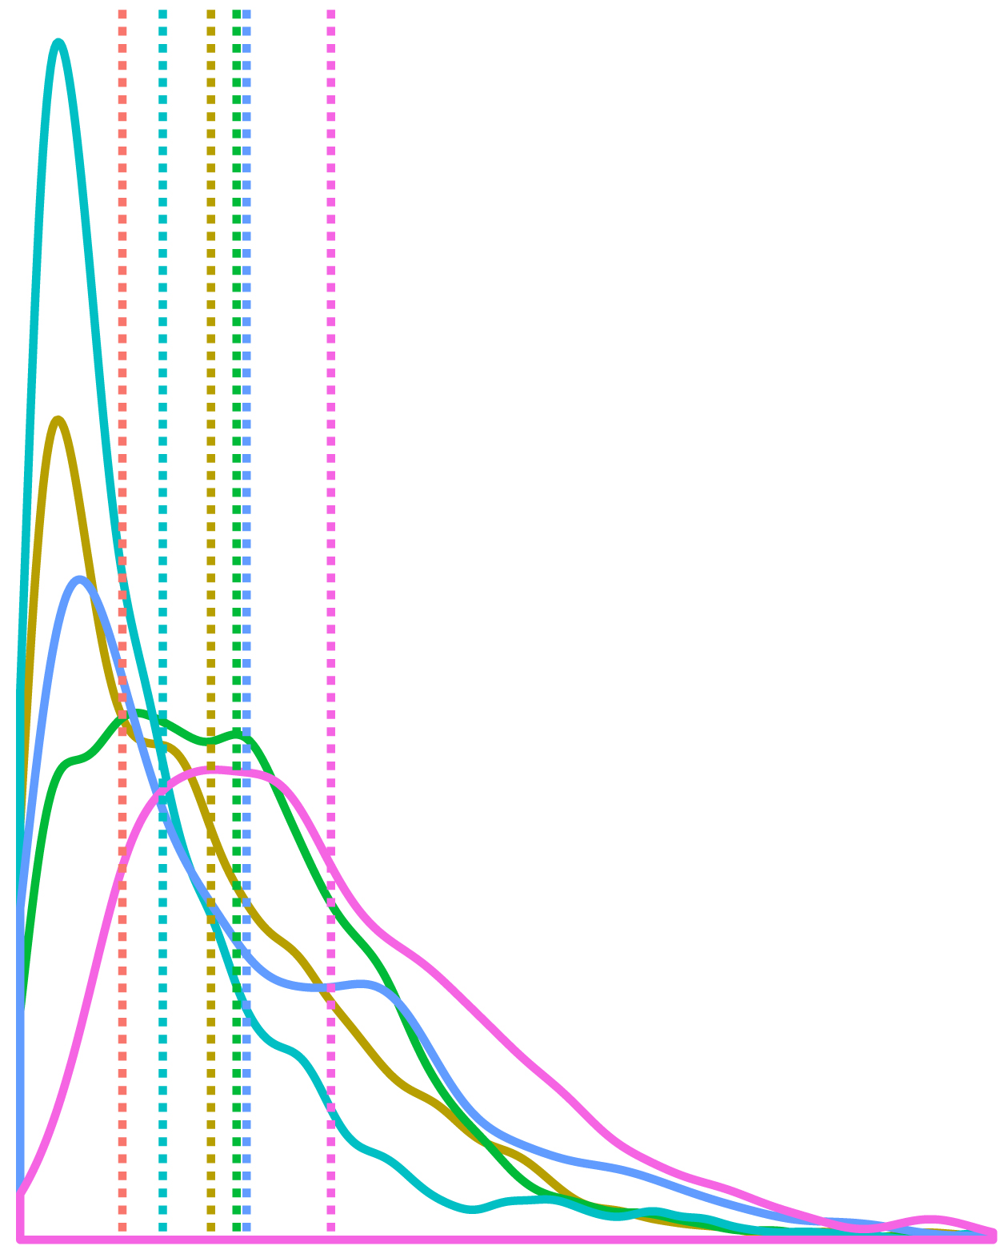
a
b
c
2.0
Annual
Perennials
1.50
C genome
F genome
1.25
Pc6
Pc947
Pg1
1.5
Pg1
1.00
Pg1227
Pg11
Ratios of solo LTRs
to intact elements
Relative abundances
Pg2
Pg5
Pg51
Relative abundances
Pg51
0.75
1.0
0.50
0.5
0.25
G^{m} F B C A D
0.00
0.0 0.5 1.0 1.5 2.0 2.5 3.0
0.0
Insertion time (MYA)
Insertion time (MYA)
0.0 0.5 1.0 1.5 2.0 2.5 3.0
d
G^{m}
C
F
A
B
D
Family sizes
copia-LTR-RT families
e
G^{m}
C
F
A
B
D
Family sizes
gypsy-LTR-RT families
Supplementary Fig. 2 | Comparison of LTR-retrotransposons in the annual and perennial Glycine species. a, Ratios of solo LTRs to intact LTR-retrotransposons identified in each genome. b, c, Relative abundances and insertion times of LTR-RTs belonging to the five largest families in G. cyrtoloba (b) and G. falcata (c). A mutation rate of 1.3x10⁻⁸ per nucleotide per year was used for estimation of insertion times of individual LTR-RTs. d, e, Relative abundances of LTR-RTs belonging to the five most abundant copia-LTR-RT families (d) and the five most abundant gypsy-LTR-RT families (e) in the G. max and each perennial genomes.

Slide 3
a
1.0
Probability
0.5
0.0
1.0
0.5
Conservation
0.0
1 5 10 15 20 25 30 35 40 45
1.0
Position
Probability
0.5
0.0
1.0
Conservation
0.5
0.0
46 50 55 60 65 70 75 80 85 90
b
Position
G^{m}-cent1
G^{m}-cent2
F-Cent
1 5 10 15 20 25 30 35 40 45
G^{m}-cent1
Position
G^{m}-cent2
F-Cent
46 50 55 60 65 70 75 80 85 90
Position
Supplementary Fig. 3 | Comparison of centromeric satellite repeat families, G^{m}-Cent1, G^{m}-Cent2, and G^{f}-Cent. a, Consensus sequence of G^{f}-Cent constructed based on 500 G^{f}-Cent repeats randomly selected from the F genome, the orange bars indicate highly variable nucleotide positions (<0.7). b, Alignment of representative G^{m}-Cent1, G^{m}-Cent2 and G^{f}-Cent repeats.

Slide 4
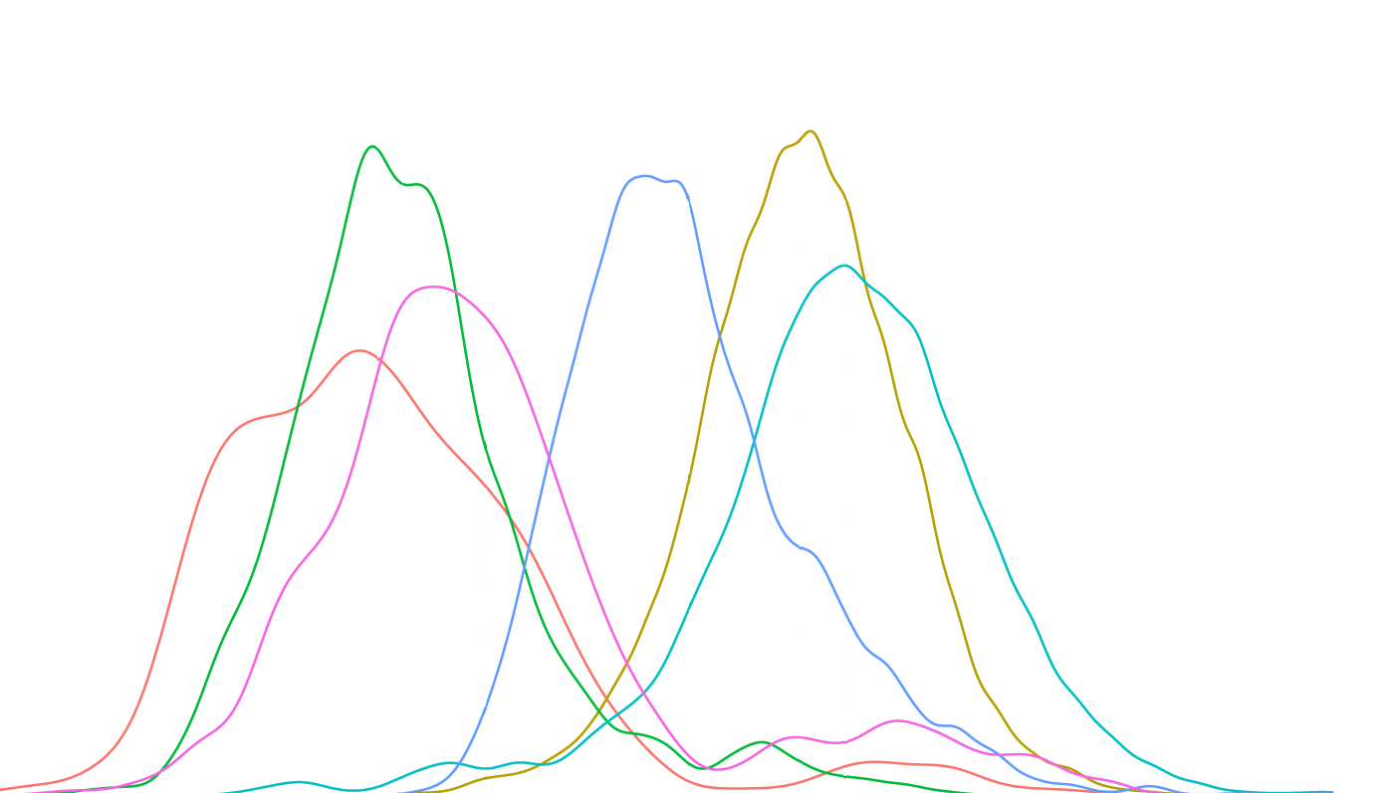
a
0.5
3.69
F-Cent vs. F-Cent
3.94
6.72
7.81
8.25
G^{m}-Cent1 vs. G^{m}-Cent1
0.4
G^{m}-Cent2 vs. G^{m}-Cent2
4.74
G^{m}-Cent2 vs. F-Cent
0.3
G^{m}-Cent1 vs. F-Cent
Relative Abundances
G^{m}-Cent1 vs. G^{m}-Cent2
0.2
0.1
0.0
0.0 2. 5 5.0 7.5 10.0 12.5
Divergence times (MYA)
b c d
100
Gmr1
100
Gmr17
100
Gfa2209
80
80
80
60
60
60
40
40
40
Enzyme found (%)
Enzyme found (%)
Enzyme found (%)
20
20
20
0
AP
RT
0
AP
0
AP
RT
GAP
INT
GAP
INT
RT
GAP
INT
RNaseH
RNaseH
RNaseH
G^{m}-Cent2 associated
G^{m}-Cent1 associated
G^{f}-Cent associated
Supplementary Fig. 4 | Analysis of centromeric satellite repeats and their associated centromeric retrotransposon families in the G. max and perennial Glycine species. a, Estimation of the divergent times of G^{m}-Cent1, G^{m}-Cent2, and G^{f}-Cent repeats. A mutation rate of 1.3x10⁻⁸ per nucleotide per year was used for estimation of divergence times. b, c, d, Relative abundance of putative centromere retrotransposon families with detected internal sequences, which were predicted to encode five key enzymes (GAP, AP, INT, RT and RNaseH).

Slide 5
a
55
b
c
d
60
Singleton
50
50
Duplicates
45
40
Number of core orthologs
(x1000)
Singletons in perennials
shared by G^{m} (%)
Duplicates in perennials
shared by G^{m} (%)
Singletons and duplicates
In each genomes (%)
40
30
35
20
35
10
0
0 5 10 15 20 26
G^{m} F B C A D
Samples included
Supplementary Fig. 5 | Relative abundances of singletons and duplicated genes in G. max and the perennial Glycine genomes. a, The numbers of core genes identified in annual Glycine datasets. b, c, Bar plot showing the number of shared singletons (b) and duplicated genes (c) between G. max and individual perennial genomes. (d) Proportions of singletons and duplicates identified in individual genomes. Undefined categories of genes such as tandem duplicates were not shown in the plots.

Slide 6
Proportions of core genes
and non-core genes
F B C A D F B C A D
Duplicates Singletons
Core genes
Non-core genes
Supplementary Fig. 6 | Proportions of core genes and non-core genes belonging to categories of singletons and duplicated genes retained from the shared ~13-MYA WGD event by the Annual and perennial linages.

Slide 7
a
Ka/Ka within G. soja species
b
flowering gene tested
Ka/Ka within perennial species
flowering gene tested
PHP
AP2
Supplementary Fig. 7 | Analysis of Ka/Ks of soybean genes orthologous to the Arabidopsis flowering network genes. Two soybean genes orthologous to the Arabidopsis PHP and AP2, showed adaptive evolution between annual and perennial Glycine lineages. a, Ka/Ks calculated for the annual group composed of G. soja accessions. b, Ka/Ks calculated for perennial Glycine species.

Slide 8
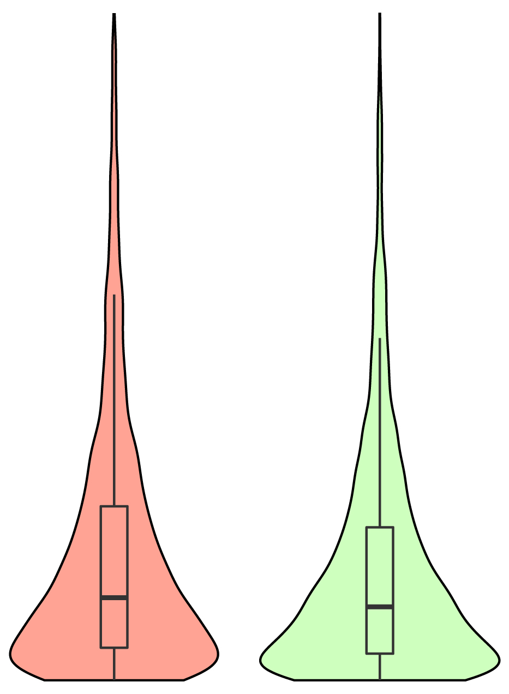
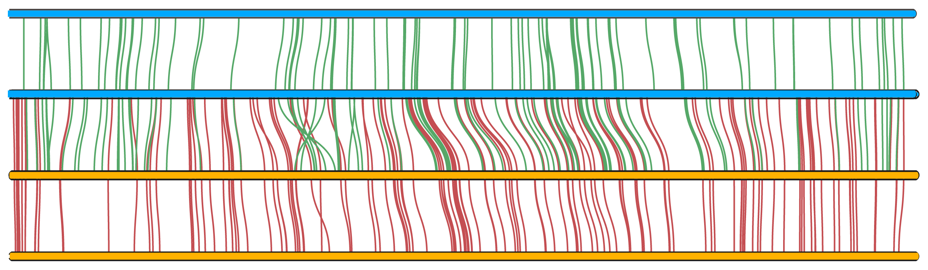
a b c d
A^{t}
D^{t}
100
100
6
**
80
80
5
60
*
4
Percentages of genes showing
lower Ka/Ks values than their
respective orthologs (%)
60
*
Percentages of genes showing
higher levels of expression than
their respective orthologs (%)
Distance of upstream TEs to
promoters of orthologs (x10kb)
Numbers of homoeologs lost
in the recent allopolyploid
40
40
3
20
2
20
0
1
1 5 10 15 20
0
A D
A D
0
High Low
e
Chromosomes
Ortholog expression
A^{t}
Chr01
A
Chr1
D
Chr01
D^{t}
Chr21
Supplementary Fig. 8 | Subgenome fractionation in the recent allopolyploid and genomic features in its ancestral diploids. a, Biased fractionation between subgenome A^{t} and D^{t} as reflected by numbers of gene losses. b, Difference of levels of ortholog expression between the A and D genomes. c, Difference of stringencies of purifying selection of orthologs between the A and D genome. d, Association between gene expressions and distances to upstream TEs. e, Distribution of lost genes in A^{t} and D^{t} detected by comparison among the two subgenomes and their two ancestral diploid genomes.

Slide 9
a
125
100
75
Numbers of TEs within genes
50
25
0
0 1500 3000 4500 6000 7500 9000 10500 12000 13500 15000 (kb)
b
Sizes of TEs within genes
Intron
Exon
Number of TEs within genes
Types of TEs within genes
Supplementary Fig. 9 | Contribution of transposon insertions within genes to subgenome fractionation in in the recent allopolyploid. a, Size of TEs inserted into genes. b, types of TEs inserted into introns and exons of genes. copia and gypsy refer to the two class of LTR-RTs.

Slide 10
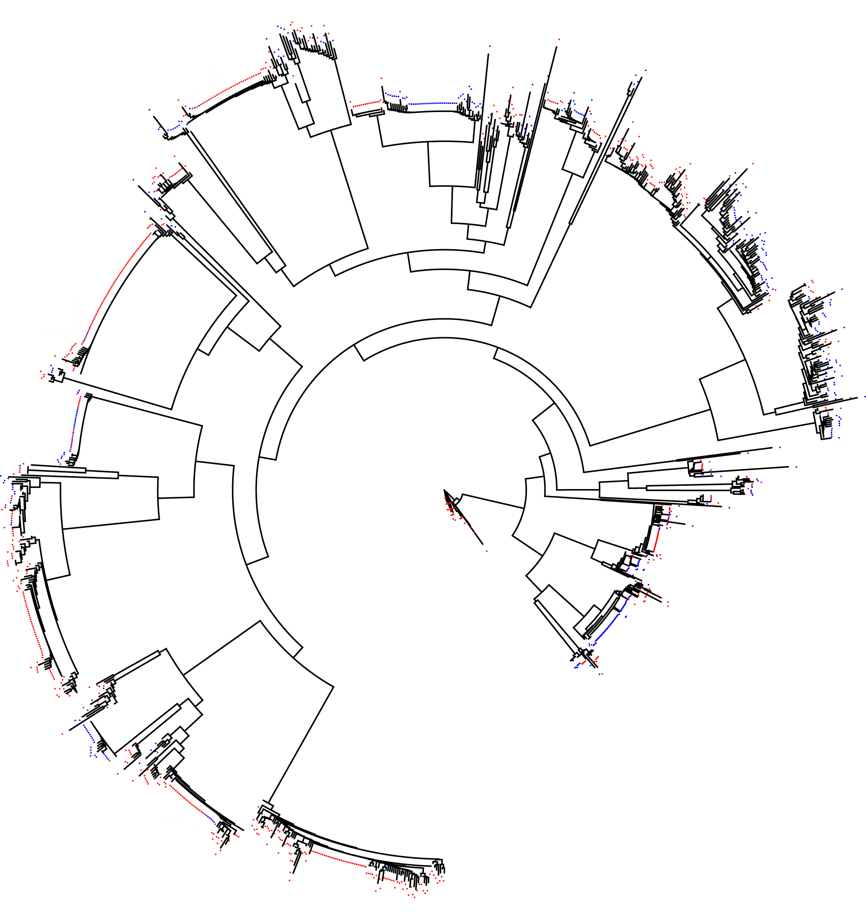



copia LTR-RT located in At
copia LTR-RT located in D^{t}
0.1
Supplementary Fig. 10 | Neighbor-joining tree of young (<0.35 MY) copia-LTR-RTs in the two subgenomes of the recent allopolyploid. Highlighted elements represent nearly identical elements amplified from one of the two subgenomes and inserted into the other subgenome. after the recent allopolyploidy event.

Slide 11
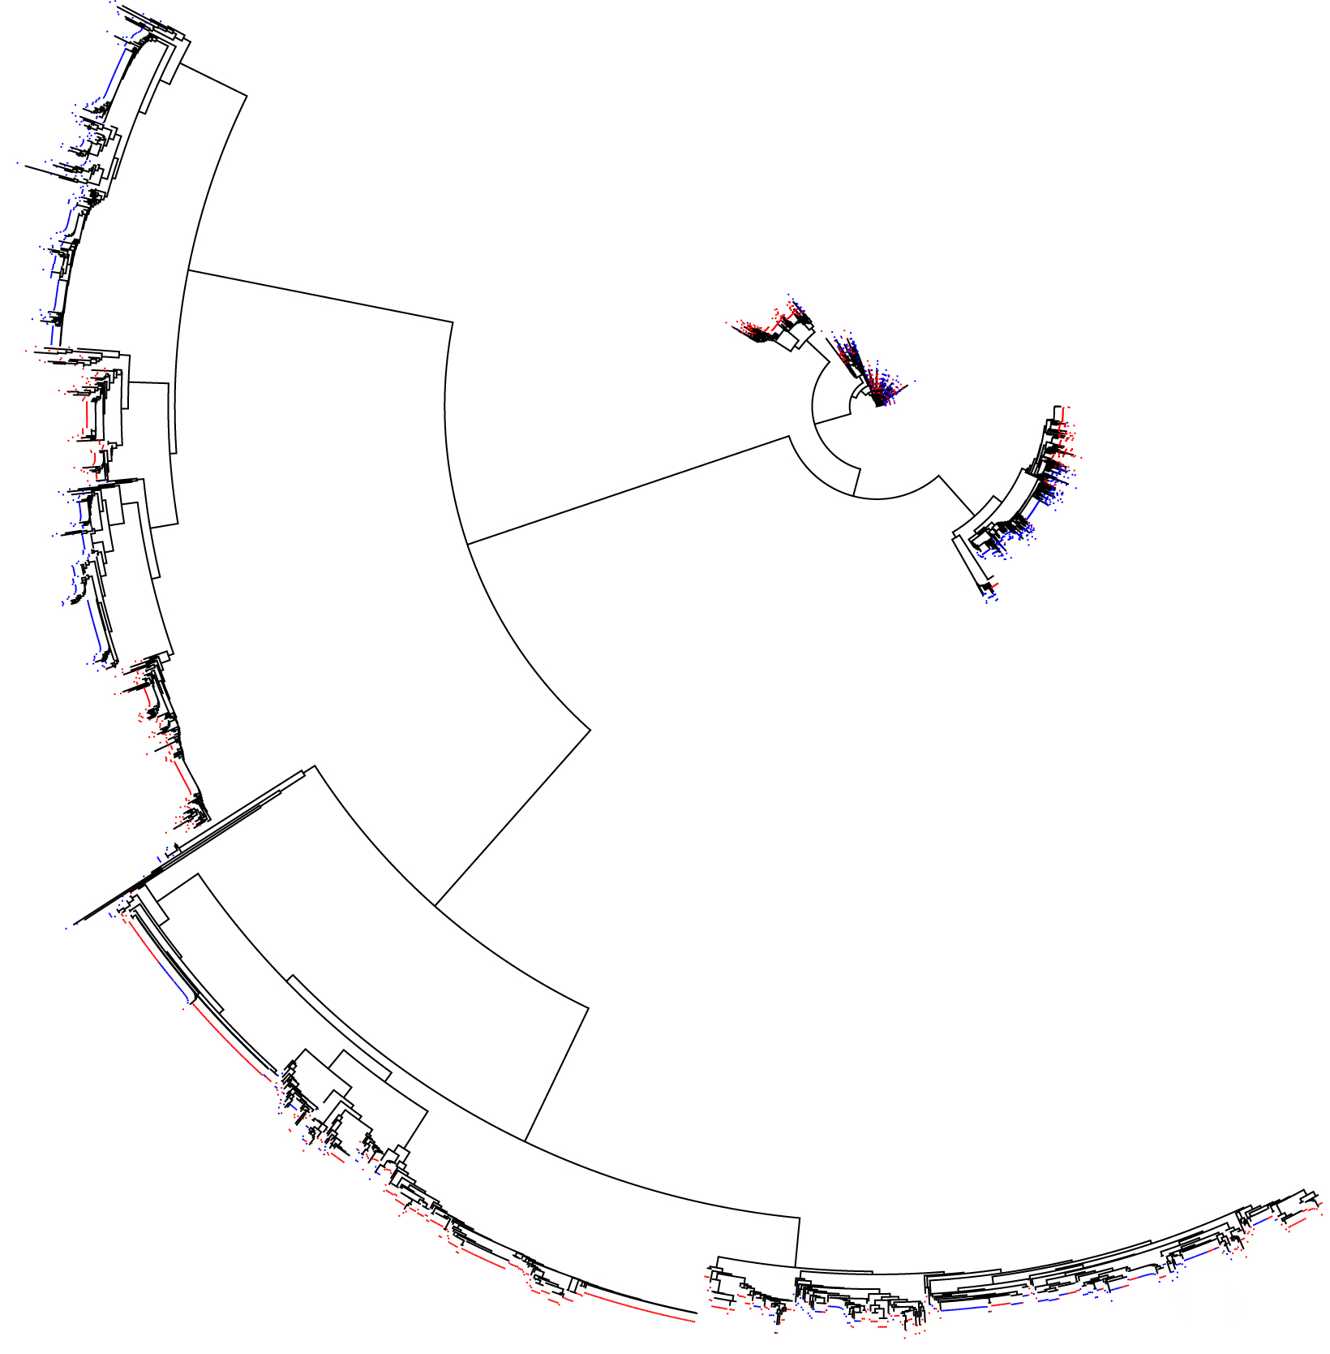
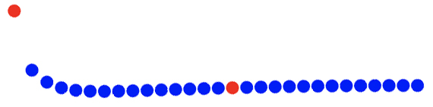
gypsy LTR-RT located on At
gypsy LTR-RT located on D^{t}
0.1
Supplementary Fig. 11 | Neighbor-joining tree of young (<0.35 MY) gypsy-LTR-RTs in the two subgenomes of the recent allopolyploid. Highlighted elements represent nearly identical elements amplified from one of the two subgenomes and inserted into the other subgenome after the recent allopolyploidy event.

Slide 12
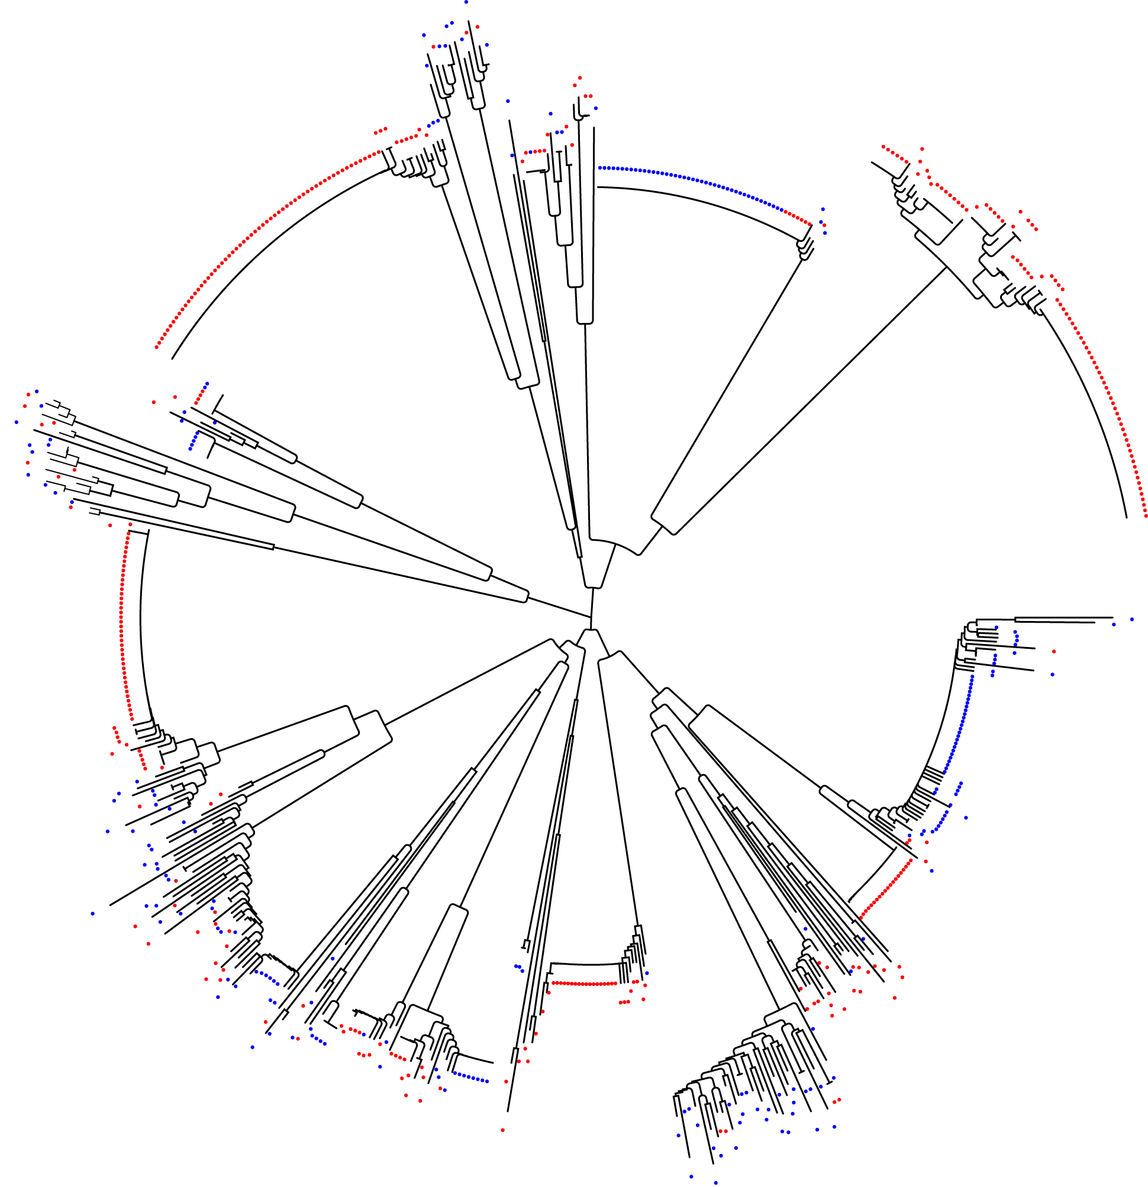
0.1
Copia LTR-RT located in A
Copia LTR-RT located in D
Supplementary Fig. 12 | Neighbor-joining tree of young (<0.35 MY) copia-LTR-RTs from in the A and D genomes. No nearly identical elements in A and D were found.

Slide 13
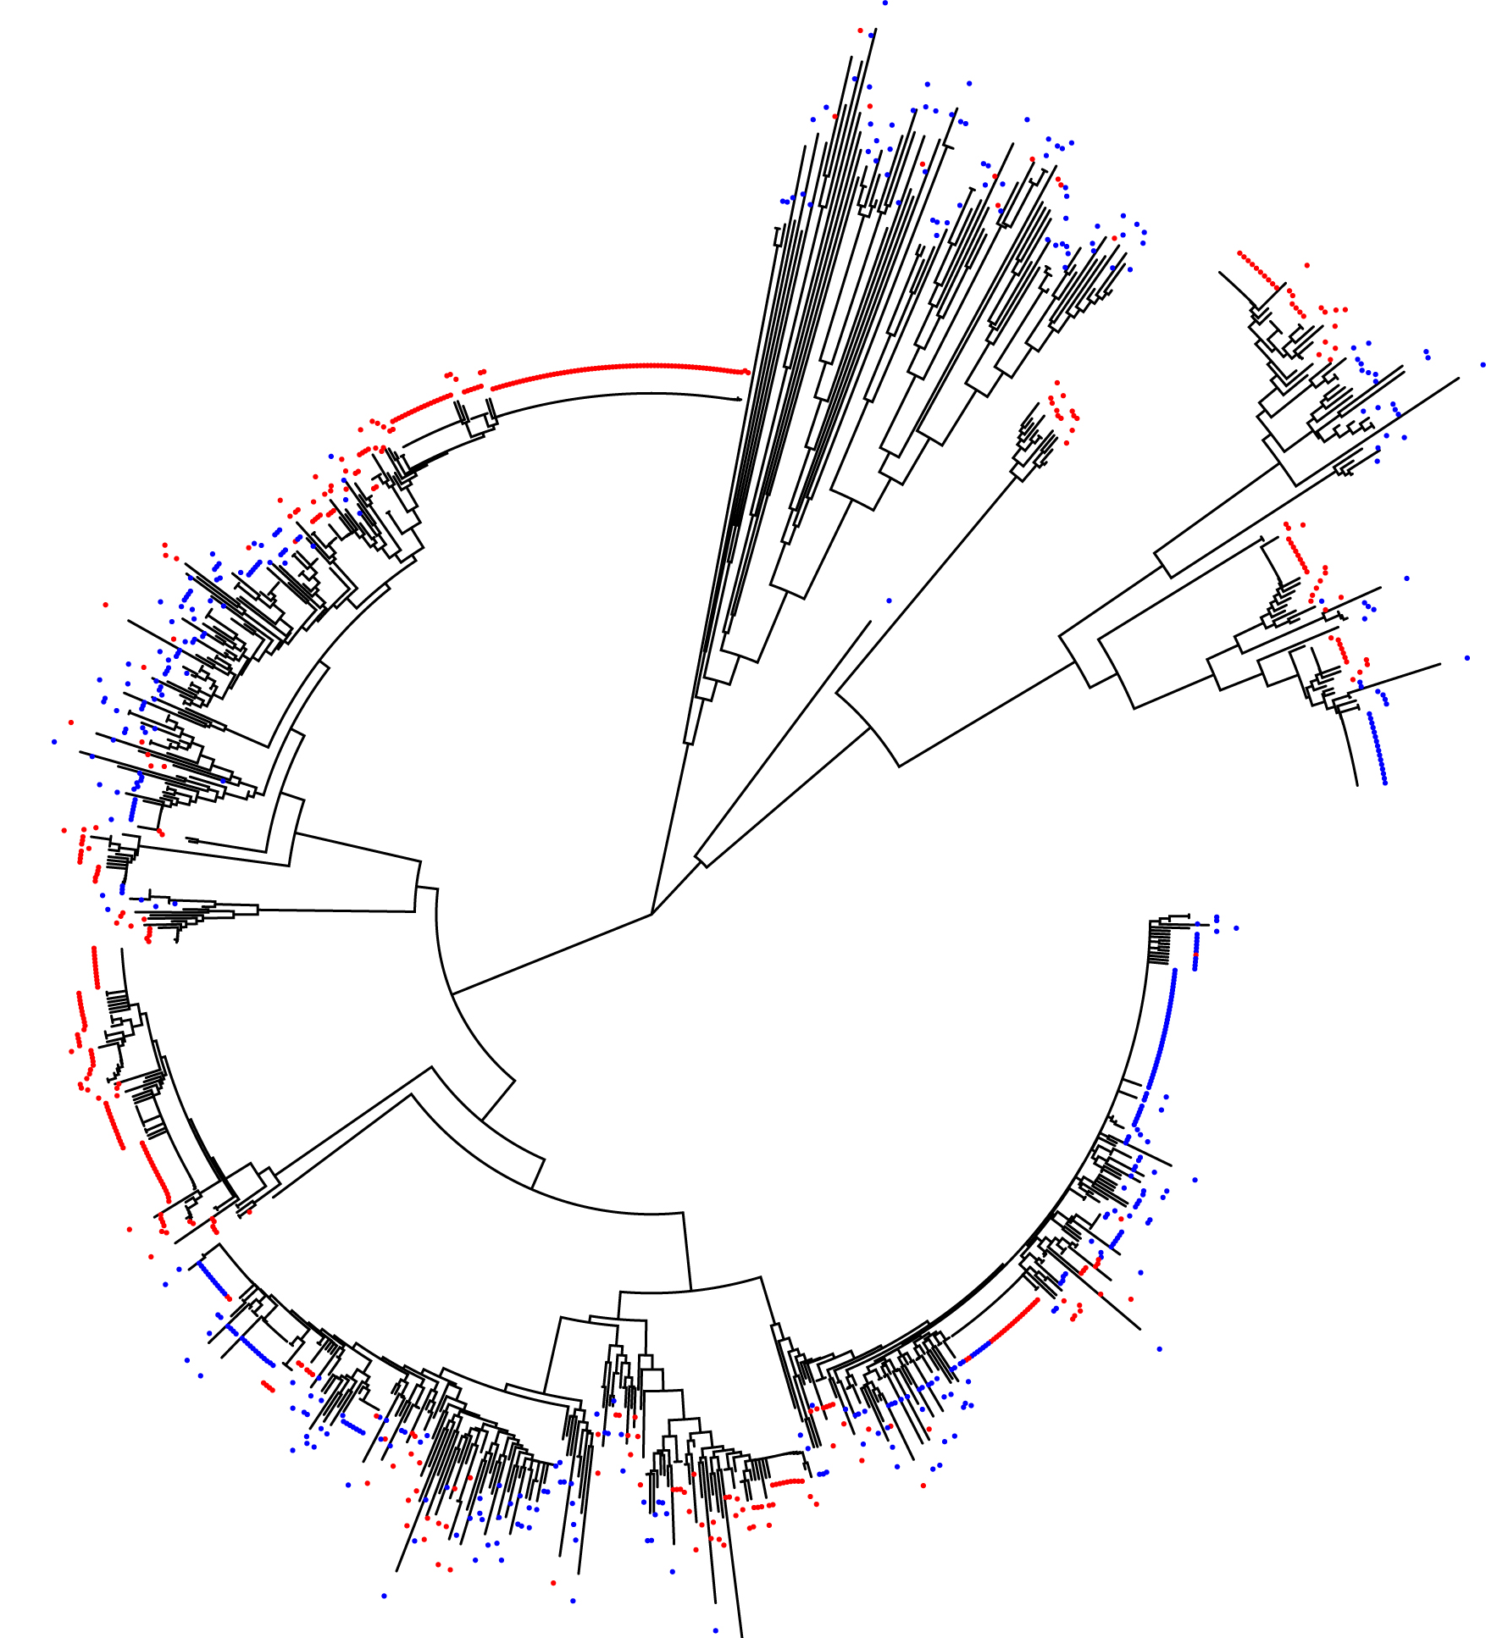
0.1
gypsy LTR-RT located on A
gypsy LTR-RT located on D
Supplementary Fig. 13 | Neighbor-joining tree of young (<0.35 MY) gypsy-LTR-RTs from in the A and D genomes. No nearly identical elements in A and D were found.

