Slide 1
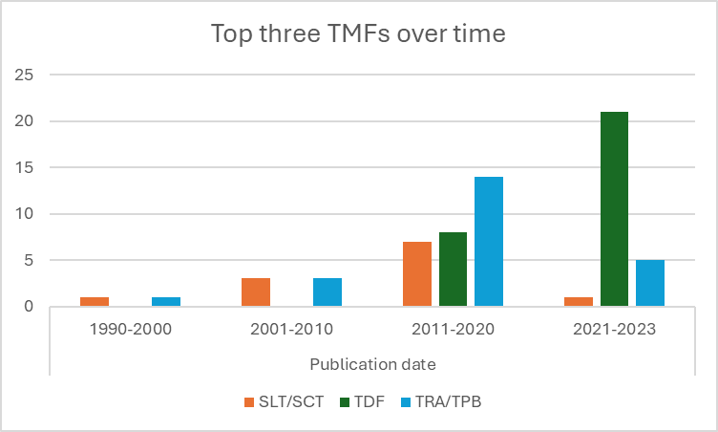
Supplementary Figure 1. Top three TMFs (most often utilised in sample) mapped across time

Slide 2
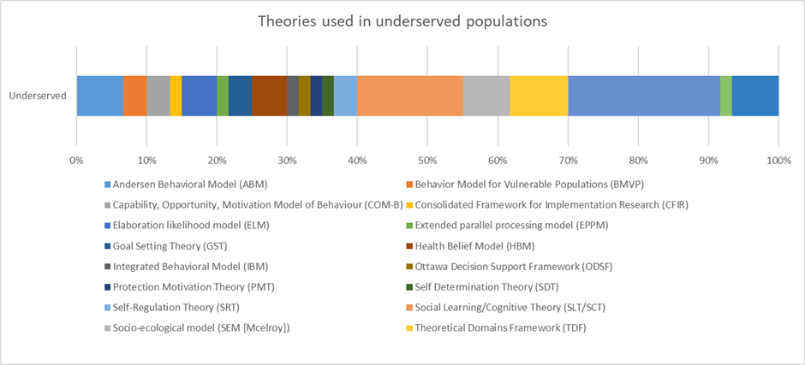
Supplementary Figure 2. Breakdown of which TMFs are used in publications focusing on underserved groups

