Slide 1
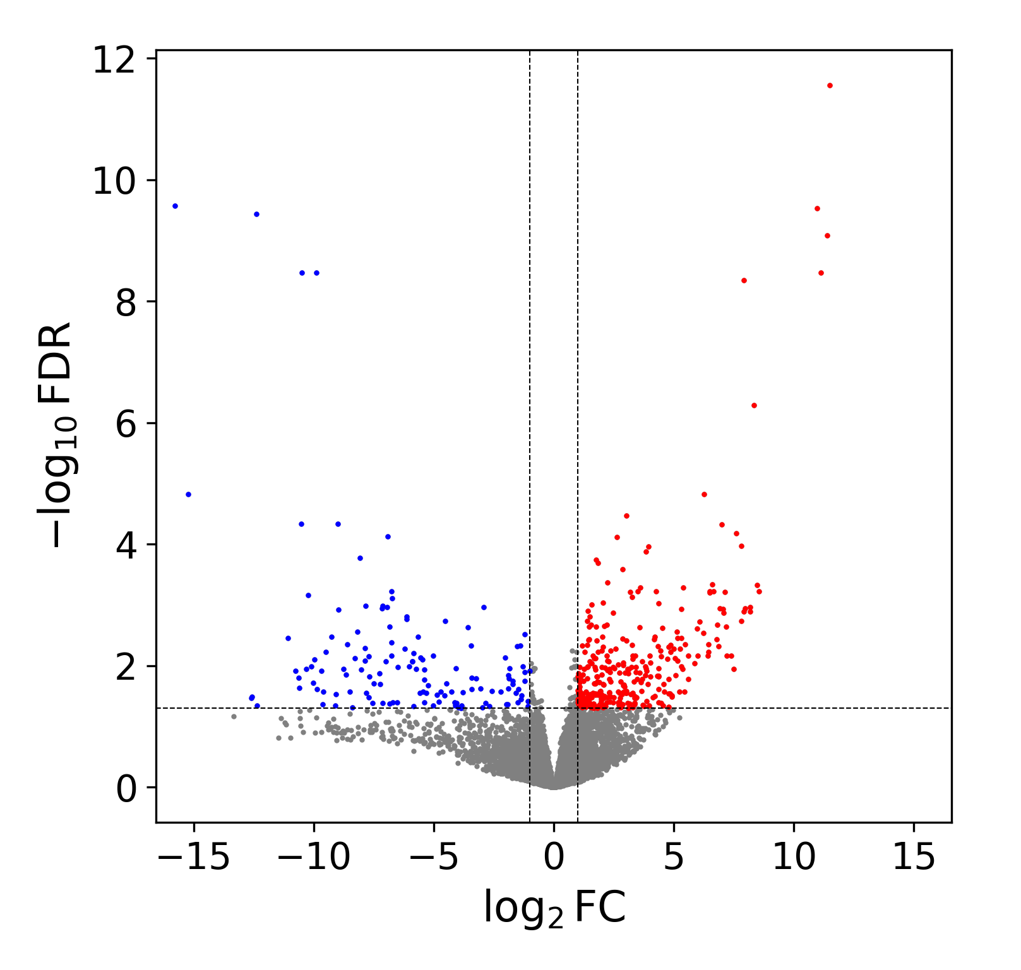
KLHL13
PHACTR3
CLSTN2
HLF
PBX1
HPGD
RORB
BEND4
MMP25
RUBCNL
WNT16
B3GNT7
C3AR1
FCGR1A
KLRK1
Fig. S11a: The volcano plot displays up-regulated (red dots) and down-regulated (blue dots) genes in TCF3::HLF-positive leukemia cell lines compared to TCF3::PBX1-positive leukemia cell lines.

Slide 2
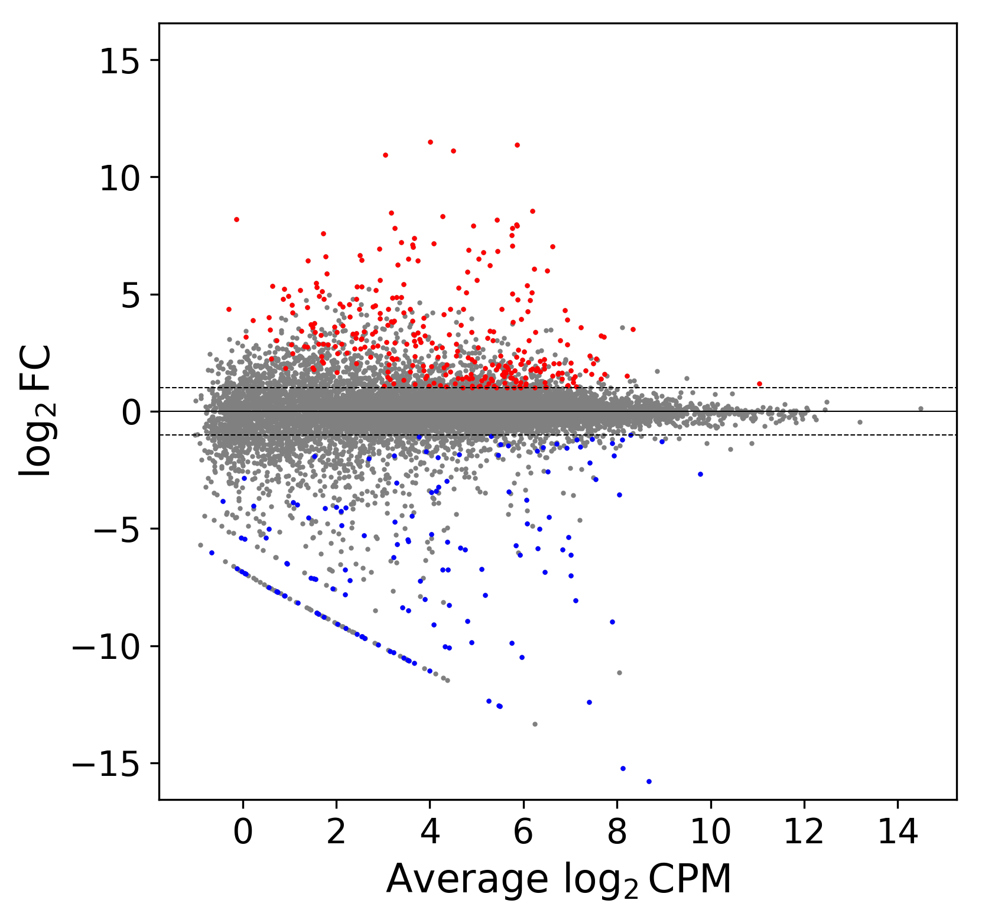
KLHL13
HPGD
CLSTN2
HLF
MCOLN2
RUBCNL
H2AC13
H2BC4
PHACTR3
TCERG1L
WNT16
GREM1
PBX1
Fig. S11b: The MA plot highlights significant number of up-regulated genes (depicted as red dots) in contrast to the down-regulated genes (represented by blue dots) observed in TCF3::HLF-positive leukemia cell lines compared to TCF3::PBX1-positive leukemia cell lines.

