Slide 1
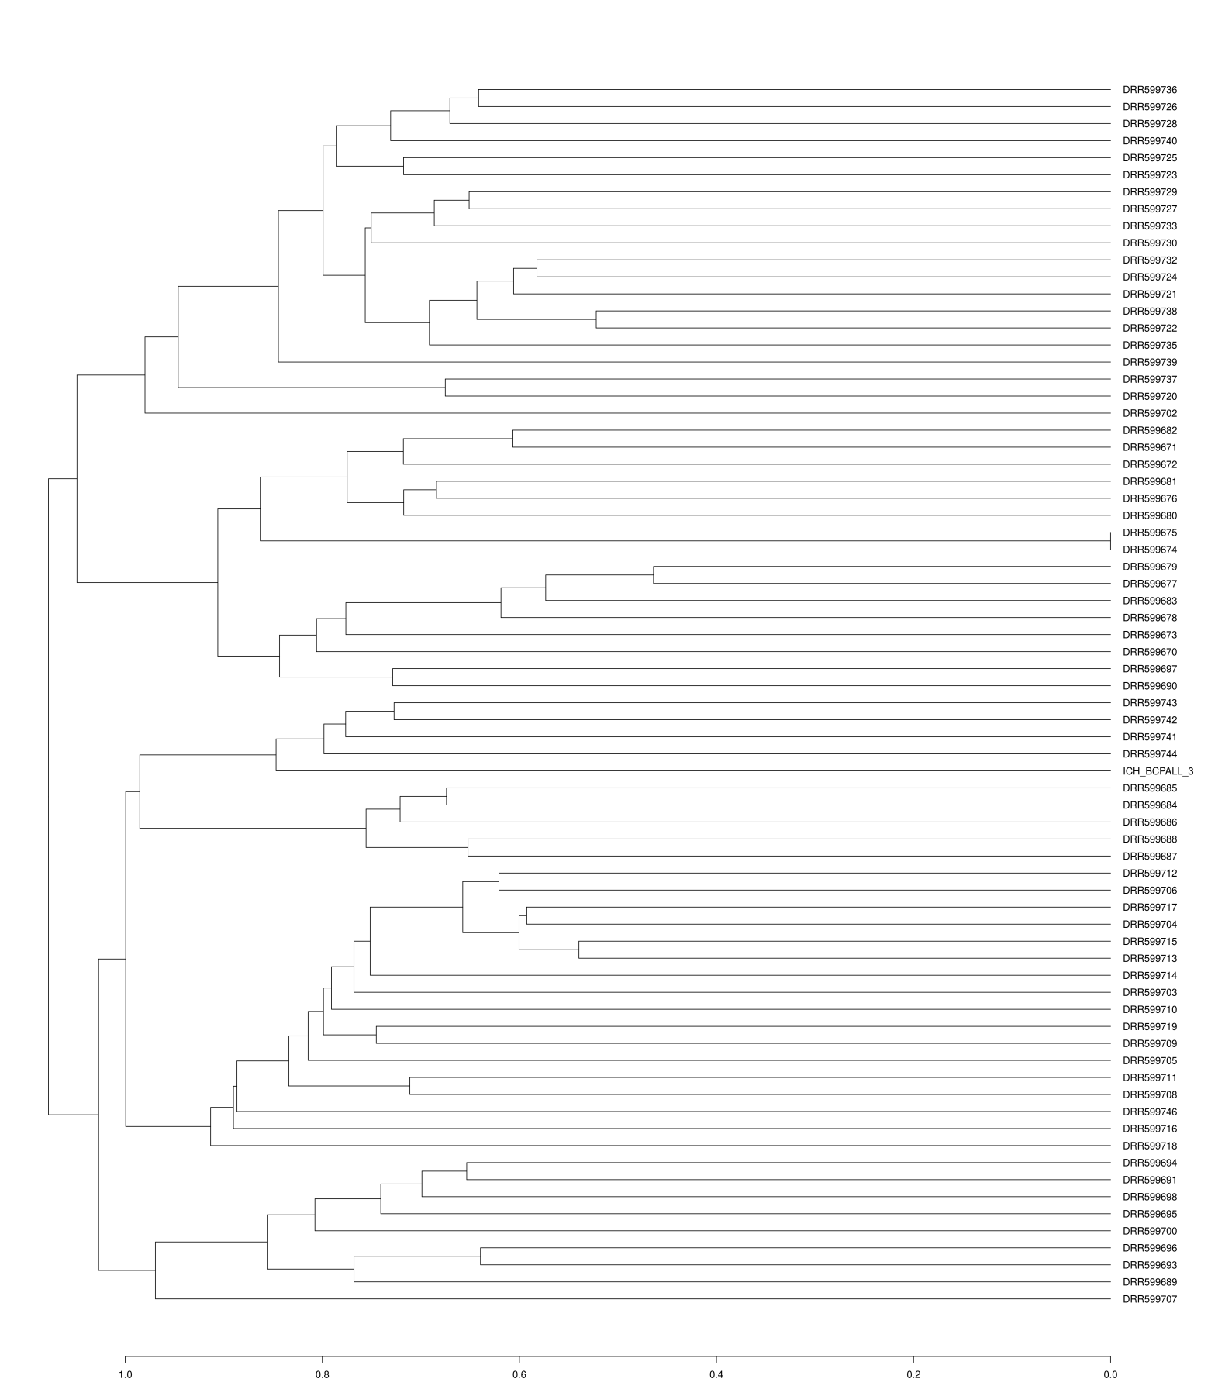
Figure S15: A dendrogram shows that hierarchical cluster analysis identifies a distinct cluster of TCF3::HLF-positive cell lines, as indicated by the red arrow (DRR599741-DRR599744 and ICH_BCPALL_3).

