Slide 1
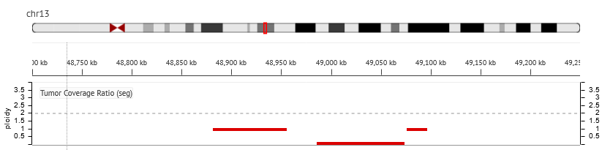
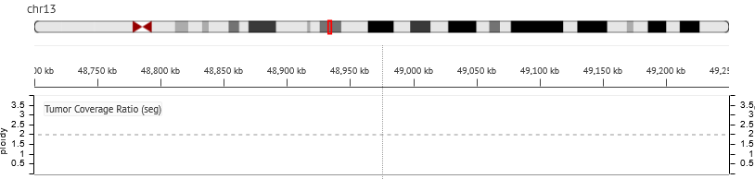
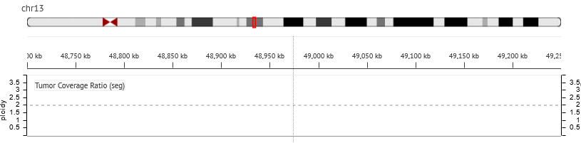
RB1
Fig. S7a:The copy number variation plot of part of chromosome 13 (chr13:48700000-49250000 on GRCh37/hg19). The upper is of the diagnostic sample, the middle is of the recurrent sample, and the bottom is of the cell line. Note that the diagnostic sample showed deletion of RB1 (chr13:48,877,888-49,056,026), which is almost entirely occupied by ploidy 0 or ploidy 1 region.

Slide 2
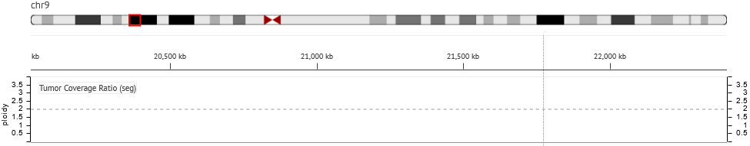
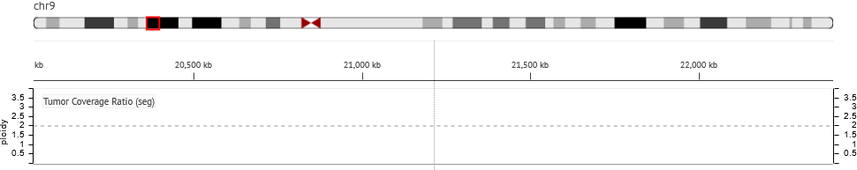
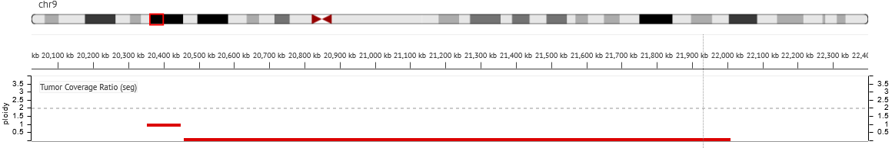
MLLT3
CDKN2A/2B
Fig. S7b:The copy number variation plot of part of chromosome 9(chr9:20025000-22400000 onGRCh37/hg19). The upper is of the diagnostic sample, the middle is of the recurrent sample, and the bottom is of the cell line. Note the cell line showed deletion of MLLT3 (chr9:20341668-20622498) with ploidy 0 or ploidy 1 and CDKN2A(chr9:21,967,752-21,995,323)/CDKN2B(chr9:22002903-22009312) with ploidy 0.

