Slide 1
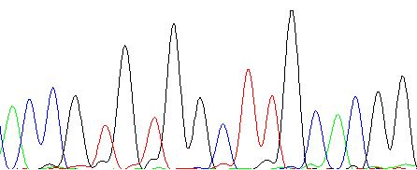
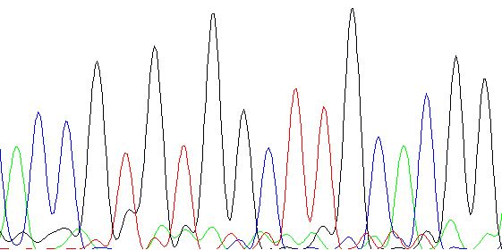
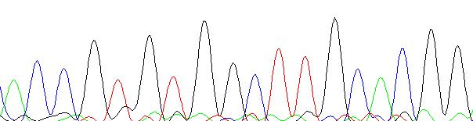
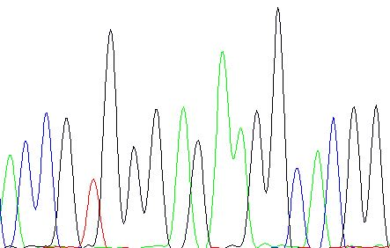
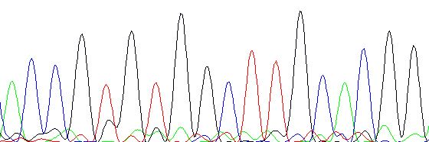
A C C G T G T G G C T T G C A C G G
A C C G T G T G G C T T G C A C G G
The sequence of the first relapse sample
A C C G T G T G G C T T G C A C G G
A normal allele of ARID5B exon 2 sequence in the diagnostic sample
A C C G T G G G A G A A G G C A C G G
The sequence of the second relapse sample
A C C G T G T G G C T T G C A C G G
A variant allele of ARID5B exon 2 sequence in the diagnostic sample
The sequence of nucleic acid extracted from the cultured cell
Fig. S8a:The results of Sanger sequencing and subcloning of ARID5B exon 2 sequence. A “TGGCTT (red letters in the upper left)” is replaced by “GGAGAAG (red letters in the bottom left)” in the variant allele sequence.

Slide 2
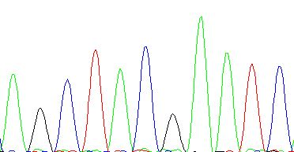
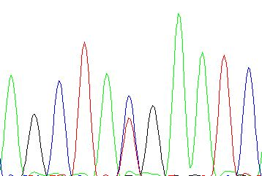
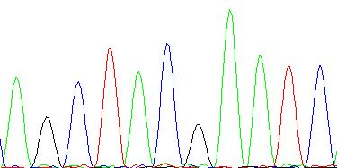
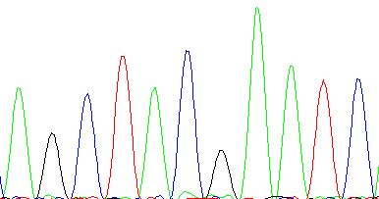
A G C T A C G A A T C
The sequence of the first relapse sample
A G C T A Y G A A T C
A G C T A C G A A T C
The sequence of the second recurrent sample
A G C T A C G A A T C
The NCOR1 exon 31 sequence of the diagnostic sample
The sequence of the second recurrent sample
Fig. S8b:The results of Sanger sequencing of NCOR1 exon 31 sequence. Note that a one-base substitution variant produced a stop codon in the diagnostic sample (c.5380C>T, left). There is no variant in the first relapse sample (upper right), the second relapse sample (middle right), and the cultured cell (bottom right ).

Slide 3
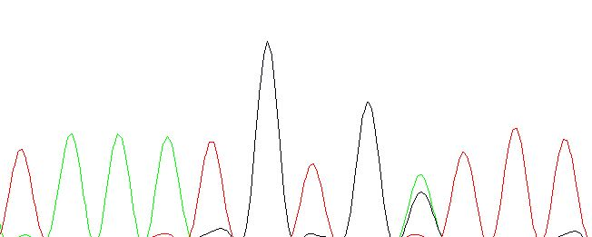
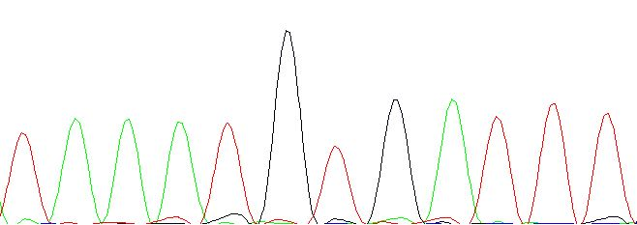
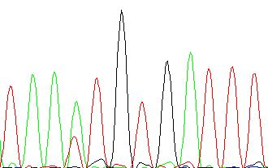
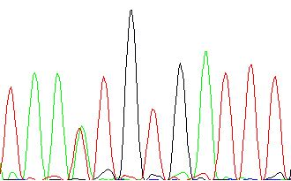
T A A A T G T G R T T T
T A A A T G T G A T T T
The sequence of the first relapse sample
T A A W T G T G A T T T
The KRAS exon 4 sequence of the diagnostic sample
The sequence of the second recurrent sample
T A A W T G T G A T T T
The sequence of the second recurrent sample
Fig. S8c:The results of Sanger sequencing of KRAS exon 4 sequence. The first relapse sample has an amino acid substitution variant (c.356A>G, upper right). Another variant is evident in the second recurrence and the cultured cell (c.351A>T, middle right and bottom right).

