Slide 1
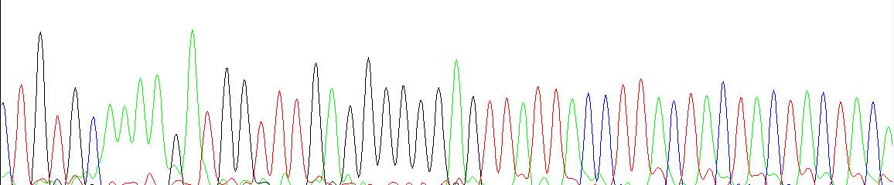
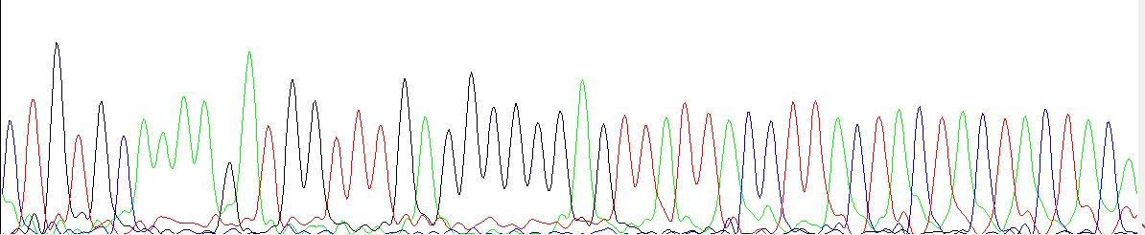
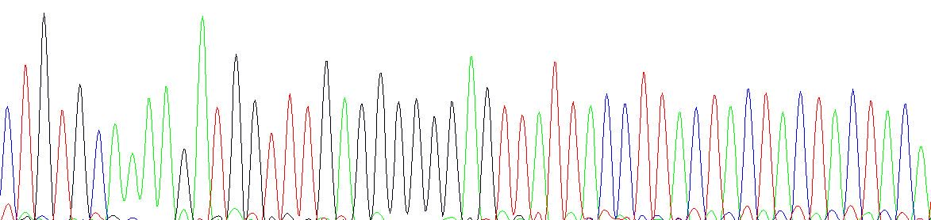
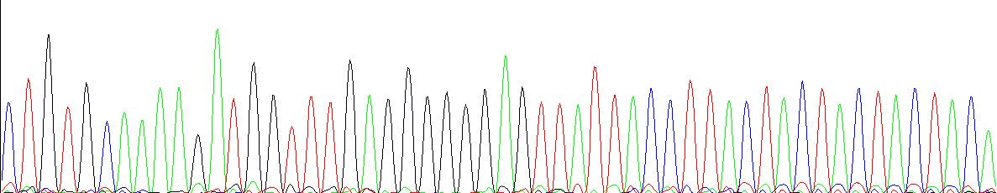
IGHV3-43
IGHD3-10
IGHJ6
The diagnostic sample
C T G T G C A A A A GA T G G T T T G AG G G G GG A GT T A T T A C C T T A C T A C T A C T A C T A C A
C T G T G C A A A A GA T G G T T T G AG G G G GG A GT T A T T A C C T T A C T A C T A C T A C T A C A
The first relapse
sample
C T G T G C A A A A GA T G G T T T G AGG G G GG A GTT A T T A C C T T A C T A C T A C T A C T A C A
The second relapse
sample
C T G T G C A A A A GA T G G T T T G AGG G G GG A GT T AT T A C C T T A C T A C T A C T A C T A C A
The cell line
Fig. S4a:The sequences of the rearranged IGH alleles on the diagnostic sample, the first relapse sample, the second relapse sample, and the cell line passage 70. The IGH V-D and D-J junction's clone-specific insertions were highlighted in bold letters. The sequences are all identical.

Slide 2
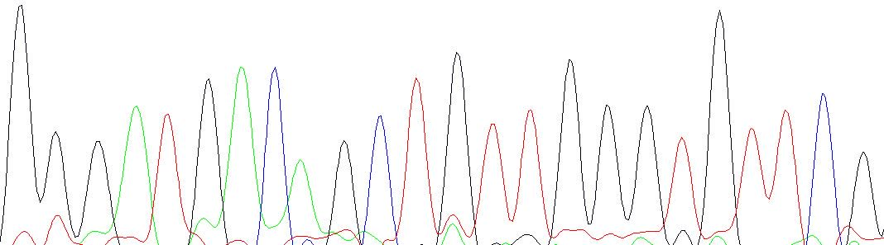
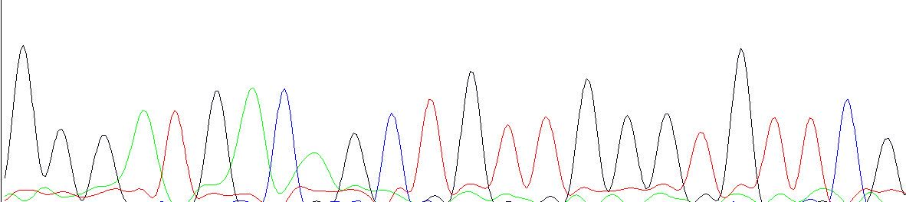
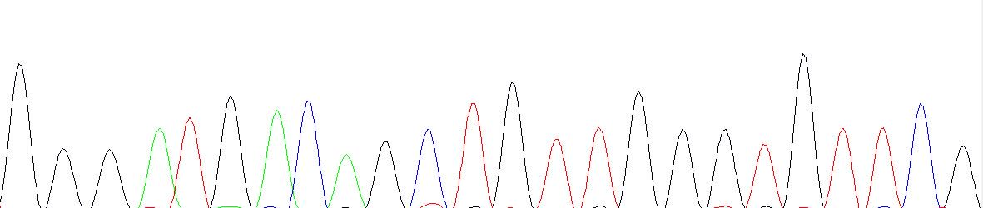
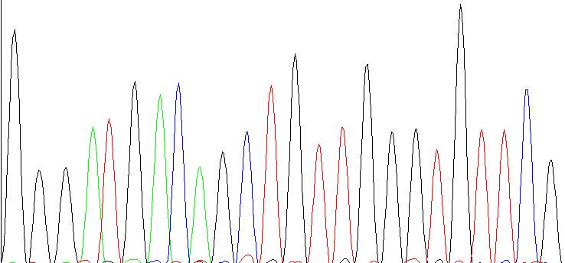
IGLV1-47
IGLJ3
The diagnostic sample
G G G A T G A C A G C T G T T G G G T G T T C G
G G G A T G A C A G C T G T T G G G T G T T C G
The first relapse
sample
G G G A T G A C A G C T G T T G G G T G T T C G
The second relapse
sample
G G G A T G A C A G C T G T T G G G T G T T C G
The cell line
Fig. S4b:The sequences of the rearranged IGL alleles. The sequences of the rearranged IGH alleles on the diagnostic sample, the first relapse sample, the second relapse sample, and the cell line passage 70. The clone-specific insertion of the IGLV-J junction was highlighted in bold letters. The sequences are all identical.

