Slide 1
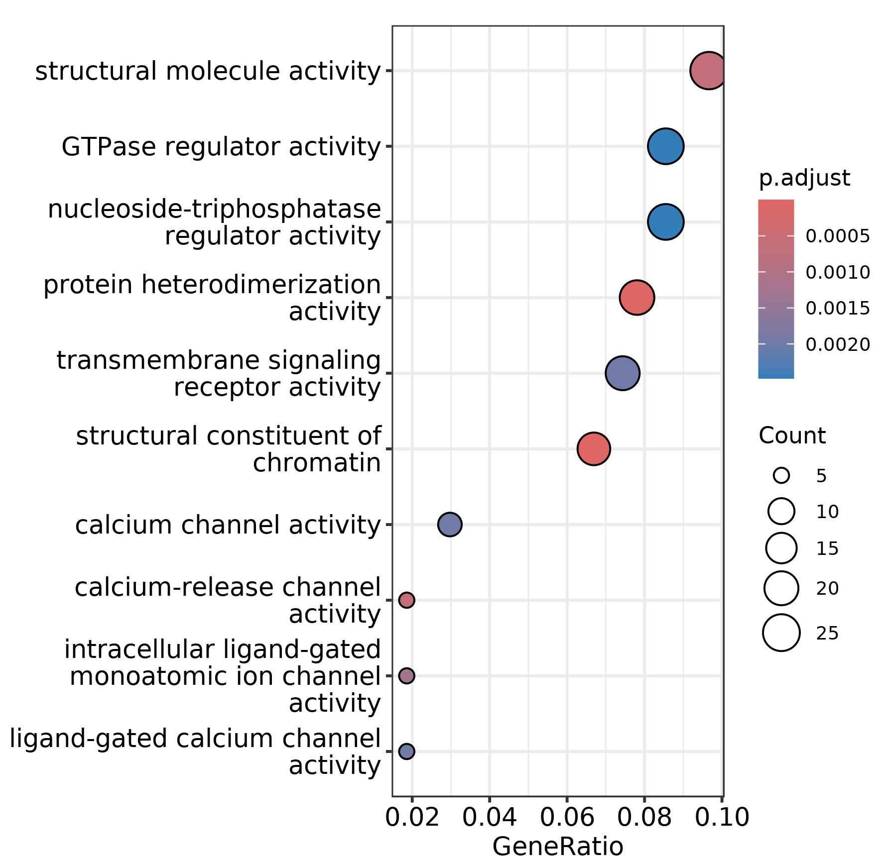
Fig. S12a: A dot plot illustrates the Molecular Function categories of Gene Ontology (GO) terms that are functionally significant in TCF3::HLF-positive leukemia cell lines compared to TCF3::PBX1-positive leukemia cell lines. The size of each circle indicates the number of genes associated with each GO term, while the color denotes the p-value.

Slide 2
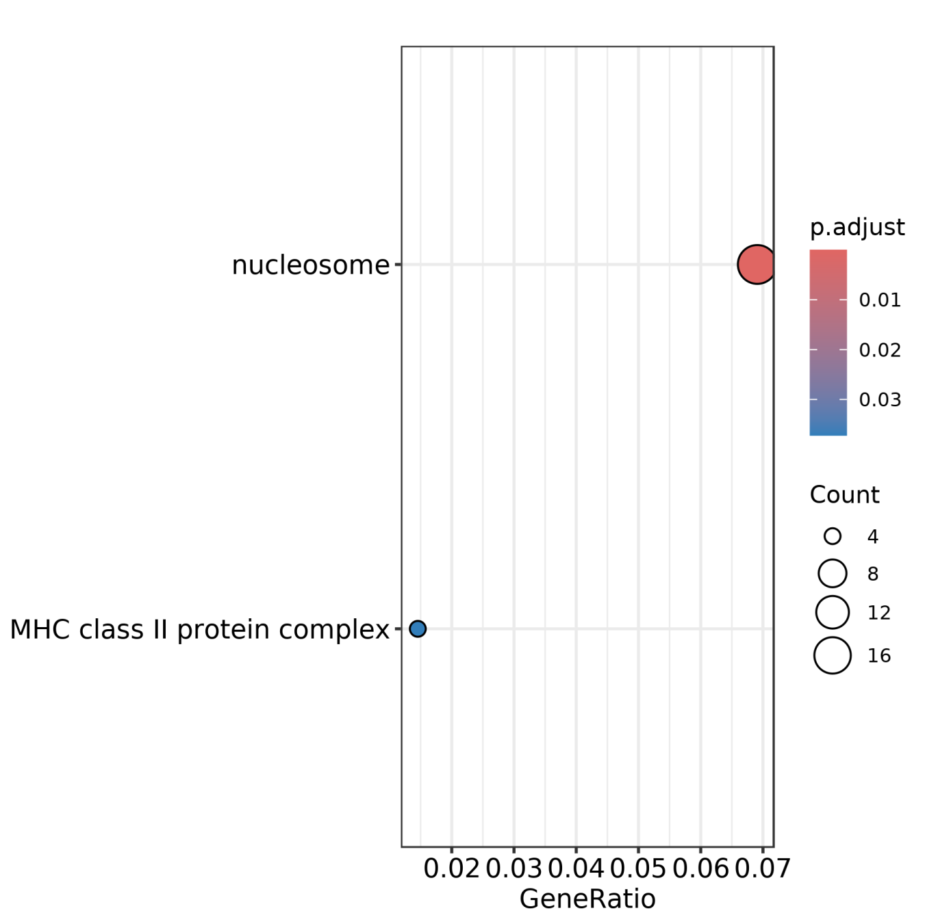
Fig. S12b: A dot plot highlights functionally significant GO terms as Cellular Component observed in the TCF3::HLF-positive leukemia cell lines compared to the TCF3::PBX1-positive leukemia cell lines. The size of each circle represents the number of genes associated with each GO term, while the color demonstrates the p-value.

Slide 3
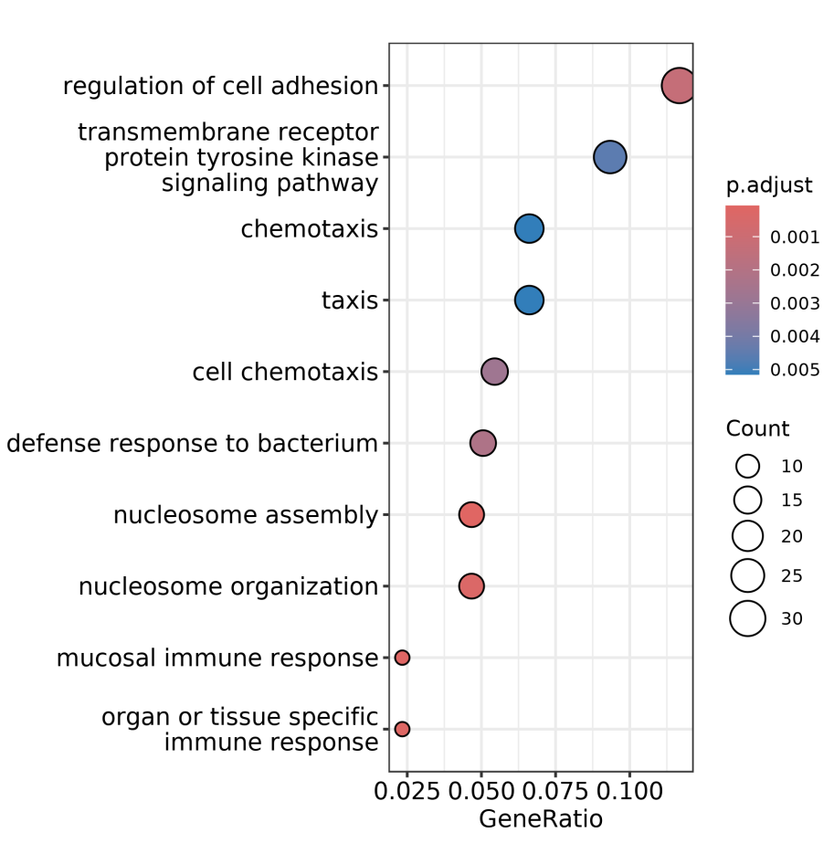
Fig. S12c: A figure shows a dot plot illustrating the Biological Process categories of GO terms that are over-represented in TCF3::HLF-positive leukemia cell lines compared to TCF3::PBX1-positive leukemia cell lines. The size of each circle exhibites the number of genes associated with each GO term, while the color indicates the p-value.

