Slide 1
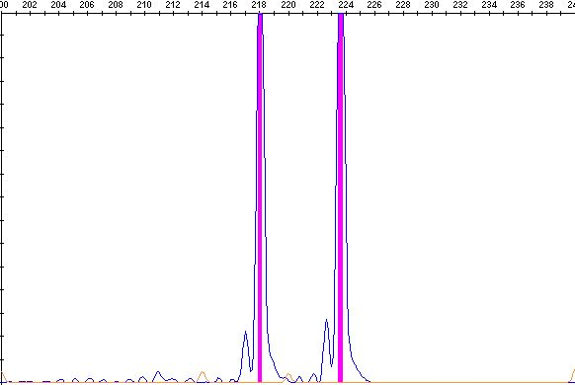
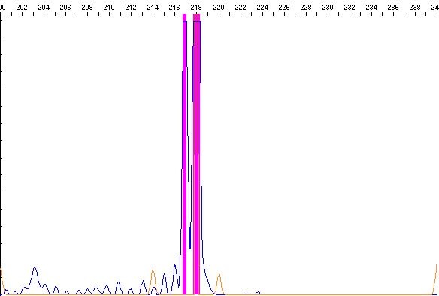
Fig. S3a
The results of length polymorphism analysis on AMELX/AMELY loci
Fig. S3a: The electropherograms of the PCR product of the AMELX/AMELY loci. The upper electropherogram shows the result of the recurrent testicular sample, and the lower demonstrates the electropherogram of the cell line. Note heterozygous peaks on the recurrent sample at 218 bp and 224 bp and a homozygous peak on the cell line at 218 bp (arrows), suggesting loss of chromosome Y in the cell line.

Slide 2
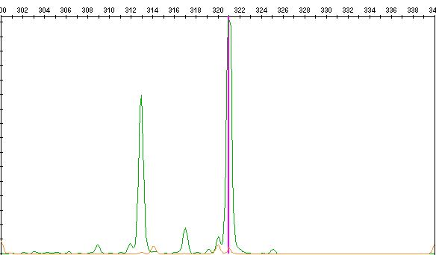
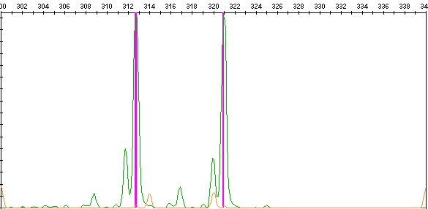
Fig.S3b
The results of length polymorphism analysis on CSF1R locus
Fig. S3b: The electropherograms of the PCR product of the CSF1R locus. The upper is from the recurrent testicular sample, and the lower shows the result of the cell line. There are heterozygous peaks at 312 bp and 320 bp (arrows).

Slide 3
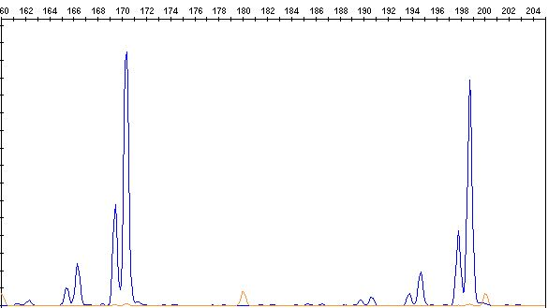
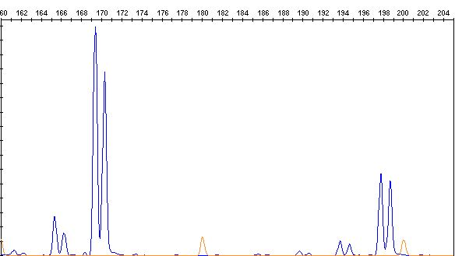
Fig. S3c
The results of length polymorphism analysis on D2S1338 locus
Fig. S3c: The electropherograms of the PCR product of the D2S1338 locus. The upper is the electropherogram of the recurrent testicular sample, and the lower shows the result of the cell line. Two heterozygous peaks are evident at 170 bp and 198 bp (arrows).

Slide 4
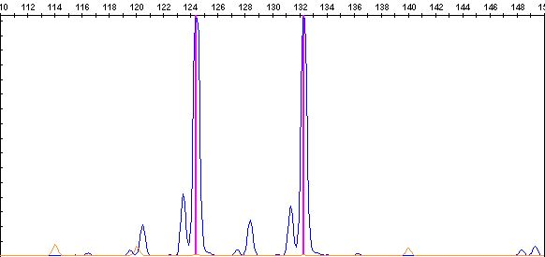
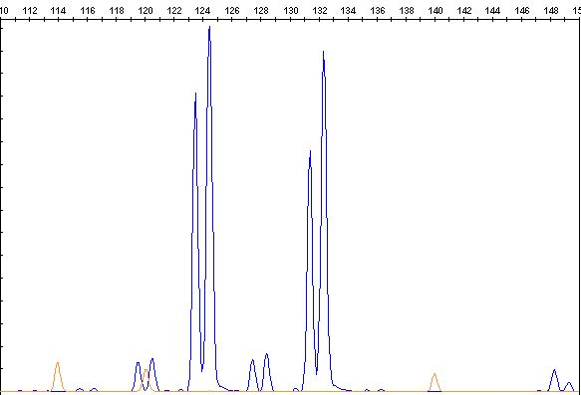
Fig. S3d
The results of length polymorphism analysis on D3S1358 locus
Fig. S3d: The electropherograms of the PCR product of the D3S1358 locus. The upper demonstrates the result of the recurrent testicular sample (two peaks represent one with and the other without a one-base overhang), and the lower is from the cell line. Note heterozygous peaks at 124 bp and 132 bp (arrows).

Slide 5
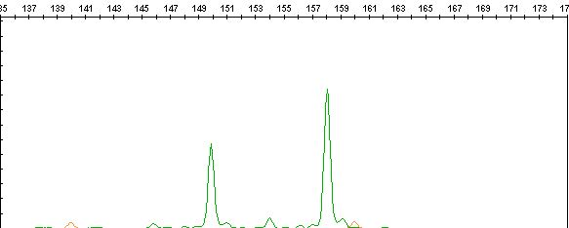
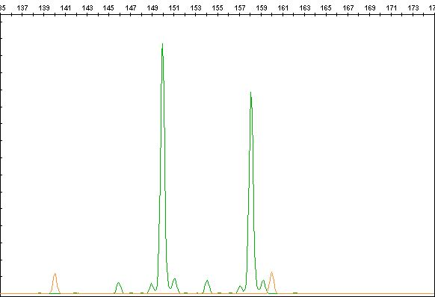
Figure S3e
The results of length polymorphism analysis on D5S818 locus
Fig. S3e: The electropherograms of the PCR product of the D5S818 locus. The upper illustrates the result of the recurrent testicular sample, and the lower exhibits the result of the cell line. Heterozygous peaks are observed at 150 bp and 158 bp on the recurrent tumor and the cell line (arrows).

Slide 6
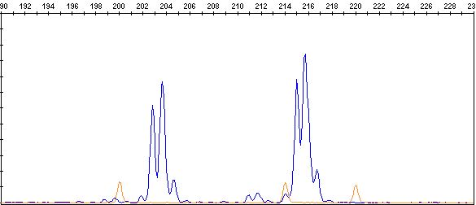
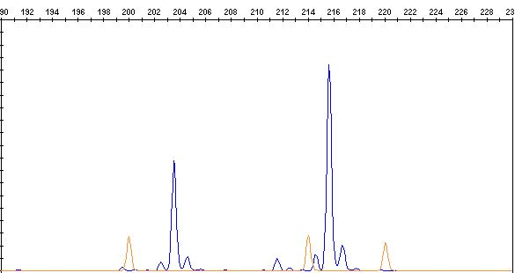
Fig. S3f
The results of length polymorphism analysis on D7S820 locus
Fig. S3f: The electropherograms of the PCR product of the D7S820 locus. The upper electropherogram is of the recurrent testicular sample, and the lower demonstrates the result of the cell line (peaks with or without a one-base overhang). Note the same heterozygous peaks at 204 bp and 216 bp (arrows).

Slide 7
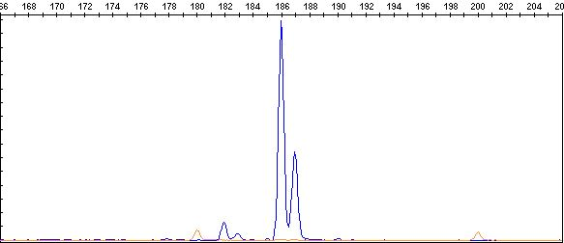
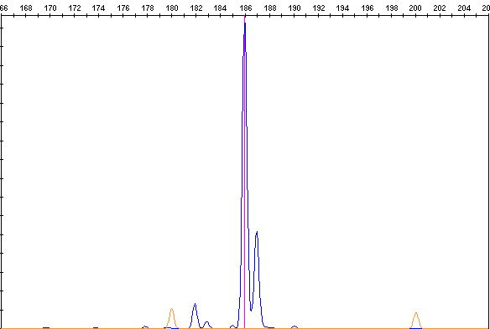
Fig. S3g
The results of length polymorphism analysis on D8S1179 locus
Fig. S3g: The electropherograms of the PCR product of the D8S1179 locus. The upper represents the electropherogram of the recurrent testicular sample, and the lower demonstrates the result of the cell line. There is a homozygous peak seen at 186 bp (arrows).

Slide 8
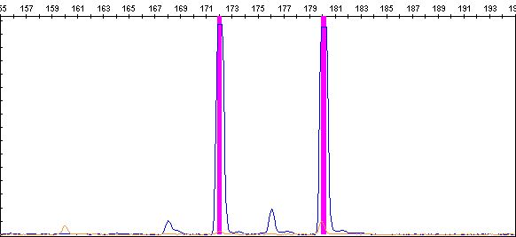
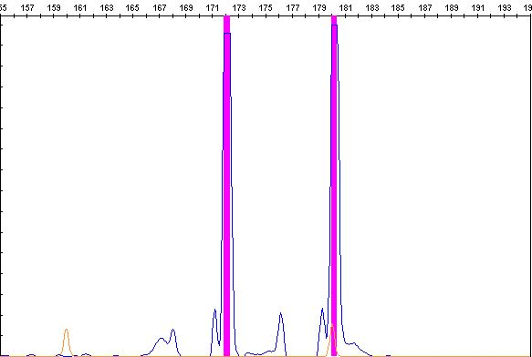
Fig. S3h
The results of length polymorphism analysis on D13S317 locus
Fig. S3h: The electropherograms of the PCR product of the D13S317 locus. The upper figure is from the recurrent testicular sample, and the lower shows the result of the cell line. Note shared heterozygous peaks on 172 bp and 180 bp (arrows).

Slide 9
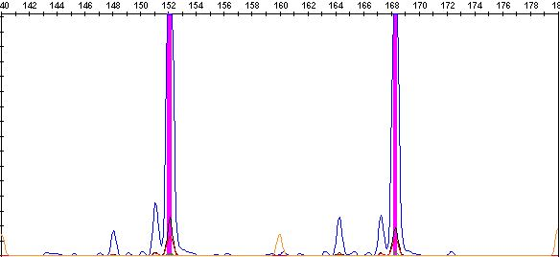
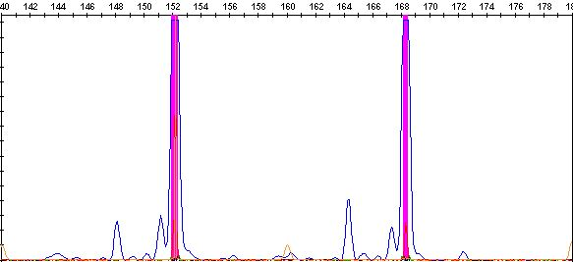
Fig. S3i
The results of length polymorphism analysis on D16S539 locus
Fig. S3i: The electropherograms of the PCR product of the D16S539 locus. The upper indicates the result of the recurrent testicular sample, and the lower is of the cell line. There are heterozygous peaks at 152 bp and 168 bp are visible (arrows).

Slide 10
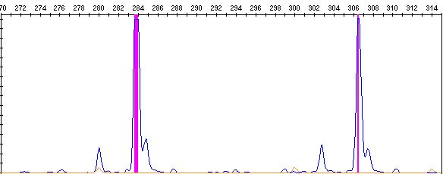
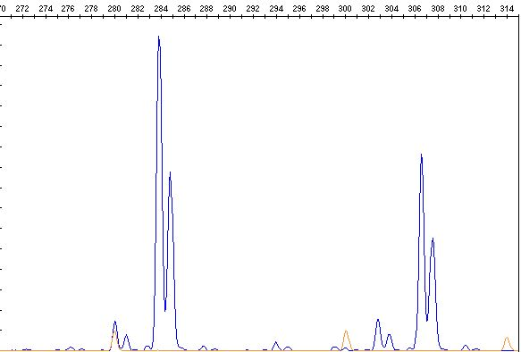
Fig. S3j
The results of length polymorphism analysis on D18S51 locus
Fig. S3j: The electropherograms of the PCR product of the D18S51 locus. The upper illustrates the result of the recurrent testicular sample, and the lower shows the result of the cell line. There are heterozygous peaks at 284 bp and 306 bp(arrows).

Slide 11
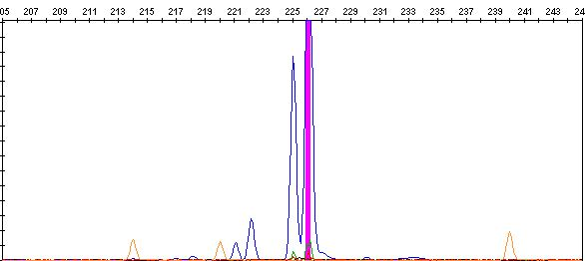
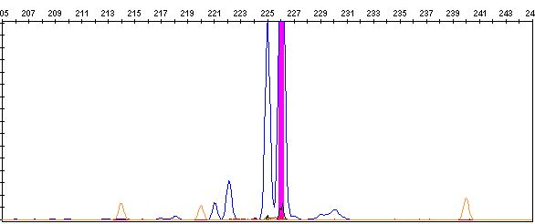
Fig. S3k
The results of length polymorphism analysis on D19S253 locus
Fig. S3k: The electropherograms of the PCR product of the D19S253 locus. The upper is the electropherogram of the recurrent testicular sample (peaks with or without a one-base overhang), and the lower is of the cell line. Note the shared homozygous peak at 226 bp (arrows).

Slide 12
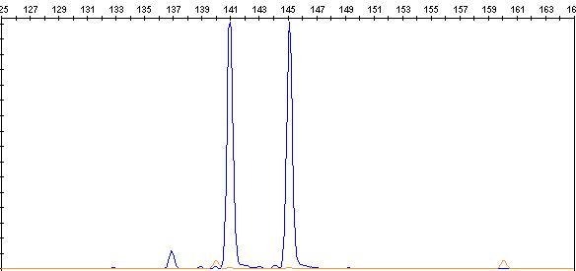
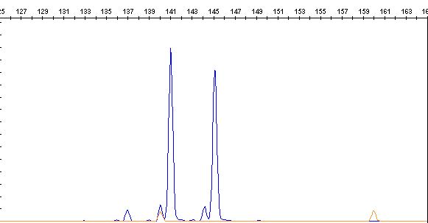
Fig. S3l
The results of length polymorphism analysis on D20S438 locus
Fig. S3l: The electropherograms of the PCR product of the D20S438 locus. The upper exhibits the result of the recurrent testicular sample, and the lower figure shows the result of the cell line. See two heterozygous peaks at 141 bp and 145 bp (arrows).

Slide 13
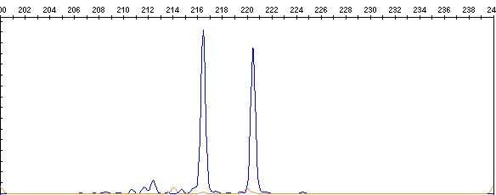
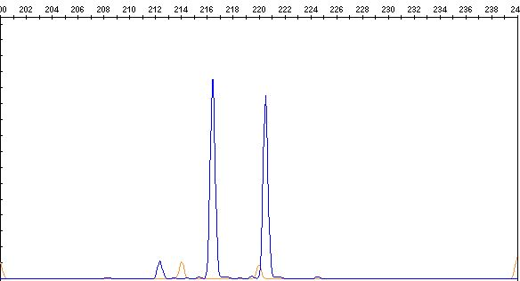
Fig. S3m
The results of length polymorphism analysis on D21S11 locus
Fig. S3m: The electropherograms of the PCR product of the D21S11 locus. The upper electropherogram indicated the result of the recurrent testicular sample, and the lower figure was the cell line. There were shared heterozygous peaks at 216 bp and 220 bp (arrows).

Slide 14
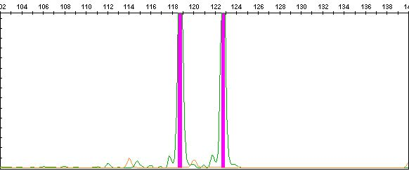
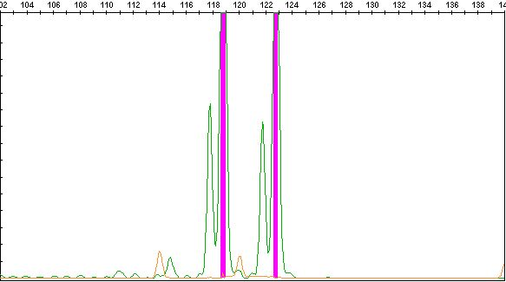
Fig. S3n
The results of length polymorphism analysis on TPO locus
Fig. S3n: The electropherograms of the PCR product of the TPO locus. The upper is the result of the recurrent testicular sample, and the lower gram shows the result of the cell line. Note shared heterozygous peaks at 118 bp and 122 bp (arrows).

Slide 15
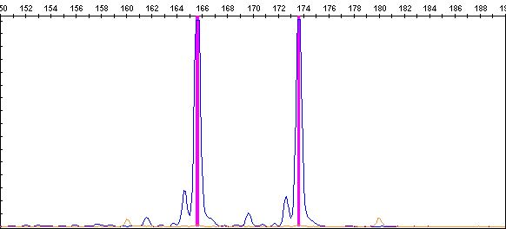
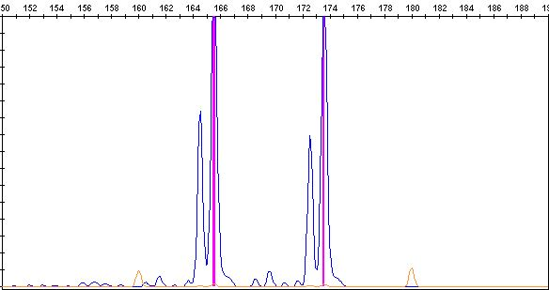
Fig. S3o
The results of length polymorphism analysis on TH locus
Fig. S3o: The electropherograms of the PCR product of the TH locus. The upper electropherogram indicates the result of the recurrent testicular sample, and the lower is the result of the cell line. Two heterozygous peaks were evident at 165 bp and 174 bp (arrows).

Slide 16
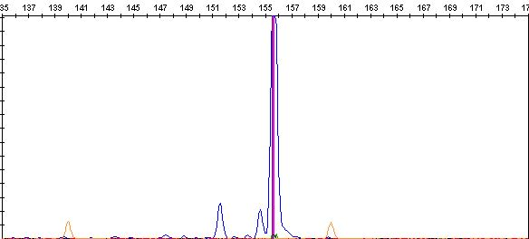
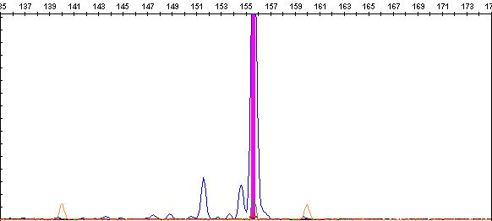
Fig. S3p
The results of length polymorphism analysis on VWF locus
Fig. S3p: The electropherograms of the PCR product of the VWF locus. The upper electropherogram demonstrates the result of the recurrent testicular sample, and the lower shows the result of the cell line. There are shared homozygous peaks at 156 bp (arrows).

