Slide 1
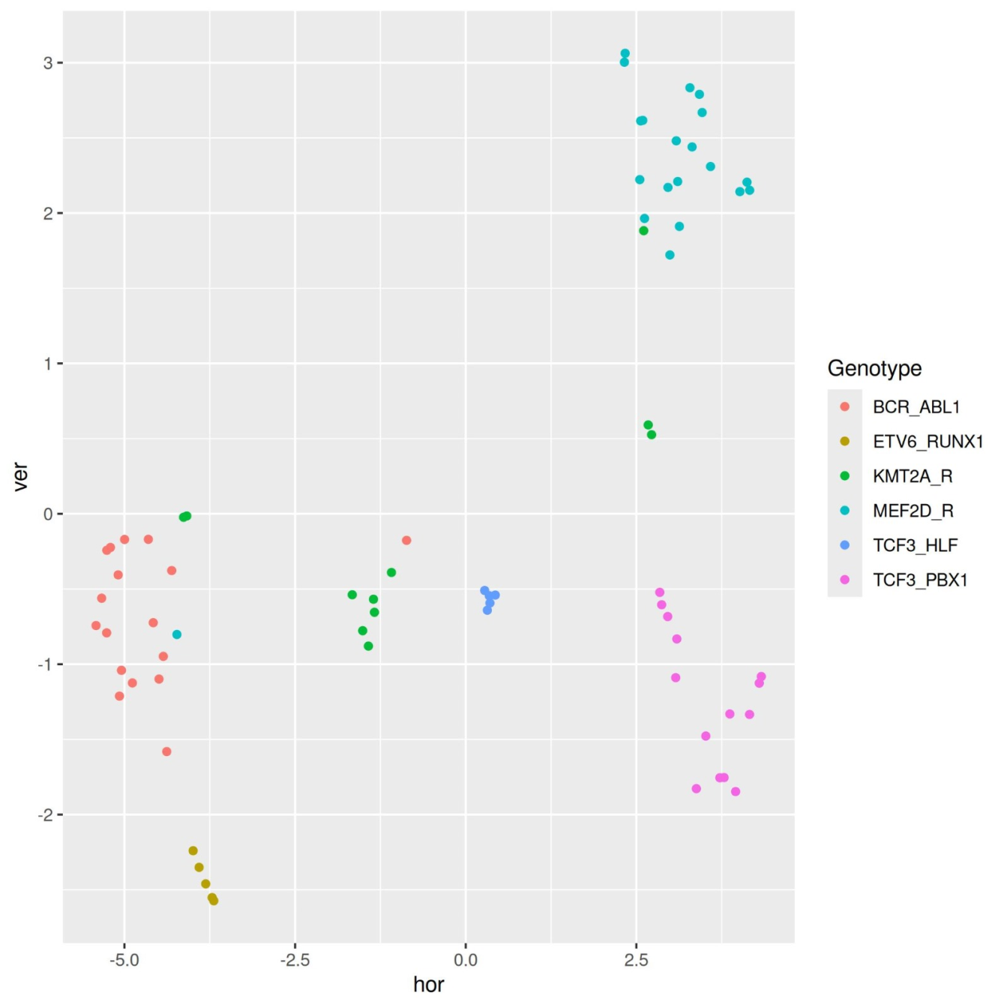
TCF3:PBX1-positive
leukemia cell lines
ETV6::RUNX1-
positive leukemia
cell lines
TCF3::HLF-positive
leukemia cell lines
Figure S14: The two-dimensional dot plot shows the TCF3::HLF-positive, TCF3:PBX1-positive, and ETV6::RUNX1-positive leukemia cell lines represented as small, distinct clusters (blue circle, purple circle, and brown circle).

