Slide 1
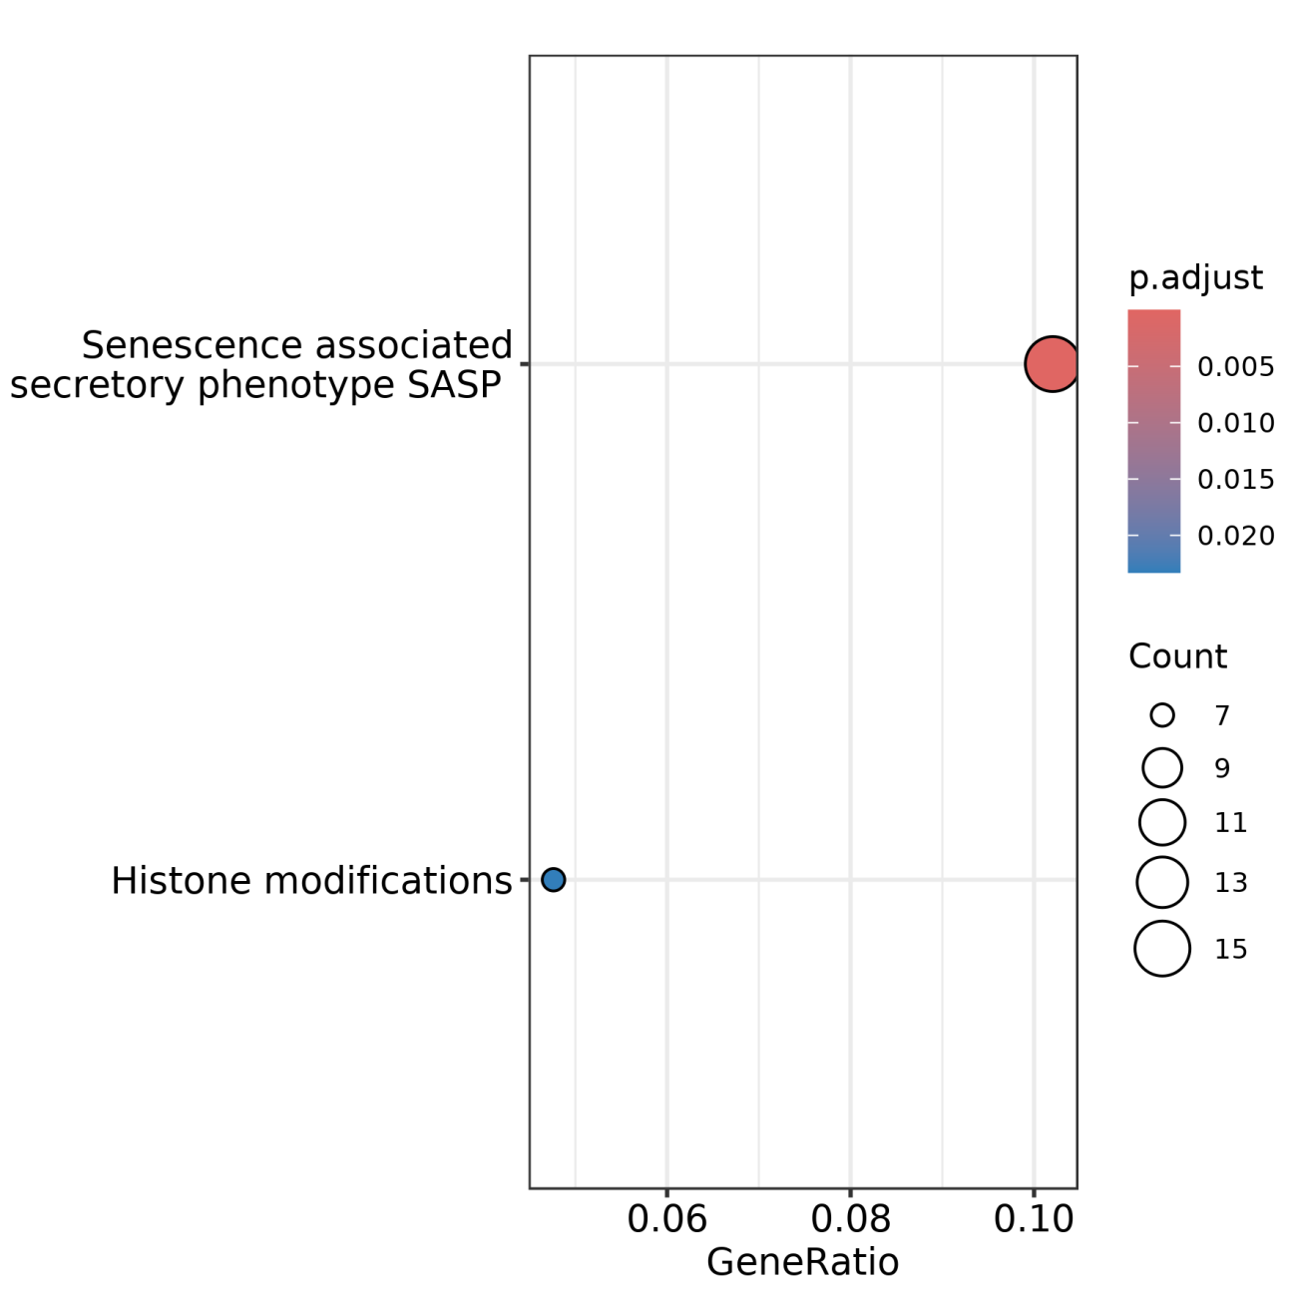
Fig. S13: A dot plot demonstrates two pathways, Senescence associated secretory phenotype SASP and Histone modifications are over-represented in TCF3::HLF-positive leukemia cell lines compared to TCF3::PBX1-positive leukemia cell lines

