Slide 1
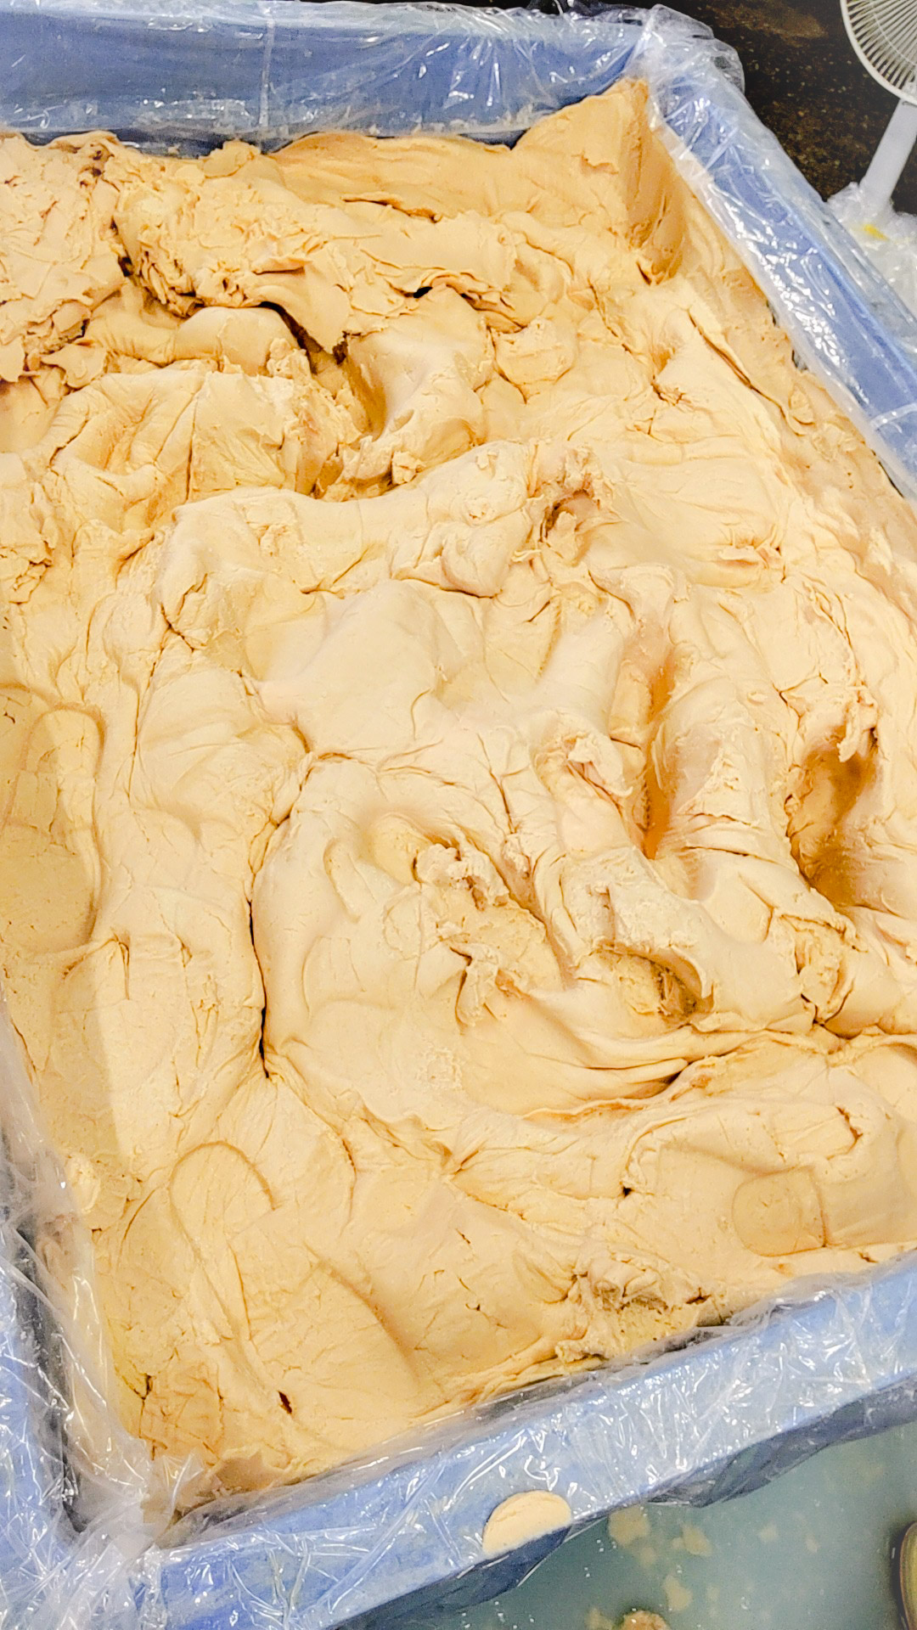
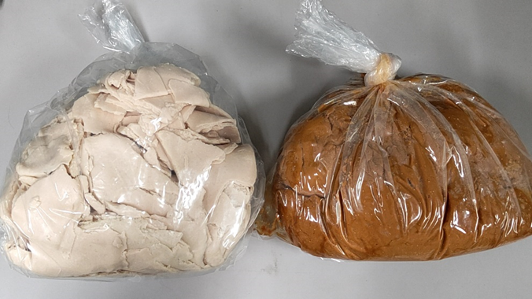
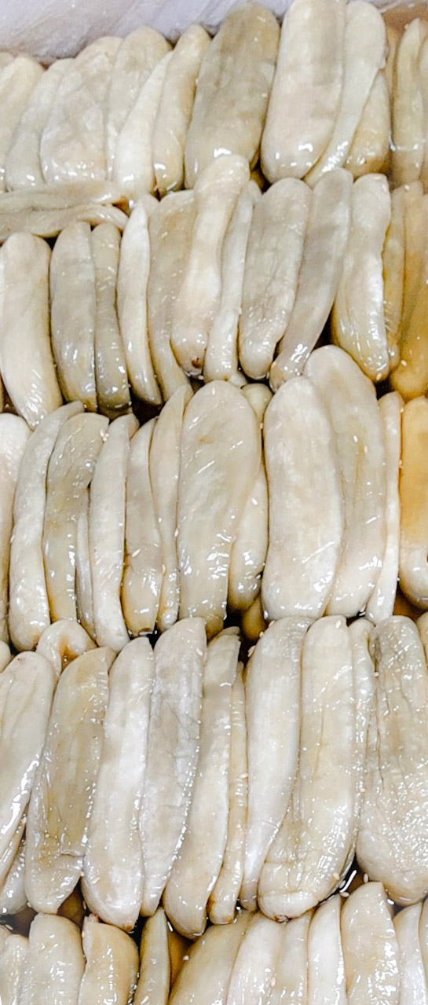
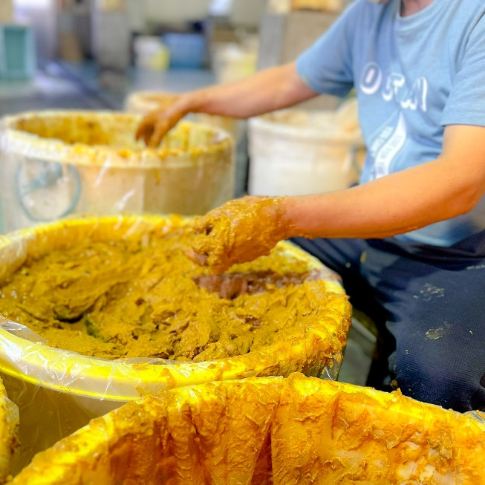
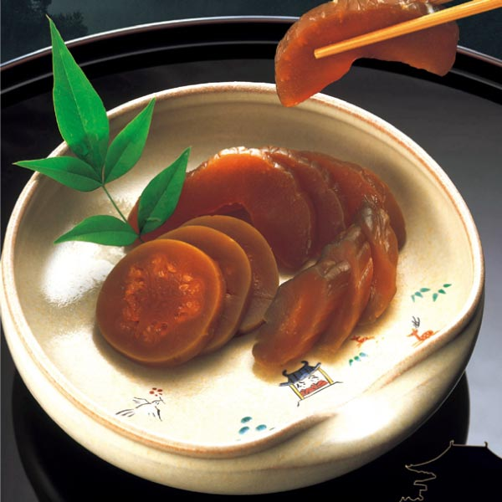
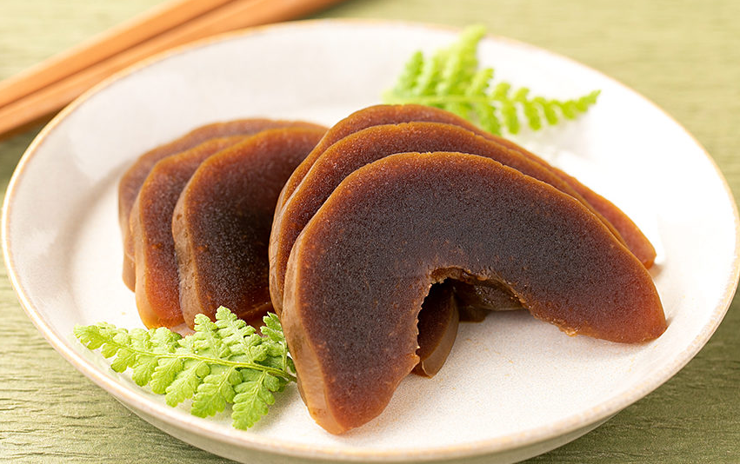
Supplementary Fig. 1 (Yoshioka et al.)
a
b
c
d
e
f
Supplementary Fig. 1. Steps in the narazuke making process. a, Fresh sake kasu, used as a base for aged sake kasu, is compressed to remove air, then aged at room temperature. b, Fresh sake kasu (left) and aged sake kasu (right). The sake kasu changes from white to brown and develops a richer flavor through aging. c, Salted vegetables (gourds). Vegetables are exposed to a saturated salt solution for dehydration. d, Embedding process. Salted vegetables are repeatedly embedded in aged sake kasu for desalting and flavoring. e, f, Finished narazuke products of Factory N (e) and Factory M (f).

Slide 2
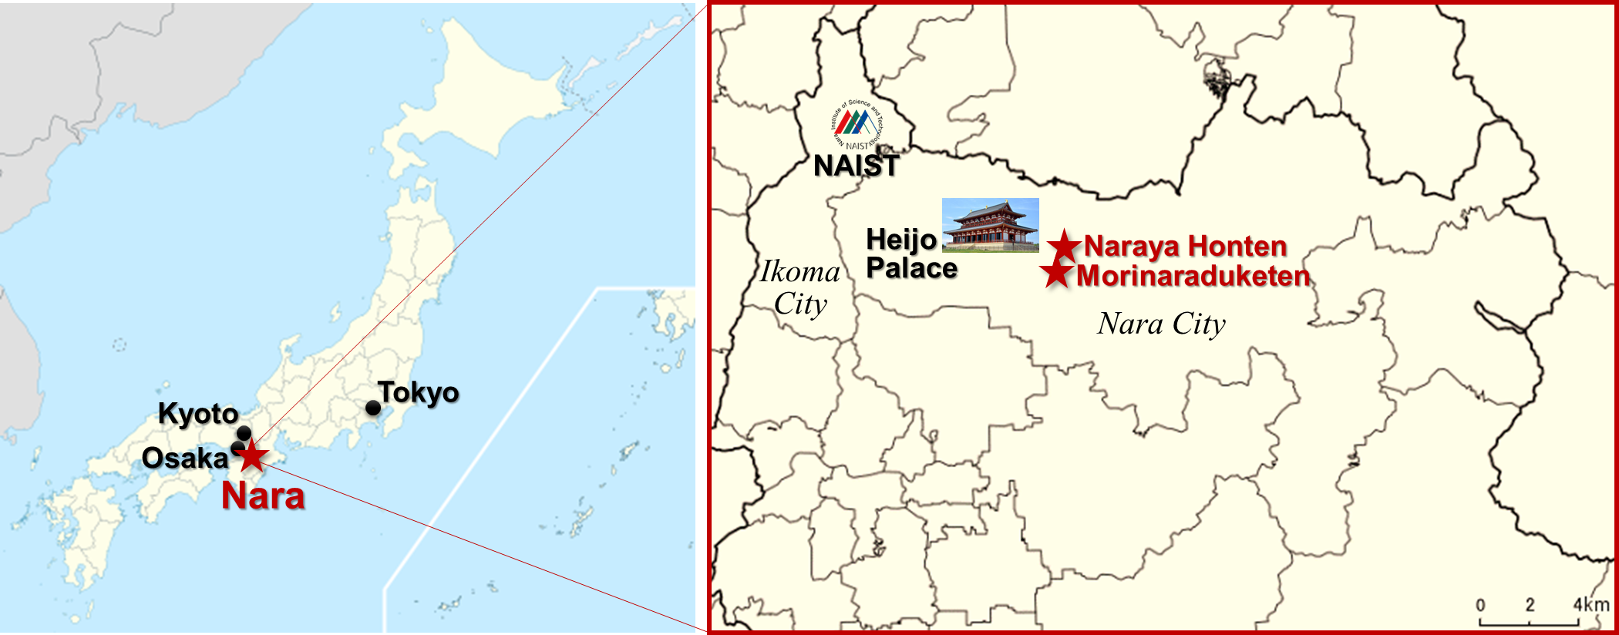
Supplementary Fig. 2 (Yoshioka et al.)
Supplementary Fig. 2. Locations of traditional narazuke factories. Naraya Honten (Factory N) and Morinaraduketen (Factory M) are the factories that provided the narazuke samples used in this study. Both are situated within 5 km of the Heijo Palace ruins, the historic capital of Nara, where the oldest records of narazuke were discovered.

Slide 3
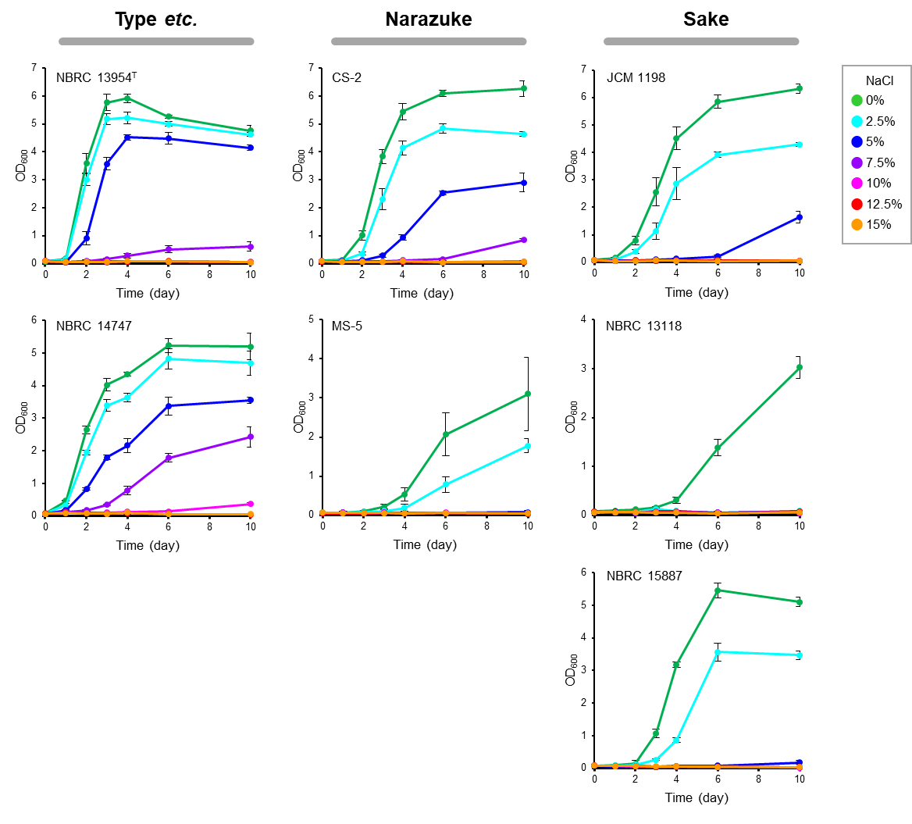
Supplementary Fig. 3 (Yoshioka et al.)
Supplementary Fig. 3. Growth of F. fructivorans under different NaCl concentrations. Seven strains of F. fructivorans were cultured in SI medium with NaCl at 0% (green), 2.5% (light blue), 5% (blue), 7.5% (purple), 10% (pink), 12.5% (red), and 15% (orange). Data represent average values ± standard deviations from three independent experiments. Strains in the left column (NBRC 13954^{T} and NBRC 14747) were isolated from salad dressing and similar sources, strains in the middle column (CS-2 and MS-5) were isolated from narazuke, and strains in the right column (JCM 1198, NBRC 13118, and NBRC 15887) were isolated from sake.

Slide 4
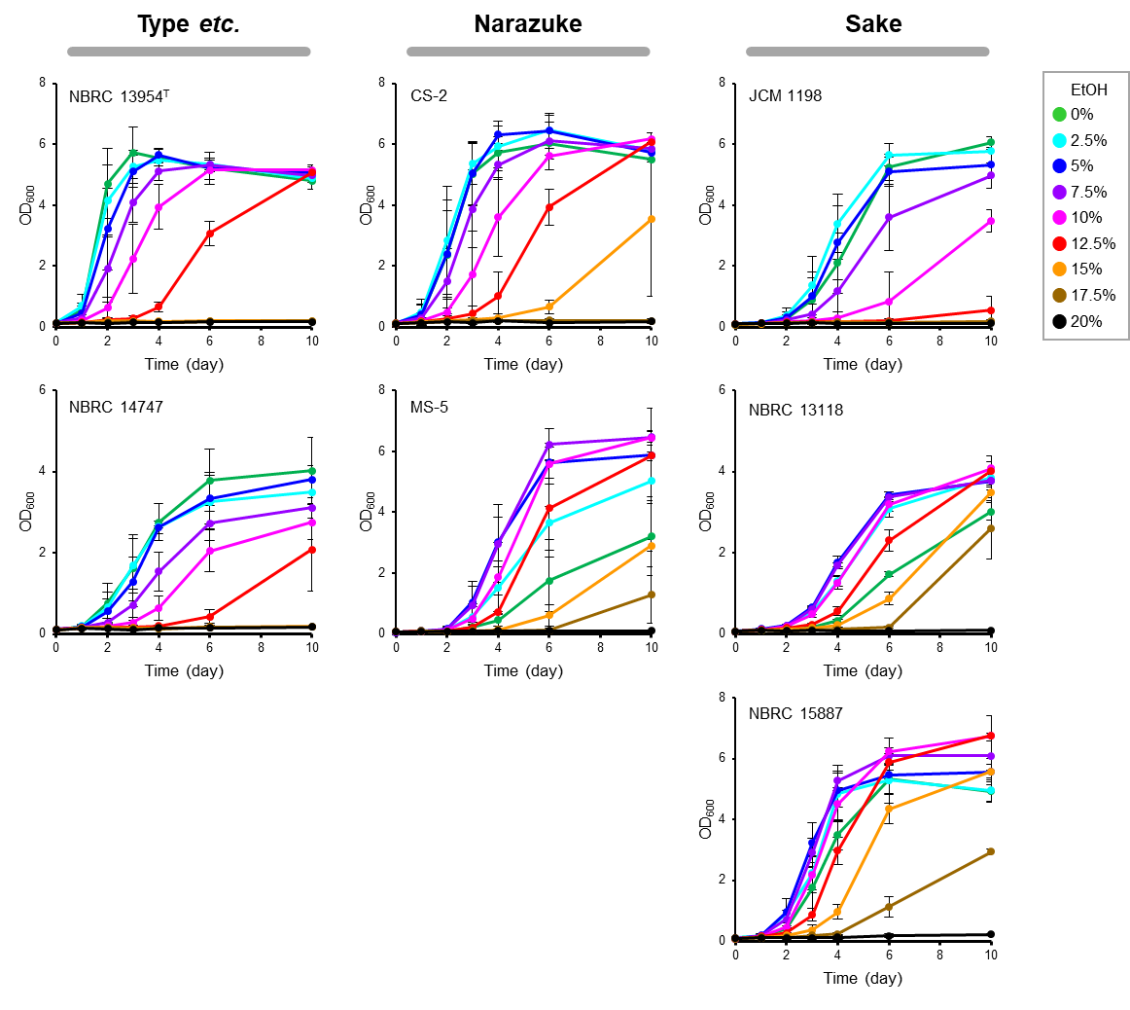
Supplementary Fig. 4 (Yoshioka et al.)
Supplementary Fig. 4. Growth of F. fructivorans under different ethanol concentrations. Seven strains of F. fructivorans were cultured in SI medium with ethanol at 0% (green), 2.5% (light blue), 5% (blue), 7.5% (purple), 10% (pink), 12.5% (red), 15% (orange), 17.5% (brown), and 20% (black). Data represent average values ± standard deviations from three independent experiments. The strains used are the same as those in Supplementary Fig. 3.

Slide 5
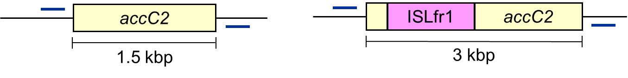
Supplementary Fig. 5 (Yoshioka et al.)
a
b
NBRC 13954^{T}
Narazuke
NBRC 15887
Marker
CS-2
MS-5
(kbp)
3 -
1.5 -
Supplementary Fig. 5. Analysis of the accC2 gene, previously reported to be involved in ethanolphilicity. a, Diagram of the accC2 gene in the type strain (left) and the sake strains (right). An insertion sequence, ISLfr1, is commonly found in the accC2 gene of the ethanolphilic F. fructivorans strains isolated from sake. b, Genomic PCR analysis of the accC2 gene. The PCR product of the ethanolphilic sake strain NBRC 15887 was 1.5 kb longer than that of the non-ethanolphilic strain NBRC 13954^{T} due to the insertion of ISLfr1. The PCR product lengths of the narazuke strains CS-2 and MS-5 were similar to that of the non-ethanolphilic strain NBRC 13954^{T}.

Slide 6
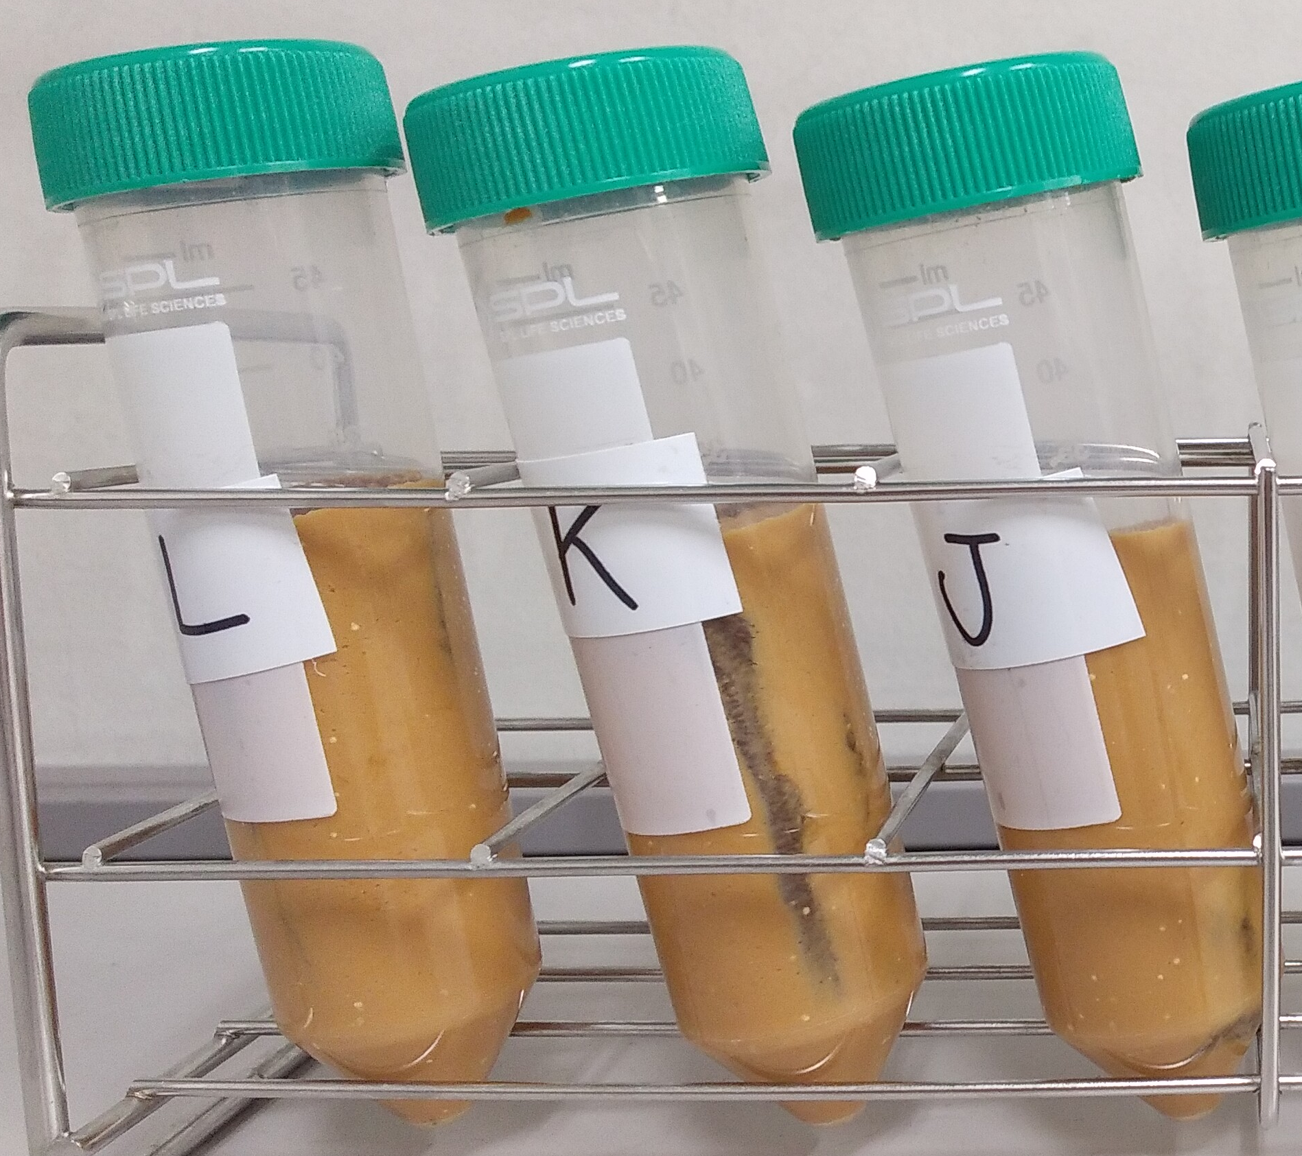
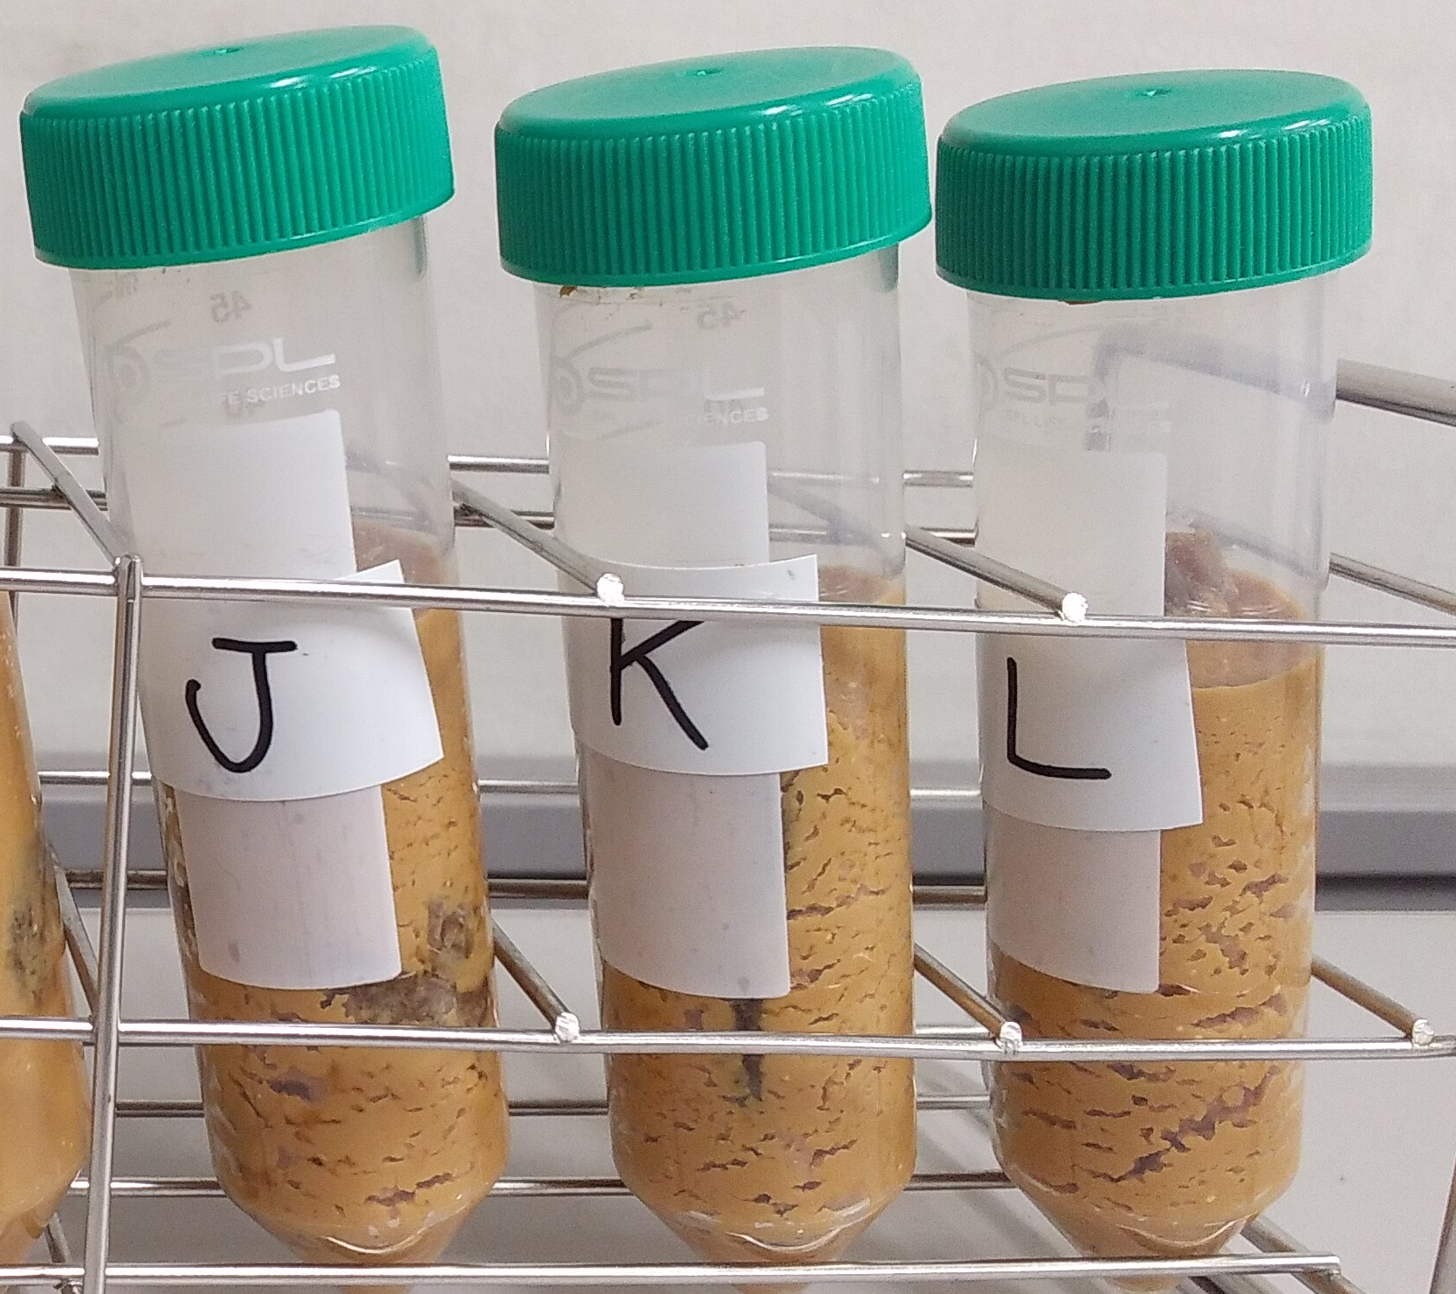
Supplementary Fig. 6 (Yoshioka et al.)
21 days
35 days
Supplementary Fig. 6. Lab-scale narazuke making using in-process gourd narazuke products. Gas production, likely associated with heterolactic fermentation, was observed in the tube after 35 days (below).

