Slide 1
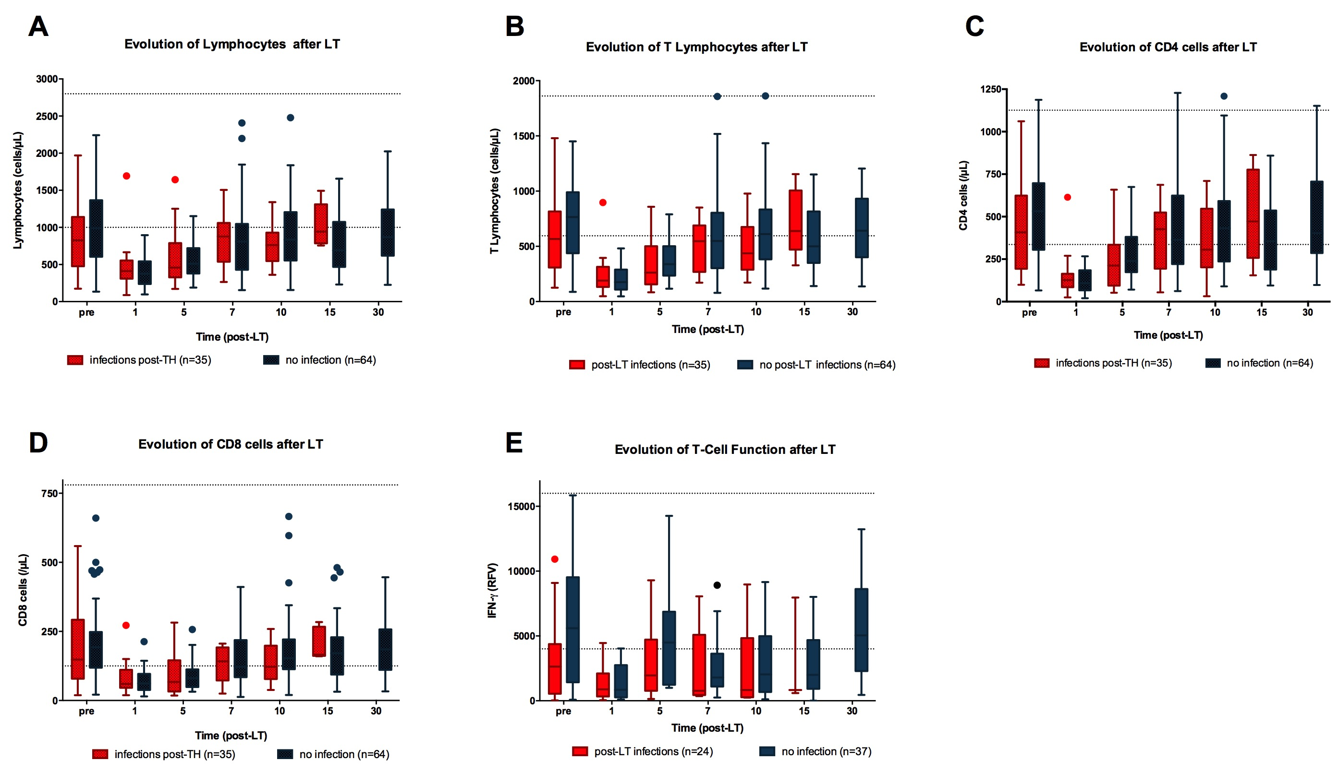
Notes:
Supp Figure 1 : Evolution of immune markers after Liver Transplantation (LT) according to the occurrence of post-LT infections: total lymphocytes (A), T lymphocytes (B), CD4 lymphocytes (C), CD8 lymphocytes (D) and T lymphocyte function assessed with Interferon-gamma release after stimulation expressed in reference fluorescence value (RFV) (E). Dotted lines represent lower and upper limits of normal values. Mann-Whitney U test was used for comparisons. * p< 0.05

Slide 2
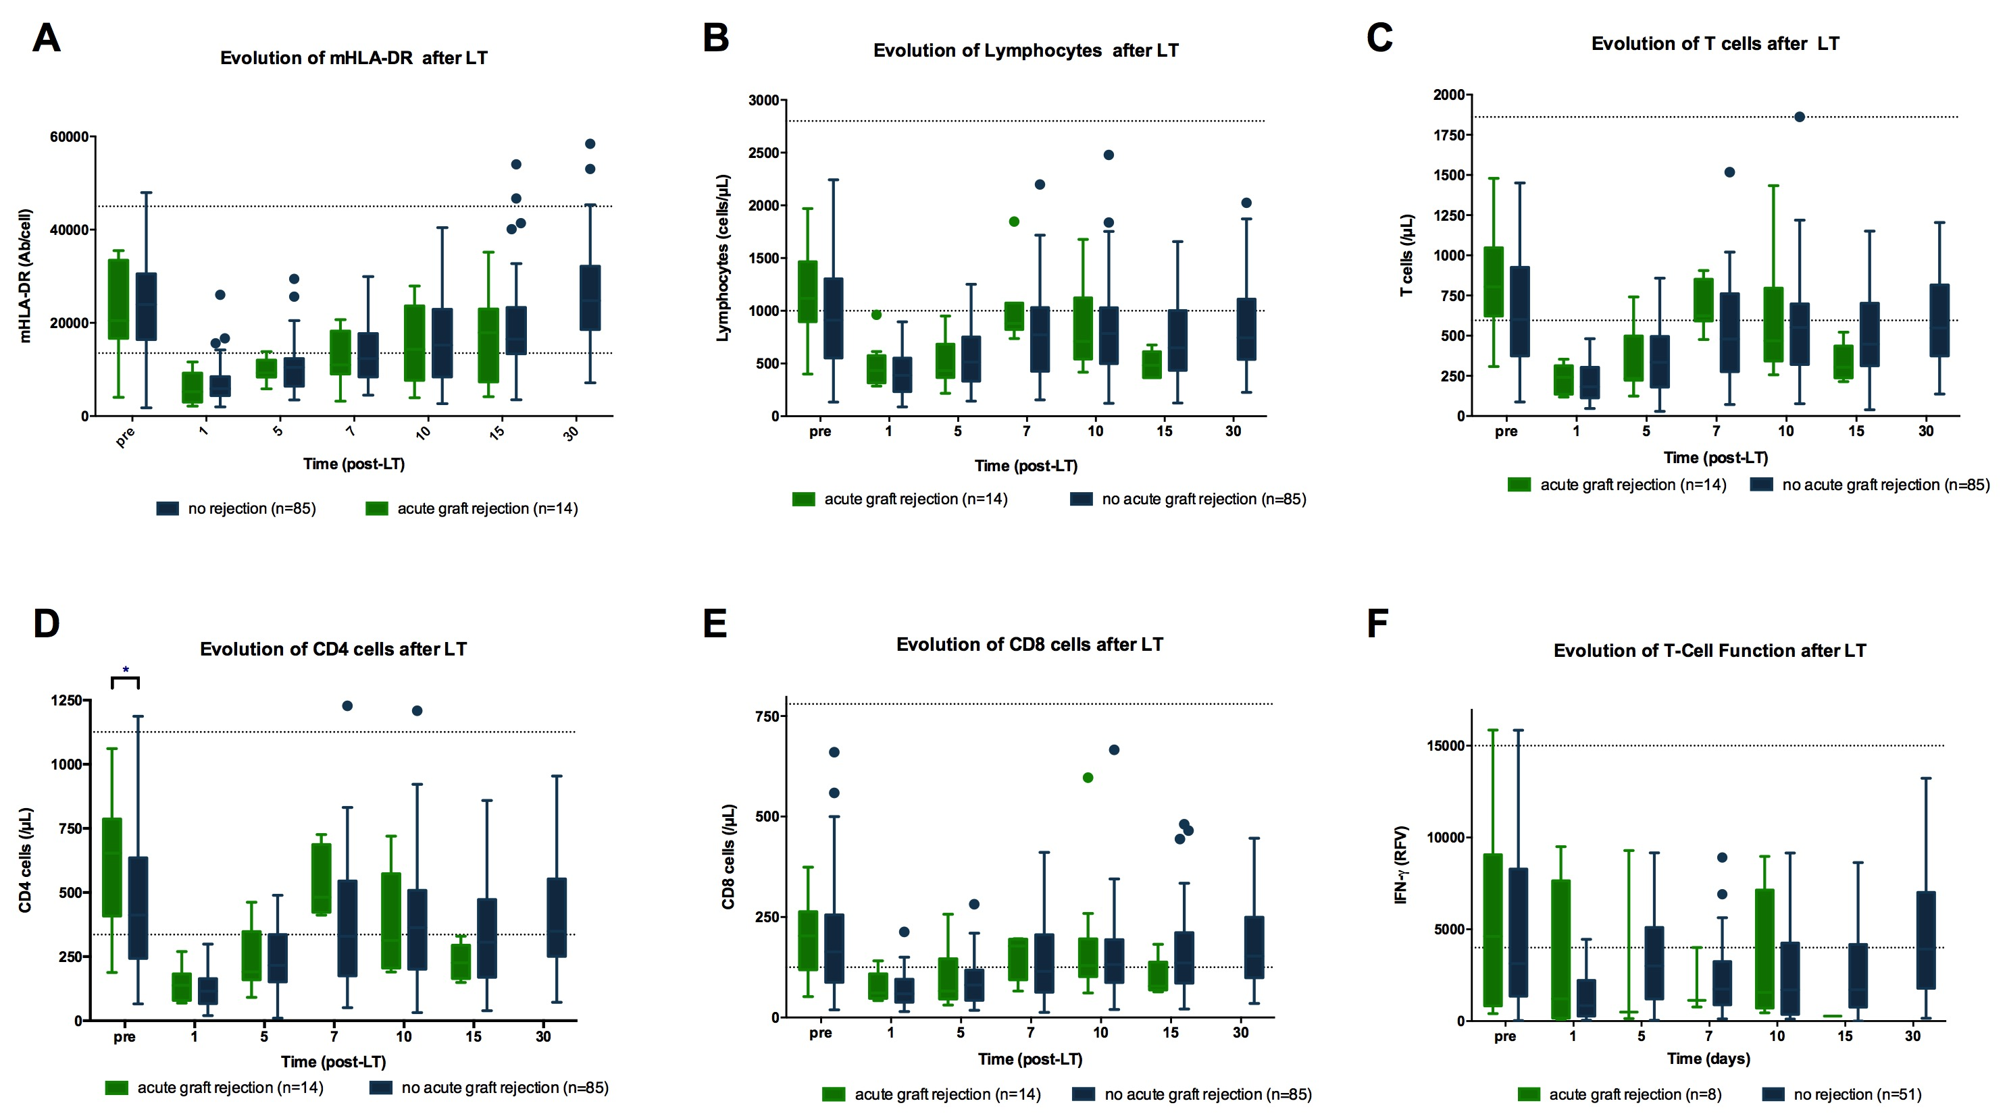
Notes:
Supp Figure 2 : Evolution of immune markers after Liver Transplantation (LT) according to the presence of acute graft rejection (n=99 : monocytic expression of HLA-DR expressed in antibody by cell (A), total lymphocytes (B), T lymphocytes (C), CD4 lymphocytes (D), CD8 lymphocytes (E) a. nd T lymphocyte function assessed with Interferon-gamma release after stimulation expressed in reference fluorescence value (RFV) (F). Dotted lines represent lower and upper limits of normal values. Mann-Whitney U test was used for comparisons. * p< 0.05

Slide 3
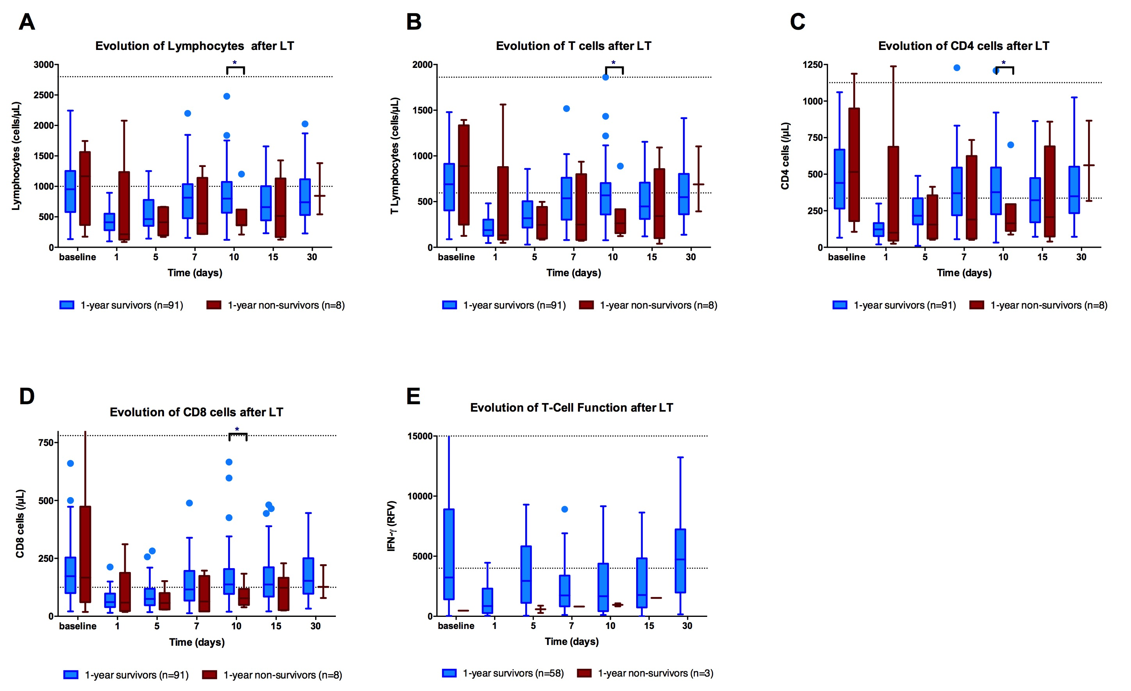
Notes:
Supp Figure 3 : Evolution of immune markers after Liver Transplantation (LT) according to one-year survival (n=99)
Total lymphocytes count (A), T cells count (B), CD4 T cells count (C), CD8 T cells count (D) and T lymphocyte function assessed by the level of Interferon-gamma released after stimulation (expressed in reference fluorescence value) (E). LT: liver transplantation, RFV: reference fluorescence value Dotted lines represent lower and upper limits of normal values. Mann-Whitney U test was used for comparisons. * p< 0.05

