Slide 1



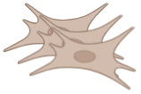
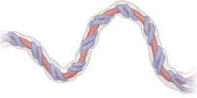


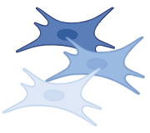

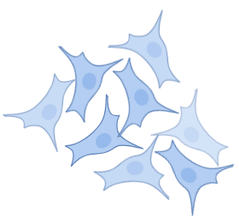

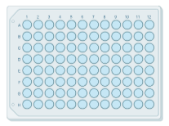
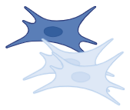
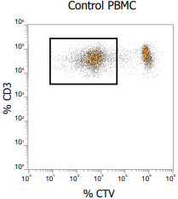
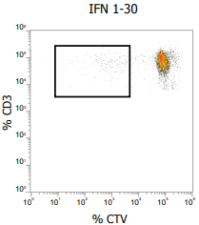
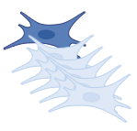
High
20%
Explant method
3 culture
conditions
Basal state
Immunomodulatory properties in vitro :
Donor-dependent heterogeneity
Mixed Lymphocyte Reaction
Basal state
Medium
30%
Umbilical cord-derived mesenchymal stromal cells (UC-MSCs)
Master Cell Stock
10 donors
IFNγ
10 umbilical cords (UC)
from healthy donors
Low
50%
IFNγ + TNFα
Classification of donors into three profiles
Rate of donors
1. Characterization of UC-MSCs^{pool} ^{3D}
Basal state
Morphology & phenotype not modified:
Similar morphology.
CD90, CD73, CD105, CD29: positive.
CD45, CD14, CD31: negative.
UC-MSCs ^{pool}
UC-MSCs^{high}
Pooling of the cells
UC-MSCs^{medium}
IFNγ
Decrease of donor dependent-heterogeneity:
Proliferative capacities.
Expression of adhesion surface markers.
UC-MSCs^{pool} ^{3D} High:Medium:Low = 1:1:1
IFNγ + TNFα
Expression of immunogenic markers not increased:
HLA-DR
Co-stimulatory molecules CD40, CD80
UC-MSCs^{low}
2. Immunomodulatory properties of UC-MSCs^{pool} ^{3D} and UC-MSCs^{pool} ^{2D}
Ratio High:Low = 1:1
Basal state
Decrease of donor dependent-heterogeneity:
IDO expression
Suppression of T-cell expansion
+
Pooling of the cells
UC-MSCs^{high}
UC-MSCs
PBMC
Ratio High:Low = 1:2
IFNγ
Increase of the immunomodulatory properties of the lowest donors :
↑ IDO expression
↑ suppression of T-cell expansion
UC-MSCs^{low}
IFNγ + TNFα
Ratio High:Low = 1:5
Control (PBMC)
PBMC+ UC-MSCs^{pool}

