Slide 1
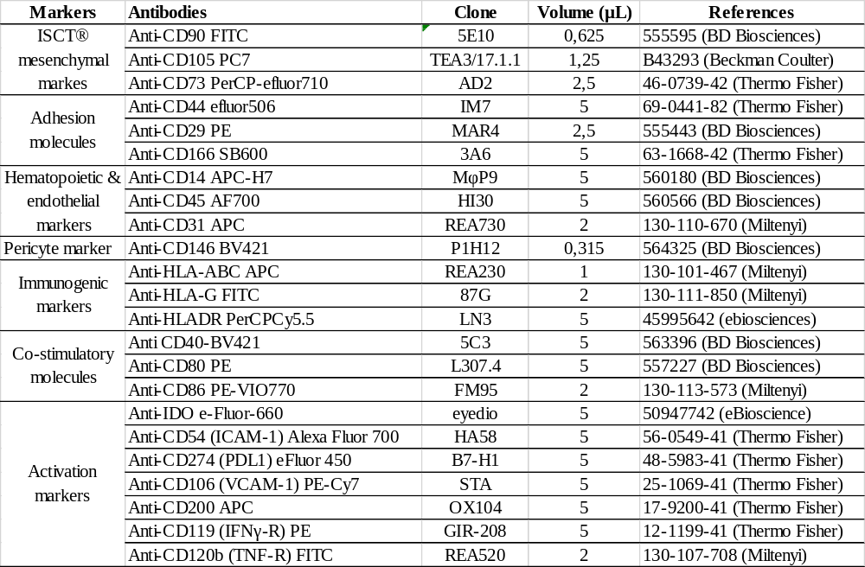
Additional file 1

Slide 2
Additional file 2

Slide 3
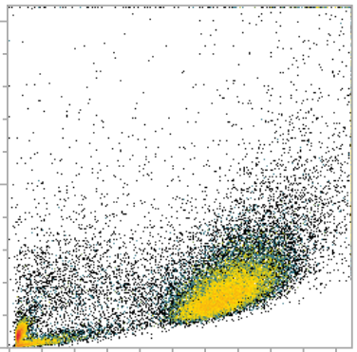
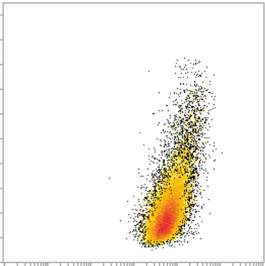
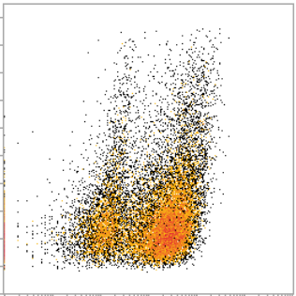
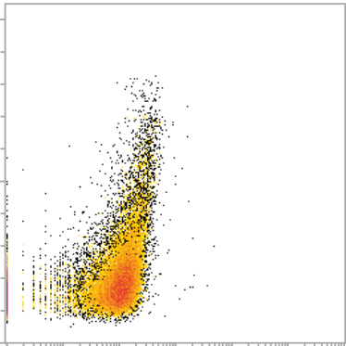
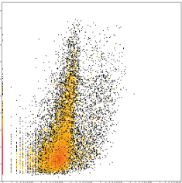
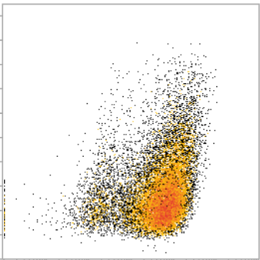
Additional file 3
A
Gated among Cells
Gated among MSCs
Cells
MSCs
MSCs expressing IDO
SSC-A
FSC-A
CD90
IDO
B
NT
Pro-inflammatory priming
IDO+ : 0%
IDO+ : 10 %
IDO+ : 90%
IDO+ : 70%
SSC-A
IDO
UC-MSCs^{low}
UC-MSCs^{high}
UC-MSCs^{pool2D}

Slide 4
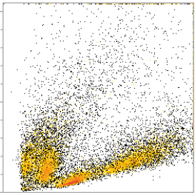
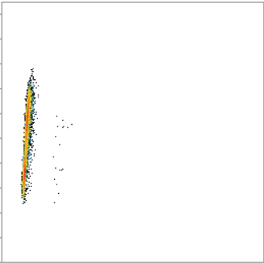
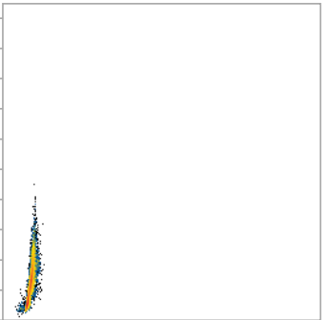
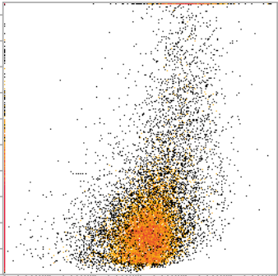
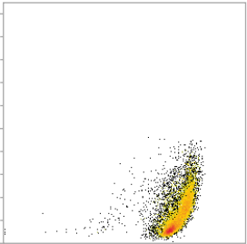
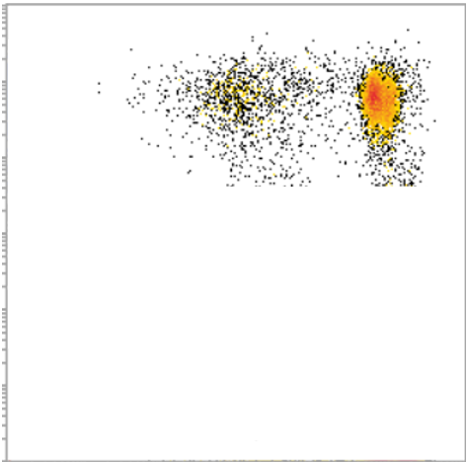
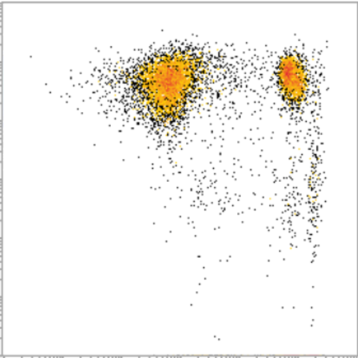
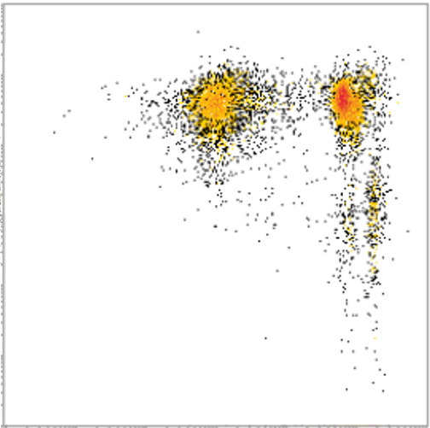
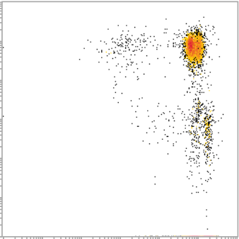
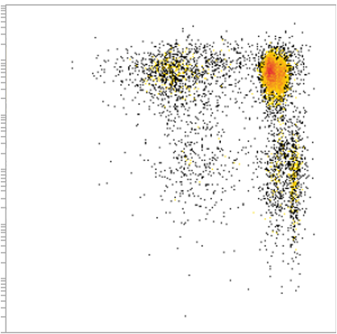
Additional file 4
A
Gated among Cells
Gated among FSC-singulets
Gated among SSC-singulets
Gated among viable cells
Gated among leukocytes
FSC-singulets
Viable cells
Cells
SSC-singulets
Leukocytes
Proliferative T-cells
SSC-A
FSC-H
SSC-H
SSC-A
SSC-A
CD3
FSC-A
FSC-W
SSC-W
7AAD
CD45
CTV
B
CD3
Proliferative T-cells : 70%
Proliferative T-cells : 50%
Proliferative T-cells : 5%
Proliferative T-cells : 25%
CTV
Control
UC-MSCs^{low}
UC-MSCs^{high}
UC-MSCs^{pool2D}

Slide 5
Additional file 5
A
B
C
D
E

Slide 6
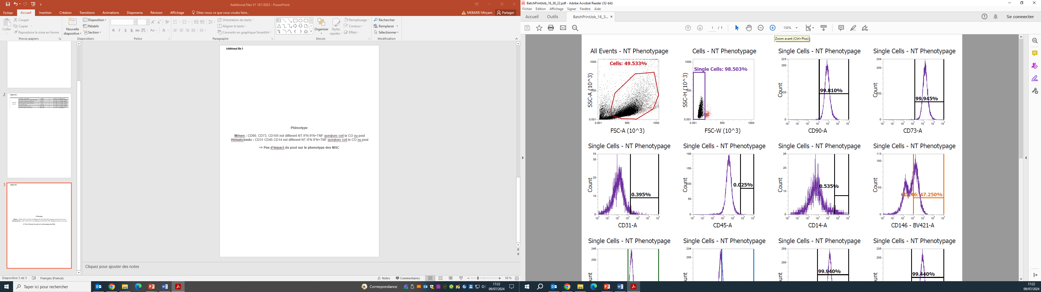
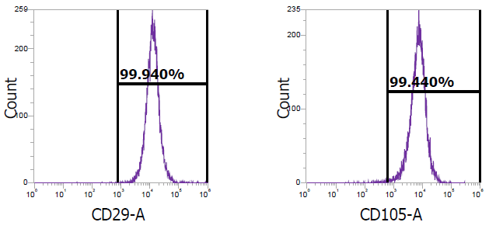
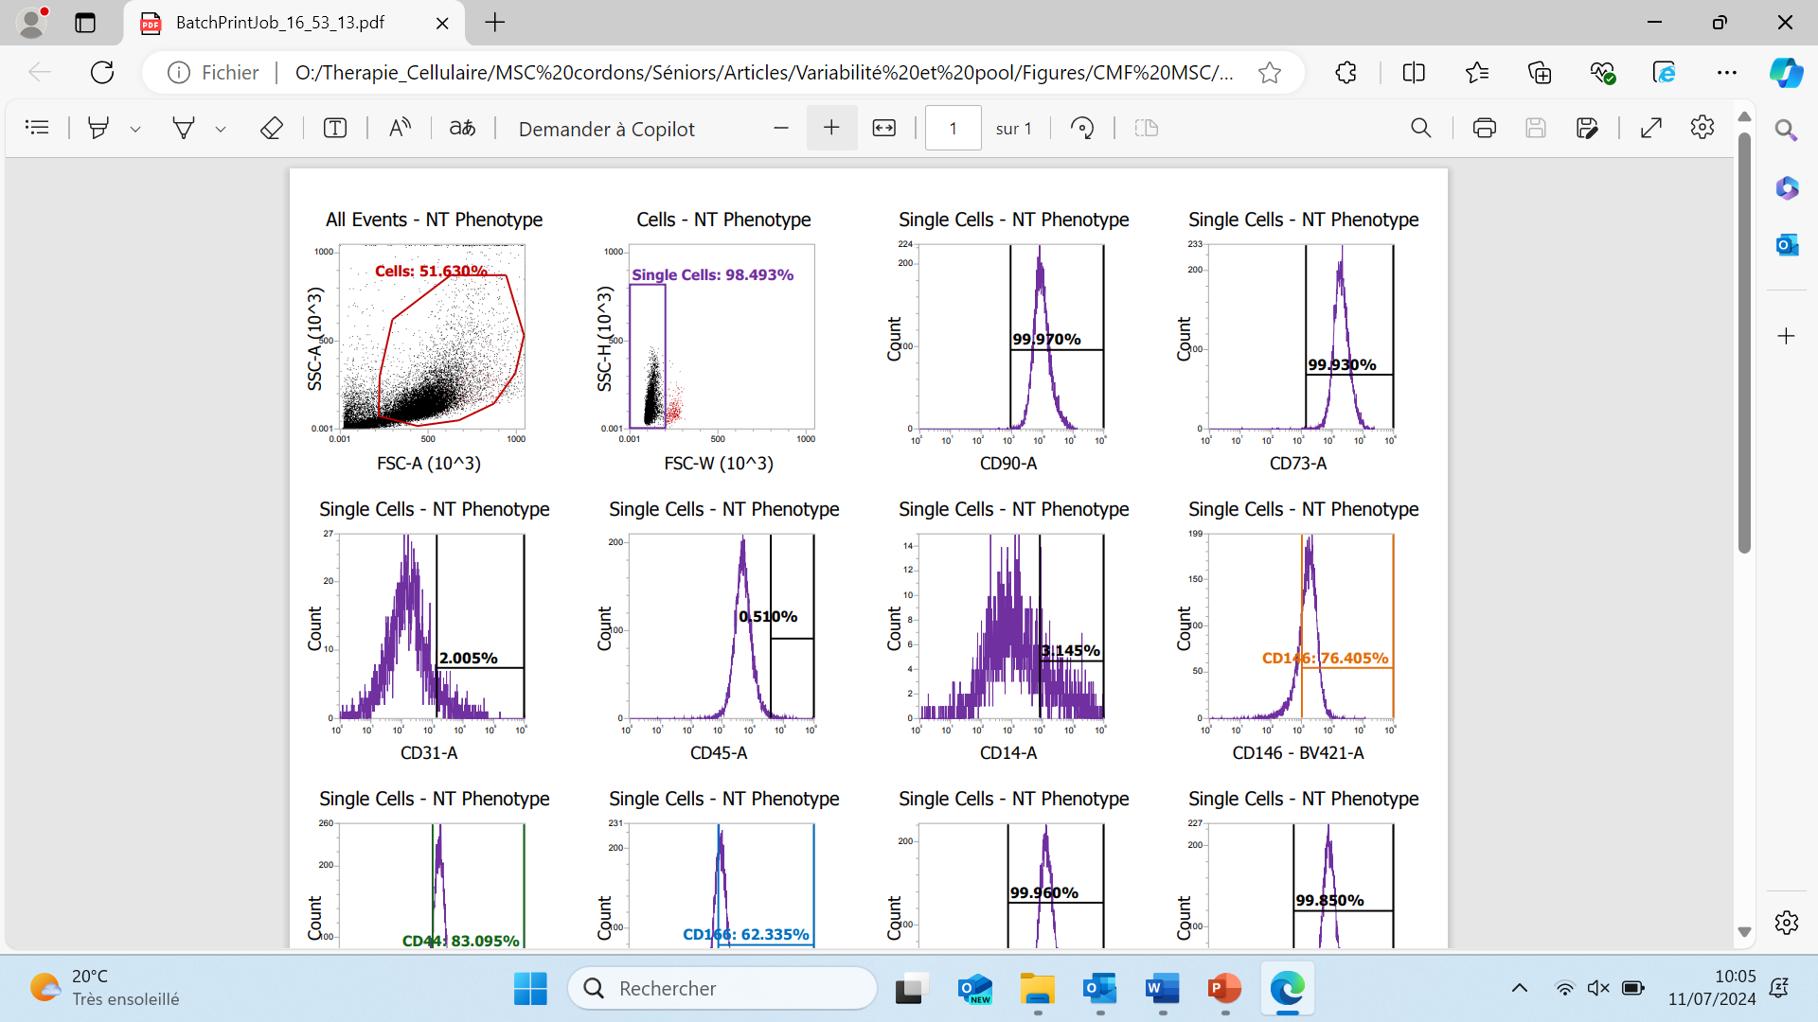
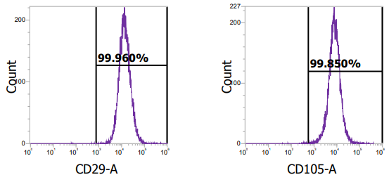
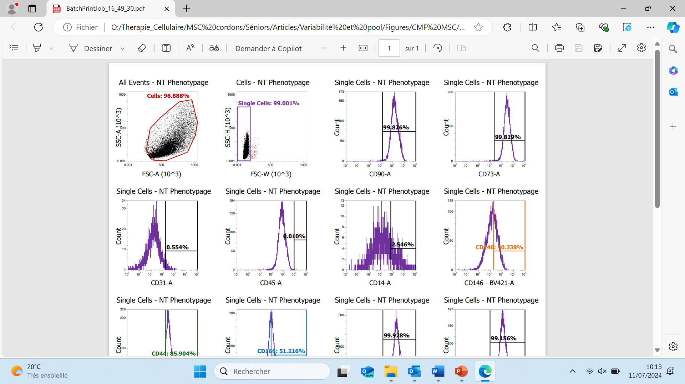
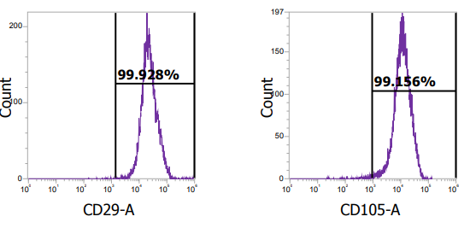
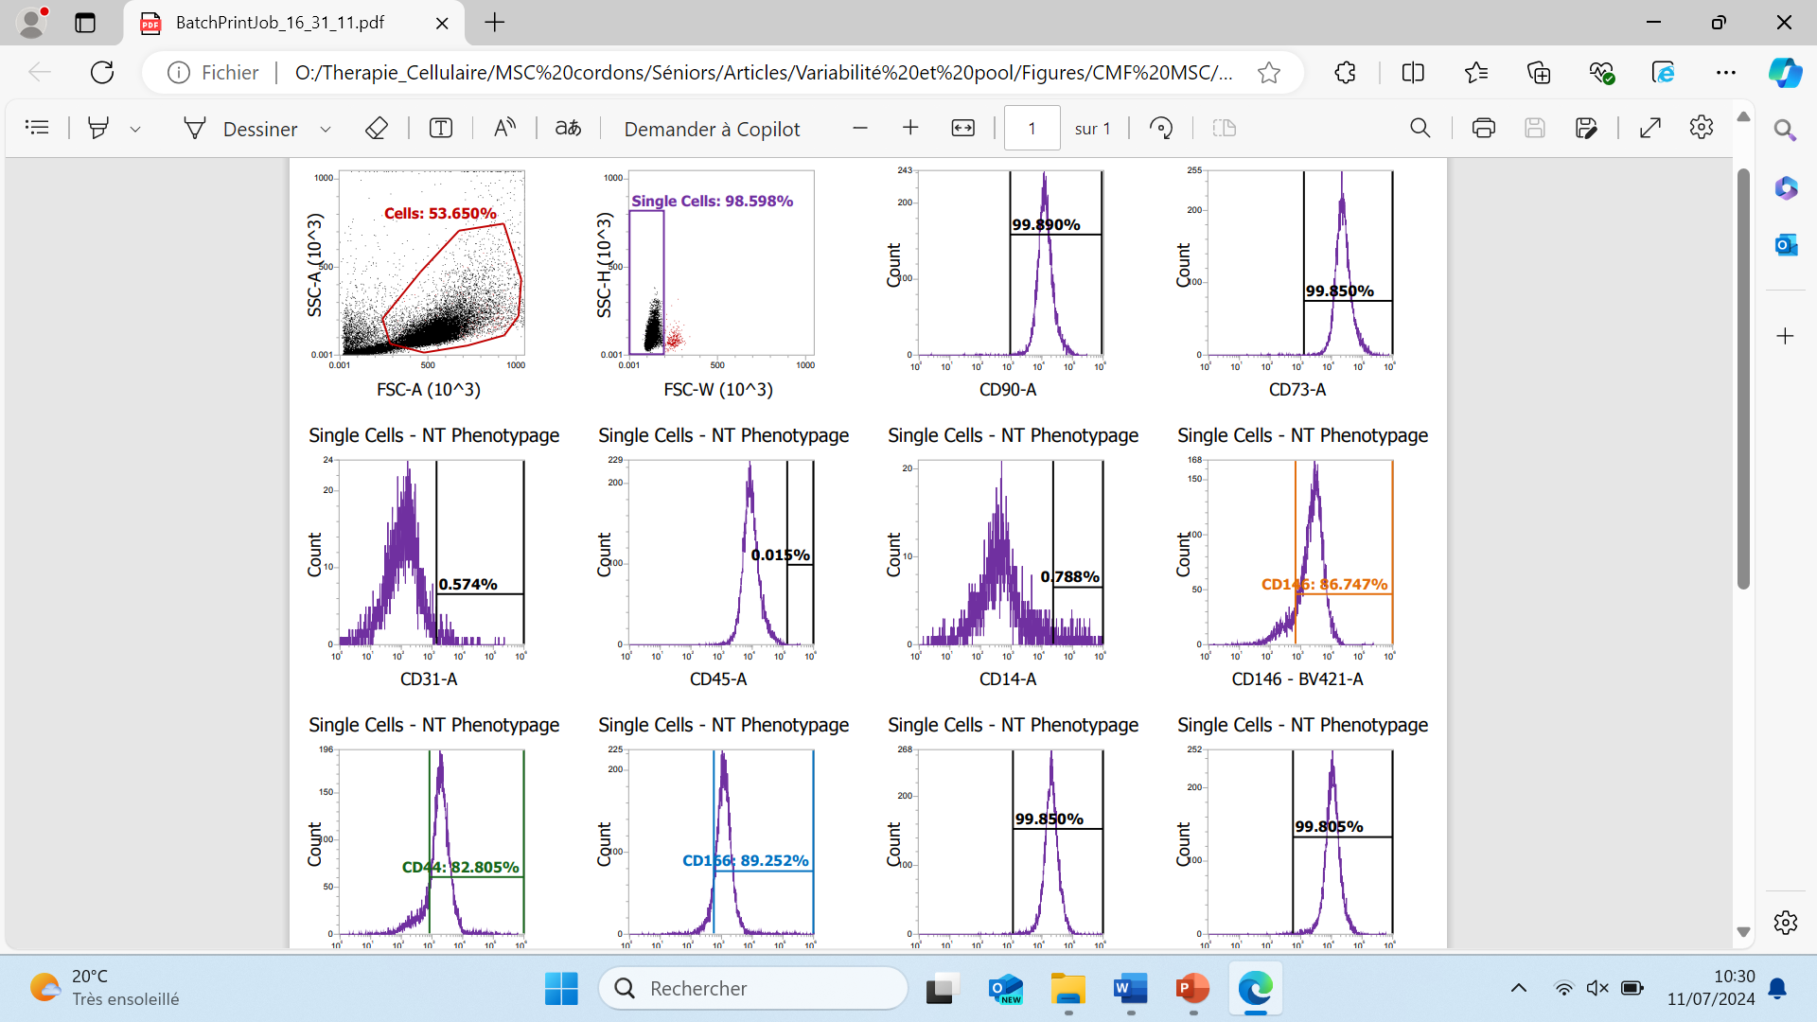
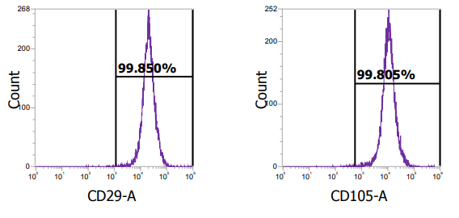
Additional file 6
A.
B.
C.
D.

