Slide 1
Supplementary Appendix
This appendix has been provided by the authors to give readers additional information about their work.
Supplement to: Tian Liu, et al. Efficacy and Safety of Low-Dose Interleukin 2 for Behçet’s Syndrome A Randomized Clinical Trial

Slide 2
Table of Contents
1、 | Supplementary Figures.............................................................................................. | 2
 | eFigure 1. .Changes of immunocyte in LD-IL-2 group and placebo group...................................................................................................................... | 3
 | eFigure 2. Phenotypic characterization of Neutrophil before Ld-IL2 therapy....................................................................................................................... | 4
 | eFigure 3. Flow cytometry results showing the changes of Neutrophil cells expression after co-stimulated with IL-2 in vitro………………………………….. | 5
 | eFigure 4. Phenotypic characterization of ILC2 subsets on ILC cells before Ld-IL2 therapy. ............................................................................................................... | 6
 | eFigure 5. Flow cytometry results showing the changes of ILC2 subsets on ILC cells expression after co-stimulated with IL-2 in vitro……………………………. | 7
 | eFigure 6. Disease Activity and clinical manifestation at Baseline, Week 4, Week 12, and Week 24........................................................................................................ | 8
 | eFigure 7. ILC2s and Neutrophils in PBMC change after IL-2 stimulation in vitro……………………………………………………………………………........
 |  | 9
2、 | Supplementary Tables............................................................................................... | 9
 | eTable 1. Clinical characteristics of study population and concomitant medication in LD-IL-2 group...................................................................................................... | 10
 | eTable 2. Clinical characteristics of study population and concomitant medication in placebo group......................................................................................................... | 11
 | eTable 3. Inclusion and exclusion criteria…………………………………………. | 12
 | eTable 4. Adverse events in participants who received low-dose IL-2 treatment…. | 13
 | eTable 5. Monoclonal antibody used in isolating neutrophil ………....................... | 14
 | eTable 6. Monoclonal antibody used in isolating ILCs ………………………….... | 15

Slide 3
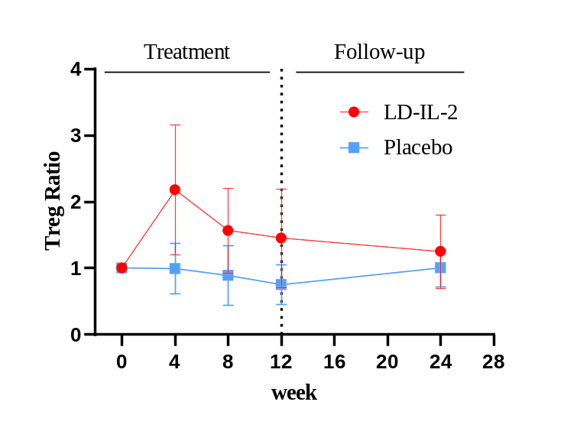
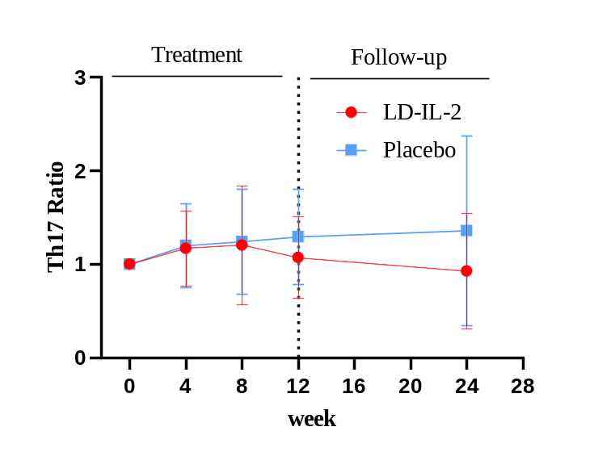
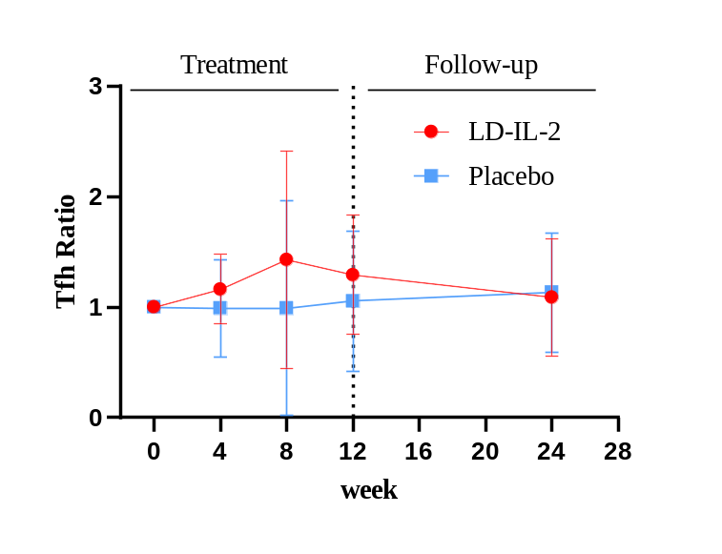
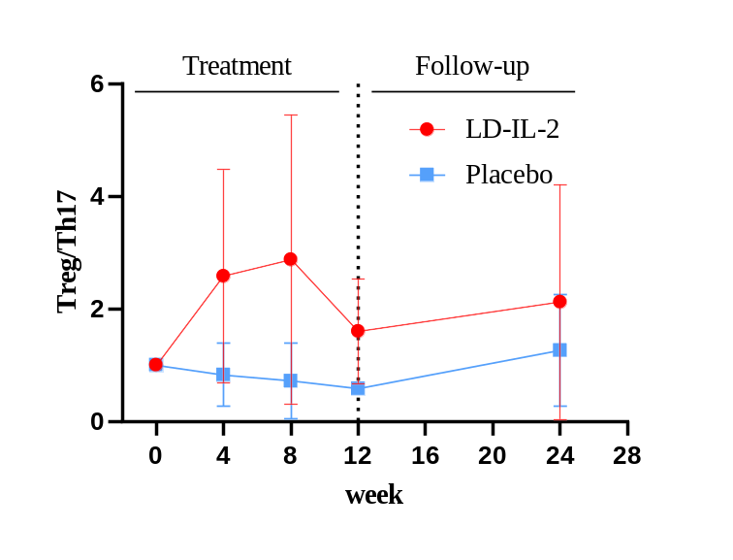
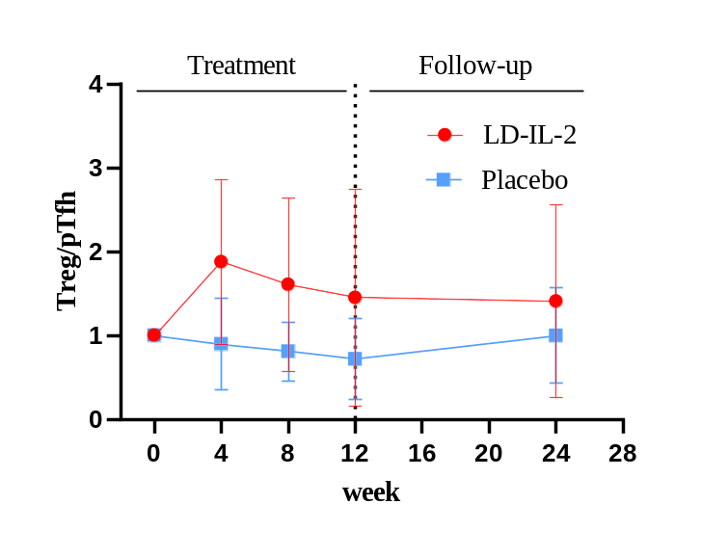
A
B
C
D
E
eFigure 1. Changes of immunocyte in LD-IL-2 group and placebo group
Multiple of cell number of Treg (A), Th17 (B), and Tfh (C) at week 4, 8, 12 and 24 to week 0. Multiple of ratio of Treg to Th17 (D) and ratio of Treg to Tfh (E) at week 4, 8, 12, 24 to week 0. The point is the mean and the error bars representing the SD.
Notes:
ESR是否保留

Slide 4
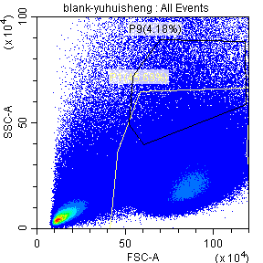
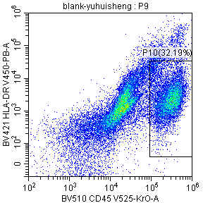
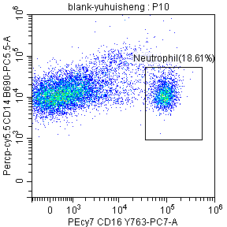
eFigure 2. Phenotypic characterization of Neutrophil before Ld-IL2 therapy.

Slide 5
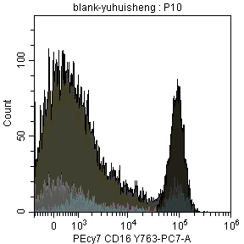
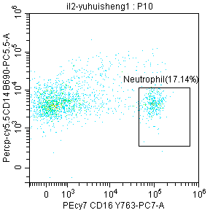
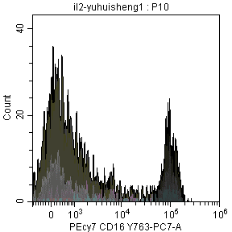
eFigure 3. Flow cytometry results showing the changes of Neutrophil cells expression after co-stimulated with IL-2 in vitro.

Slide 6
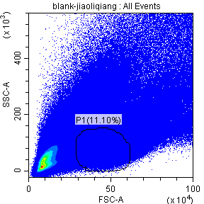
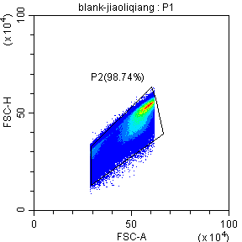
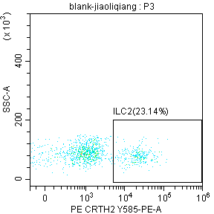
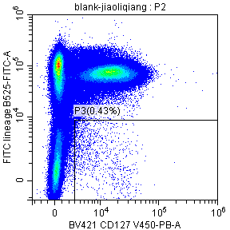
eFigure 4. Phenotypic characterization of ILC2 subsets on ILC cells before Ld-IL2 therapy.

Slide 7
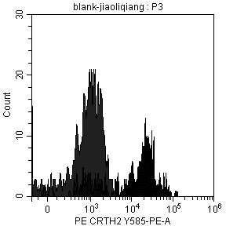
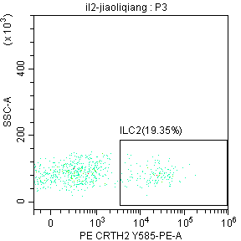
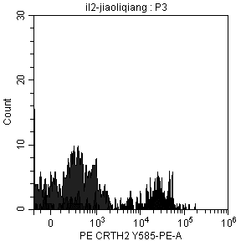
eFigure 5. Flow cytometry results showing the changes of ILC2 subsets on ILC cells expression after co-stimulated with IL-2 in vitro.

Slide 8
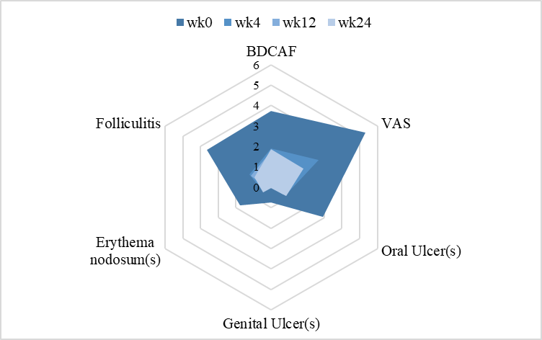
eFigure 6. Disease Activity and clinical manifestation at Baseline, Week 4, Week 12, and Week 24.

Slide 9
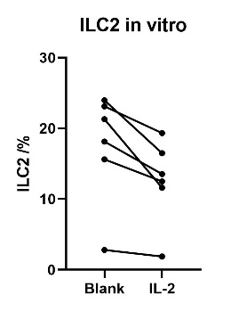
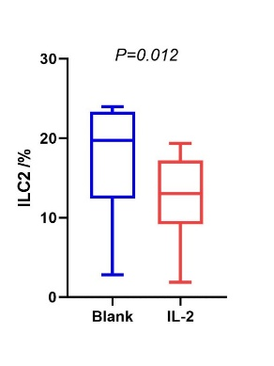
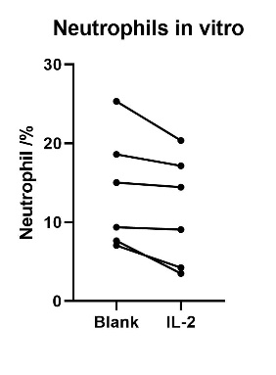
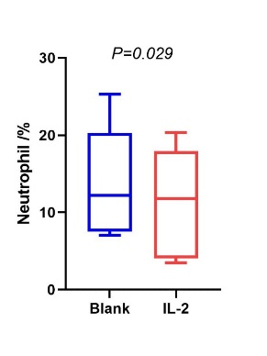
eFigure 7. ILC2s and Neutrophils in PBMC change after IL-2 stimulation in vitro

Slide 10
eTable 1. Clinical characteristics of study population and concomitant medication in LD-IL-2 group
SN | Sex | Age (yrs) | Duration (months) | Manifestation | Baseline concomitant treatment | Concomitant treatment at week 12 | Complete response
1 | M | 40 | 53 | Oral ulcer Erythema nodosum Folliculitis Joint involvement | Pred 15mg qd Col 0.5mg bid | Pred 7.5mg qd Col 0.5mg bid | CR
2 | M | 27 | 22 | Oral ulcer Erythema nodosum | Pred 12.5mg qd Thal 50mg qn | Pred 2.5mg qd Thal 50mg qn | CR
3* | F | 46 | 36 | Oral ulcer Genital ulcer | Col 0.5mg qd | discontinued the trial
4* | F | 50 | 240 | Oral ulcer | - | discontinued the trial
5 | M | 20 | 48 | Oral ulcer Folliculitis | HCQ 200mg bid | HCQ 200mg bid | CR
6 | F | 43 | 22 | Oral ulcer Genital ulcer Folliculitis | Thal 25mg qn | Thal 25mg qn
7* | F | 63 | 120 | Oral ulcer Folliculitis Joint involvement | HCQ 200mg bid | discontinued the trial
8 | F | 39 | 60 | Oral ulcer Genital ulcer Erythema nodosum | Col 0.5mg bid | Col 0.5mg bid
9 | M | 33 | 24 | Oral ulcer Erythema nodosum | - | -
10 | F | 41 | 120 | Oral ulcer Folliculitis | - | -
11 | M | 22 | 12 | Oral ulcer Folliculitis | Thal 50mg qn | Thal 50mg qn
12 | M | 43 | 180 | Oral ulcer Genital ulcer Erythema nodosum | Pred 10mg qd Thal 25mg qn | Thal 25mg qn | CR
13 | M | 36 | 22 | Oral ulcer Joint involvement | Pred 7.5mg qd MMF 500mg bid | MMF 500mg bid | CR
14 | F | 37 | 60 | Oral ulcer Erythema nodosum | Col 0.5mg bid HCQ 200mg bid | Col 0.5mg bid HCQ 200g bid | CR
15 | M | 34 | 60 | Oral ulcer Folliculitis | - | -
16 | M | 46 | 84 | Oral ulcer | Thal 12.5mg qn | Thal 12.5mg qn | CR
17 | M | 47 | 60 | Oral ulcer Genital ulcer Erythema nodosum | Pred 6.25mg qd Col 0.5mg bid | Col 0.5mg bid | CR
18 | F | 29 | 36 | Oral ulcer Genital ulcer Folliculitis | HCQ 200mg bid | HCQ 200mg bid | CR
19* | M | 23 | 16 | Oral ulcer Erythema nodosum | Pred 5mg qd Col 0.5mg bid | discontinued the trial
20 | M | 54 | 120 | Oral ulcer Genital ulcer Folliculitis Joint involvement Eye involvement | Pred 25mg qd CTX 50mg qod | Pred 10mg qd CTX 50mg qod
21 | M | 29 | 180 | Oral ulcer Genital ulcer Erythema nodosum Folliculitis Joint involvement Eye involvement | Pred 12.5mg qd MMF 500mg bid | Pred 7.5mg qd MMF 500mg bid | CR
22 | M | 22 | 5 | Oral ulcer Folliculitis | Col 0.5mg qd | Col 0.5mg qd | CR
23 | M | 28 | 36 | Oral ulcer Folliculitis | HCQ 200mg bid | HCQ 200mg bid | CR
24 | M | 37 | 72 | Oral ulcer Erythema nodosum Folliculitis | Pred 10mg qd Col 0.5mg bid HCQ 200mg bid | Col 0.5mg bid HCQ 200mg bid | CR
25 | M | 55 | 36 | Oral ulcer Joint involvement | Col 0.5mg bid | Col 0.5mg bid | CR
26 | M | 57 | 48 | Oral ulcer Erythema nodosum Folliculitis Eye involvement | Thal 25mg qn Col 0.5mg bid HCQ 200mg bid | Thal 25mg qn Col 0.5mg bid HCQ 200mg bid
27 | F | 44 | 12 | Oral ulcer Genital ulcer Erythema nodosum Folliculitis | Pred 10mg qd Thal 25mg qn | Pred 10mg qd Thal 25mg qn
28 | F | 40 | 12 | Oral ulcer Genital ulcer Eye involvement | Thal 50mg qn MMF 750mg bid | Thal 50mg qn MMF 750mg bid | CR
29 | F | 47 | 240 | Oral ulcer Joint involvement | - | - | CR
30 | M | 28 | 18 | Oral ulcer Genital ulcer Folliculitis Joint involvement Gastrointestinal | Pred 15mg qd Col 0.5mg bid CTX 50mgqod | Pred 12.5mg qd Col 0.5mg bid CTX 50mgqod
Pred: prednisone; Col: colchicine; MMF: mycophenolatemofetil; HCQ: hydroxychloroquine; CTX: cyclophosphamide; Thal: thalidomide
-：only ues topical glucocorticoids.

Slide 11
eTable 2. Clinical characteristics of study population and concomitant medication in placebo group
SN | Sex | Age (yrs) | Duration (months) | manifestations | Baseline concomitant treatment | Concomitant treatment at week 12 | Complete response
1 | F | 33 | 36 | Oral ulcer Genital ulcer | Thal 50mg qn | Thal 50mg qn | CR
2 | F | 29 | 36 | Oral ulcer Gastrointestinal | Pred 5mg qd MMF 500mg bid | Pred 5mg qd MMF 500mg bid
3 | M | 38 | 96 | Oral ulcer Folliculitis | Thal 25mg qn | Thal 25mg qn
4 | M | 39 | 48 | Oral ulcer Genital ulcer Folliculitis | Thal 25mg qn | Thal 25mg qn | CR
5 | M | 68 | 288 | Oral ulcer Genital ulcer Erythema nodosum Folliculitis Joint involvement | Pred 5mg qd MMF 500mg bid | Pred 5mg qd MMF 500mg bid
6 | F | 38 | 24 | Oral ulcer Genital ulcer Eye involvement | Col 0.5mg bid | Col 0.5mg bid
7 | M | 44 | 84 | Oral ulcer Genital ulcer Eye involvement | Pred 10mg qd | Pred 7.5mg qd
8 | F | 55 | 60 | Oral ulcer Genital ulcer Folliculitis Joint involvement | Col 0.5mg bid | Col 0.5mg bid | CR
9 | M | 57 | 360 | Oral ulcer | HCQ 200mg bid | HCQ 200mg bid
10 | M | 58 | 204 | Oral ulcer Folliculitis Joint involvement Gastrointestinal | Pred 15mg qd HCQ 100mg bid | Pred 12.5mg qd HCQ 100mg bid
11 | M | 42 | 60 | Oral ulcer Genital ulcer Erythema nodosum Eye involvement | Pred 30mg qd CTX 400mg q2w | Pred 15mg qd CTX 400mg q2w
12 | F | 28 | 36 | Oral ulcer | Thal 50mg qn | Thal 50mg qn
13 | F | 50 | 1 | Oral ulcer Eye involvement | Pred 10mg qd Thal 25mg qn | Pred 10mg qd Thal 25mg qn
14 | F | 34 | 24 | Oral ulcer Folliculitis | Col 0.5mg bid | Col 0.5mg bid
15 | M | 56 | 72 | Oral ulcer Genital ulcer | - | -
16 | M | 14 | 24 | Oral ulcer | Pred 10mg qd | Pred 5mg qd
17 | F | 32 | 48 | Oral ulcer | Thal 100mg qn | Thal 100mg qn
18 | M | 54 | 360 | Oral ulcer Folliculitis | Pred 10mg qd | Pred 10mg qd
19 | M | 33 | 9 | Oral ulcer Genital ulcer Folliculitis | Pred 20mg qd Col 0.5mg bid | Pred 10mg qd Col 0.5mg bid
20 | F | 21 | 60 | Oral ulcer Genital ulcer Erythema nodosum | Pred 5mg qd HCQ 200mg bid Thal 25mg qn | HCQ 200mg bid Thal 25mg qn
21 | M | 31 | 10 | Oral ulcer Folliculitis | - | - | CR
22 | M | 53 | 60 | Oral ulcer Folliculitis Eye involvement | Pred 10mg qd MMF 750mg bid | Pred 7.5mg qd MMF 750mg bid
23 | F | 63 | 48 | Oral ulcer Genital ulcer Joint involvement Gastrointestinal | Pred 12.5mg qd CTX 400mg q2w | Pred 10mg qd CTX 400mg q2w
24 | M | 34 | 42 | Oral ulcer Folliculitis Gastrointestinal | Thal 50mg qn MMF 500mg bid | Thal 50mg qn MMF 500mg bid
25 | M | 40 | 240 | Oral ulcer Genital ulcer | Pred 15mg qd | Pred 15mg qd
26 | F | 63 | 24 | Oral ulcer Joint involvement Gastrointestinal | Thal 25mg qn MMF 500mg bid | Thal 25mg qn MMF 500mg bid
27 | F | 35 | 120 | Oral ulcer Folliculitis Gastrointestinal | Pred 10mg qd MMF 500mg bid HCQ 0.2g bid | Pred 10mg qd MMF 500mg bid HCQ 0.2g bid
28 | F | 45 | 24 | Oral ulcer Folliculitis Eye involvement | Pred 40mg qd CTX 400mg q2w | Pred 25mg qd CTX 400mg q2w
29 | M | 41 | 120 | Oral ulcer Folliculitis | - | - | CR
30 | M | 31 | 240 | Oral ulcer Genital ulcer Folliculitis | Thal 50mg qn | Thal 50mg qn
Pred: prednisone; Col: colchicine; MMF: mycophenolatemofetil; HCQ: hydroxychloroquine; CTX: cyclophosphamide; Thal: thalidomide
-：only ues topical glucocorticoids.

Slide 12
eTable 3. Inclusion and exclusion criteria.
Inclusion criteria
1. Men or women 18-70 years of age (or the legal age of consent in the jurisdiction in which the study is taking place).
2. Diagnosis of Behçet’s Disease (according to the 1990 ISG ) for ≥3 months before screening.
3. Active oral ulcer at time of screening.
4. Patients on corticosteroids ( (≤1 mg/kg/d prednisone or equivalent), DMARDs (e.g. methotrexate, hydroxychloroquine, azathioprine, MMF, leflunomide, ciclosporin etc.), must have been on a stable dose for 4 weeks prior to receiving the first infusion of study medication and expected to remain on this dose throughout the study. If the registered doctor plans to quit using current DMARDs or glucocorticoids, the washout period needs to be followed before patients join the groups. Each drug needs to meet the following washout period glucocorticoids 2 weeks DMARDs ( including m methotrexate, hydroxychloroquine, azathioprine, MMF, leflunomide, and ciclosporin ) 4 weeks IVIg or cyclophosphamide 2 months Rituximab 6 months other bDMARDs e.g. Infliximab, Adalimumab, Enanercept etc.etc.) 12 weeks
Exclusion criteria
1. BD related active major organ involvement requiring immunosuppressive therapy, e.g., pulmonary (e.g., pulmonary artery aneurysm ), vascular (e.g., thrombophlebitis , recurrent malignant aneurysms), gastrointestinal (e.g., gastrointestinal ulcers), and central nervous system (e.g., meningoencephalitis).
2. High dose glucocorticoid (>1mg/kg/d) usage within 1 month.
3. Severe comorbidities: including Heart failure (≥ grade III NYHA); Renal Renal insufficiency (creatinine clearance ≤30 ml/min); insufficiency (creatinine clearance ≤30 ml/min); Hepatic insufficiency (serum ALT or AST >3 times the ULN, or total bilirubin >ULN for the central laboratory conducting the test).
4. Other severe, progressive or uncontrolled hematologic, gastrointestinal, endocrine, pulmonary, cardiac, neurologic, or cerebral disease (including demyelinating diseases such as multiple sclerosis).
5. Known allergies, hypersensitivity, or intolerance to IL-2 or its excipients.
6. History of severe allergic reaction to monoclonal antibodies or to murine, chimeric, or human proteins or their excipients.
7. Had a severe infection (including, but not limited to hepatitis, pneumonia, sepsis, or pyelonephritis); had been hospitalized for an infection; or had been treated with IV antibiotics for an infection, within 2 months prior to the first administration of study agent.
8. Chest radiograph within 3 months prior to the first administration of study agentthat showed an abnormality suggestive of a malignancy or current active infection, including TB.
9. Infected with HIV (positive serology for HIV antibody) or hepatitis C (positiveserology for Hep C antibody). If seropositive, consultation with a physician with expertise in the treatment of HIV or hepatitis C virus infection was recommended.
10. Infected with hepatitis B virus. For patients who were not eligible for this study due to hepatitis B virus test results, consultation with a physician with expertise in the treatment of hepatitis B virus infection was recommended.
11. Had any know, malignancy or has a history of malignancy within the previous 5 years (with the exception of a nonmelanoma skin cancer that had been treated with no evidence of recurrence for ≥3 months before the first study agent administration or cervical neoplasia with surgical cure).
12. Had uncontrolled psychiatric or emotional disorder, including a history of drug and alcohol abuse within the past 3 years that might prevent the successful completion of the study.
13. Received, or was expected to receive, any live virus or bacterial vaccination within 3 months before the first administration of study agent, during the study, or within 4 months after the last administration of study agent. Had a BCG vaccination within 12 months of screening.
14. Pregnancy, lactation or women of child-bearing potential (WCBP) unwilling to use medically approved contraception whilst receiving treatment and for 12 months after treatment has finished.
15. Men whose partners are of child-bearing potential but who are unwilling to use appropriate medically approved contraception whilst receiving treatment and for 12 months after treatment has finished.

Slide 13
eTable 4. Adverse events in participants who received low-dose IL-2 treatment.
 | Low-dose IL-2 group (n=30) | Placebo group (n=30)
Injection site reaction | 4/30 | 1/30
Fever after injection | 2/30 | 0

Slide 14
eTable 5. Monoclonal antibody used in isolating neutrophil.
Antigen | Clone | Fluorochrome | Vendor
CD45 | HI30 | BV510 | Biolegend
HLA-DR | L243 | BV421 | Biolegend
CD14 | HCD14 | Percp-cy5 | Biolegend
CD16 | 3G8 | PEcy7 | Biolegend

Slide 15
eTable 6. Monoclonal antibody used in isolating ILCs.
Antigen | Clone | Fluorochrome | Vendor
CD127 | AO19D5 | BV421 | Biolegend
CRTH2 | BM16 | PE | Biolegend
CD3 | UCTH1 | FITC | Biolegend
CD4 | RPA-T4 | FITC | Biolegend
CD8 | MEM-31 | FITC | Biolegend
CD15 | HI98 | FITC | Biolegend
CD16 | RMO52 | FITC | Biolegend
CD19 | H1B19 | FITC | Biolegend
CD20 | 2H7 | FITC | Biolegend
CD33 | HIM3-4 | FITC | eBioscience
CD34 | 561 | FITC | Biolegend
FcεRI | AER-37 | FITC | Biolegend
CD203c | NP406 | FITC | Biolegend

