Slide 1
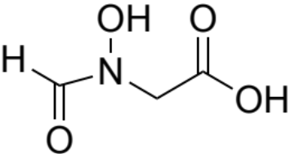
PF3D7_0206700
ADSL (adenylosuccinate lyase)
80/78
Involved in purine salvage, an essential process
It is essential in falciparum, and berghei screens
Distant from human ortholog, low genetic variation
Expressed in asexuals, oocysts and mosquito spz
Recombinant expression of active enzyme
Known spectrophotometric assay
P vivax structure exists
Tool compounds available (Hadacidin kill parasites and has mid micromolar concentrations)
Determine reasons research was halted
  Possibly evaluation of pathway and looked at all the enzymes to understand function, not really trying to find drugs
HTS library screen to identify drug-like inhibitor starting points​
No publications for 15 years
Tool compound concerns
  May not be hitting target
  Need better tool compound
  Quite a lot of work to even get to tool compound, no structure starting point
Small polar active sites are challenging

Slide 2
PF3D7_1354500
ADSS (adenylosuccinate synthetase)
83/94
Catalyses the Mg2+ dependent formation of adenylosuccinate from IMP and aspartate, the reaction being driven by the hydrolysis of GTP to GDP.
Important in the purine salvage pathway.
Essential in Pf screen, no other data.
Mostly expressed in asexual stages.
Moderate amount of SNPs present.
The structure of AdSS has been solved complexed to 6-phosphoryl IMP, GDP, Mg2+ and the aspartate analogue, hadacidin at 2 A resolution (PMID: 14729341).
  Crystal structure forms homodimer
The conversion of IMP to succinyl-AMP and enzyme kinetics were analyzed (PMID:15500910)
Compounds for bacterial ADSS known
Confirm falciparum essentiality and likely confirm for other species
Perform ABS assay
Identify falciparum tool compound with analog or library screening
No inhibitor studies in Pf cultures, in vitro enzyme assays only.
Prostate cancer target, cancer inhibitors don’t work against plasmodium
  There may be chemistry liabilities
Hypoxanthine might be issue for readout/bypass if it’s in purine biosynthesis pathway as well

Slide 3



PF3D7_1344800
ATCase (aspartate carbamoyltransferase)
78/86
Enzyme catalyzing the second step in Pf pyrimidine biosynthesis: condensation of L-aspartate with carbamoyl phosphate ​
Other drugs targeting this pathway (DHODH is 4th step)​
Human CAD enzyme has modest similarity (49% similar)​
Little genetic variation: 7 nonsynonymous SNP’s​
Allosteric ligand identified: weakly active, not drug-like (2,3 dihydroxynaphthalene, enzyme IC50 = ~5 uM)​
Truncated functional enzyme has been cloned and expressed​
Multiple assay formats have been described in the literature (doi.org/10.1016/j.bbrc.2018.02.112)​
X-ray structure available, 5ILN with citrate bound in orthosteric site and 6FBA with allosteric ligand bound ​
N-carbamoyl-l-aspartate​
Citric acid​
2,3 dihydroxynaphthalene​
Three possible approaches:​
  Structure-guided FHA on 2,3-dihydroxynaphthalene to move into more druglike space; potential to employ fragment linking strategy​
  Utilize crystal structure with bound allosteric for virtual screening​
  HTS using small molecule library to identify drug-like inhibitor starting points​
All approaches require cloning and expressing functional enzyme and assay​
Active site is extremely polar, may not identify drug-like orthosteric inhibitors​
Allosteric inhibitors identified to date are not potent or drug-like, have not demonstrated parasite inhibition​
Need for human selectivity​
Parasite inhibition likely to have a lag phase (like DHODH)​

Slide 4
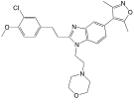


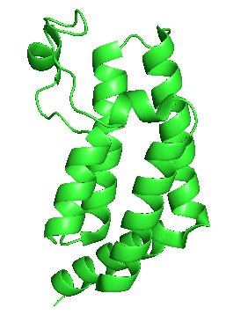
PF3D7_1033700
BDP1 (bromodomain protein 1)
86/86
Epigenetic ‘reader’ of histone acetylated lysine, recognizes and assists other factors to mediate cellular invasion and growth of parasite​
Protein expressed in Ecoli (for xray) ​
Essentiality proven on genetic testing​
Some genetic variation, (9 nonsyn, 0 stop codons of 135)​
No exact Hs ortholog, but other Hs bromodomains do exist ​
Good work published​
Biochemical binding assays known for other BRDs​
PfBDP1 expressible​
Phenotypic ABS active inhibitors1 identified via VS of commercial Hs BRD library, but no binding data​
Apo pfBDP1 structure available (7m97)​
Liganded pfBDP4 structure available (5vs7)​
SGC-CBP30​
Dd2 IC50=10uM​
HEK293 22uM​
OSSK-842646​
Dd2 IC50=11.3uM​
HEK293 >50uM​
OSSL-258906​
Dd2 IC50=11.8uM​
HEK293 >50uM​
Ligand
site
Develop biochemical target assays​
Screen for new inhibitors​
Screen further known Hs bromodomain ligands​
Follow-up literature cpds​
VS available libraries (pharmacophore and docking)​
Biochemical assays known for other BRDs, but no BDP1 binding assay currently available​
Finding new ligands may require extensive HTS screening​
Availability of additional libraries for screening
Literature cpds must be vetted/validated
VS may not produce progressible hits​
PDB 7m97​

Slide 5
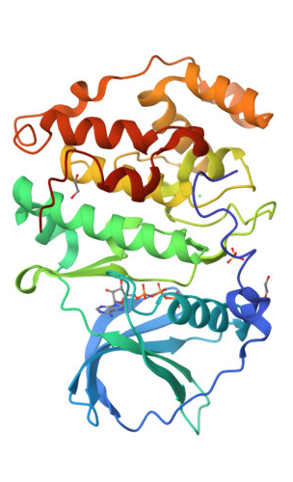
PF3D7_1108400
CK2alpha (casein kinase 2, alpha subunit)
82/82
Serine/threonine-selective protein kinase implicated in cell cycle control, DNA repair, regulation of the circadian rhythm, and other cellular processes (hundreds of substrates in Plasmodium)
De-regulation of CK2 has been linked to tumorigenesis as a potential protection mechanism for mutated cells.
CK2 is a tetramer; α 42 kDa; α’ 38 kDa, two β 28 kDa
The catalytic subunit of Plasmodium falciparum casein kinase 2 is essential for gametocytogenesis
Essential for merozoite invasion and gametocytogenesis
Conditional knockdown of PfCK2α expression (PMID 33712726)
  Prevented transition of stage IV into stage V gametocytes
Conditional knockout of PfCK2α expression (PMID 33712726)
  Blocked gametocyte maturation
Crystallographic structure of the catalytic domain in complex with ATP at a resolution of 3.0 Å (PMID 29743645)
Functional Analysis available
Tool compounds available (silmitasertib, Quinalizarin, Rottlerin)
Evaluate essentiality in ABS, currently unclear
Potential allosteric sites (not yet explored)
  Redesign compounds
Challenging to develop a high-throughput screening assay
Selectivity may be challenging, despite examples showing it is possible
cKD shows no effect on ABS growth (but β regulatory subunit seems to be essential in this stage)
Ligand
site
PDB 5XVU​

Slide 6
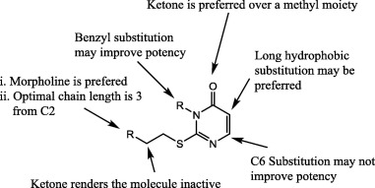
PF3D7_0307400
ClpP (ATP-dependent Clp protease proteolytic subunit)
77/74
Part of multisubunit complex (ATP-dependent Clp protease proteolytic subunit)
ClpS regulates activity of ClpA/P chaperone/protease itself
Only a couple of papers on Plasmodium ortholog; most recent being 2017
Structure solved for P. falciparum
Parasite-active probes identified (PMID: 28917450, 20545854)
Deep literature in prokaryotes/source for additional inhibitors
Proteomics data available (PlasmoDB)
PMID 28917450
Verify essentiality
Identify inhibitors that disrupt the adaptor function of ClpP
Variants of FP assay could be used for HTS
Binding site is quite small
Not an easy target, have to have the whole complex to be functional
There could be synergies, not classic biochemical pathway, is part of the degradation pathway
Interfering with recognition of degron sequences drives cell death phenotype but it could be indirect instead

Slide 7
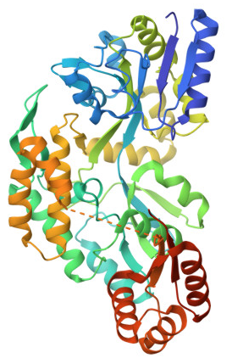
PF3D7_1320100
ClpS (ATP-dependent Clp protease adapter protein ClpS)
77/69
ClpS is predicted to function as an adaptor protein that delivers N-end rule substrates to the ClpA/P chaperone/protease in the apicoplast (PMID: 26701219)
In bacteria, ClpS recognizes specific N-terminal degrons and delivers the associated substrates to the ClpA/P chaperone/protease
No known human homologs
Seems to be expressed in schizonts, trophozoites, rings, gametocytes, ookinetes
Gene is highly conserved
Crystal structure of Pf fragment solved (res 73-192; PMID 26701219) – 2.7 Å
E. coli crystal structure of ClpS solved (PDB ID: 3O2B) - 2.05 Å
Predicted small molecule binding sites (N-terminal peptide degrons)
Functional assays available (PMID 26701219)
Identify inhibitors that disrupt the adaptor function of ClpS
Variants of FP assay could be used for HTS
Binding site is quite small based on E. coli ClipS
Not an easy target, have to have the whole complex to be functional
There could be synergies, not classic biochemical pathway, is part of the degradation pathway
Interfering with recognition of degron sequences drives cell death phenotype but it could be indirect instead
PDB 4O2X​

Slide 8
PF3D7_0907400
ClpY (ATP-dependent protease ATPase subunit ClpY)
72/73
The ClpQY machinery is a multimeric system consisting of a small barrel of two stacked hexameric rings of ClpQ protease with the active site facing inside the barrel
ATP-dependent protease ATPase subunit ClpY
ClpY recognizes, unfolds, and translocates substrates into PfClpQ.
Essential by falciparum parasites. In berghei, gene deletion was successful suggesting that the gene is not essential for asexual blood stage growth/multiplication
No human orthologue for the PfClpY/Q system. In prokaryotes the orthologue is HsIU.
PfClpY/Q recombinantly expressed individually and isolated as a complex by immunoprecipitation from parasite lysates.
Assays for protease activity or rudimentary binding assays reported
Structures of the HslU and HSIUV complex in E. coli available.
Homology model available for PfClpY/Q complex.
Small molecules have been reported to inhibit ClpQ protase activity and peptides to disrupt the PfCpY/Q complex
Identify disruptors of ClpY/Q complex
Gather more information to determine next steps/assays to perform
Peptide-based inhibitor caused loss of mitochondrial membrane potential, stopping mitochondria can cause a lot of havoc
Artemisinin resistant parasite quiescent state still susceptible to mitochondria targeting drugs
Recombinant expression of protein complex could be challenging
High through put assay to identify compounds that disrupt ClpY/Q complex needs to be developed

Slide 9
PF3D7_1444800
FBPA (fructose-bisphosphate aldolase)
79/88
FBPA is a central enzyme in glycolysis splitting fructose-1,6-bisphosphate into two triose sugars (or condensing them in the reverse direction).
Expressed in all life cycle stages
Has been considered as a therapeutic target in oncology (PMID: 34458323)
Structural information with a compound for Pf is available (PDB 1A5C, 4TR9, 2EPH)
A novel mode of action is reported, which stabilises the interaction of FBPA with TRAP (thrombospondin-related anonymous protein) which in turn inhibits gliding and invasion (PMID 26289816).
Compounds that bind to the enzyme active site inhibit aldolase-TRAP interaction, and vice versa (PMID 14595113)
Structures of class I and class II FBP aldolases are known from multiple species, with and without ligand
Functional assays are NADH coupled, so need to be modified for HTS screening
Confirm druggability
  Identify where are the inhibitors binding
FRET assay to screen for protein protein interaction
  MTRAP interacts with aldolase, aldolase and microtubule interaction propels merozoite invasion
Knockdown evaluation
Might show selectivity concerns
  54% identity to human enzyme
Compounds binding other proteins may have effects or vice versa
Requires stoichiometric amounts of inhibitor since it’s not catalytic event

Slide 10
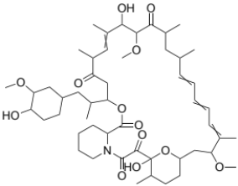
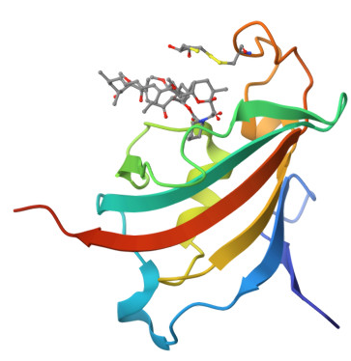
PF3D7_1247400
FKBP35 (peptidyl-prolyl cis-trans isomerase FKBP35)
71/74
PfFKBP35 belong to the immunophilin family, more commonly known as FK506 binding proteins (FKBPs).
Members of the FKBP family show a canonical peptidyl-prolyl cis-trans isomerase (PPIase) or rotamase activity and regulate various physiological functions, including protein folding, stability, histone chaperone activity, receptor signaling, protein trafficking, transcription, calcium homeostasis, spermatogenesis, and neuroprotective and neurotrophic activities.
Essential in falciparum and unclear in berghei parasites
Not very similar to human ortholog, but conserved in Pf7 dataset
Has X-ray crystallographic structures
  PfFK506-binding protein with rapamycin (PMID 26057671)
  PfFK506 and PvFK506 binding domains in complex with small molecule D44 (PMID 23974147)
Genetically validated as a target (PMID 37934560)
  Conditional knockdown and knockout
  Cellular thermal shift assays
Identify additional hit/tool compounds
  Test inhibition
  Perform SAR, if needed
Evaluate phenotypic response
Difficulty generating growth phenotype in cKD line
FKBP35 requires near maximal knockdown in order to observe a growth phenotype
Slow acting
Rapamycin
PDB 4QT3​

Slide 11
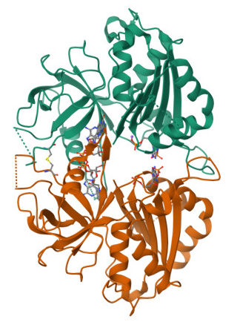
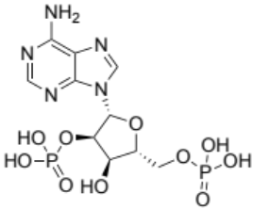
PF3D7_0623200
FNR (ferredoxin--NADP reductase)
89/89
FNR is a plant-type ferredoxin-NADP+ reductase and yields reduced ferredoxin for biosynthetic pathways in the apicoplast (PMID: 17258767)
Seems to be expressed in trophozoites, rings, gametocytes, and ookinetes
No known human homologs
Strong essentiality data
Plasmodium protein has been expressed and structure is solved (PMID 17258767, 19736991)
Functional assays developed
Small molecule binding site known (binds FAD, adenosine-2'-5'-diphosphate)
Tool compound available
  Adenosine-2'-5'-diphosphate (2'-P-AMP; NADP(H)) mimetic; KD ~2 uM
Design luciferase assay to study enzymatic activity
SAR to find small molecule inhibitors
Spectrophotometric assay is likely not amenable to HTS as it requires high enzyme concentrations (>10 μM)
Better tool compound may be needed
Ligand A2P
PDB 2OK7​

Slide 12
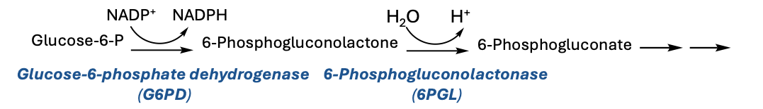
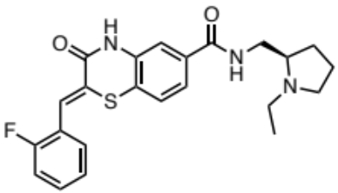
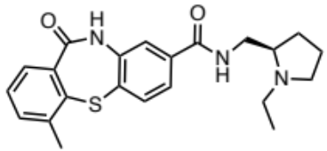
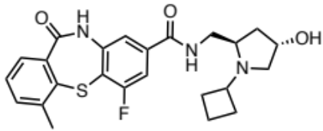
PF3D7_1453800
GluPho (glucose-6-phosphate dehydrogenase-6-phosphogluconolactonase)
79/78
Bifunctional enzyme that catalyzes first two steps of the pentose phosphate pathway, the major NADPH
source for parasites highly sensitive to oxidative stress (PMID 30683097, 26198663).
Essentiality demonstrated via 3 methods
Conservation: 25 nonsyn. SNPs, No stop codon mutations
Expressed in blood stage and gametocytes (PMID 16689939)
Recombinant expression: PfGluPho, PfG6PD, PvG6PD, HsG6PD and Hs6PGL
Multiple reported assay formats
Lit. ligands shown to be competitive with G6P (PMID 35266827, 22813531, 22496096)
Ligand selectivity potentially explained by homology model
Set up published assays
Evaluate literature compounds/potential HTS
No plasmodium G6PD crystal structure available, but multiple structures from other organisms including HsG6PD; also, Pv6GPL (PMID 24501782, 21443518)
Current ligands have liabilities
ML276
PfGluPho IC₅₀=0.89 μM
HsG6PD IC50 >80 μM
Pf3D7 ED₅₀=2600 nM
PfDd2 ED₅₀ =3700 nM
ML304
PfGluPho IC₅₀=0.19 μM
HsG6PD IC50 >80 μM
Pf3D7 ED₅₀=471 nM
SBI-0797750
PfGluPho IC₅₀=0.007 μM
HsG6PD IC50 >99 μM
Pf3D7 ED₅₀=22 nM

Slide 13
PF3D7_0629000
GNA1 (glucosamine 6-phosphate N-acetyltransferase)
65/64
Acetyltransferase, catalyzes acetylation of GlcN6P to form GlcNAc6P
Belongs to a family of Gnc5-N-acetyltranferases (GNAT)
GNA1 has an independent evolutionary origin with low sequence similarity and identity to non-apicomplexan GNA1 including human
Crypto and Pf binding site very similar (15 out of 19 residues), and less similar to Human (11 residues)
Conditional knockout available
Assay for Crypto enzyme has been developed (PMID 33082260, 29507322)
Protein binding site identified
Xray structure of CpGNA1 (PDB 6YUG; 1.95A), identity 48.8%, similar 61.9%
Conditional knockdown needed
Protein expressed in SF9 cells, small amount of active protein, needs optimization
Chemical tools need to be identified
Identify life cycle stage specificity and rate of kill
Very polar substrate
No inhibitors identified

Slide 14
PF3D7_1239500
GyrB (DNA gyrase subunit B)
76/70
Plasmodium gyrase is a tetrameric protein (GyrA₂GyrB₂) harbored by the apicoplast
Belongs to a subclass of Type II topoisomerases, which are essential for reducing topological strain in an ATP dependent manner while double-stranded DNA is being unwound (PMID 35699968, 37904923)
Gyrases and topoisomerases are “clinically validated targets” for bacterial and cancer disease
Genetically essential in Pf and Pb
GyrB has been recombinantly expressed and biochemical assays available (PMID 34339271, 25881748)
Fluorescence-mediated biochemical assay available (PMID 37904923)
Toxoplasma gondi GyrA and GyrB were generated recombinantly and shown to be active
Bacterial gyrases and human topoisomerase structures solved
Measure double strand breakage of DNA using fluorescent marker
Identify additional compounds using existing (purpurogallin, novobiocin, ciprofloxacin)
On target cellular assays potential (using cKD lines or IPP assay)
Structure not available for Plasmodium
Fast-killing is unlikely with an apicoplast inhibitor (delayed death effect)
Tool compounds are only weakly active

Slide 15
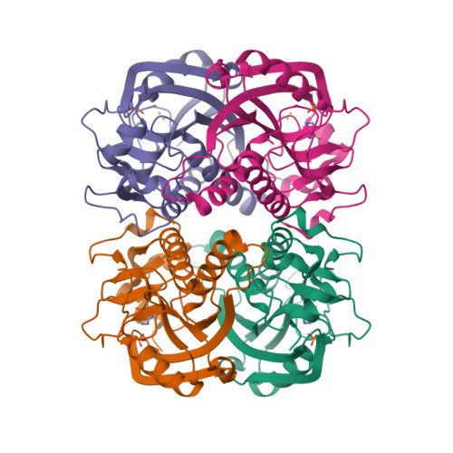
PF3D7_1012400
HGPRT (hypoxanthine-guanine phosphoribosyltransferase)
73/81
Required for essential purine salvage, catalyzes synthesis of 6-oxopurine mononucleotides
Likely essential in falciparum parasites, and with significantly slow growth in Pb
Expressed throughout life cycle in ABS, gametocytes, sporozoites, oocyst confirmed with several proteomics datasets
Recombinantly expressed and protein mechanism characterized (PMID: 36413975)
Crystal structure resolved in complex with hypoxanthine at 1.94Å (PDB 3OZF)
Inhibitors against both the Pf and Pv enzymes with nM Ki’s (PMID 35175749, 22726686)
IMPDH coupled assay, spectrophotometric shift from NAD+ to NADH measured
Investigate phenotypic response
  Additional inhibitors
  Additional/optimize assays
In vivo studies
Selectivity
  ~50% identity to human ortholog
Protein inhibition potency does not translate to phenotypic potency (good protein inhibitor only)
PDB 3OZF​

Slide 16
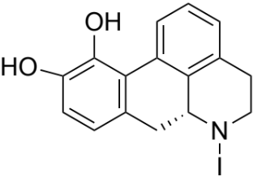
PF3D7_0624000
HK (hexokinase)
75/91
Essential and rate-limiting enzyme for glycolysis in intraerythrocytic stages​
First step in glycolysis
Limited identity to human ortholog, including a unique loop insert (P-insert) in active site​
Moderate resolution (2.8 Å) X-ray crystal structure solved (Int J Mol Sci 2023 Aug 13; 24 (16))​
ADP-Glo reporter system used to conduct 60K compound screen in 1536w format (Antimicrob Agents Chemother. 2016 Oct; 60(10))​
Potential tool compounds
NCGC00025349 ​
PfHK = 5.47 uM​
PfEC50 = 1.3 uM ​
CC50 >25 uM​
On-target validation in Plasmodium for tool compound (i.e. conditional knockdown)​
Identify good tool compounds
Selectivity is biggest concern, also abundance

Slide 17
PF3D7_0209300
IspF (2C-methyl-D-erythritol 2,4-cyclodiphosphate synthase)
76/82
IspF is the fifth enzyme in the non-mevalonate pathway (also known as the MEP/DOXP pathway) for isoprenoid precursor biosynthesis
  Because the MEP pathway is absent in humans
IspF forms a homotrimer
Small molecule binding site info from AlphaFill
Gene is highly conserved
Crystal structures available (PMID 24410837)
Small molecule binding site (4-amino-n-(pyridin-2-yl)benzenesulfonamide)
Assays available
  Assay Readout
  LCMS/LC-MS
  ¹³C NMR assay
  Fluorescence assay
  Photometric assay
Better quantitative measure of essentiality
  Evaluate abundance, functional activity/catalytic efficiency
Enzymatic screen
Computational analysis to identify active site
Delayed death/slow rate of kill
No tool compounds available
Resistance in the field to phosphonomycin

Slide 18
PF3D7_1446200
LAP (M17 leucyl aminopeptidase)
87/82
This enzyme has been expressed in insect cells as a functional 320-kDa homo-hexamer that is optimally active at neutral or alkaline pH, is dependent on metal ions for activity, and exhibits a substrate preference for N-terminally exposed hydrophobic amino acids, particularly leucine
Produced by all stages in the intra-erythrocytic developmental cycle of malaria but was most highly expressed by trophozoites
Amino acid dipeptide analogs, such as bestatin and its derivatives, are potent inhibitors
  Block the growth of P. falciparum malaria parasites in culture
Recombinant protein available
Tool compound available (hydroxamic acid)
  activity in phenotypic assay, no activity in hepG2
Non hydroxamic acids inhibitors identified in a screening vs T.Cruzi (PMID 38359089)
Find long-acting inhibitor
Confirm druggability
Cross-specie investigation
Selectivity
  If interacting with metal in binding site, could be challenging
Slow killing

Slide 19
PF3D7_0907900
PDF (peptide deformylase)
83/78
Apicoplast targeted peptide deformylase, a metallohydrolase that releases formate from formylated-methionyl peptides during nascent polypeptide synthesis by ribosomes
Likely essential for apicoplast biogenesis
Evidence of expression of PbPDF throughout replicating stages (ABS, liver, oocyst) and low expression in female gametocytes (malaria cell atlas)
Bacterial and oncology inhibitors clinically validated with mixed results (GSK1322322, BB-83698, LBM-415, actinonin; PMID: 21233508)
Crystal structures have been determined for the PfPDF (PDB 1RL4, 1JYM) and hsPDF (3G5K) at <2A resolution
  Structure in apo and peptide-mimic bound states (PMID 12005434, PMID 15010544)
Expressed in E. coli and assays have been conducted with the PfPDF protein using formylated model peptides (PMID 11747293)
Functional assay with formylated peptides
SAR around actinonin could make it more active against Plasmodium
Generate cKD line
PfPDF may not be the primary target of actinonin
Limited work has been published since early 2000’s
Likely to be delayed death phenotype
Active site inhibitors may be difficult to optimize
Selectivity

Slide 20
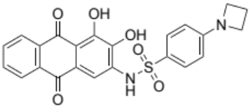
PF3D7_1120100
PGM1 (phosphoglycerate mutase, putative)
79/68
Essential in falciparum and berghei screens
Differences in the Pfal vs. human structures (eg. formation of tetramer vs. dimer, respectively) suggest room for selectivity
Expressed in multiple stages
cKD validation of essentiality
Development of an in vitro functional assay
Crystal structure available (PMID 35150741, PDB ID(s) 1XQ9, 3KKK)
Inhibitors have been described for orthologs (PMID 31607564)
HKB99 ​
Test tool compounds against the Plasmodium enzyme and whole cell
  SAR to find better tool compound, if needed
Test selectivity and druggability
Generate conditional knockouts
Computational analysis of active site
Does not have tool compound (in Plasmodium)
No selectivity nor druggability information

Slide 21
PF3D7_1113100
PRL (protein tyrosine phosphatase)
70/74
Protein tyrosine phosphatases (PTPs) are essential signaling enzymes that, together with protein tyrosine kinases, regulate diverse cellular processes such as cell motility, division, proliferation, and survival
Very small protein (25 kDa)
RNA sequence data shows this gene is expressed in 3 stages (asexual blood stage, gametocyte, and liver stage)
Gene is highly conserved
Recombinant PfPRL is expressed and purified
Recombinant PfPRL phosphatase activity assay is developed
Inhibitor known that blocks parasite growth (PMID 33934569)
Protein tyrosine phosphatase assay kit (commercially available)
In silico screens available
Crystal structures of PRL2 in complex with the CNNM3 CBS-pair domain (PMID 27856537)
Measure activity
Confirm allosteric binding site
Design inhibitors
Selectivity
  Has human ortholog, 45% identity, human has crystal structure in complex with CNNM3
Very polar binding site

Slide 22
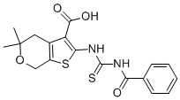
PF3D7_1144900
RAB6 (ras-related protein Rab-6)
76/61
Small GTPases play crucial roles in vesicle transport and membrane trafficking
The rab6 gene product in mammalian cells and yeast is localized to and regulates protein transport in the medial and trans Golgi cisternae, as well as the trans Golgi network
Full length and truncated version expressed in E. coli for crystallography, both forms expressed in soluble fraction
Crystal structure of GDP-bound PfRab-6 nucleotide-binding domain with 2.3 Å (PDB 1D5C)
GTPase assay kits available
Tool compounds available for other species. GTP-competitive and allosteric inhibitors explored
CID 1067700
Human Rab7 Inhibitor Ki = 13 nM
Confirm essentiality in falciparum
HTS screen to find possible inhibitors
Selectivity
  Shares 67% Seq ID with human Rab6A (PDB 4DKX)]
  Very potent inhibitors required for physiological effect at cellular GTP concentrations.
Research papers looking at the function of PfRAB6 are from 2000’s
Not well characterized in Plasmodium

Slide 23
PF3D7_0410700
RbgA (ribosome biogenesis GTPase A, putative)
81/54
It is an essential GTPase ribosome assembly factor for biogenesis of the 50S apicoplast large ribosomal subunit​
RbgA (bacterial YlqF) likely functions uniquely from human RbgA which involves with 55S mitoribosome biogenesis​
An inhibitor of the apicoplast ribosome biogenesis may be able to combine with the cytoplasmic EF2 translation inhibitor or with the apicoplast IPP pathway inhibitor​
It expresses mostly in the early ring, late top-schizont blood stage but less in gametocyte and ookinete
Recombinant RbgA protein and biochemical assay were published in several papers (e.g. PMID 22267738​)
There are several RbgA structures shown on RCSB PDB (PMID 30366986​)
Identify tool compounds
Measure activity
Available ligand is not drug-like

Slide 24
PF3D7_1235600
SHMT (serine hydroxymethyltransferase)
96/91
Critical enzyme in “one carbon” intermediary metabolism
  Thymidine biosynthesis
  Vital for folate recycling
Essential by both falciparum and berghei screens
Human ortholog exists
  42% overall sequence identity with human enzyme
  80% similarity at the active site
Validated druggable pathway in Plasmodium (e.g., DHFR and TS inhibitors)
Recombinant enzyme expressed in Pf and Pv with 2.20 Å resolution (e.g., PDB: 5YG2, 5YG5; 4TMR)
Enzymatic assays available
  Coupled assays (PMID 22691309)
  Fluorescence assay (PMID 30787298)
Tool compound available (PMID 25785478)
Target validation
Resistance selections
Structure-guided drug design
Investigate synergy between DHFR and SHMT inhibitors
Antifolate resistance
  Pathway or enzymes targeted
Target ID validation not well-established
Metabolic liability concerns
Hs selectivity could be challenging due to high active site homoloy

Slide 25
PF3D7_1251300
TMK (thymidylate kinase)
88/68
Non-protein kinase that phosphorylates deoxythymidine 5′-monophosphate (TMP) to deoxythymidine 5′-diphosphate (TDP), which is the precursor to deoxythymidine 5′-triphosphate (TTP), an essential building block in the process of DNA replication and repair
Has human homologue (P23919) with quite some similarities (TM aligh 0.93; TM-align sequence: 0.38)
Essential in falciparum parasites
Expressed in ABS and mature gametocytes (Malaria Cell Atlas)
Potential drug target against P. Falciparum but also for other diseases
Plenty of literature available
Many tool compounds available
Crystal structures available for many species, including falciparum
Extensive biochemical studies
Functional assays available
Confirm drug targets
Evaluate expression in liver stage (currently unclear)
Generate phenotypic data (less available)
Off-target effects
Selectivity

Slide 26
PF3D7_0510500
TopoI (topoisomerase I)
80/71
Type IB family of highly conserved enzymes that regulate DNA topology; ATP-independent; introduces transient single-strand breaks in double-stranded DNA
Relieves torsional strain in DNA by cleaving and re-sealing the phosphodiester backbone; Cleavage results in a covalent enzyme-DNA intermediate established by a conserved tyrosine residue
Implicated in transcription and DNA replication during the falciparum asexual blood-stage cycle
Full length functional enzyme has been cloned and expressed
Multiple assay formats have been described (PMID 23121492, 27796331)
Crystal structures of human ortholog are available
Tool compounds (e.g. camptothecin) exist with activity against both human and parasite (blood stage) enzymes
Inhibitors in clinical use for cancer and bacterial infections
Cloning and expressing functional enzyme and assay
Utilize crystal structure with bound allosteric for virtual screening
HTS using small molecule library to identify drug-like inhibitor as starting points
Protein structure and a small molecule inhibitor hit specifically targeting PfTopo1 are not available
Inhibitors identified to date all act by reversibly stabilizing the covalent intermediate state TopoI-DNA complex
Need for selectivity against the human ortholog

Slide 27
PF3D7_1460400
UCHL3 (ubiquitin carboxyl-terminal hydrolase isozyme L3)
88/84
Deubiquitinating and a deNeddylating enzyme (May cleave pro-Ub, does not cleave diUb)
Dual-specificity enzyme for ubiquitin and Nedd8
Likely essential in falciparum parasites
Expressed across lifecycle: ABS, high in stage V gametocytes, liver-stage in Pb by malaria cell atlas (Malaria Cell Atlas)
Low homology to human (32% identity)
Assay reaction with Ub/Nedd8 probes (PMID 17371404)
Recombinant protein expressed and structure solved with Ub and UbVME substrates (PMID 20042598)
Compounds evaluated in mammalian and Leishmania
Identification of covalent fragment inhibitors for Plasmodium falciparum UCHL3 with anti-malarial efficacy (PMID 37634761)
Assay available for Pf and mammalian cells
Confirm essentiality
Validation with target/knockout-down
Isozyme activity may be important to evaluate in context of druggability
Confirm druggability
  BindingDB compounds
Transfections of catalytically-dead mutant not successful (PMID 20042598)

