Slide 1
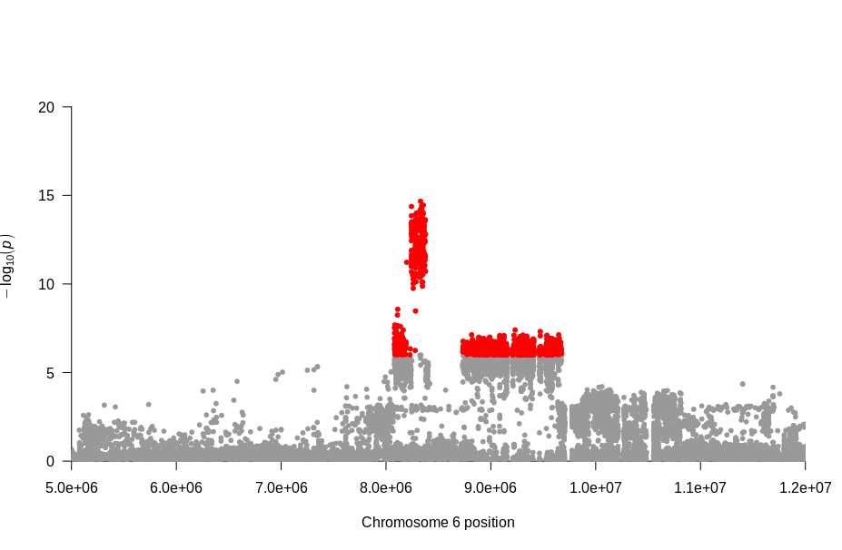
Heading date
chr06:8329287
Figure S1. Association signals for heading date on chromosome 6 by GWAS using all variants including InDels. Red dots denote significant associations with HD ( p ≤ 1.0 x 10⁻⁶).

