Slide 1
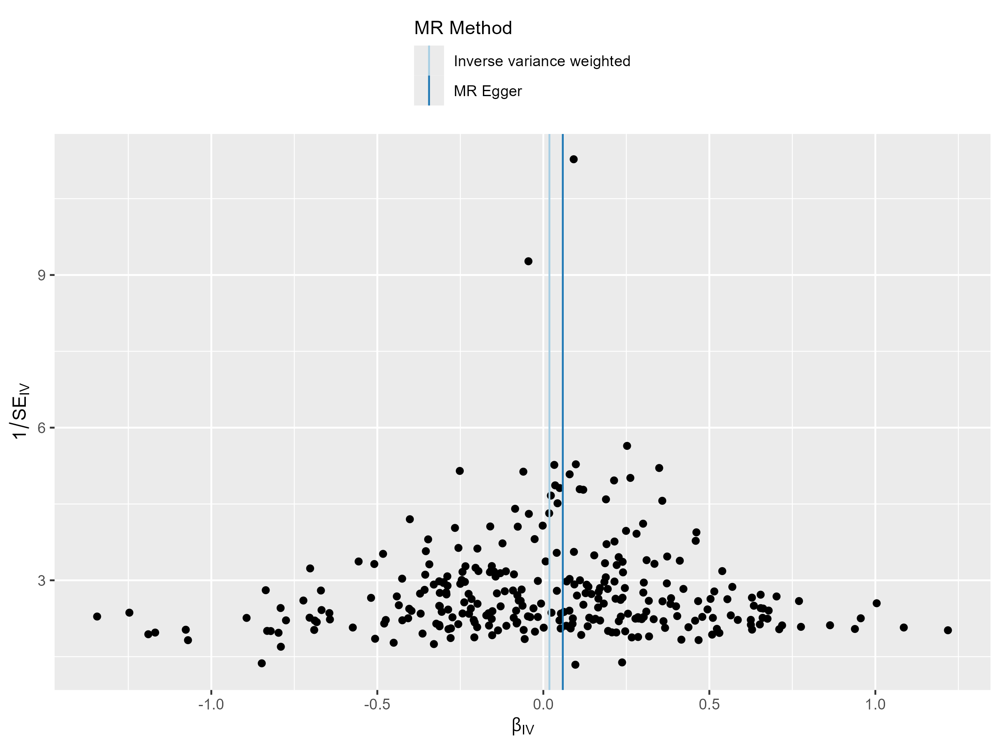
sporadic miscarriage

Slide 2
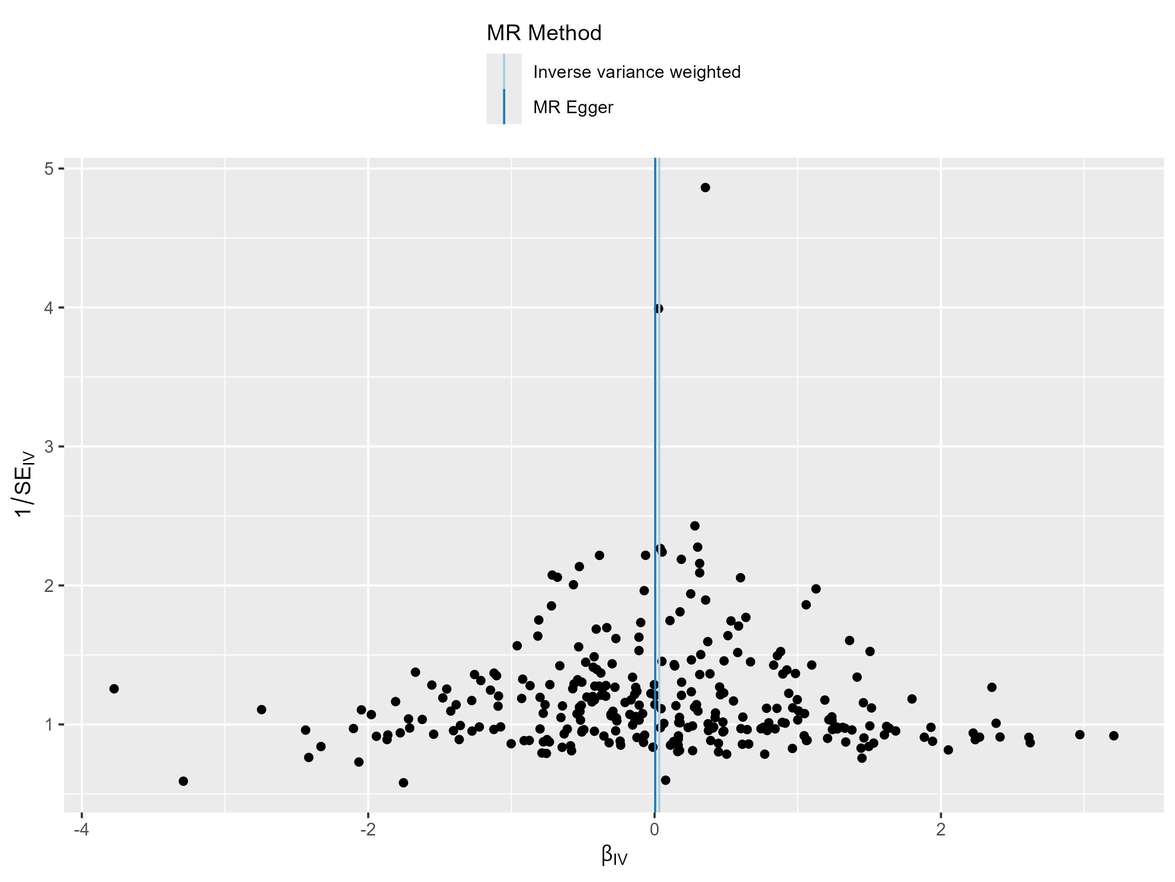
multiple pregnancy

Slide 3
ectopic pregnancy

Slide 4
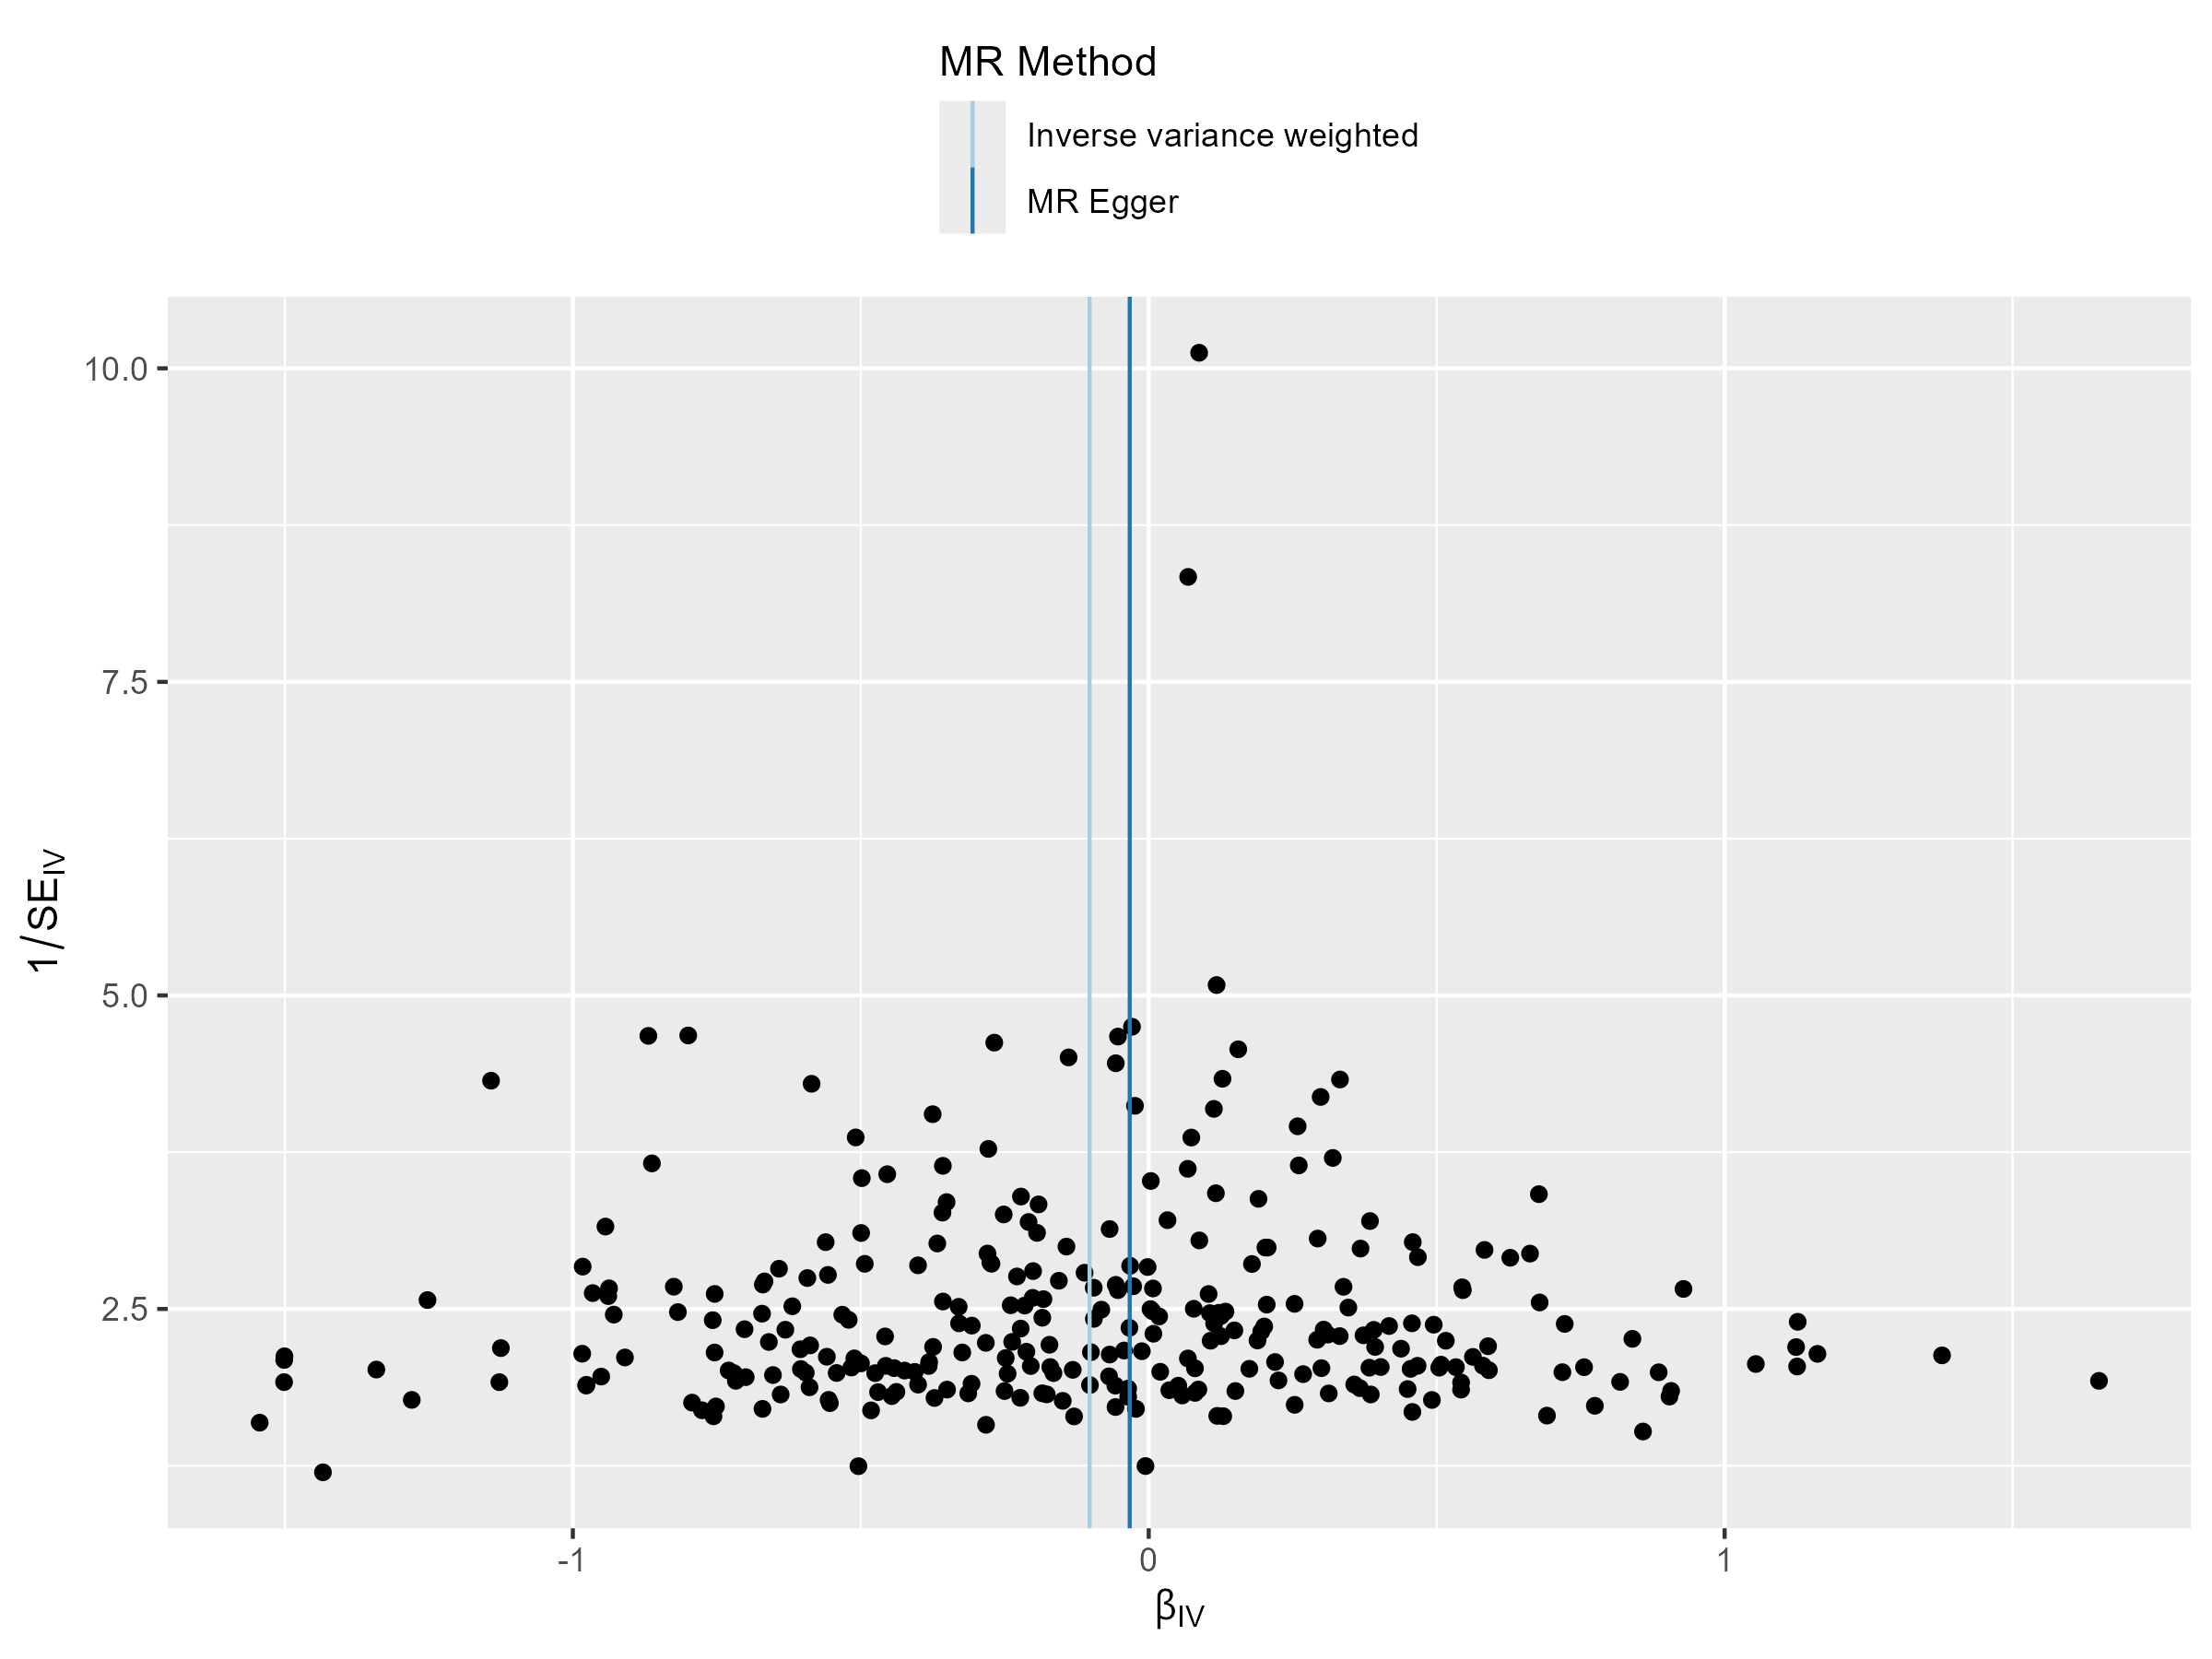
gestational diabetes mellitus (GDM)

Slide 5
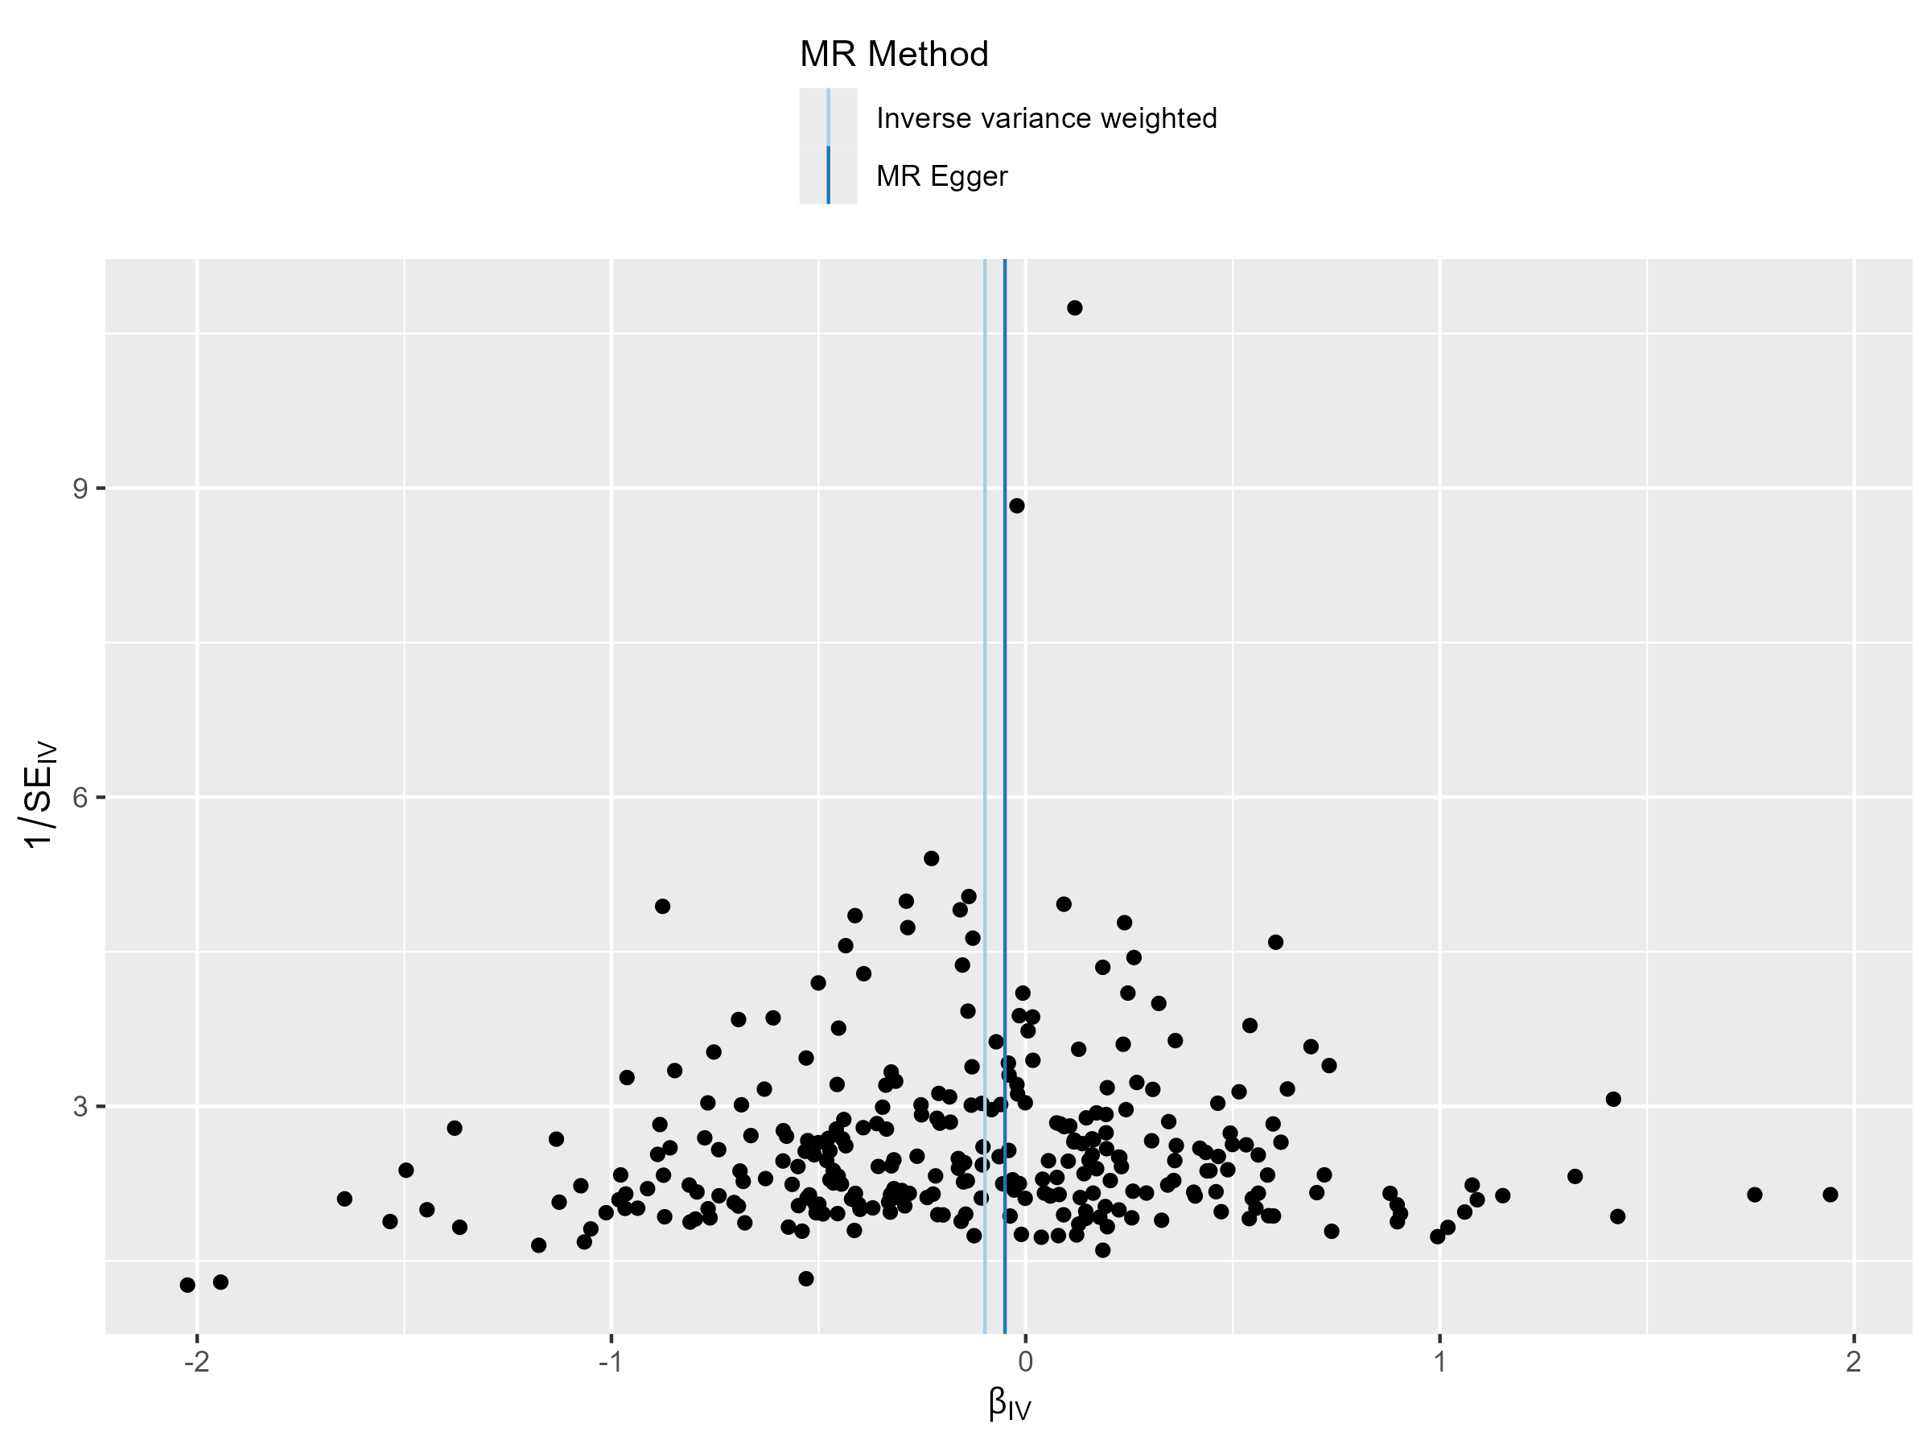
hypertensive disorders of pregnancy

Slide 6
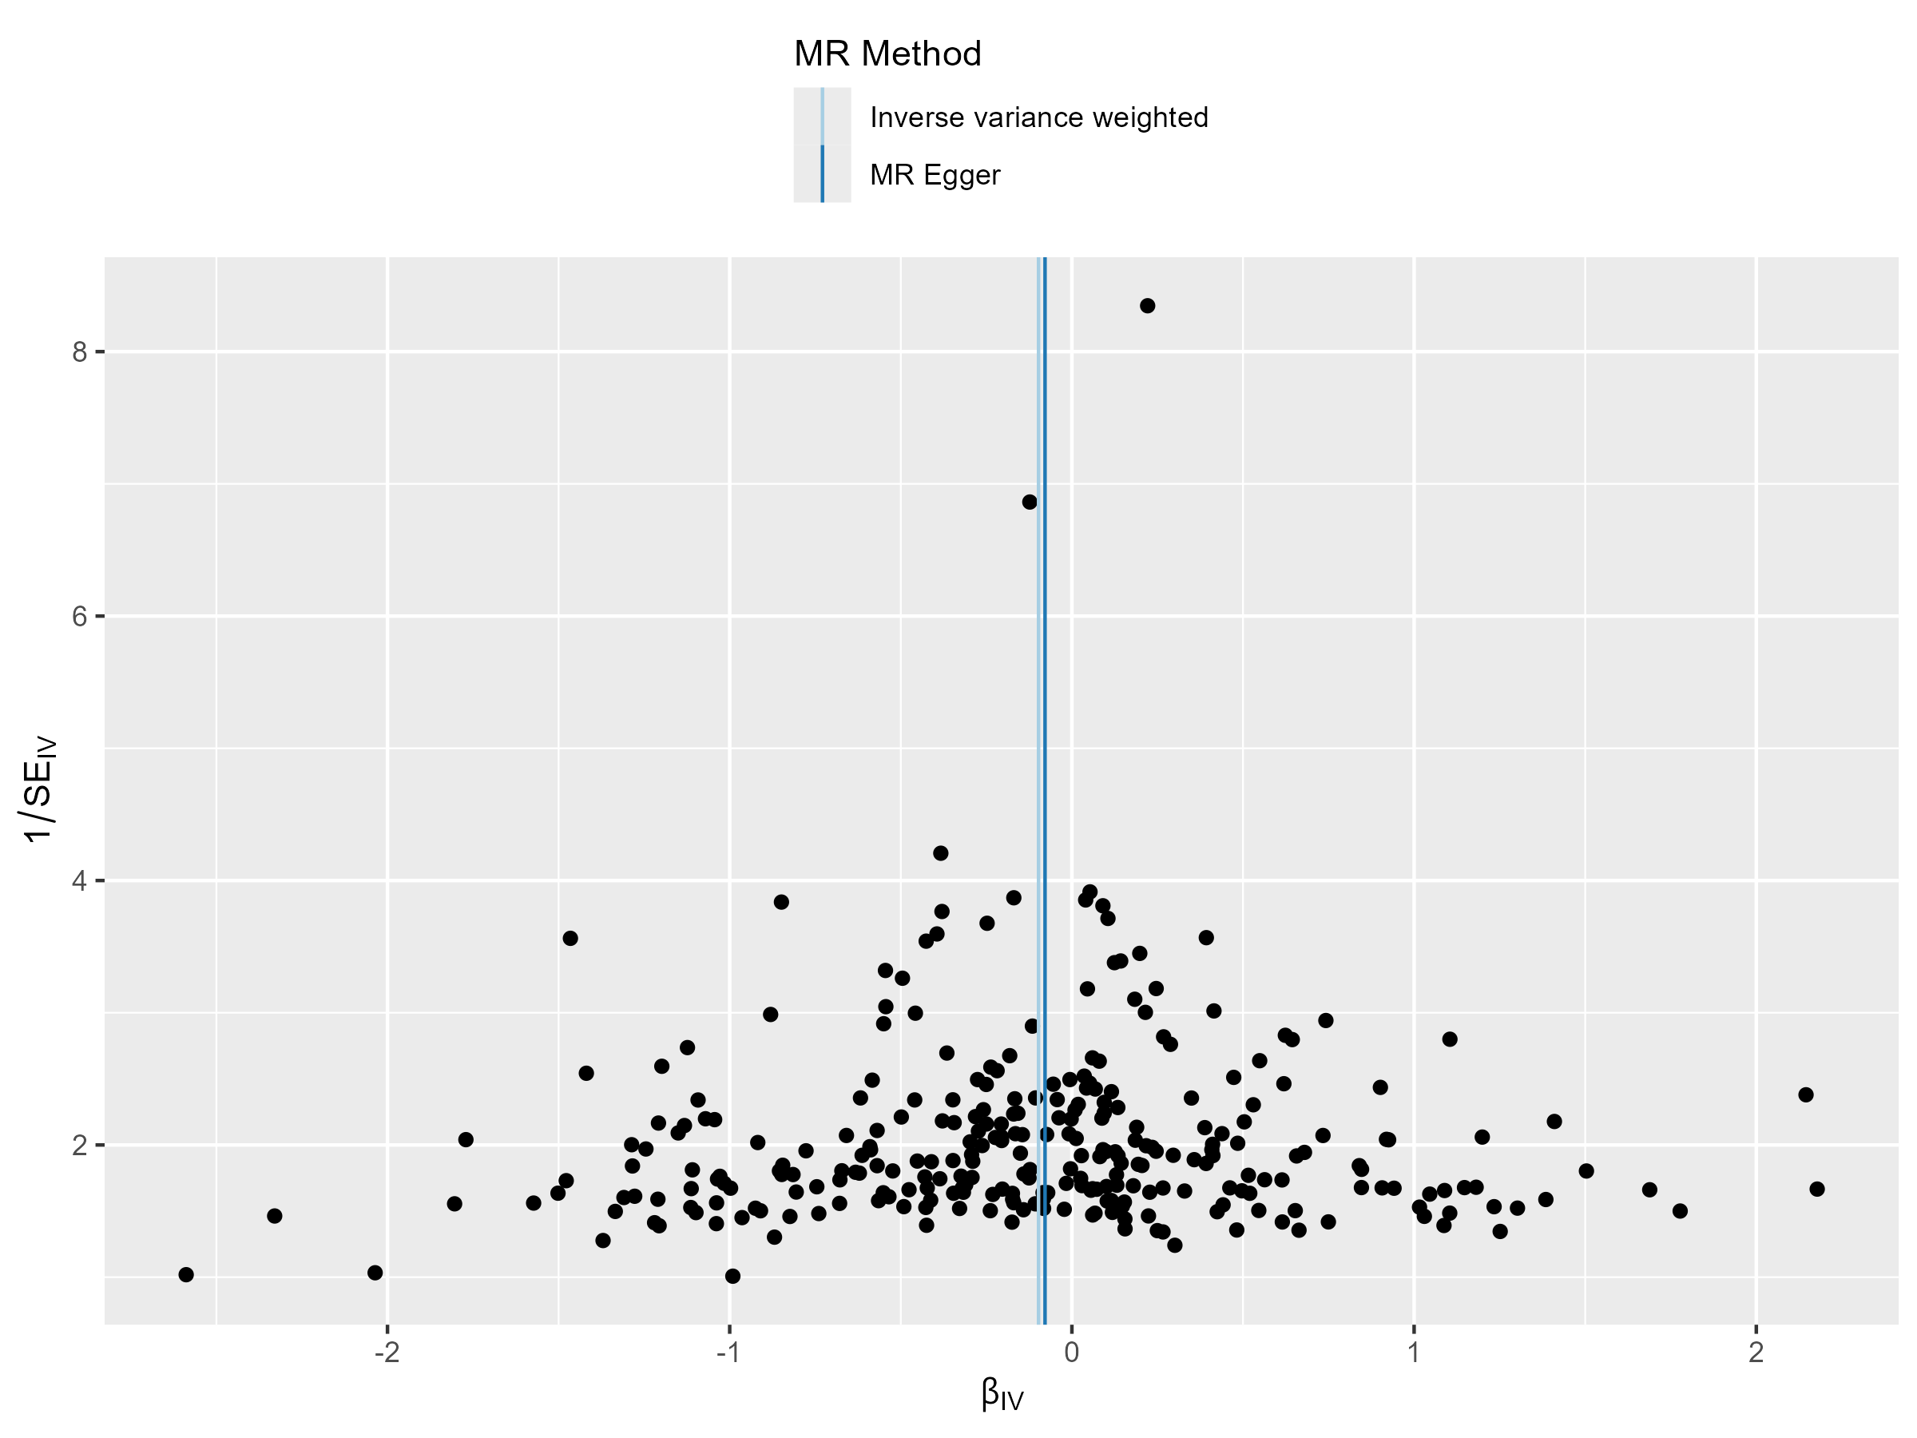
gestational hypertension

Slide 7
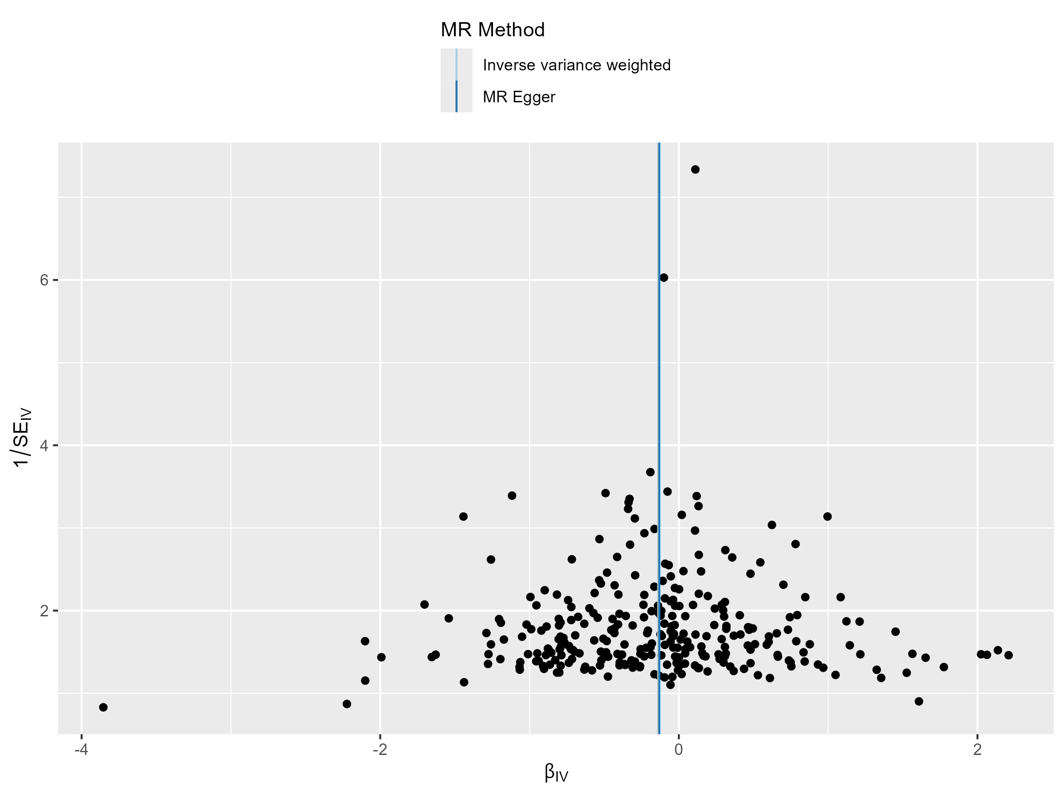
pre-eclampsia or eclampsia

Slide 8
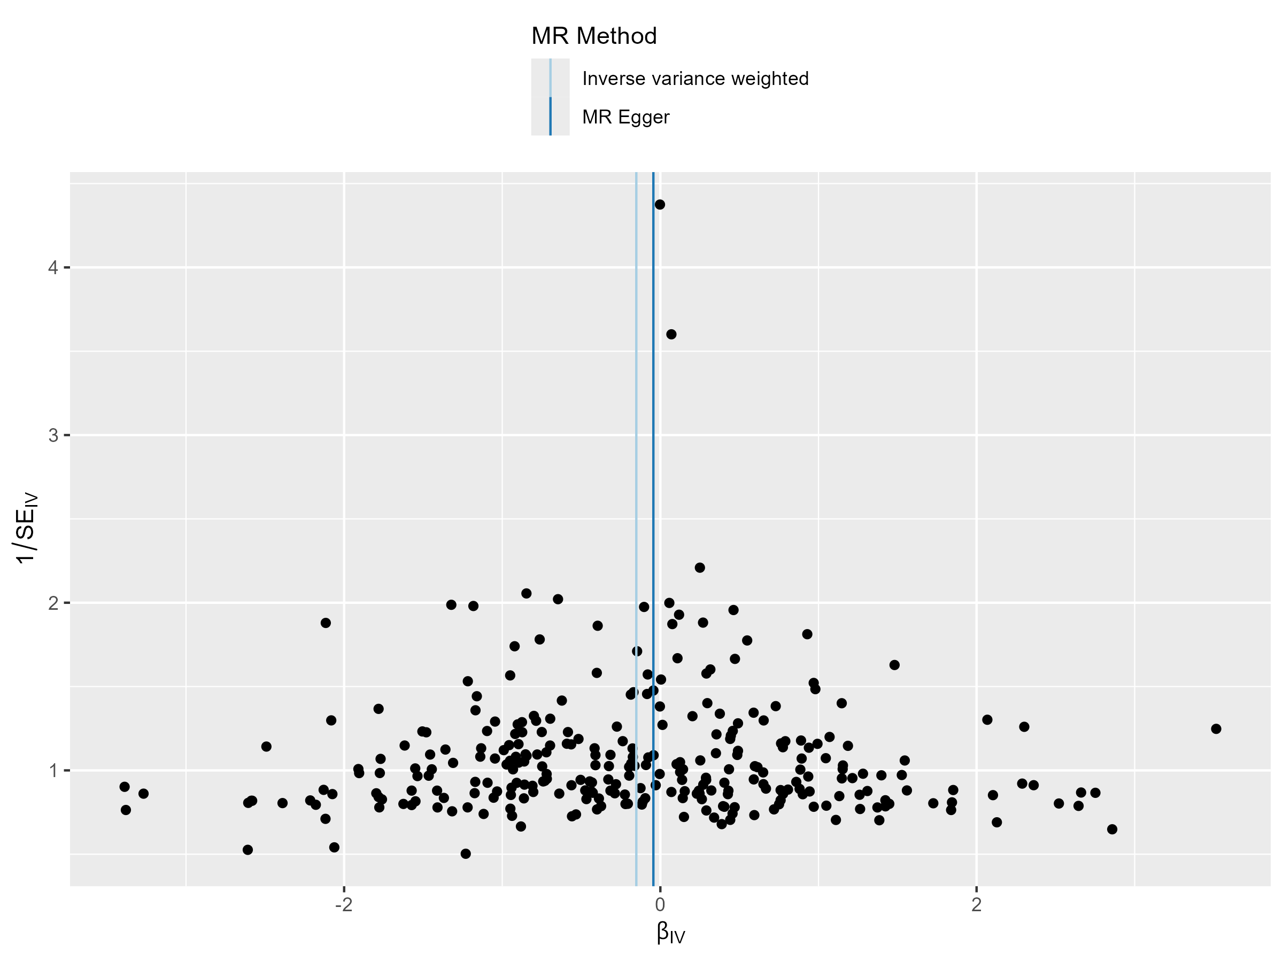
chronic hypertension

Slide 9
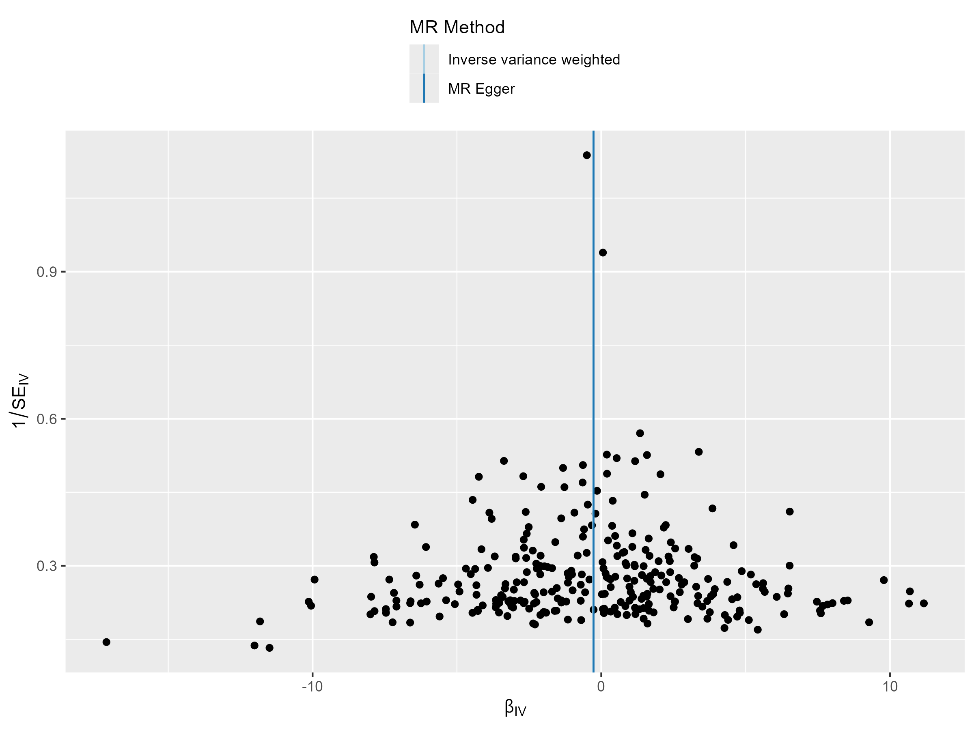
chronic hypertension with superimposed pre-eclampsia

Slide 10
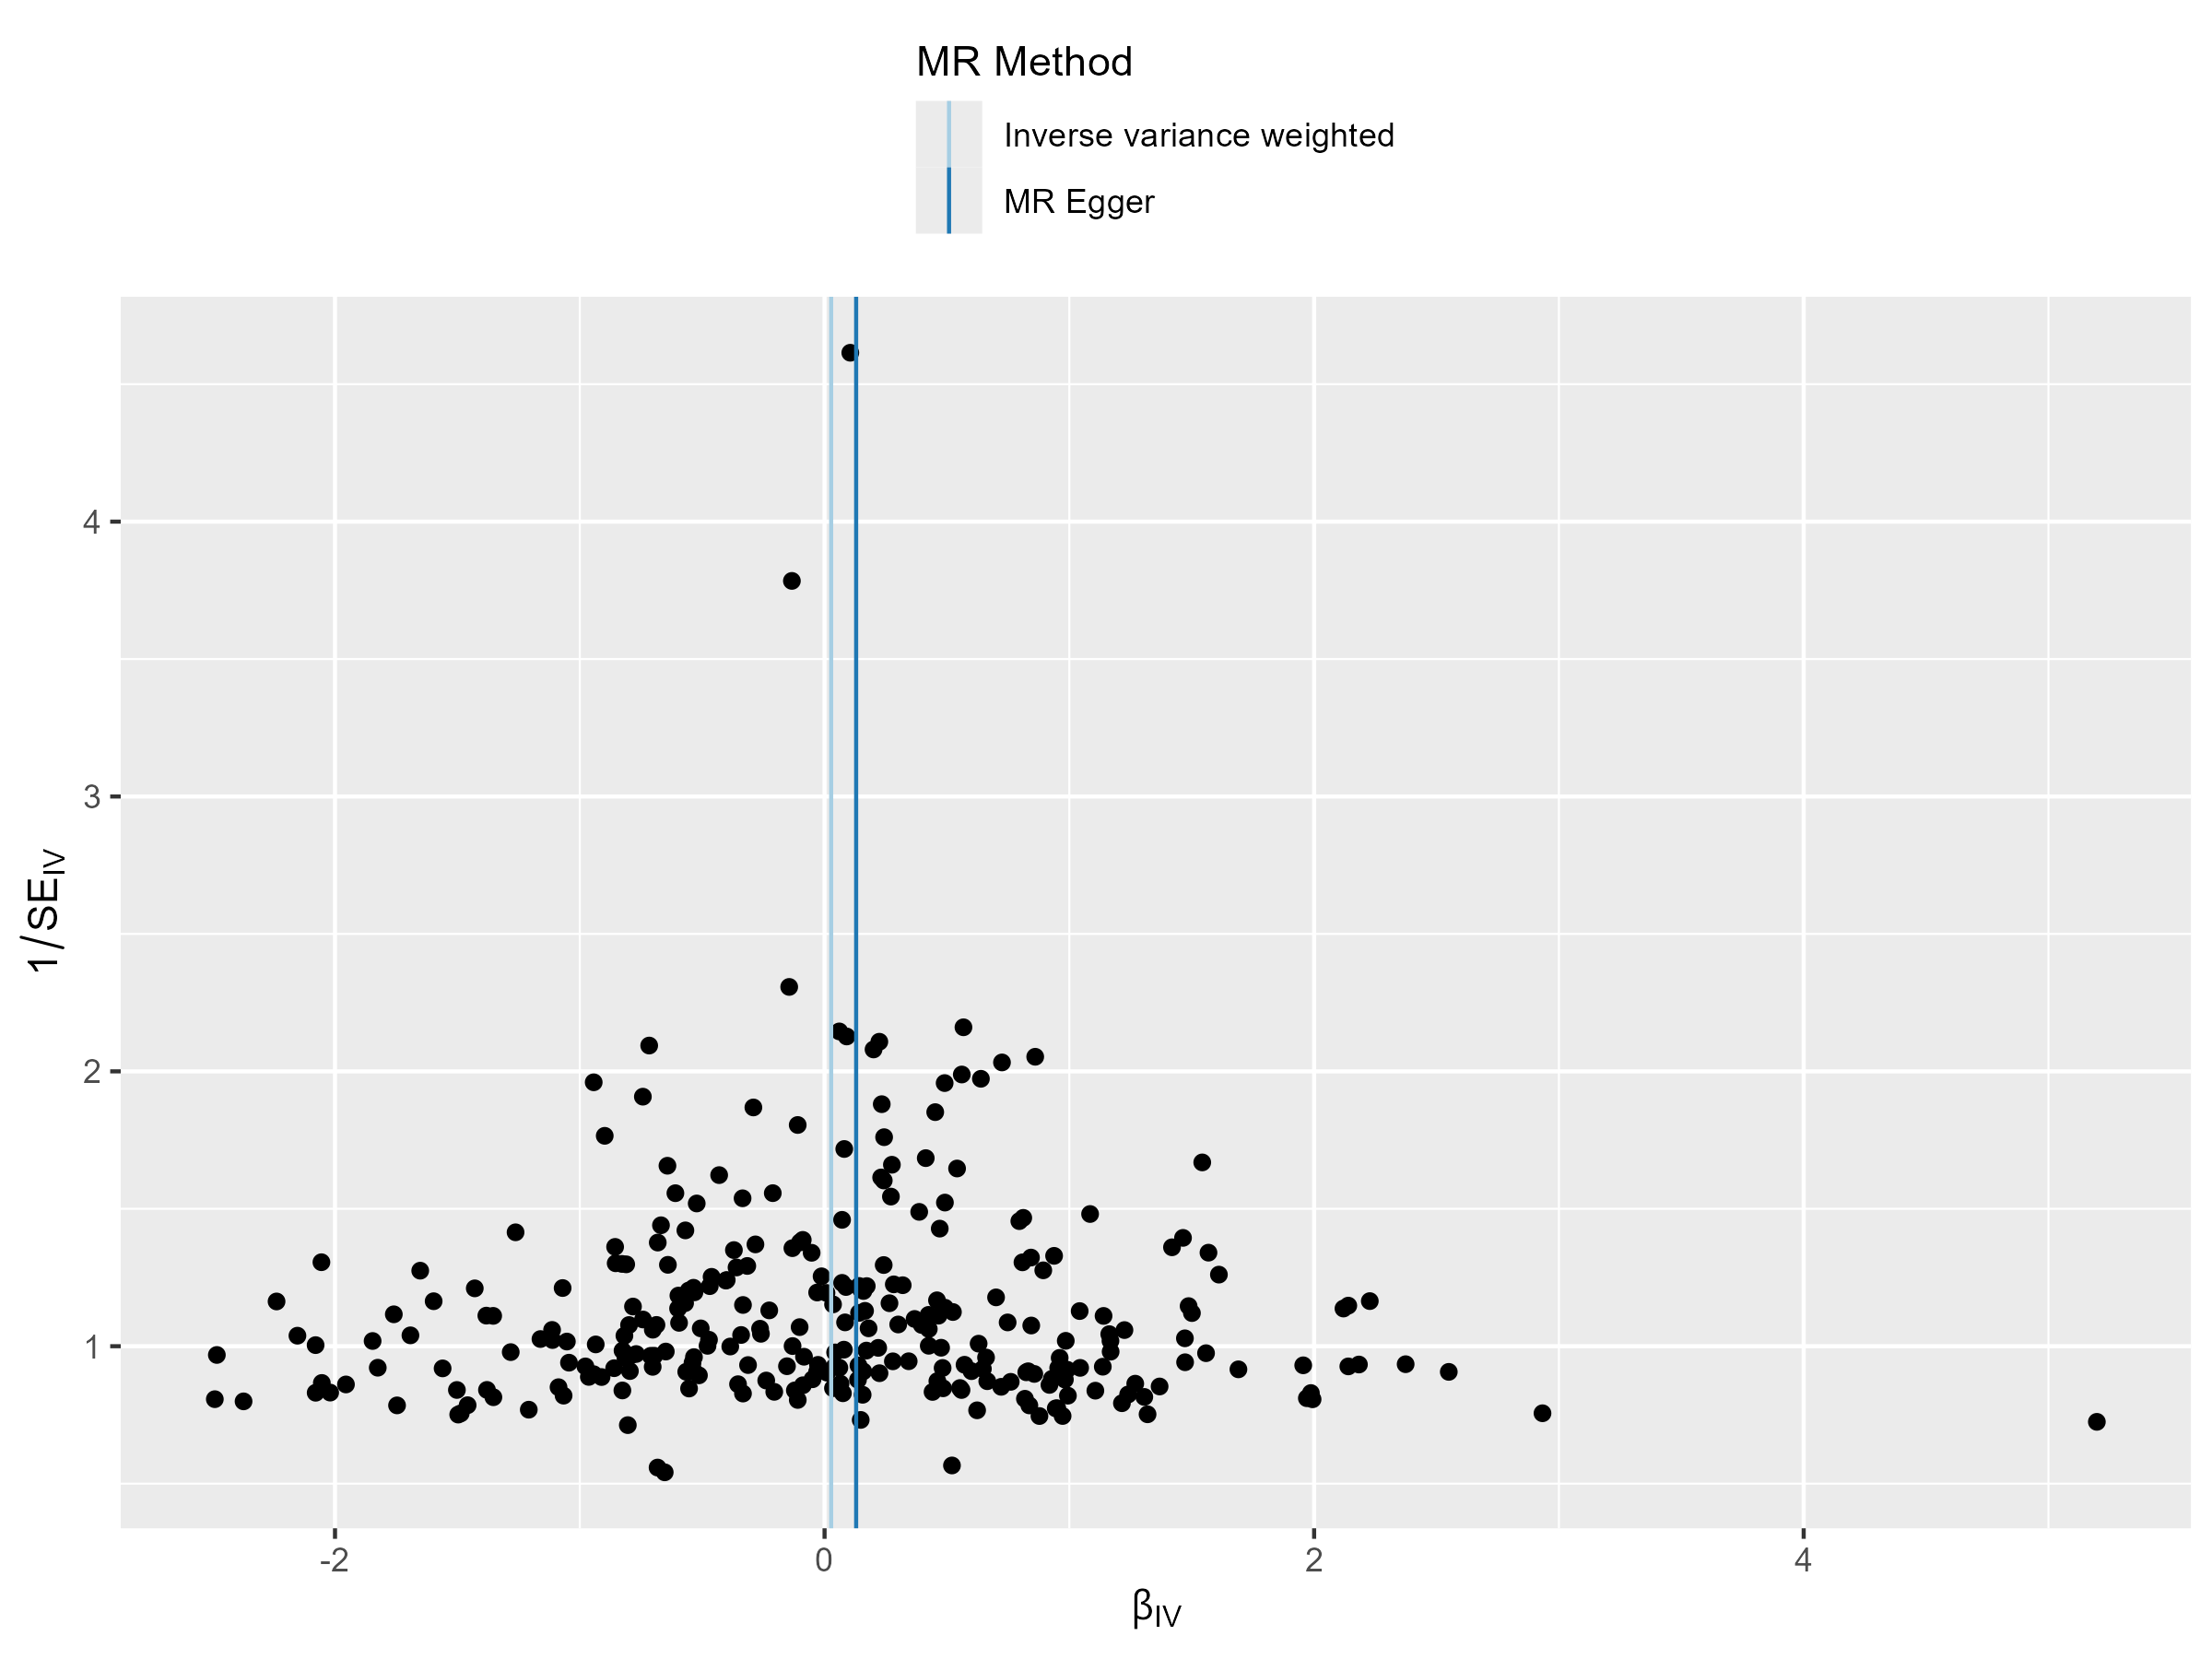
gestational oedema and proteinuria without hypertension

Slide 11
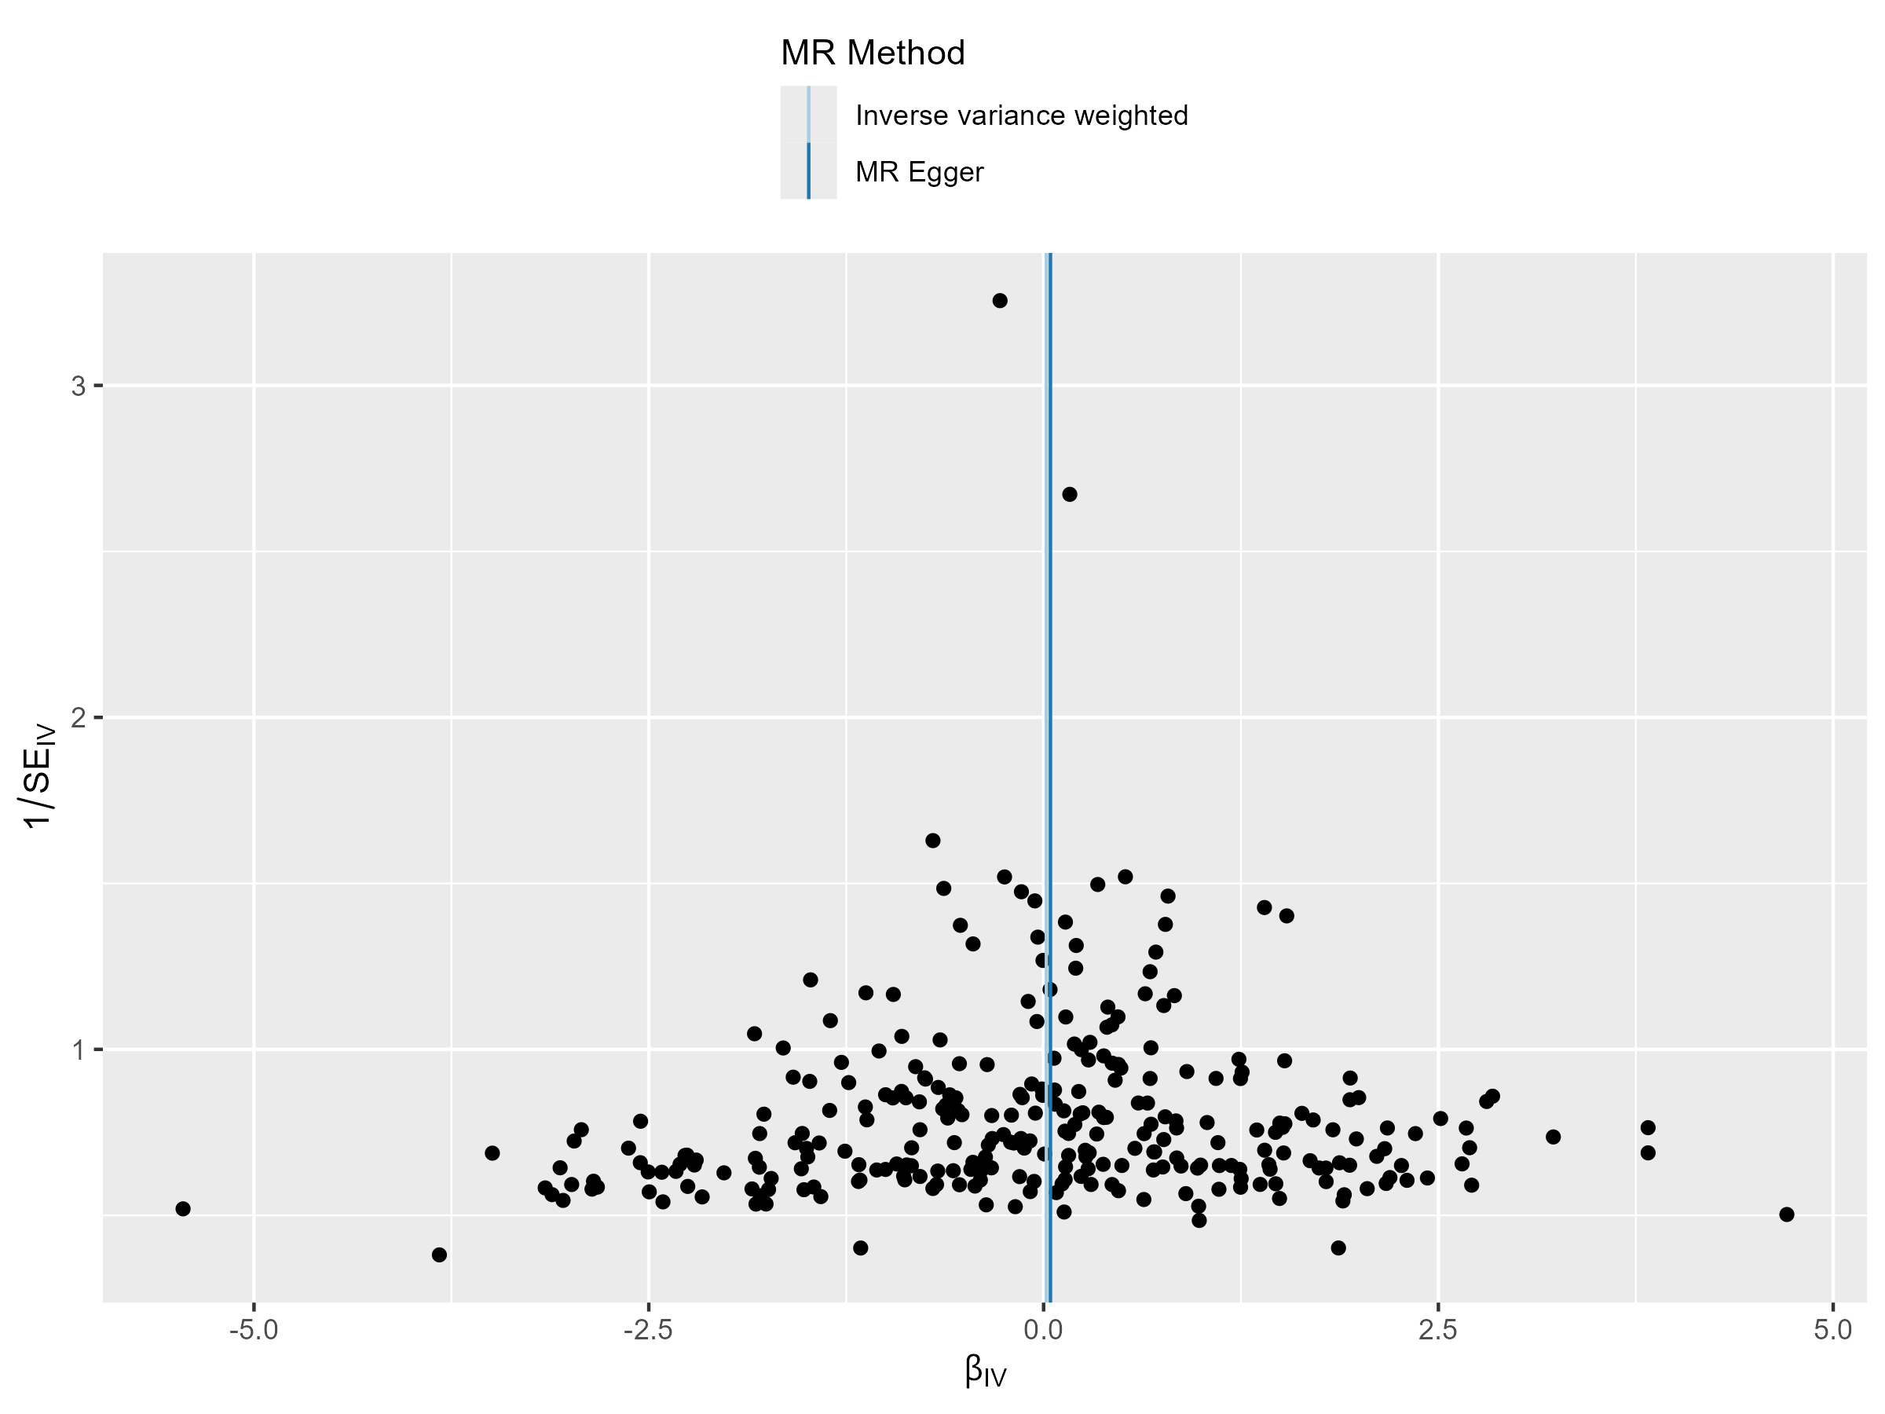
polyhydramnios

Slide 12
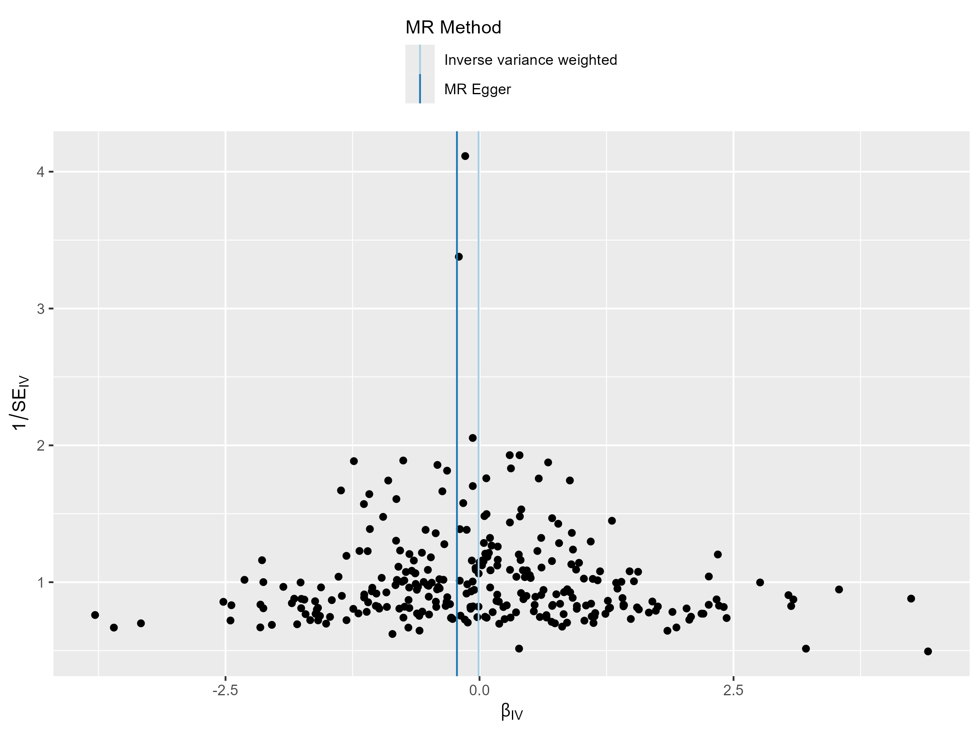
intrahepatic cholestasis of pregnancy (ICP)

Slide 13
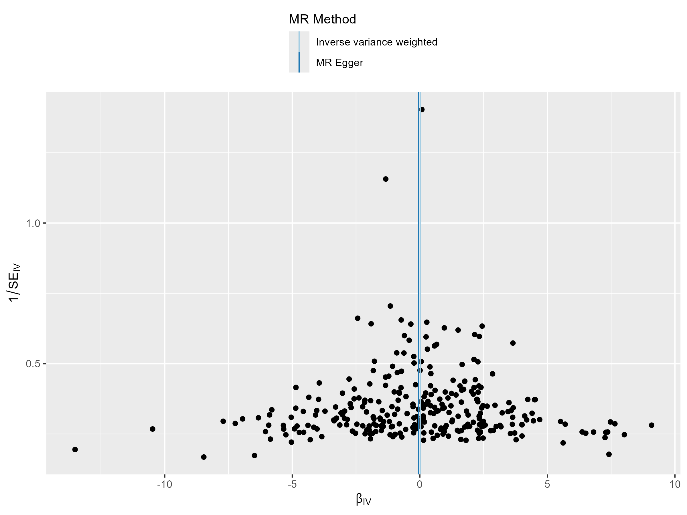
placenta disorder

Slide 14
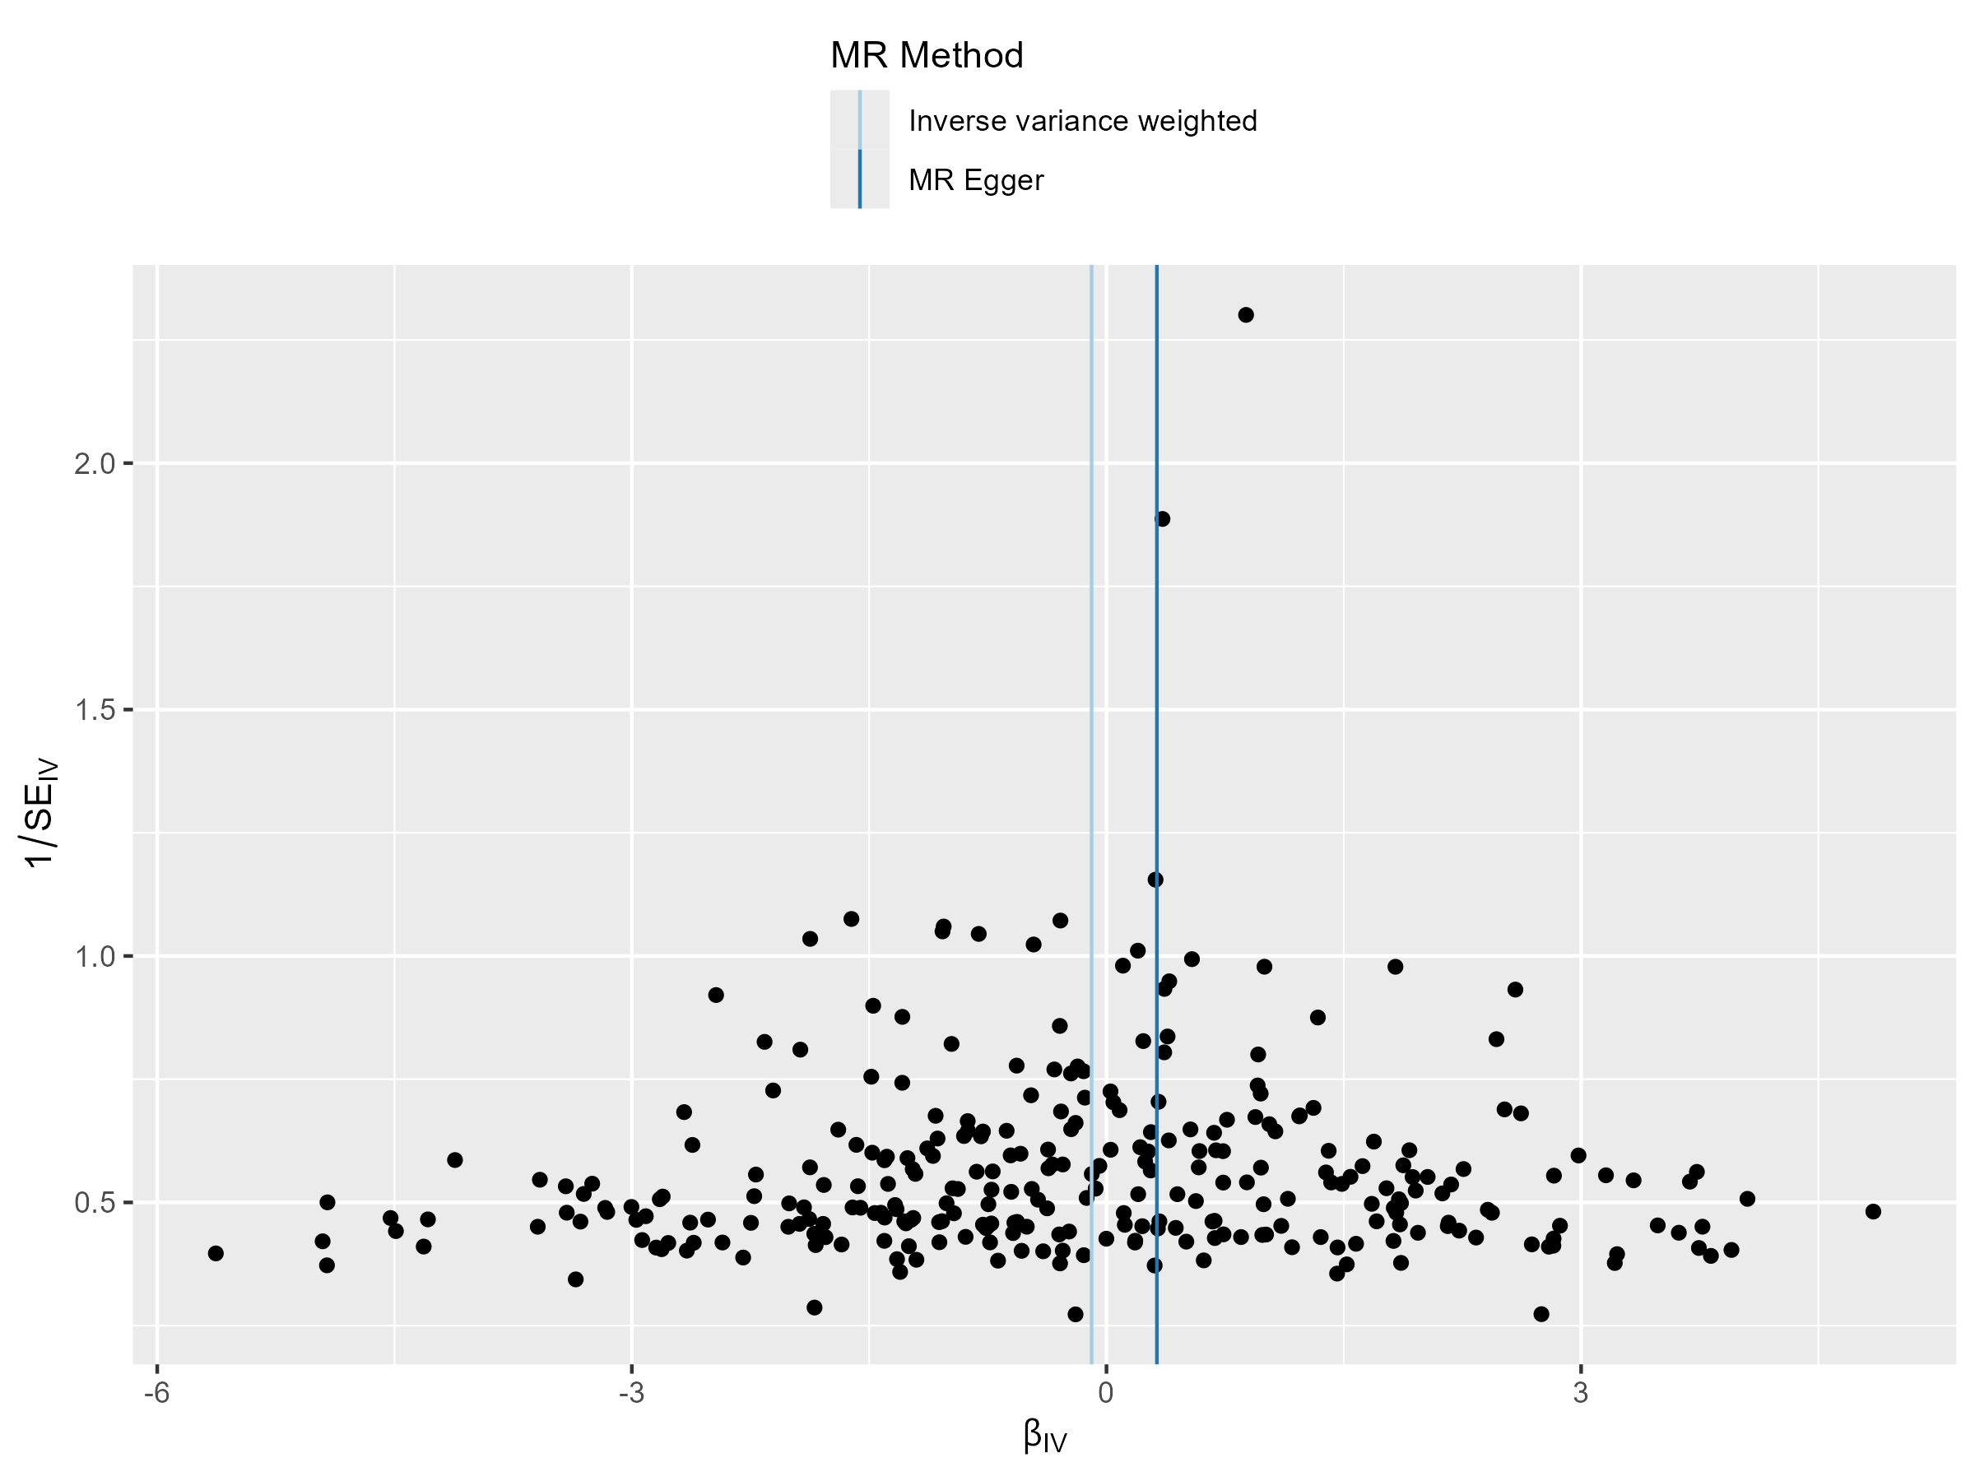
placental abruption

Slide 15
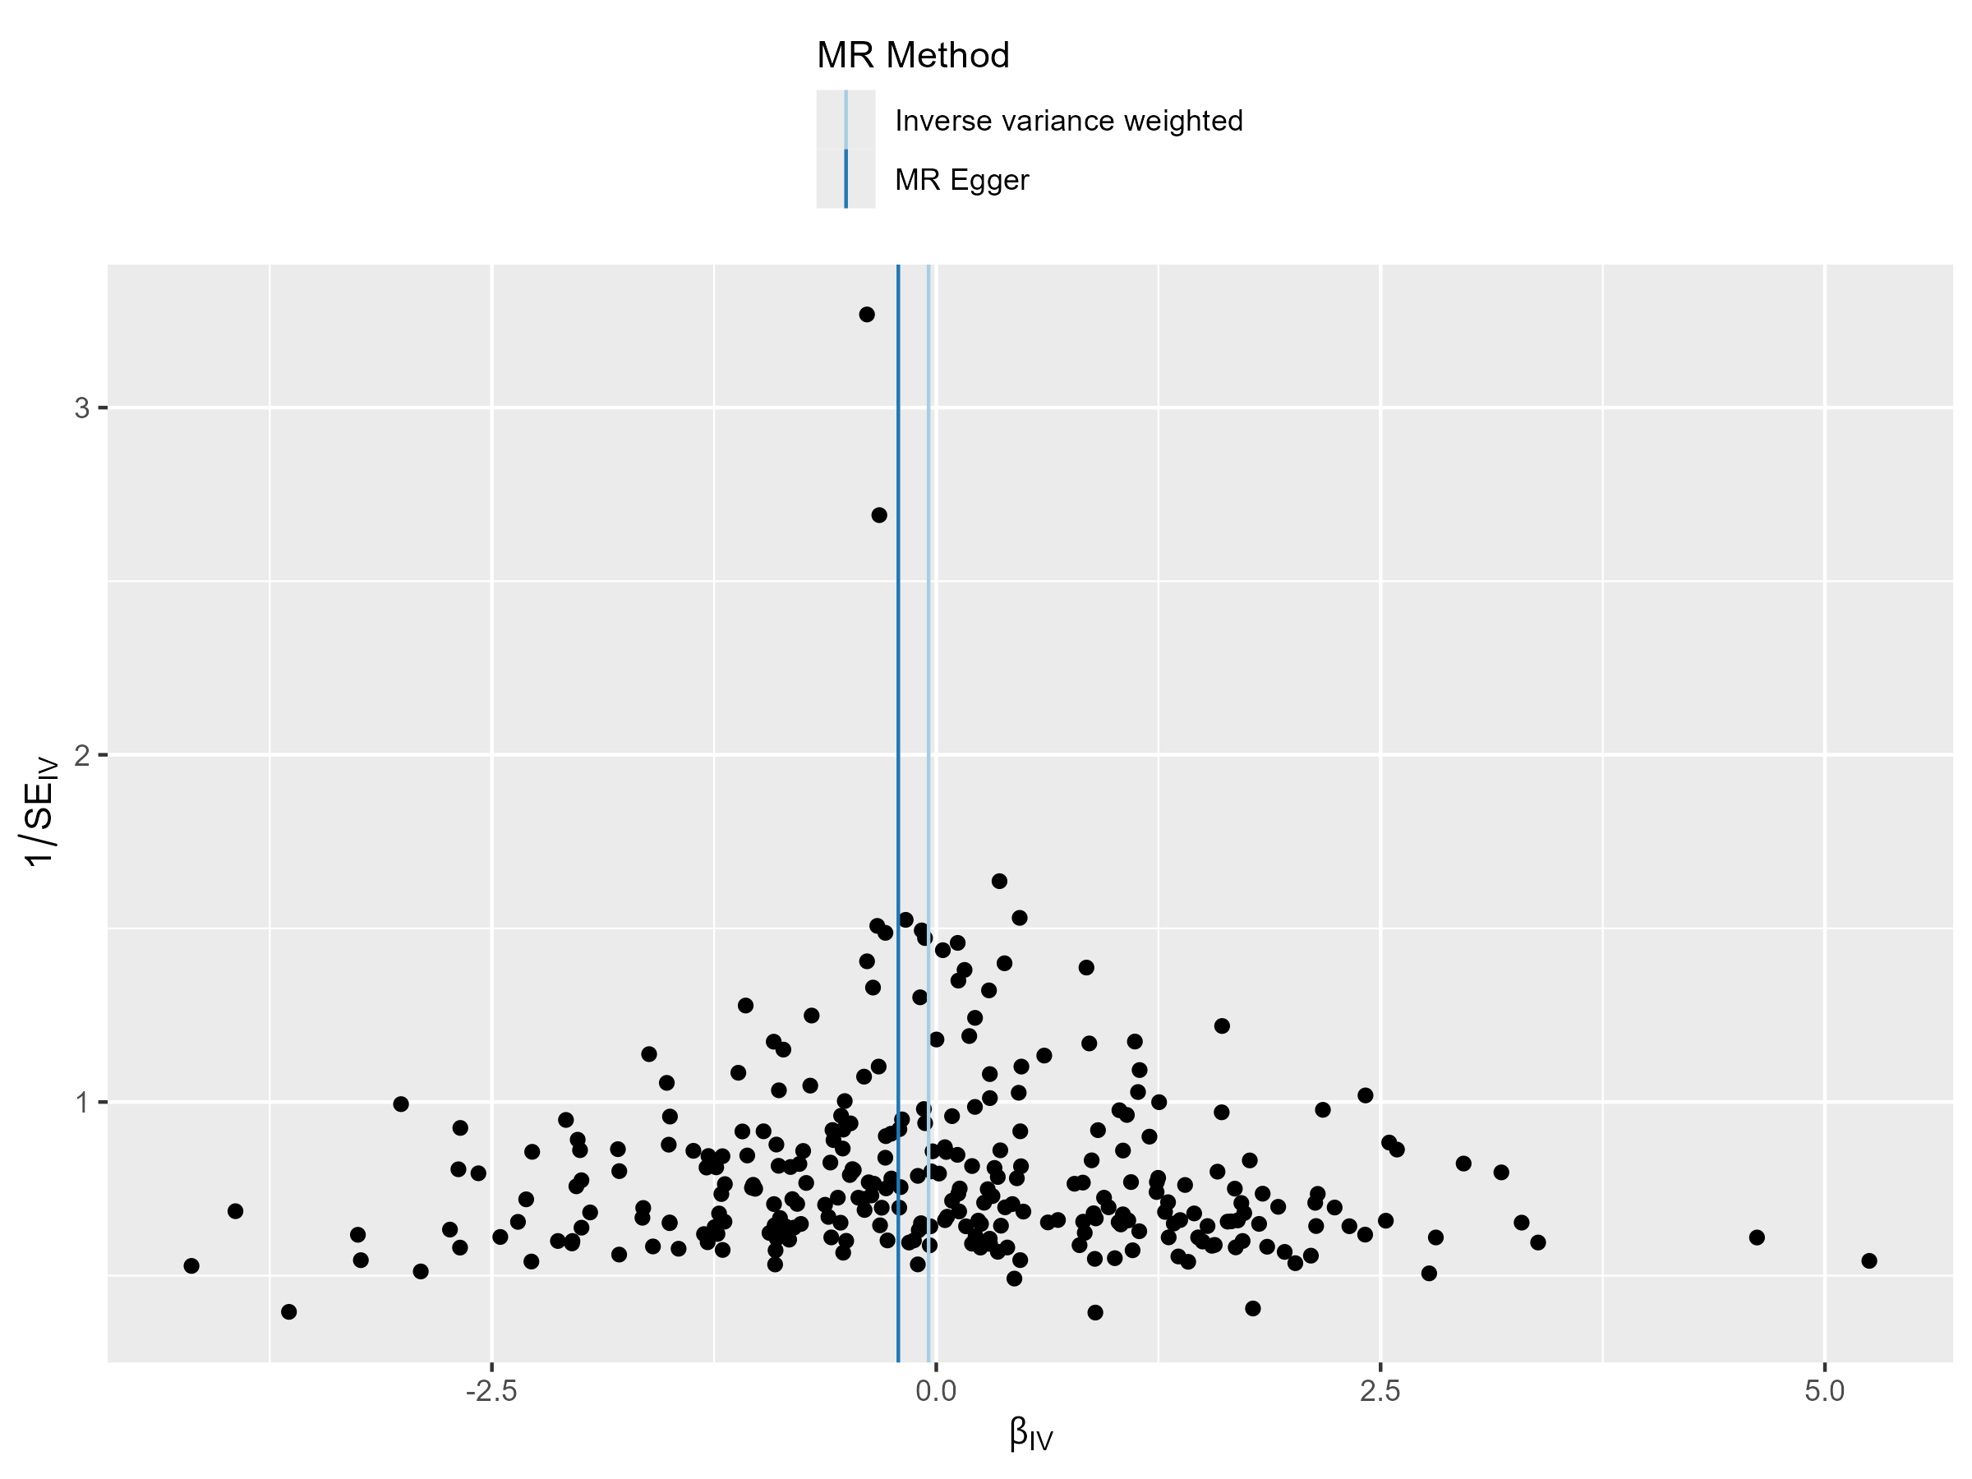
placenta previa

Slide 16
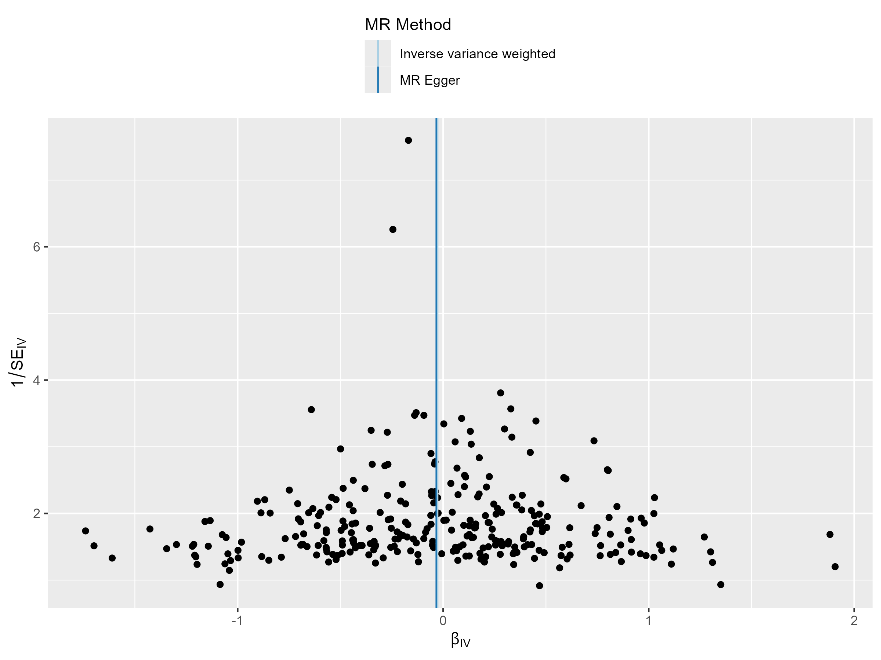
premature rupture of membranes (PROM)

Slide 17
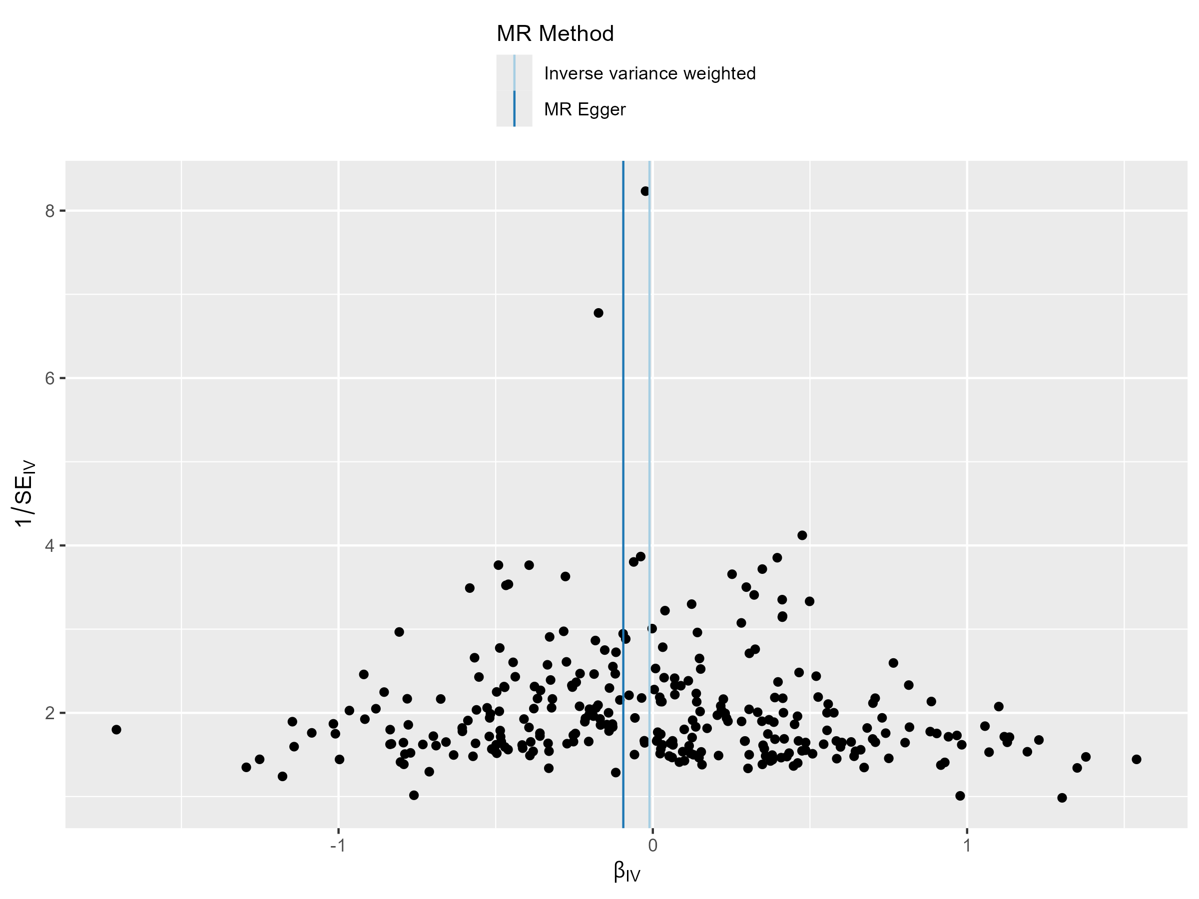
postpartum haemorrhage

Slide 18
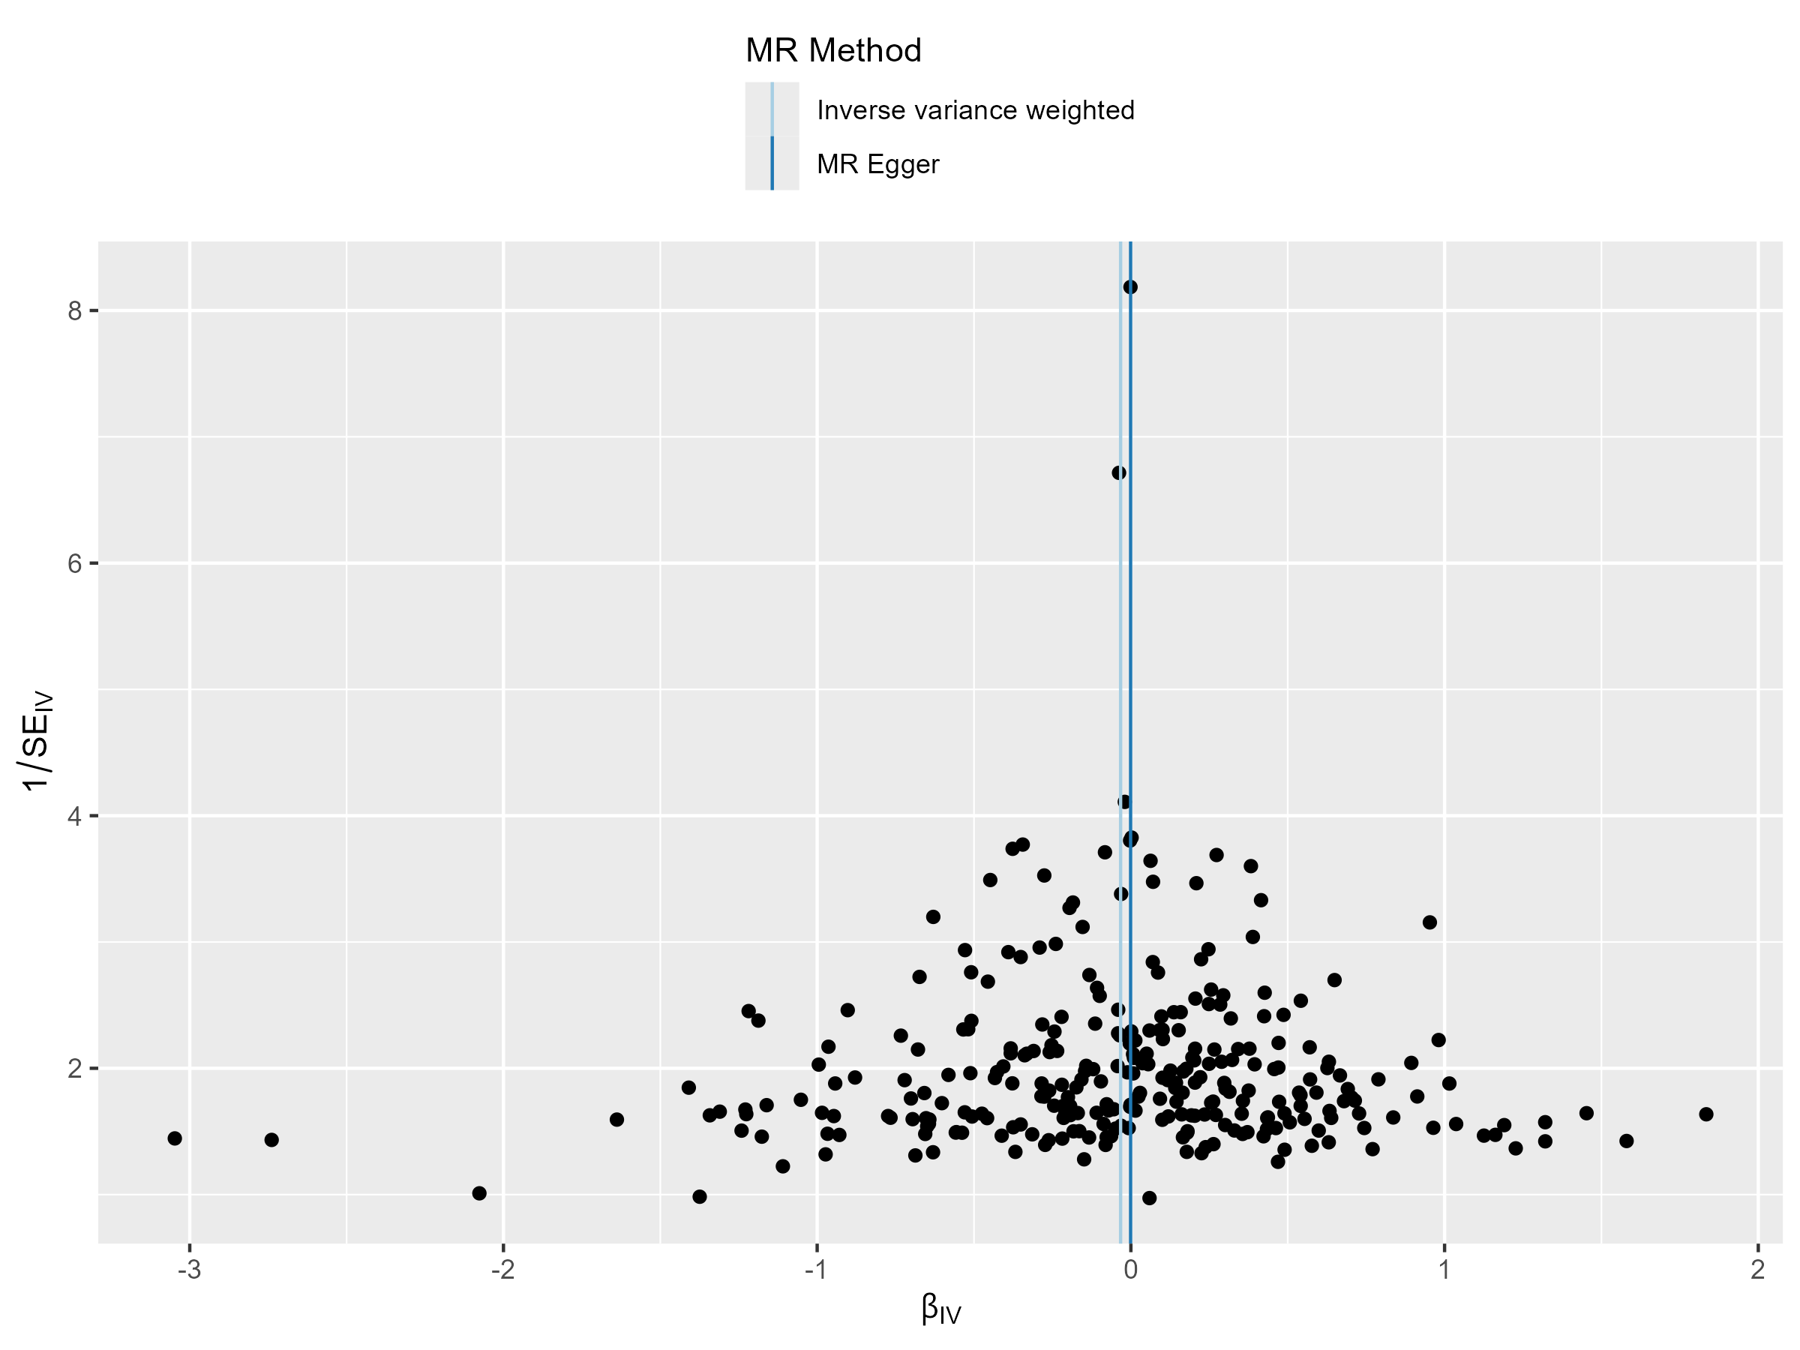
preterm labour

Slide 19
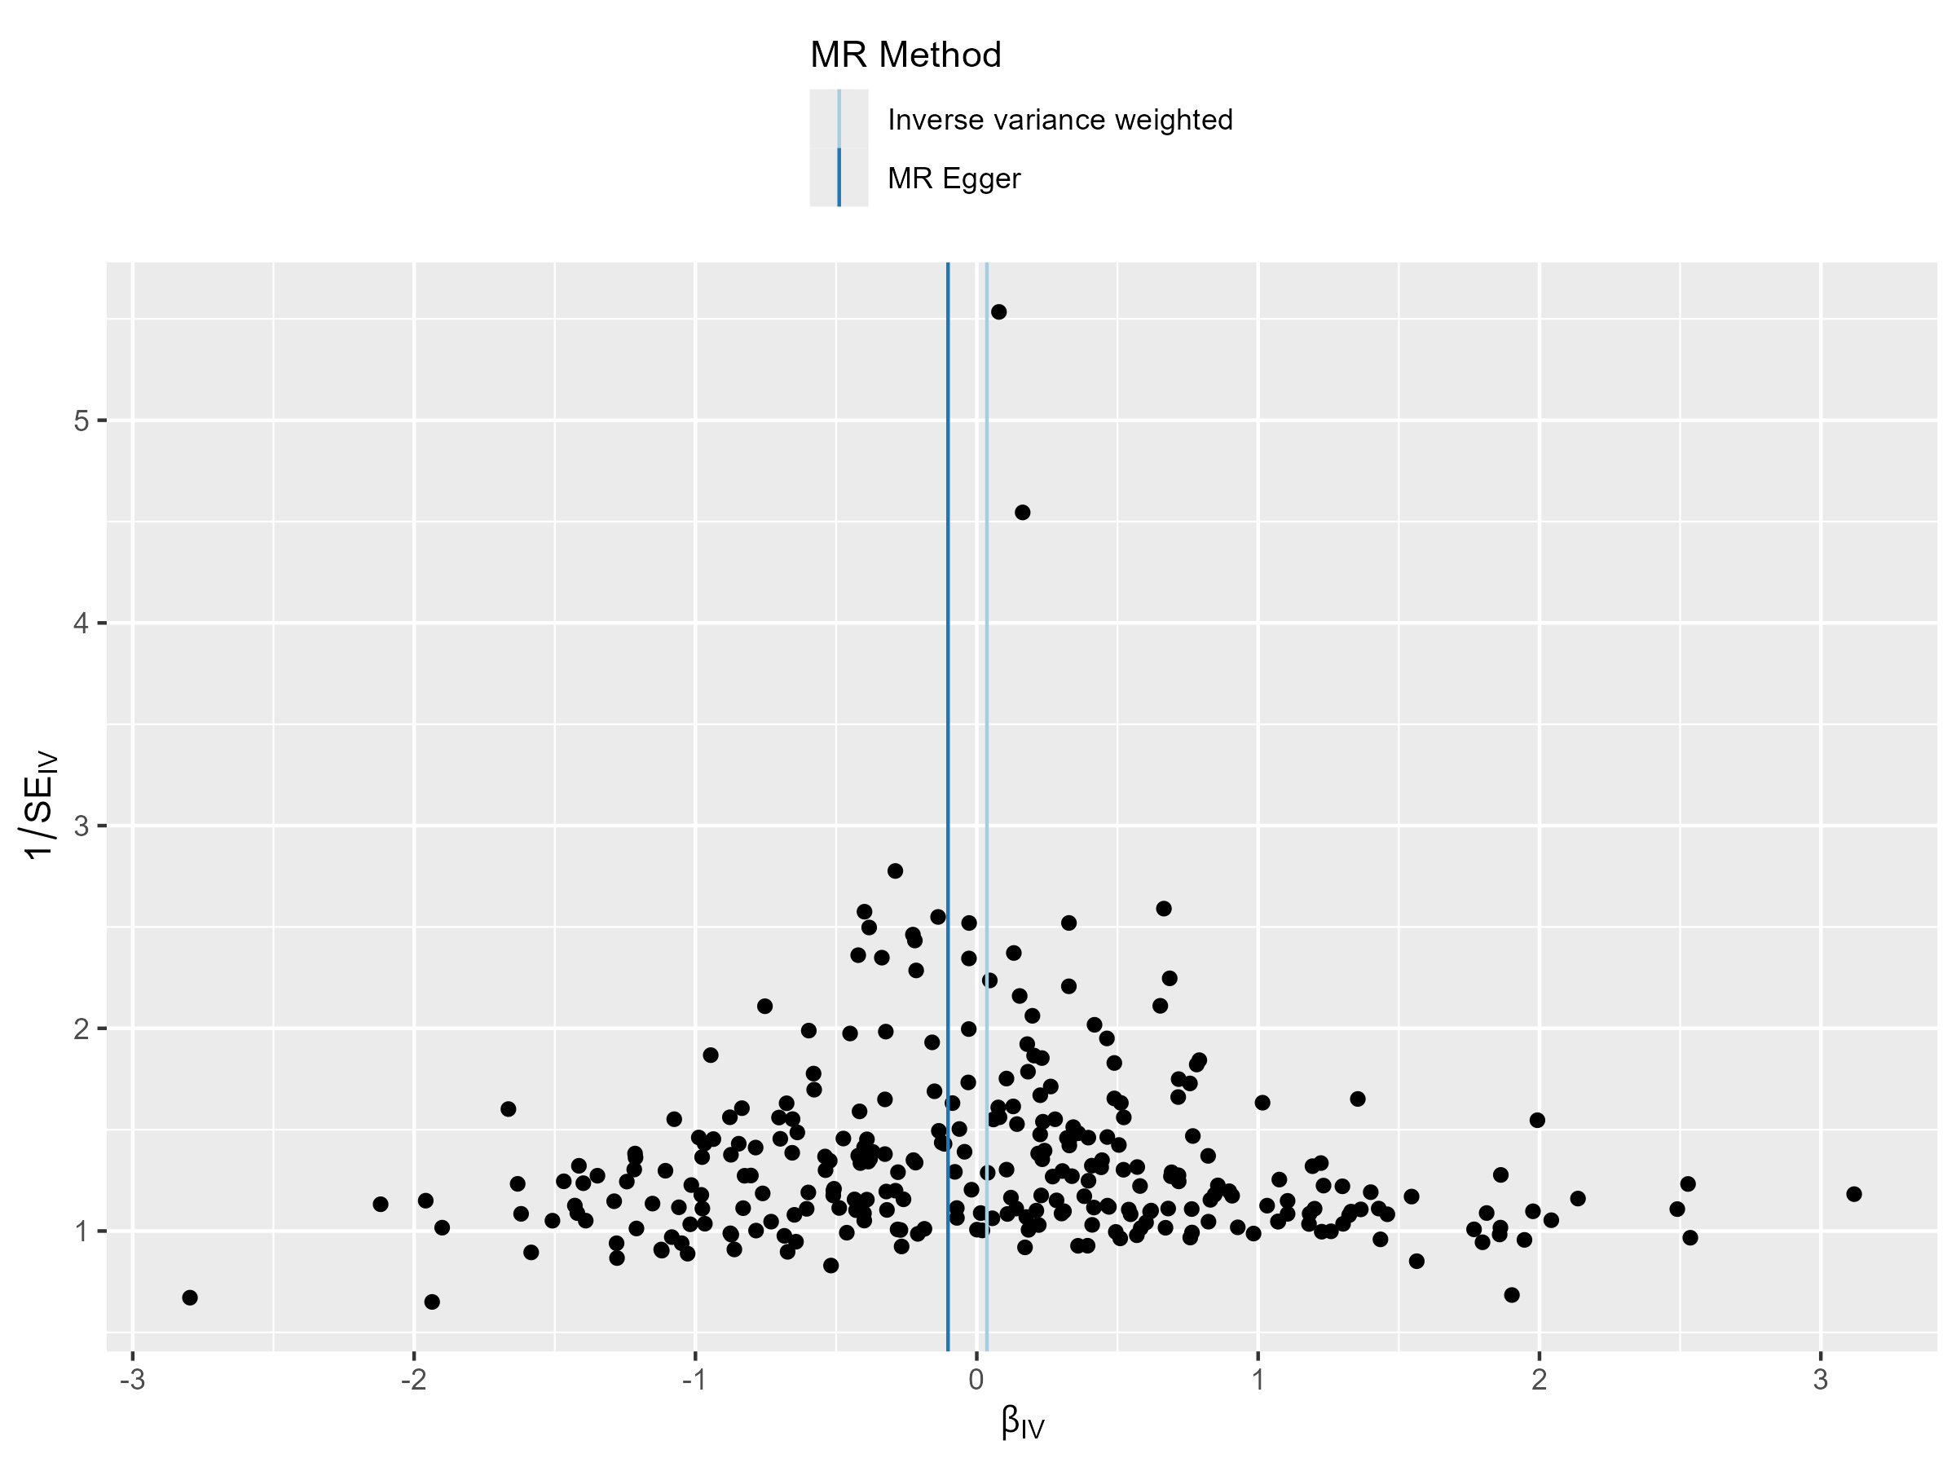
poor fetal growth

Slide 20
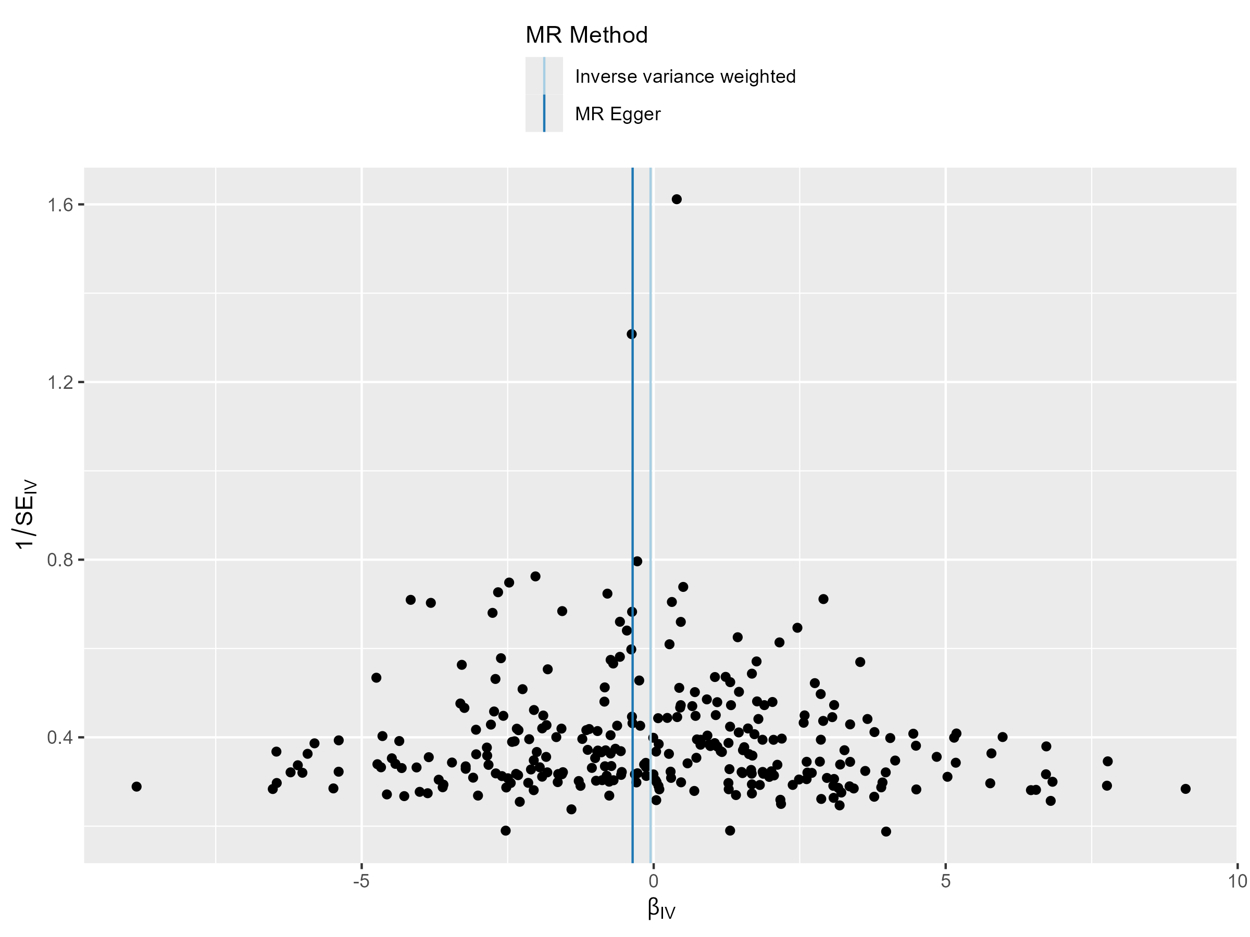
respiratory distress of newborn

